Slide 1
Back2School
By: Junyi Pan, Diana Haiden, Fernanda Bonilla, and Michelle Anyanwu
Notes:
Michelle

Slide 2

Back2School
We created an ecommerce website to purchase school supplies.
Our motivation behind creating the website was to alleviate the stress of back to school shopping for parents and students.
Notes:
Michelle

Slide 3
How the Work Was Divided
Junyi: Login, Registration, Session
Diana: Products View and Shopping Cart
Fernanda: Check Out
Michelle: Search/Search Results
Notes:
Michelle

Slide 4
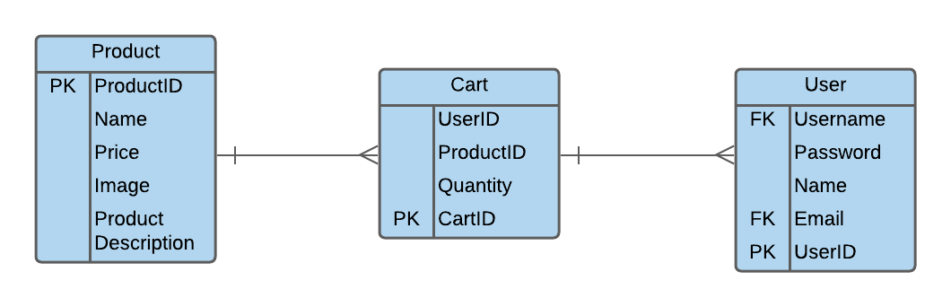
ER Diagram and Relational Schema

Slide 5
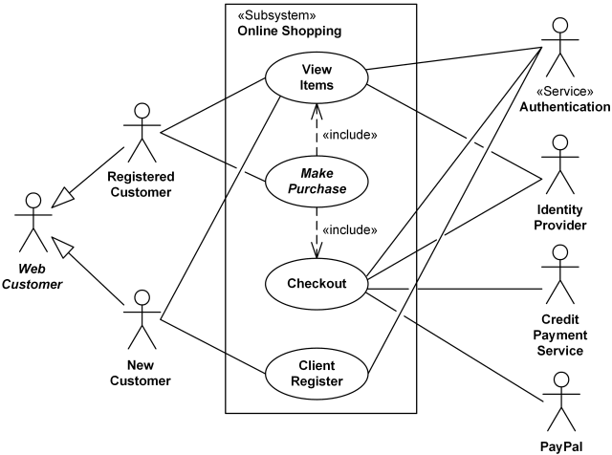
Use-Case Diagram
Notes:
Fernanda

Slide 6
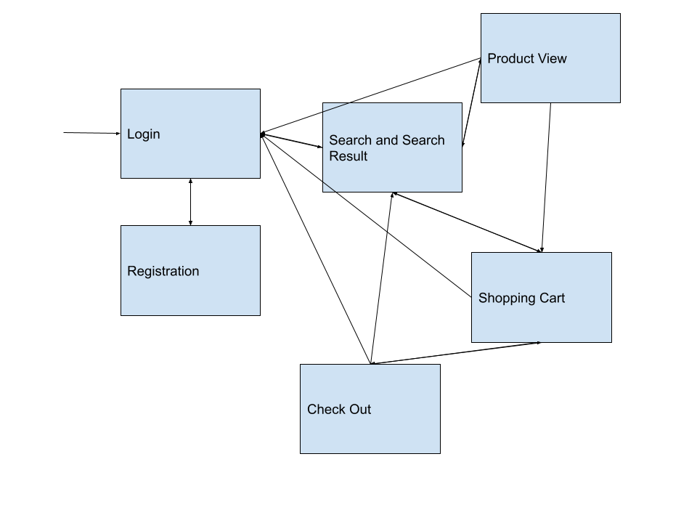
Navigational Chart
Notes:
Fernanda

Slide 7
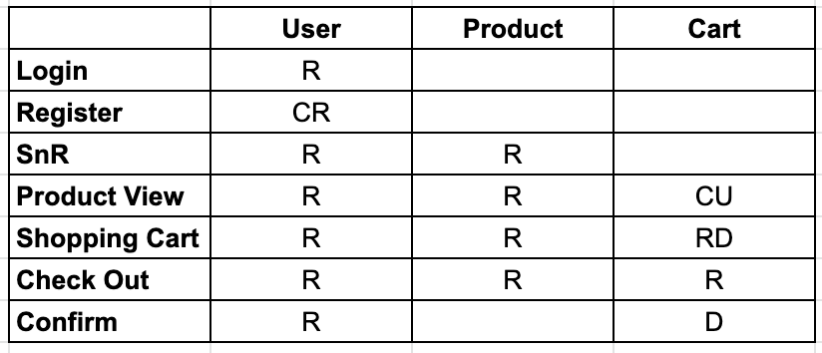
CRUD Matrix
Notes:
Tim

Slide 8
Problems Encountered
Organizing our work between group members
Solution: We used GitHub to ensure that each of us the most up-to-date code
Not being familiar with PHP
Solution: We relied on the help of each other, class assignments, and the internet to help especially when we received errors that we didn't understand.
Design/Styling
Solution: We had different CSS for different pages so having our header and footer already styled made it easier to style the website as a whole.
Java Script being bypassed
Solution: Visited office hour with TA, placed the script inside the php file instead of a separate file, java script was being by passed and went straight into the action php file.

Slide 9
Lessons Learned
We should have created separate branches on GitHub and merged them instead of applying the changes directly to the main branch.
Being that each person had different pages we were working on we should have exported the database and imported it to GitHub to make it easier to have the most up-to-date code.

Slide 10
Results (Next Steps)
More products with a variety of colors
Different shipping options
Reset password option

Slide 11
Run Program and Show Source Code

