Slide 1
Nuclear receptor variation in mice
Praktikum Genomorientierte Bioinformatik – Blockteil, 2015
      Supervisors: Prof. Dr. H. W. Mewes, Dr. Desislava Boyanova
      Students: Diana Iacob, Alexander Beratis

Slide 2
Introduction
Mouse model organism
Nuclear Receptors
Genotype ⇔ Phenotype

Slide 3
Materials
Case study: 49 nuclear receptors in the mouse
    242 associated gene Ids
Public databases:
  MGI (Mouse Genome Informatics)
  MPD (Mouse Phenome Database)
  UCSC Genome Browser
Internal database

Slide 4
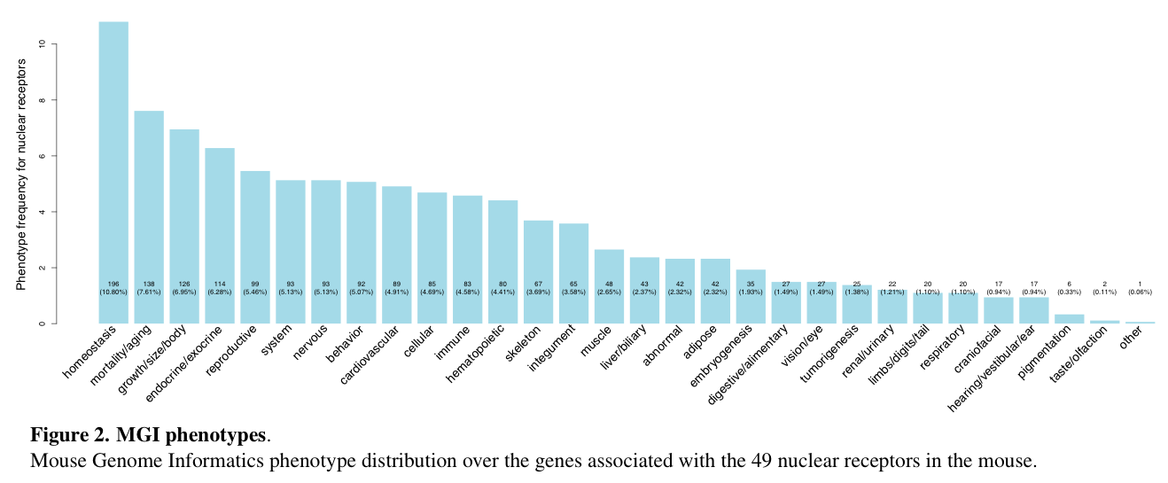
MGI Phenotypes (I)
Similar

Slide 5
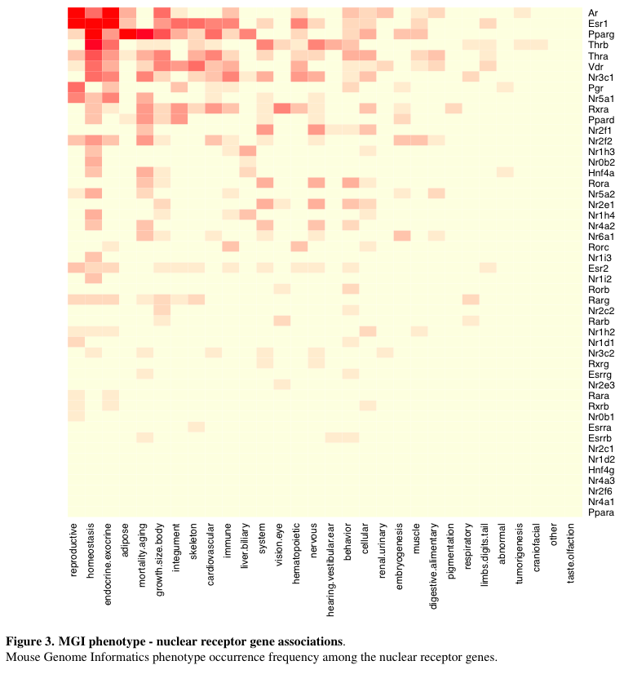
MGI Phenotypes (II)

Slide 6
MPD Phenotypes (extreme low)
Under

Slide 7
MPD Phenotypes (extreme low)
Under

Slide 8
MPD Phenotypes (extreme high)
Under

Slide 9
MPD Phenotypes (extreme high)
Under

Slide 10
References

Slide 11
Thank you!

