Slide 1
Software archıtectures

Slide 2
Outline
Using Git
Branches
Pull, add, commit and push
Cloning a repository (GitHub and GitLab)
Breaking the ice with NetBeans IDE
Run a web application
Working with Payara Server
The Best Practises of EJBs
Stateless Session Bean
Statefull Session Bean
Singleton Session Bean
Data persistence
Connecting, starting and creating a database

Slide 3
Using Git

Slide 4
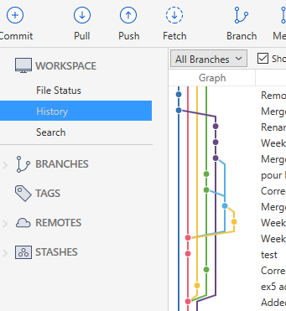
branches
A commit
Remove useless files
Merge branch ‘developer1’
Rename files
Hotfix
Merge branch ‘master’
Tests are written
Code fix
Merge pull request
New cases are added
New test cases
…
…
…
master branch
other branches

Slide 5
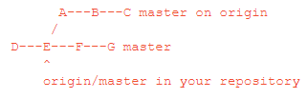


pull [1]
git pull - Fetch from and integrate with another repository or a local branch
pulling
Path to the Git Repository
Path to the Git Repository
[1] https://git-scm.com/docs/git-pull

Slide 6
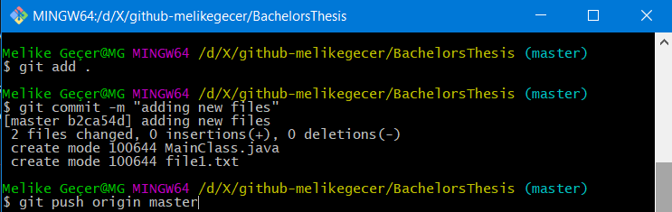
add [2], commit [3] and push [4]
git commit - Record changes to the repository
git push - Update remote refs along with associated objects
git add <file_name> [or git add . ]
git commit –m <commit_message>
git push origin <branch_name>
Path to the Git Repository
Path to the Git Repository
Path to the Git Repository
Path to the Git Repository
pushing
[2] https://git-scm.com/docs/git-add
[3] https://git-scm.com/docs/git-commit
[4] https://git-scm.com/docs/git-push

Slide 7
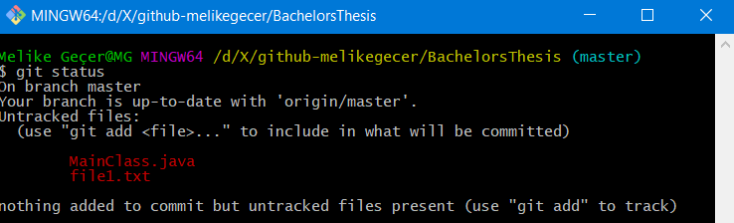
Other useful Git commands – status [5]
git status – Show the working tree status
Path to the Git Repository
Path to the Git Repository
[5] https://git-scm.com/docs/git-status

Slide 8
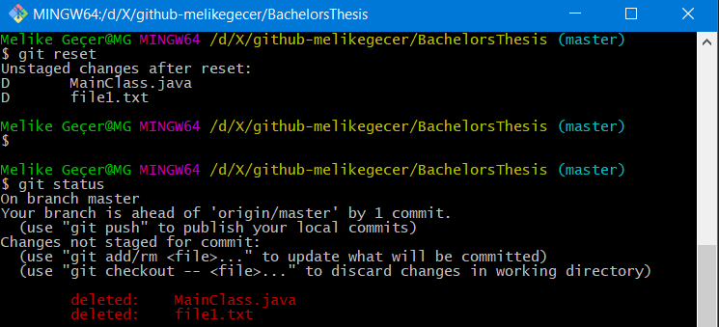
Other useful Git commands – reset [6]
git reset – Reset current HEAD* to the specified state
Path to the Git Repository
Path to the Git Repository
Path to the Git Repository
[6] https://git-scm.com/docs/git-reset
* HEAD is the current branch

Slide 9
Cloning a repository
Go to https://gitlab.unil.ch/users/sign_in
Login using your UniL account details (username and password)
Go to the given git repository URL. (i.e. https://github.com/doplab/soar-tp)

Slide 10
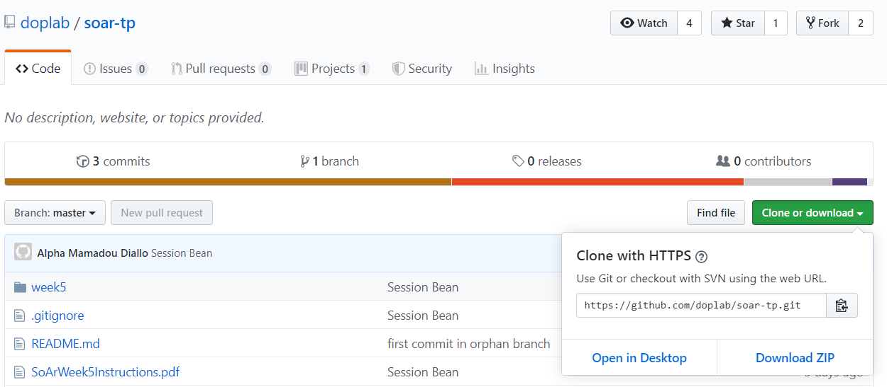
Cloning a repository
Copy the https:// clone URL of the given repository.
Copy the URL

Slide 11
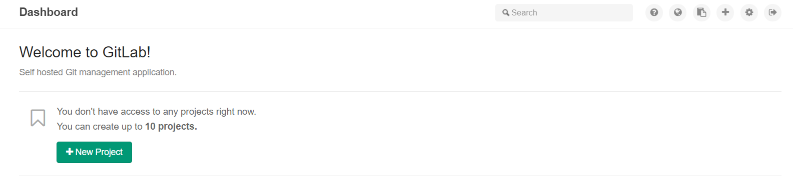
Cloning a repository
Create a new project on GitLab
Create a new project

Slide 12
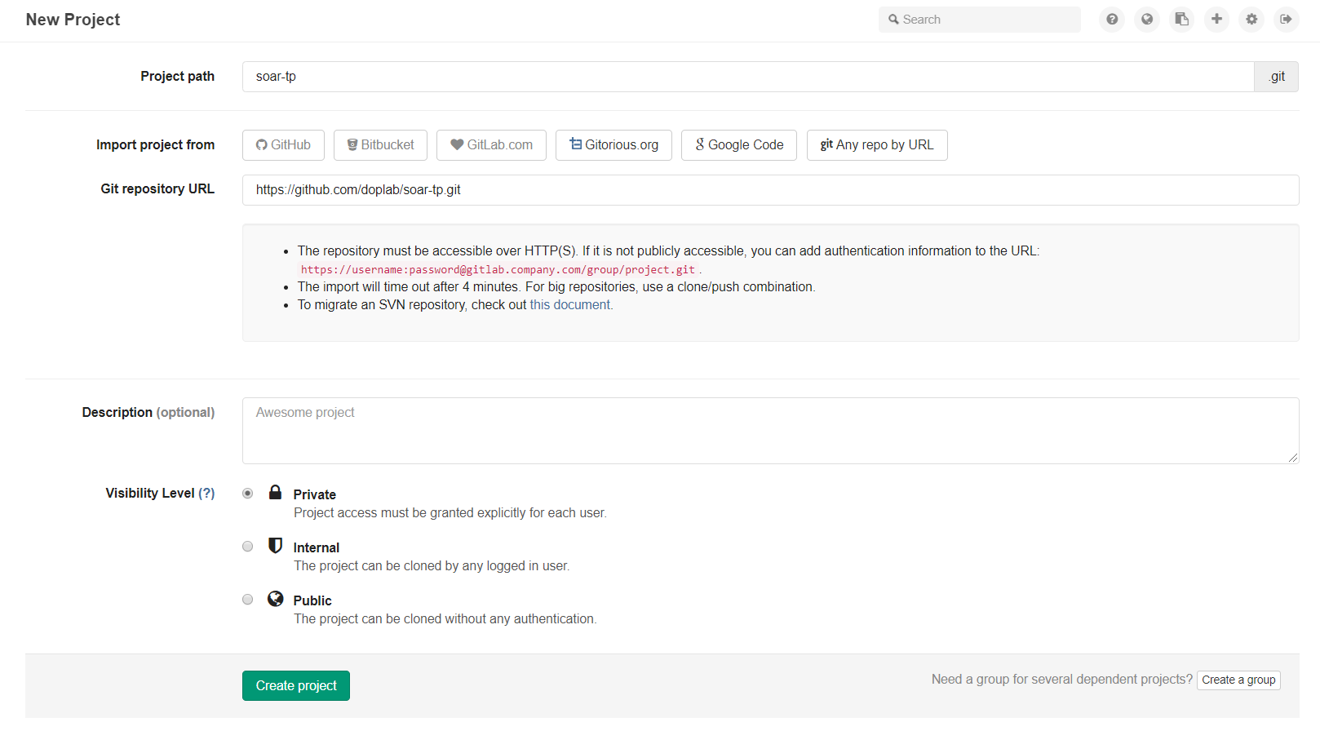
Cloning a repository
Your project path and name
Click on «Any repo by URL»
Copy the URL here
«Create project»

Slide 13
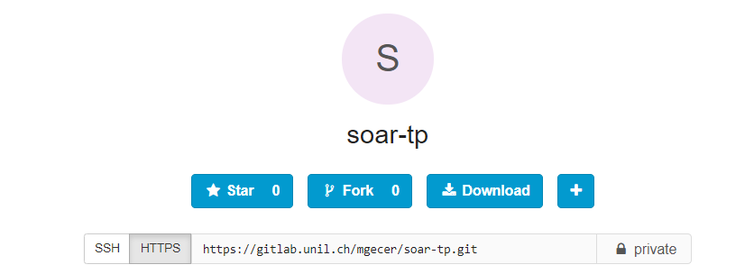
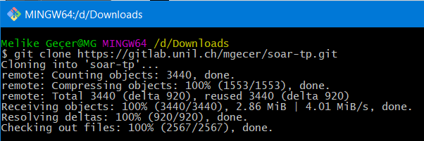
Cloning a repository
Copy the URL
Use
git clone https://...
to clone the repository from your GitLab account to your local machine.
Path to the Git Repository
Path to the Git Repository

Slide 14
Breaking the ice with NetBeans IDE

Slide 15

Run a Web Application
Unlike Java projects you’ve seen before, a Java web application DOESN’T have a MainClass.
A Java Application
A Java Web Application

Slide 16
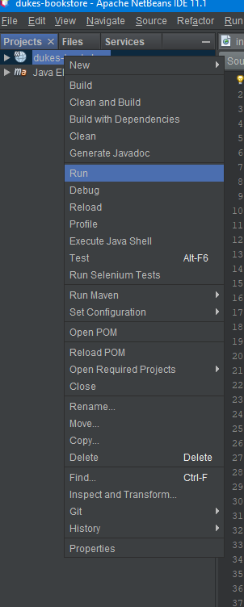
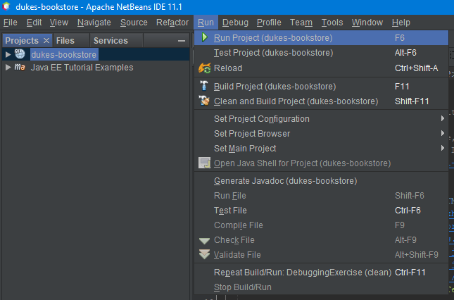
Run a Web Application
There are two ways to run a project;
Right-click on the project and RUN
Click on Run tab and Run Project

Slide 17
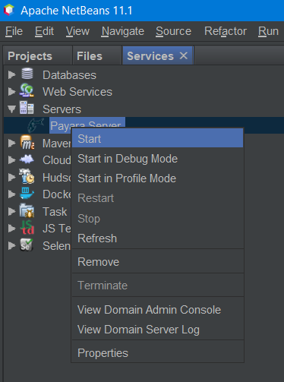
Working with Payara Server
Web applications require a server to run. In exercise sessions, we will use the Payara Server.
If you don’t have the Payara Server on NetBeans,
please refer to this document.

Slide 18
EJB Enterprise JavaBeans

Slide 19
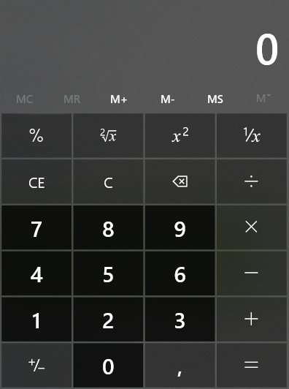
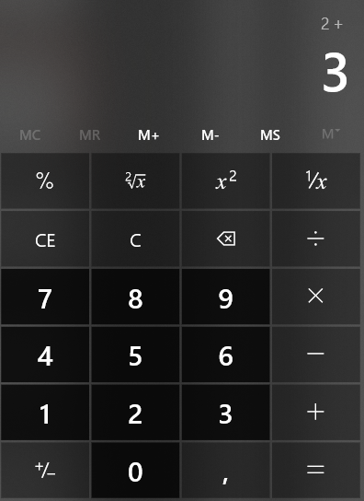
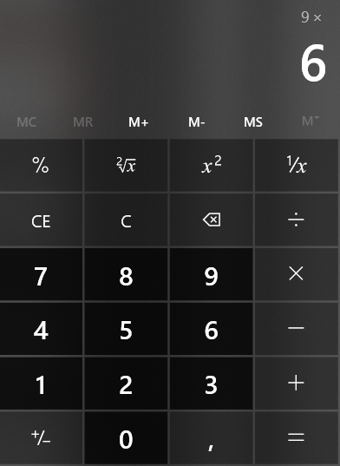
Stateless Session Bean [7]
When a client invokes the methods of a stateless bean, the bean’s instance variables may contain a state specific to that client but only for the duration of the invocation.
Except during method invocation, all instances of a stateless bean are equivalent, allowing the EJB container to assign an instance to any client.
Client 1
Client 2
Client 1
Client 2
Initial states
During method invocation
[7] https://docs.oracle.com/javaee/6/tutorial/doc/gipjg.html

Slide 20
Stateless Session Bean [7]
@Stateless
public class CalculatorBean {
…
public double add(double n1, double n2) {…}
public double subtraction(double n1, double n2) {…}
public double multiplication(double n1, double n2) {…}
public double division(double n1, double n2) {…}
…
}

Slide 21

Stateful Session Bean [7]
In a stateful session bean, the instance variables represent the state of a unique client/bean session.
A session bean is not shared; it can have only one client, in the same way that an interactive session can have only one user.
Client 1
Client 2
Client 1
Client 2
Shopping cart #1
{}
Shopping cart #2
{}
Shopping cart #1
{ book1, book2}
Shopping cart #2
{book3, movie1, movie2}
Initial states
After few transactions

Slide 22
Stateful Session Bean [7]
@Stateful
public class CartBean {
String customerId;
String customerName;
List<String> contents;
…
public void addBook(String title) {…}
public void removeBook(String title) {…}
public List<String> getContents() {…}
…
}

Slide 23
Singleton Session Bean [7]
A singleton session bean is instantiated once per application and exists for the lifecycle of the application.
Singleton session beans are designed for circumstances in which a single enterprise bean instance is shared across and concurrently accessed by clients.
…
Developer #1 created the project.
Developer #2 put new data files.
Program #18 gave an exception.
Developer #2 created test classes.
…
Developer #6
Developer #3
Developer #5
Developer #2
Developer #4
Developer #1

Slide 24
Singleton Session Bean [7]
@Singleton
public class LogBean {
String logFileName;
…
public void addLog (String logMessage) {…}
public void removeLog(int logID) {…}
public String getLog(int logID) {…}
…
}

Slide 25
The Lifecycles of Enterprise Beans
Client #76, addBook(), addBook(), removeBook(), addBook()
@Stateful
Client #23, addMovie()
Client #43, addMovie(), removeBook(), addMovie()
Client #3, multiply()
Client #9, divide()
@Stateless
Client #5, add()
Client #5, add()
addLog(), addLog(), getLog(), removeLog(), addLog(), …
@Singleton

Slide 26
Data Persistence

Slide 27
Using a database on NetBeans
Apache Derby is an open source database written in Java. It is used in JDK (Java DB).
In exercise sessions, we will use Java DB (Apache Derby) as a database.

Slide 28
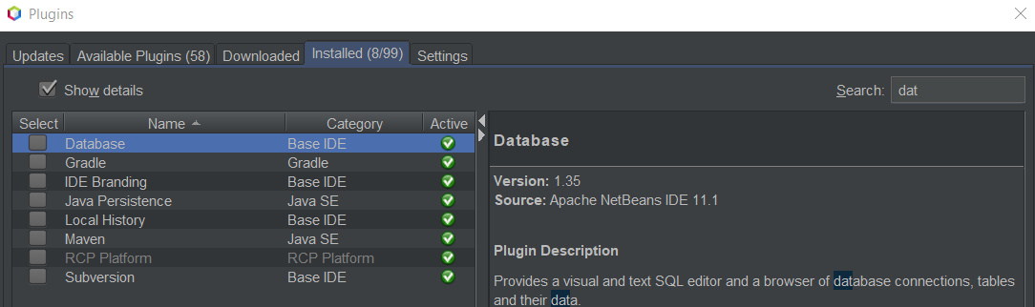
Connecting to a database
Before we start, make sure you have «Database» plugin. If you don’t have by default, please install it.
Tools >> Plugins >> Installed >> Search «Database»

Slide 29
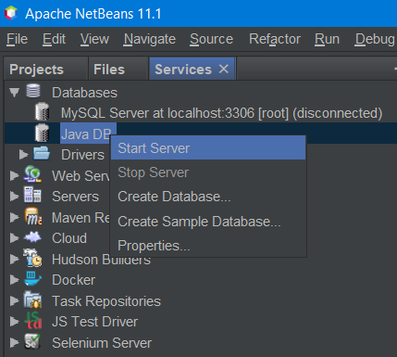
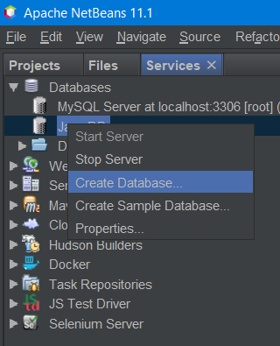
Starting and creating a database
From Services tab, expand Databases right-click on Java DB and click on Start Server
Once the server starts, right-click again and Create Database

Slide 30
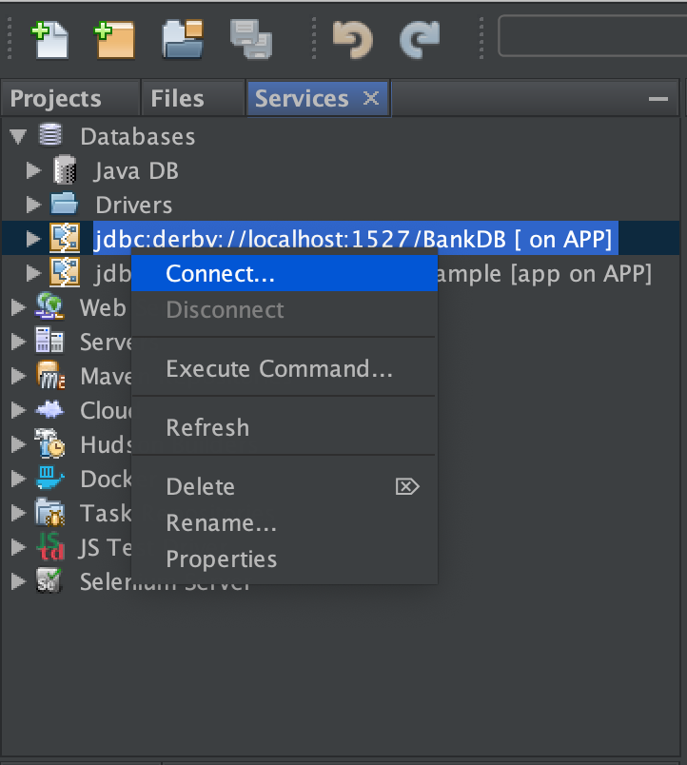
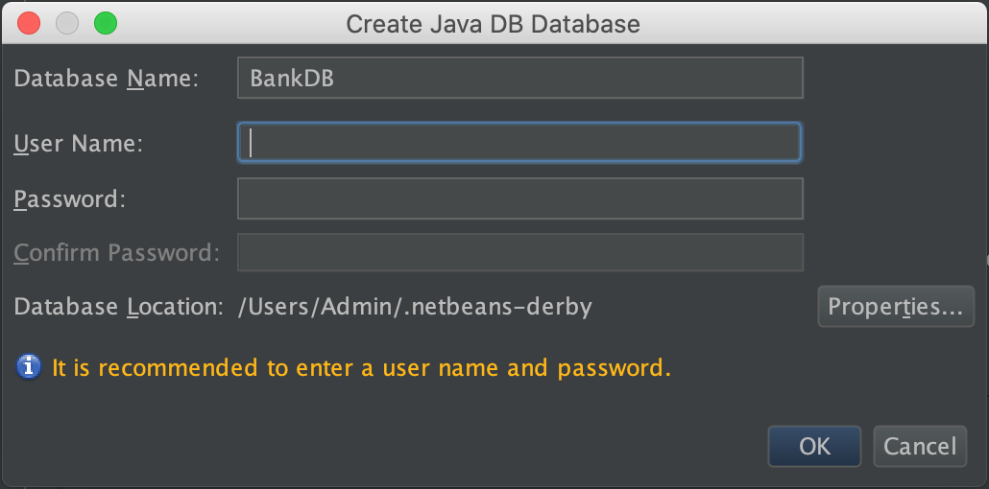
Creating a database
Create a database called BankDB. (if you want you can enter a user name and a password, but don’t forget them!)
Right-click on the new database
connection and click on Connect…

Slide 31
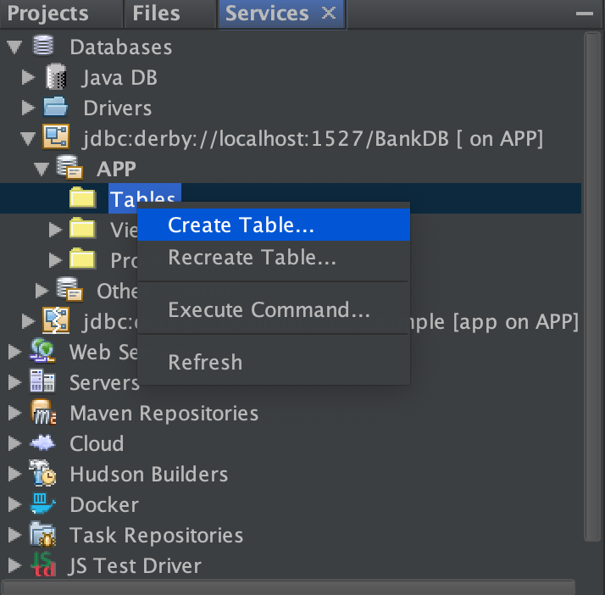
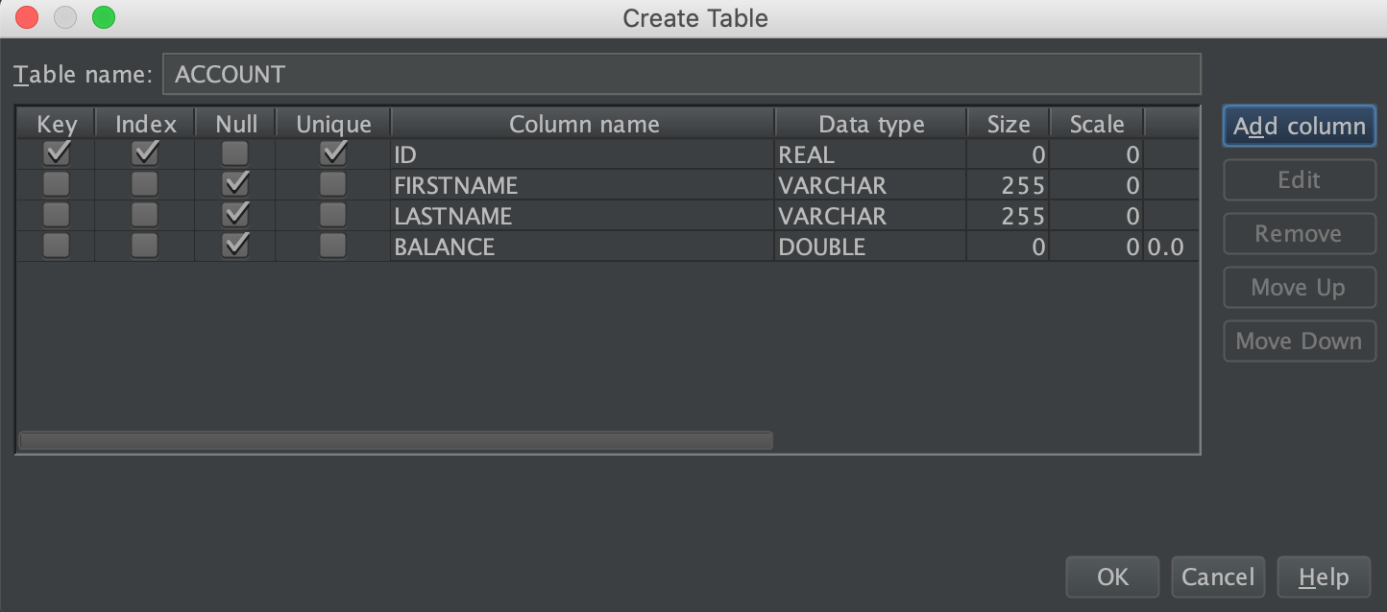
Creating a table in the database
Expand the connection and right-click on Tables, then click on Create Table
Create a Table called “Account” with the following columns:
Make sure to define ID as a Primary Key

Slide 32
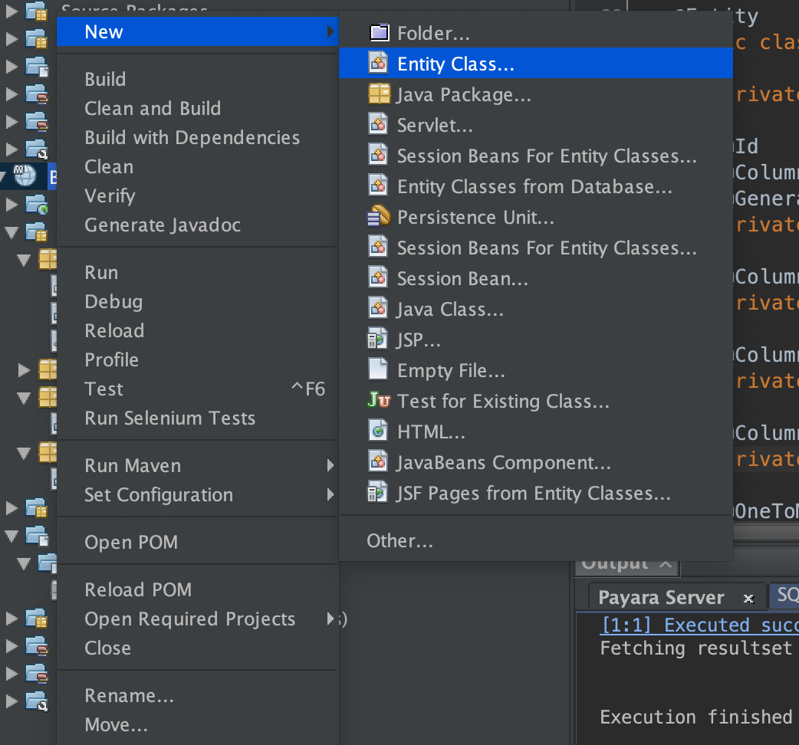
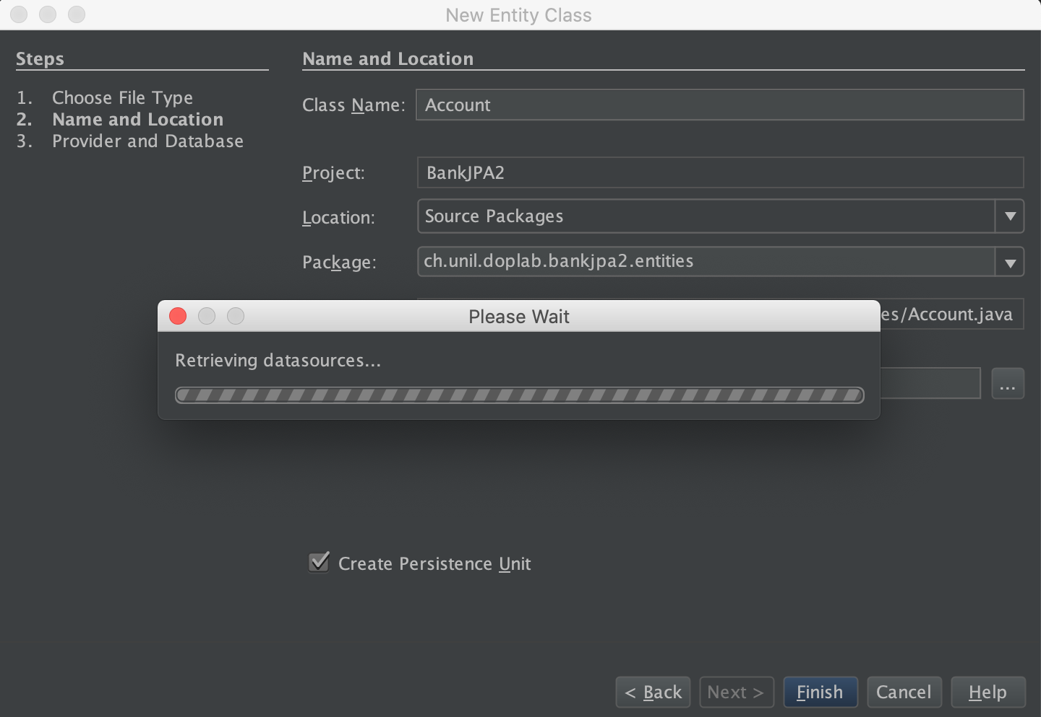
Creating a new Entity class
In order to do the persistence, we need to create an object which reflect the attributes of our table.

Slide 33
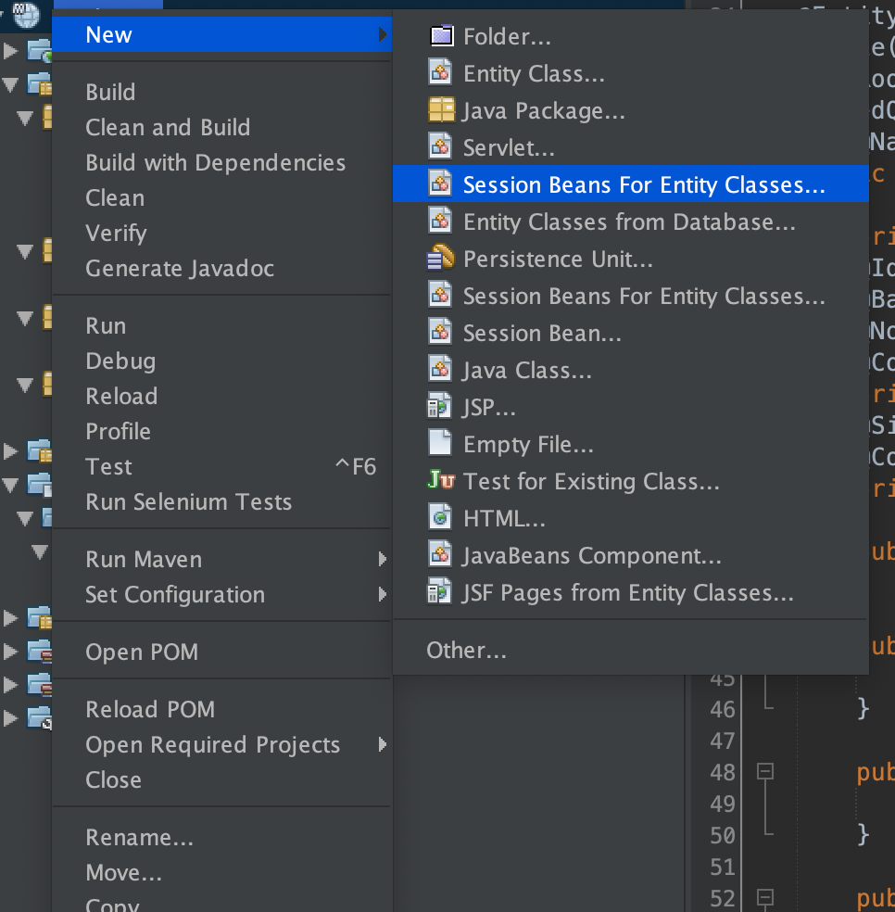
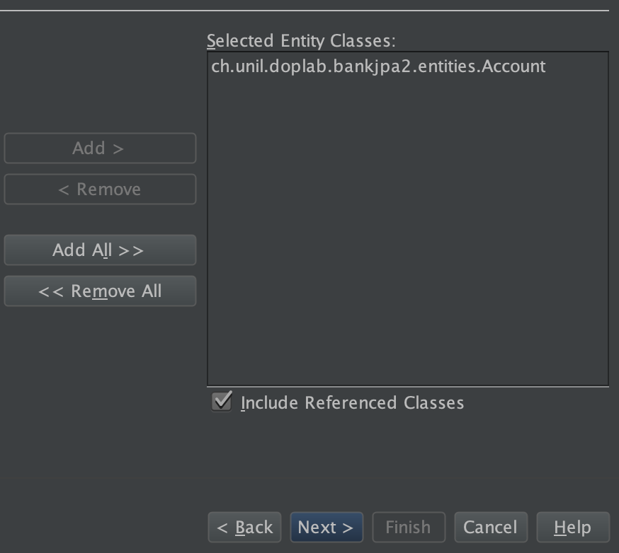
Create a new session bean for Entity
On the newly generated file, we can already see the generated method which will allow us to do the mapping with our database

Slide 34
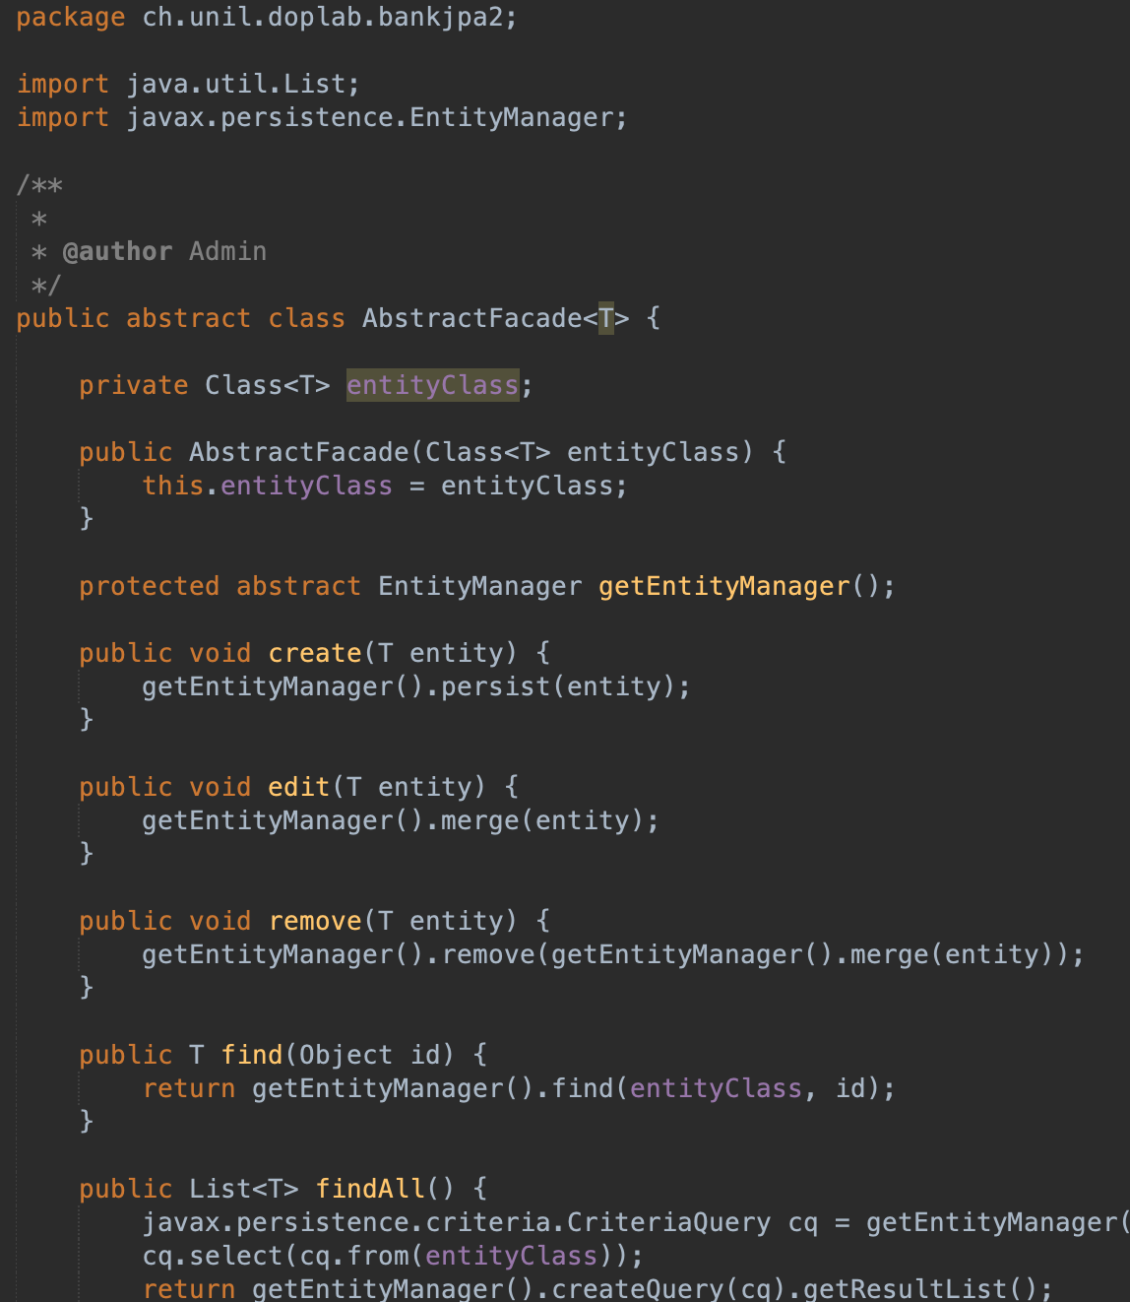
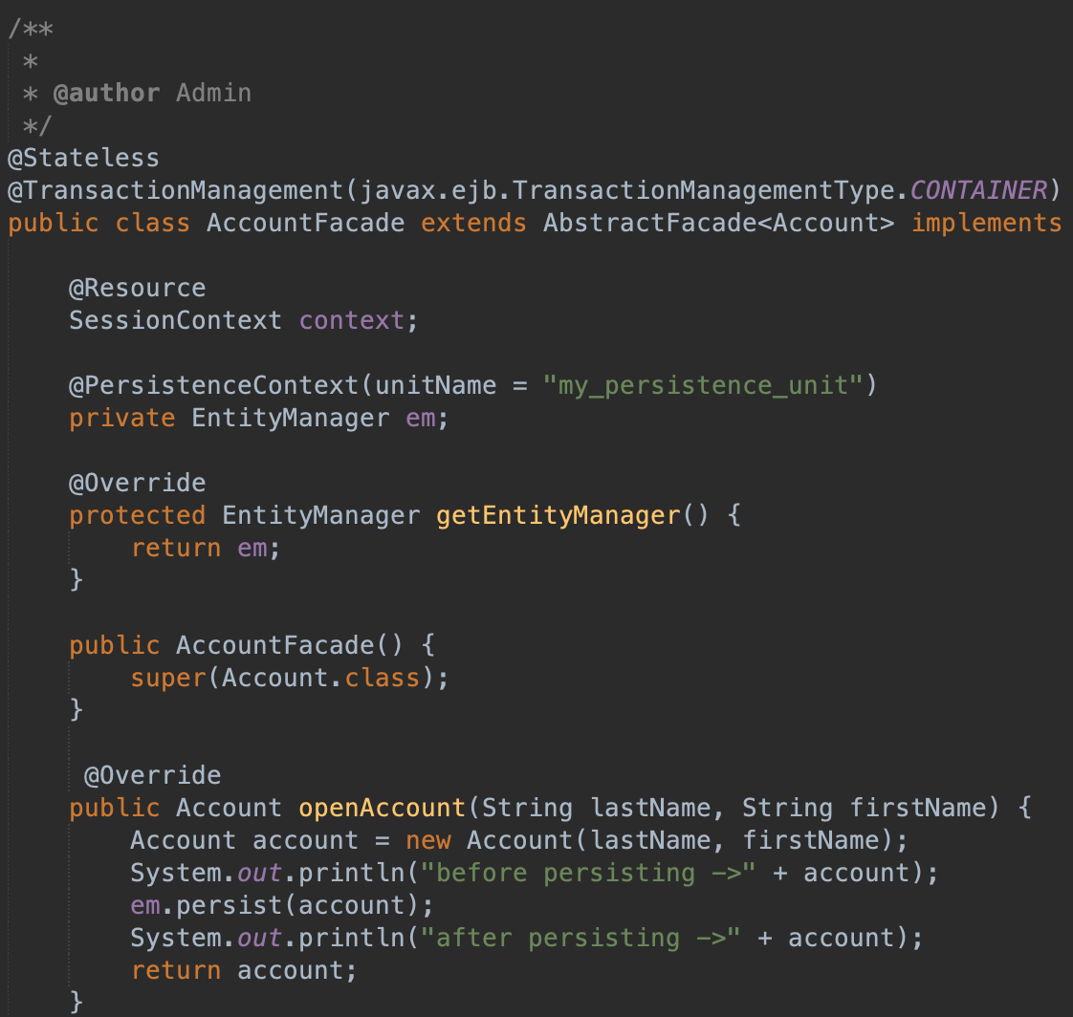
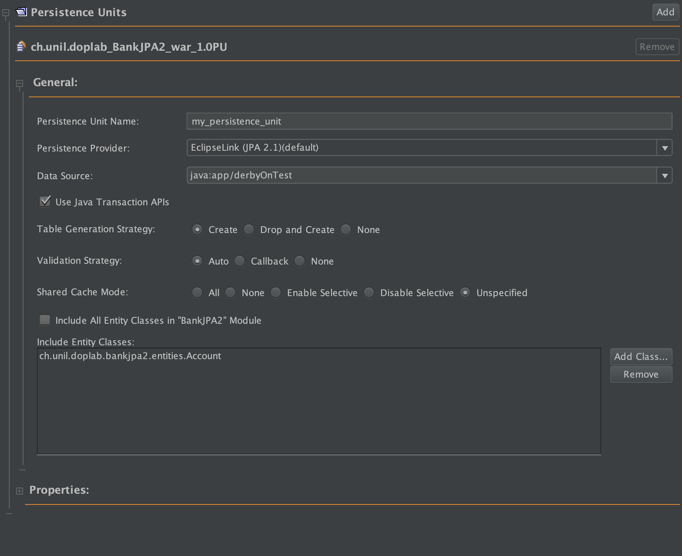
Accessing the generated files
The newly created class will allow us to do all the usual CRUD operations on the database.
Netbeans automatically generate a Persistence Unit (persistence.xml)

Slide 35
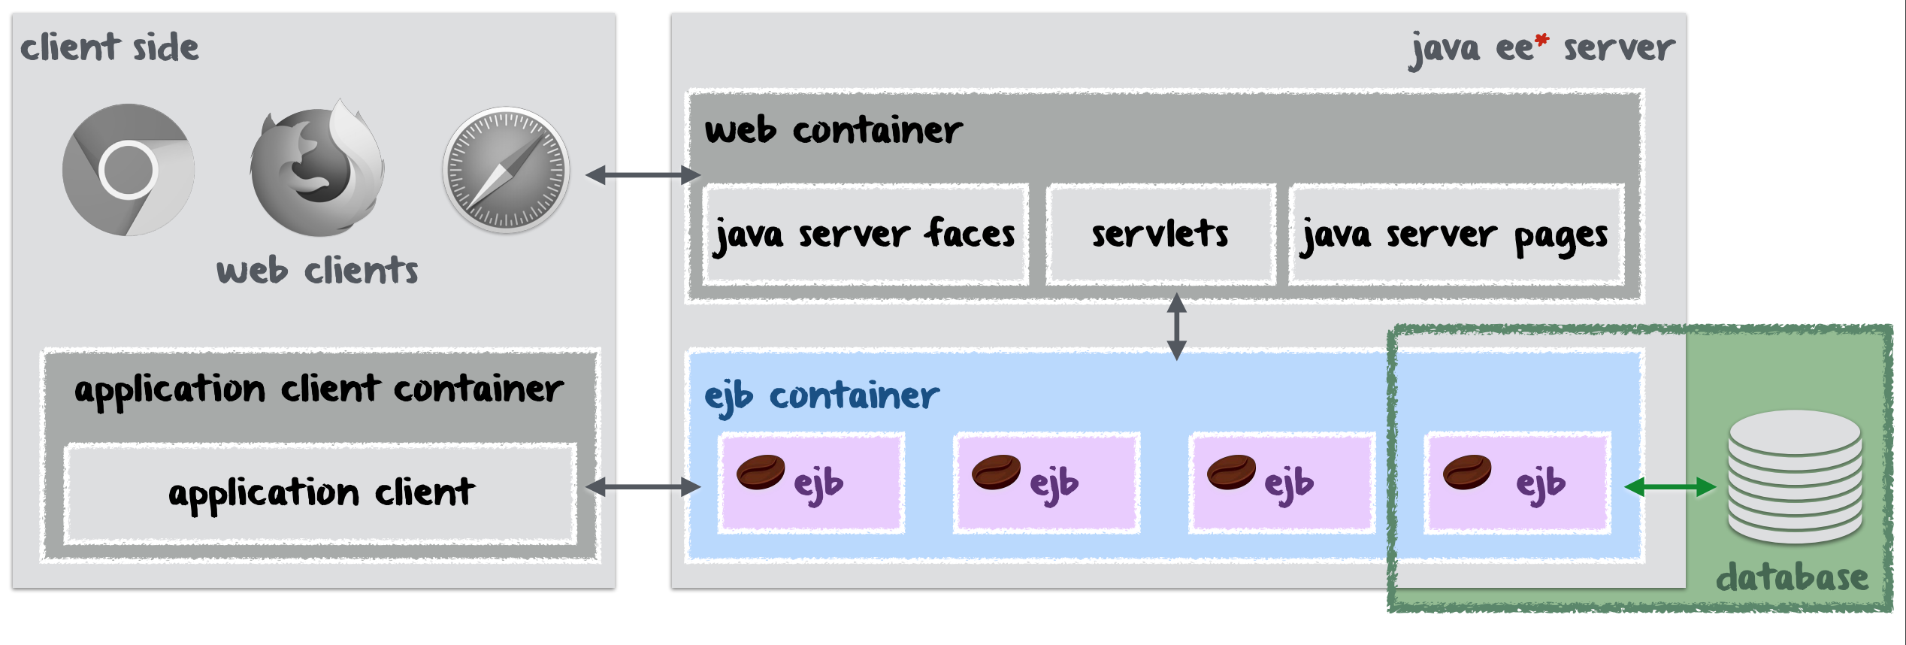
Web container
The web container is the link between your EJBs and the web clients. For this exercise session, we generated some servlets and JSP files for you.

Slide 36
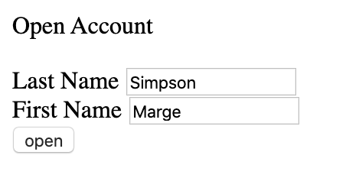
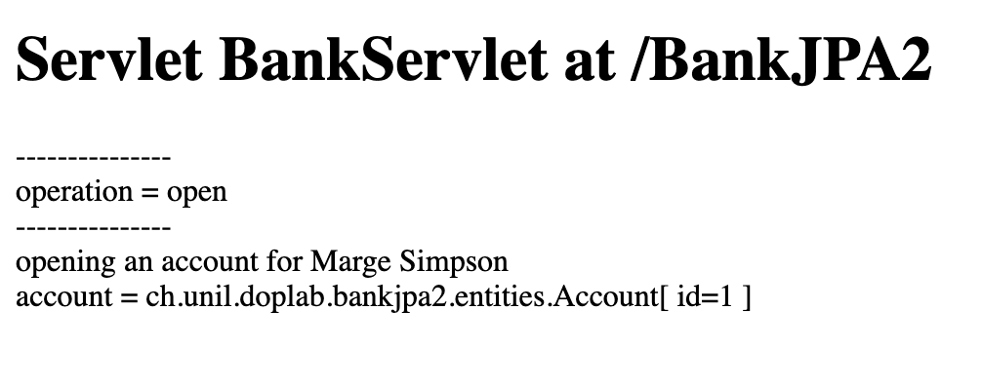
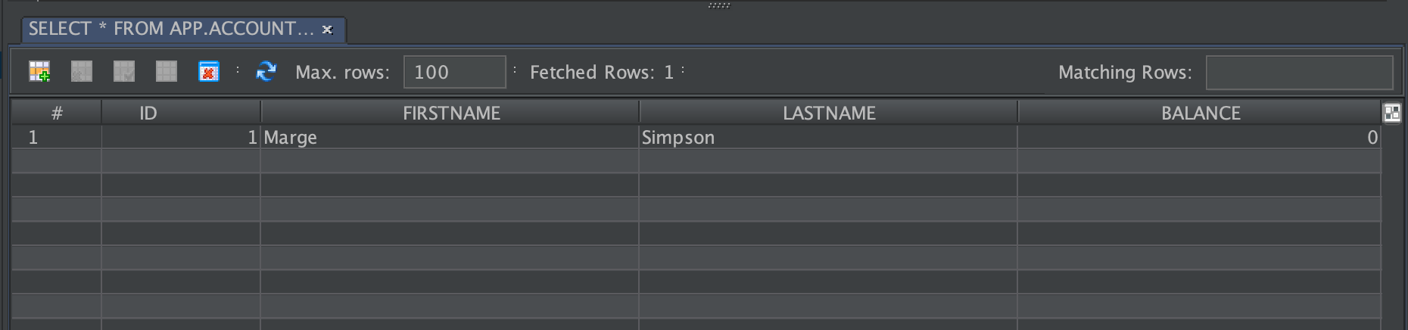
Executing the project
To start a new page, right-click on your servlet (servlet -> insert.java) and click on Run

Slide 37
Exercises
As an exercise, we provide you with a new project called « JPA_Bank_Exercise », you have to create new tables called Account and Payment. You can use the following code to generate the tables:
create table ACCOUNT (
ACC_ID INT GENERATED ALWAYS AS IDENTITY not null primary key ,
FIRST_NAME VARCHAR(50),
LAST_NAME VARCHAR(50),
ACC_BALANCE DOUBLE
);
create table PAYMENT (
PAY_ID INT GENERATED ALWAYS AS IDENTITY not null primary key ,
EXEC_DATE DATE ,
PAY_AMOUNT DOUBLE
);
You will generate the Entity class and the Session Bean for the Entity class.

