Slide 1
AI Agents, MCP and Real Work
Diana Kuklova
Peter Baus

Slide 2

Fun fact
DID YOU KNOW?
Being rude to AI scored higher accuracy
Same test questions, only the tone of the prompt changed:
80.8 %
Very polite prompts
84.8 %
Very rude prompts
+4 pp
for rude
Blunt, direct instructions can beat excessive politeness — tone is part of the context.

Slide 3
Context
Skills
MCP

Slide 4
Bring me water

Slide 5


Context is most important

Slide 6


Context is most important

Slide 7


Context is most important

Slide 8


Context is most important

Slide 9
Context engineering is getting the most out of today’s models

Slide 10
LLMs are stateless, so the only way how to improve performance is to change context.

Slide 11
Context engineering is magic spell 🪄

Slide 12
System prompt
AGENTS.md
MCP tools
User instructions
Go and build something cool…
“smart zone”
40%
168k tokens
“dumb zone”
32k tokens
Reserved for autocompact
Reserved for output
32k tokens

Slide 13
System prompt
AGENTS.md
MCP tools
User instructions
Go and build something cool…
40%
168k tokens
“dumb zone”
32k tokens
Reserved for autocompact
Reserved for output
32k tokens

Slide 14
System prompt
AGENTS.md
MCP tools
Reading file ABC.ts lines 0-500
Reading file ABC.ts lines 500-1000
Reading file XYZ.ts lines 100-780
Reading file 123.ts lines 0-3000
40%
168k tokens
“dumb zone”
32k tokens
Reserved for autocompact
Reserved for output
32k tokens

Slide 15
System prompt
System prompt
Results of code analysis…
MCP tools
User instructions
Go and build something cool…
Read()
Read()
Search()
Thinking…
“dumb zone”
40%
Output: Results of code analysis…
subagent
32k tokens
Reserved for autocompact
Reserved for output
32k tokens

Slide 16
Setup: before we start
INSTALLED ON YOUR MACHINE
WHAT YOU SHOULD KNOW
Claude Code
claude --version
Basic Git commands
clone · checkout · pull · commit · push
✓
✓
Node.js 22+
node -v
Basic terminal usage
cd · ls · running commands & scripts
✓
✓
Git
git --version
✓

Slide 17
Sub-agents

Slide 18
Subagents keep context clean
Subagents receive only their own system prompt (plus basic environment details like working directory) – not the full Claude Code system prompt
That isolation is the whole point: it keeps the main conversation’s context clean
Run multiple subagents concurrently to dramatically speed up complex workflows
e.g. during a review, in parallel:
Main conversation
style-checker subagent
security-scanner subagent
test-coverage subagent
Only results return to main context

Slide 19
Fun fact
DID YOU KNOW?
Claude Code ships with built-in subagents
Beyond any you create, two come out of the box:
Explore
for file system exploration
Plan
for architectural thinking

Slide 20
Fun fact
DID YOU KNOW?
Subagents can route easy work to a cheaper model
A noisy task like reading 500 lines of logs doesn’t need your most powerful model
Haiku
handles the easy work
Opus
not burned on log reading

Slide 21
“Spawn a sub-agent that will…”

Slide 22
Exercise: spawn your first subagent
Checkout branch kuklova/review-skill and find file broken-page.html.
HANDS-ON EXERCISE
1
GOAL
You want a subagent with instructions (“review HTML for accessibility issues”) that return a short list of problems + fixes.
Create a subagent that audits an HTML page, and watch the main agent delegate to it and return only the results.
2
Write a prompt that will trigger subagent as a sub-process and main process only formats the results.
3
</>

Slide 23
Subagents are just a file
Adding a subagent = adding one Markdown file: .claude/agents/AGENT-NAME.md
YAML frontmatter sets the name, a description (tells Claude when to delegate) and optional tools / model
The body of the file is the subagent’s own system prompt
Commit it to the repo and the whole team gets it – or use ~/.claude/agents/ for personal agents
e.g. an accessibility reviewer:
.claude/agents/html-auditor.md
---
name: html-auditor
description: Reviews HTML for
accessibility issues
tools: Read, Grep
---
You are an accessibility reviewer.
Return a short list of problems
+ fixes.
No registration – just save the file

Slide 24
Exercise: build your first subagent
Checkout branch kuklova/review-skill and find file broken-page.html.
HANDS-ON EXERCISE
1
GOAL
Create a subagent a11y-auditor with a name, a clear description (“review HTML for accessibility issues”) and tools: Read, Grep, Glob. In the body, tell it to read the file and return a short list of problems + fixes.
Create a subagent that audits an HTML page, and watch the main agent delegate to it and return only the results.
2
Open the repo in Claude Code and run /agents to confirm it’s registered.
3
</>
Write a prompt that will trigger subagent as a sub-process and main process only formats the results.
4

Slide 25
Writing Skills

Slide 26

Different Hats of software engineer
Make it work by specs
Good UX
Security & Performance
Code maintainability and reusability
Future proof & Need to refactor
Price of infrastructure & DevOps

Slide 27
Define
Build
Test
Review
Try out
…what you
are going
to build.
…it by
writing code.
…it by
writing tests.
…and validate
code changes.
…open the app
and check if
it works.

Slide 28
“Redesign broken-page.html”

Slide 29
https://github.com/emilkowalski/skills

Slide 30
Exercise: redesign a page with a skill
Checkout branch kuklova/review-skill and find file broken-page.html.
HANDS-ON EXERCISE
1
GOAL
Install the skills from the previous slide: npx skills@latest add emilkowalski/skills
Install a community skill, then watch Claude apply its design expertise to fix a broken page.
2
Open the repo in Claude Code and run /skills to confirm skill s loaded.
3
Write a prompt that will installed skill and redesign broken-page.html in a specific way that you describe.
</>
4

Slide 31
Writing Claude Skills — tips 1 & 2
1
Description = the trigger
2
Only write what Claude doesn't know
Write in third person.
Include words users actually type.
Lead with the key use case — it's cut at 1,536 chars in Claude Code.
Skip generic explanations.
Keep team-specific rules: naming conventions, internal service names, gotchas.
Target under 500 lines.

Slide 32
Writing Claude Skills — tips 3 & 4
3
Match strictness to fragility
4
Control who can invoke it
Define high freedom → creative/review tasks
Define low freedom → database migrations, releases, etc.
Templates, scaffolding, code examples.
Side effects (deploy, commit) → disable-model-invocation: true
Background knowledge → user-invocable: false

Slide 33
Writing Claude Skills — tips 5 & 6
5
Use progressive disclosure
6
Inject live context
Keep SKILL.md as an overview.
Link to detail files loaded only when needed.
One level deep only.
Use !`command` syntax to pre-load real data.
Ship scripts for repeatable logic instead of having Claude regenerate it each time.
## Current changes
!`git diff HEAD`
## Instructions Summarize the changes above in two or three bullet points

Slide 34
Writing Claude Skills — tips 7 & 8
7
Build validation loops in
8
Show examples, not descriptions
Pattern: run validator → fix errors → repeat.
For destructive work: plan → validate → execute.
Input/output pairs beat prose.
“ALWAYS use this exact template” vs. “adapt as needed” - be explicit about flexibility.

Slide 35
Writing Claude Skills — tips 9 & 10
9
Build evals before writing
10
Write for persistence, iterate
Don't write an extensive skill for imagined problem
Run Claude without the skill first. Note failures.
Write 3+ eval scenarios.
Write the minimum fix.
Test in a fresh session.
After compaction only the first ~5,000 tokens of each skill are kept.
Use standing instructions (“run tests after each edit”), not one-time ones (“run tests”).
Prune with /skill-doctor; commit shared skills to .claude/skills/

Slide 36
/grill-me

Slide 37
Exercise: create your own skill /grill-me
1
In your repo, create .claude/skills/grill-me/SKILL.md
HANDS-ON EXERCISE
GOAL
Add frontmatter with name: grill-me and a description that acts as the trigger, e.g. “Interview the user relentlessly about a plan or design until every decision is resolved. Use when the user says ‘grill me’.”
Write your first skill: one that makes Claude interview you about a plan before any code is written.
2
In the body, tell Claude to: ask one question at a time, walk every branch of the decision tree, suggest a recommended answer, check the codebase instead of asking when it can, and end with a summary of decisions.
3
</>
Run /skills to confirm it’s loaded, then try it: “Grill me on my plan to add new pagen into site in broken-page.html.”
4

Slide 38
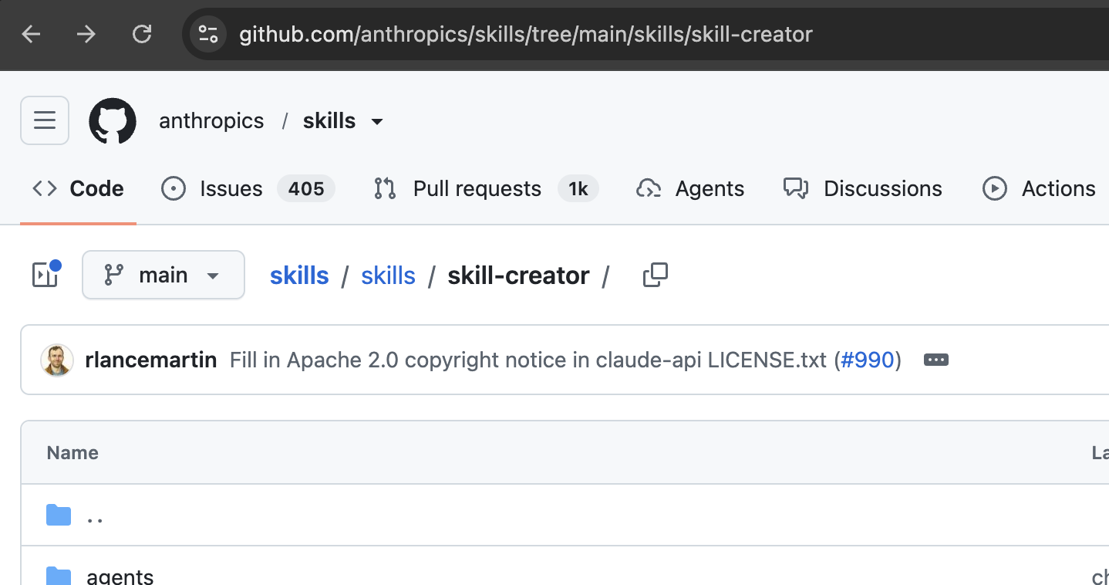

Slide 39
MCP

Slide 40
MCP servers in a nutshell
Model Context Protocol: an open standard (introduced by Anthropic, Nov 2024) – that connects agents to tools and data
Servers expose three primitives: tools (actions), resources (data) and prompts (templates)
Run locally over stdio or remotely over HTTP; messages use JSON-RPC 2.0
In Claude Code: claude mcp add, scoped local, project (.mcp.json) or user; check status with /mcp
e.g. Claude Code connected to:
Claude Code (MCP host + client)
GitHub MCP server
Database MCP server
Jira / Figma MCP server
One protocol, any tool or data source

Slide 41
“Use Playwright MCP to open google.com
and search for cat images”

Slide 42
Fun fact
DID YOU KNOW?
The three primitives compose — a skill can even run inside a subagent
A skill runs inside a subagent via context: fork in its frontmatter; a subagent preloads skills at startup via a skills field. First-class composition, not a workaround.
MCP server
for the connection
Skill
for the know-how
Subagent
for isolation
A typical power setup uses all three at once

Slide 43
Exercise: Playwright MCP in action
1
Add Playwright MCP server: claude mcp add playwright npx @playwright/mcp@latest
HANDS-ON EXERCISE
GOAL
Create a skill: .claude/skills/workshop-finder/SKILL.md that accepts a name of workshop and then uses Playwright MCP to visit https://www.openslava.sk/2026/#/workshops and highlights the workshop and creates screenshot in the project root.
Drive a real browser with Playwright MCP: open a live site, highlight a workshop and save a screenshot.
2
Trigger skill and ask for the workshop “AI Agents, MCP and Real Work”.
3
</>
You should see the screenshot in the root folder of your project.
4

Slide 44
Exercise: Issue → Investigate → Implement Fix
1
Add GitHub MCP server
HANDS-ON EXERCISE
GOAL
Create a skill only you can trigger: .claude/skills/fix-issue/SKILL.md with disable-model-invocation: true. Its body: read the issue via MCP, delegate the investigation, then implement the fix.
Turn a GitHub issue into a fix: read it via MCP, investigate in a subagent, implement in the main session.
2
Create a subagent .claude/agents/issue-investigator.md. It explores the code, finds the root cause and returns a suggested fix - keeping your main context clean.
3
</>
Chain it: run /fix-issue 2 → MCP reads the issue → subagent investigates → main session implements the fix and runs the tests.
4

Slide 46
Weknesses of agentic engineering

Slide 47
Main weaknesses
Context size limitations
Trained on older data
The "Feedback Loop" Fallacy – LLMs cannot directly validate outputs of their work
High-Level Architectural "Drift”
Hallucinations
  new category of vulnerability called "Slopsquatting”

Slide 48
How to fix the weknesses?

Slide 49
1. Context size limitations
Skills
Planning mode
Sub-agents
Ralph Wiggum loop
Task breakdown

Slide 50
2. Trained on older data
AGENT.md file
Fetch tools
hooks

Slide 51
3. The "Feedback Loop" Fallacy cannot directly validate outputs of their work
MCP servers
Tools

Slide 52
4. High-Level Architectural "Drift”
Custom agents
Governance-as-code
Auto-restriction loop

Slide 53
5. Hallucinations
Hooks
Validations
Reviewer-personality agent
Human-in-the-loop

Slide 54

Happy vibing…
Presenter 14pt
Notes:
Ensure the titles are not duplicated. Please check the set of best practices.

