Slide 1


First steps with R in Life Sciences: Statistics
February, 2022 - Streamed
Wandrille Duchemin
-- with slides from Diana Marek, Wandrille Duchemin, Leonore Wigger

Slide 2
Taking advantage of R for your work
Tidying & data manipulation
Import in R
Exploration
Modelling
Export
Notes:
General workflow to take advantage of R for your work:
-specify your question very clearly.
Your Question, what hypothesis you're making, what data you will collect, coming from different type of experiment ( simulation study, field study, lab study, measurement machine ) – this will be your dataset(s)
-design your experiment very well
-format your dataset nicely
Tidy step: checking some variables are of the correct type, manipulating the structure of the data
Explore in terms of graph, table, summary stats to get an idea of the answer(s)
Stats will give you a reliable Answer to confirm the question, confirming that the graphs gave you a reliable answer
Communicate answer, data, graphs to colleagues, boss: report, publication , summary – reproducible research and it is essential otherwise the previous steps were meaningless

Slide 3
Taking advantage of R for your work
Communicate
Tidying & data manipulation
Scientific question
Formatted Data In R
Data representation
Statistical analysis
Import in R
Exploration
Modelling
Export
Notes:
General workflow to take advantage of R for your work:
-specify your question very clearly.
Your Question, what hypothesis you're making, what data you will collect, coming from different type of experiment ( simulation study, field study, lab study, measurement machine ) – this will be your dataset(s)
-design your experiment very well
-format your dataset nicely
Tidy step: checking some variables are of the correct type, manipulating the structure of the data
Explore in terms of graph, table, summary stats to get an idea of the answer(s)
Stats will give you a reliable Answer to confirm the question, confirming that the graphs gave you a reliable answer
Communicate answer, data, graphs to colleagues, boss: report, publication , summary – reproducible research and it is essential otherwise the previous steps were meaningless

Slide 4
07
Starting with statistics in R

Slide 5
Getting started
From the data you have collected, you will have one or more question(s) (hypotheses to test).
Make informative pictures to reveal relationships between variables.
Decide on statistical model.
Assess the assumptions underlying your modelling before final decision (results might be unreliable if assumptions are violated).
Translate statistical model into R language, run statistical test
Notes:
Statistical analyses may be unreliable if assumptions are violated, so check them!
In the next slides, we will see some examples of question and types of variables and translate some of them in R

Slide 6
Covered in this lecture:
T-test
Correlation
Simple linear regression

Slide 7
Hypothesis testing and linear modelling in R
Notes:
Intro on this very vast subject

Slide 8
Statistical hypothesis testing
Two hypotheses in competition :
H0: the NULL hypothesis (usually the most conservative)
H1: the alternative hypothesis (usually the one we are actually interested in)
Example:
H0: « There is no difference in weight between two given strains of mice »
H1: « The average weight in KO mice is different from that in WT mice »
Statistical test:
Calculate test statistic,
Calculate associated p-value,
Check if p-value is small enough to reject H0, according to pre-defined significance level.
Notes:
There are many ways to « analyze data », depending on the type of experiment and the questions asked
The questions are usually framed in the context of hypothesis testing, and often summarised by The question:
«Which test should I use ?
P-value = result of an hypothesis test
For those in the know, this is Frequentist statistics, inherited from (but kind of despite) Fisher.

Slide 9
Statistical hypothesis testing
Test statistic:
Variable calculated from sample data. Measures the degree of agreement between the sample of data and the null hypothesis. Example: t statistic in the t-test.
p-value:
Probability of observing a result (and test statistic) at least as extreme as the one obtained from the analyzed data, assuming the null hypothesis is true.
significance level (alpha level):
Decision threshold for the p-value below which we reject the null hypothesis (conventionally, 0.05 or 0.01). It is also the probability of mistakenly rejecting the null hypothesis.
Notes:
P-value thresholds should be decided upon before running the test. Changing the threshold based on the test’s results is a mild form of p-hacking.
P-value = result of an hypothesis test , is a probability that is used to assess the significance of a test.
The p-value is the probability of getting a result that is as or more extreme than the observed result, assuming that the null hypothesis is true.
Infer conclusions based on p-value: if the probability of observing such an extreme or more extreme test statistic assuming H0 is true is very low, infer that H0 wasn’t true to begin with.
Biological significance can be present in the absence of statistical significance - typically in underpowered studies. Pvalue=x= Probabilité x de rejeter par erreur l'hypothèse nulle=there is a probability of x that you will mistakenly reject the null

Slide 10
Being careful with interpretations
1. statistical significance does NOT imply biological significance, biological significance does NOT imply statistical significance.
2. The absence of a statistically significant difference does NOT imply a an equivalence (i.e. that groups are the same).

Slide 11
T-test
Goal:
Compare a continuous measure between two groups: Is the difference between the two group means statistically significant?
Assumptions:
Observations are independent
Values are normally distributed within in each group
Values’s means are normally distributed within each group
(Same variance in each group)
R uses Welch's t-test, which does not assume equal variance

Slide 12
Example data set: sleep
Student's sleep data: shows the effect of two soporific drugs on 10 patients:
hours of sleep gained with the drug compared to control condition without drug
>data(sleep)
>head(sleep)
extra group ID
1 0.7 1 1
2 -1.6 1 2
3 -0.2 1 3
4 -1.2 1 4
5 -0.1 1 5
6 3.4 1 6
>summary(sleep)
extra group ID
Min. :-1.600 1:10 1 :2
1st Qu.:-0.025 2:10 2 :2
Median : 0.950 3 :2
Mean : 1.540 4 :2
3rd Qu.: 3.400 5 :2
Max. : 5.500 6 :2
(Other):8
Cushny, A. R. and Peebles, A. R. (1905) The action of optical isomers: II hyoscines. The Journal of Physiology 32, 501–510.
Student (1908) The probable error of the mean. Biometrika, 6, 20.

Slide 13
Check normality of the data with plots
>data(sleep) # Data which shows the effect of two soporific drugs (increase in hours of sleep compared to control) on patients.
Using histograms (hist() ) and QQ-Plots (qqnorm(), qqline()), we can visually assess the normality of the data.
>par(mfrow=c(2,2))
>hist(sleep$extra[sleep$group==1],
freq=FALSE, xlab="Drug 1",
main=" Extra sleep on drug 1")
>qqnorm(sleep$extra[sleep$group==1])
>qqline(sleep$extra[sleep$group==1])
>hist(sleep$extra[sleep$group==2],
freq=FALSE, >xlab="Drug 2",
main=" Extra sleep on drug 2")
>qqnorm(sleep$extra[sleep$group==2])
>qqline(sleep$extra[sleep$group==2])
Notes:
Sleep data in datasets package. Datasets package not availabe in R version 3.5.1 , use datasets.load package instead
Shapiro test : si p value élevée, on ne rejette pas H0 donc data normale
Si p value basse, on rejette H0 donc data non normale
H0: normal
H1: non normal
However, since the test is biased by sample size,the test may be statistically significant from a normal distribution in any large samples. Thus a Q–Q plot is required for verification in addition to the test.
The Q-Q plot, or quantile-quantile plot, is a graphical tool to help us assess if a set of data plausibly came from some theoretical distribution such as a Normal or exponential. For example, if we run a statistical analysis that assumes our dependent variable is Normally distributed, we can use a Normal Q-Q plot to check that assumption. A Q-Q plot is a scatterplot created by plotting two sets of quantiles (percentiles= points in your data below which a certain proportion of your data fall). against one another. If both sets of quantiles came from the same distribution, we should see the points forming a line that’s roughly straight. Here’s an example of a Normal Q-Q plot when both sets of quantiles truly come from Normal distributions.

Slide 14
Check normality of the data with a test
In addition, we can run a statistical test to assess normality of the data:
Shapiro-Wilk test.
H0: Data is normally distributed. H1: Data deviates significantly from normality
>shapiro.test(sleep$extra[sleep$group==1]) # data normal
Shapiro-Wilk normality test
data: sleep$extra[sleep$group == 1]
W = 0.92581, p-value = 0.4079
>shapiro.test(sleep$extra[sleep$group==2]) # data normal
Shapiro-Wilk normality test
data: sleep$extra[sleep$group == 2]
W = 0.9193, p-value = 0.3511
Notes:
Data is normal , p value above 5%
October 2020: Hiding this slide from the course. In practice, statistics teachers do not recommend the Shapiro-Wilk normality test to check assumptions. QQ plot is better.
Histogram is problematic as well, but at least students can easily see how it is quite un-informative for our own particular data sets, and most are not tempted much to draw their conclusions regarding normality based on the histograms. (Leonore)

Slide 15
Recommendations for assessing normality
T-test is somewhat robust to non-normal data. No need to be too strict about normality requirement.
QQ-Plot: If you only do one type of assessment, use this!
Histograms: Better for larger data sets. Distributions hard to asses for small data sets.

Slide 16
Recommendations for assessing normality
T-test is somewhat robust to non-normal data. No need to be too strict about normality requirement.
QQ-Plot: If you only do one type of assessment, use this!
Histograms: Better for larger data sets. Distributions hard to asses for small data sets.
Shapiro-Wilk normality test: Better for smaller data sets. Its usefulness is somewhat controversial, don't use it by itself to assess normality.
Notes:
Include this slide when teaching Shapiro-Wilk test.
Hide this slide when leaving out Shapiro-Wilk test. (Leonore)

Slide 17
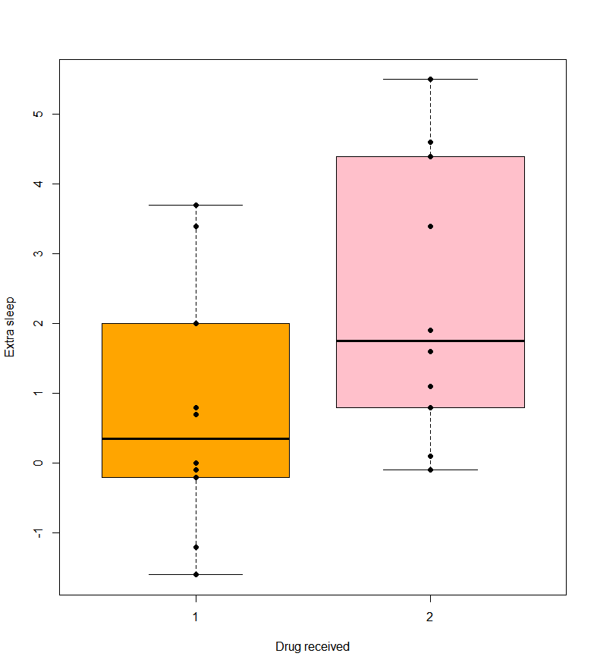
Visualize group differences with boxplot()
>boxplot(extra ~ group, data=sleep, col=c("orange", "pink"), ylab="Extra sleep", xlab="Drug received")
>points(extra ~ group, data = sleep, col="black",pch = 19)
Are the two means significantly different?

Slide 18
Function t.test()
>t.test(sleep$extra[sleep$group==1],
sleep$extra[sleep$group==2])
>t.test(extra ~ group, data=sleep) #equivalent to the above
# Two-sided Welch two-sample t-test (modified t-test, does not assume equal sample variances)
Welch Two Sample t-test
data: extra by group
t = -1.8608, df = 17.776, p-value = 0.07939
alternative hypothesis: true difference in means is not equal to 0
95 percent confidence interval:
-3.3654832 0.2054832
sample estimates:
mean in group 1 mean in group 2
0.75 2.33
No significant difference between group means
at alpha level 0.05
Notes:
This test is one of the most widely used tests. However, it can be used only if the background assumptions are satisfied.
• The populations from which the samples have been drawn should be normal. One needs to note that the normality assumption has to be tested individually and separately for the two samples.
• The standard deviation of the populations should be equal i.e.
σX2 = σY2 = σ2, where σ2 is unknown. This assumption can be tested by the
F-test.
• Samples have to be randomly drawn independent of each other. There is however no requirement that the
two samples should be of equal size - often times they would be unequal though the odd case of equal size
cannot be ruled out
The Welch t-test (a slightly modified version of the t-test) takes into account different sample variances.
If the variances are actually the same, it provides the same results as the standard Student t-test.

Slide 19
T-test object
t.test() and other tests return an R object that can be assigned to a variable. This object is a list.
View the names of the list’s slots using names().
Access the elements of a list using the $ or the [[ ]] operators.
> test.res <- t.test(sleep$extra[sleep$group==1], sleep$extra[sleep$group==2])
> names(test.res) [1] "statistic" "parameter" "p.value" "conf.int" [5] "estimate" "null.value" "alternative" "method" [9] "data.name"
> test.res[["statistic"]] #or: test.res$statistic
t
-1.860813
> test.res[["p.value"]] #or: test.res$p.value
[1] 0.07939

Slide 20
Paired data
Sleep data set has two measurements per person (ID): one for each drug.
A paired t-test would be more appropriate than an unpaired t-test.
Normality assumption:
The mean of the differences between pairs are normally distributed.

Slide 21
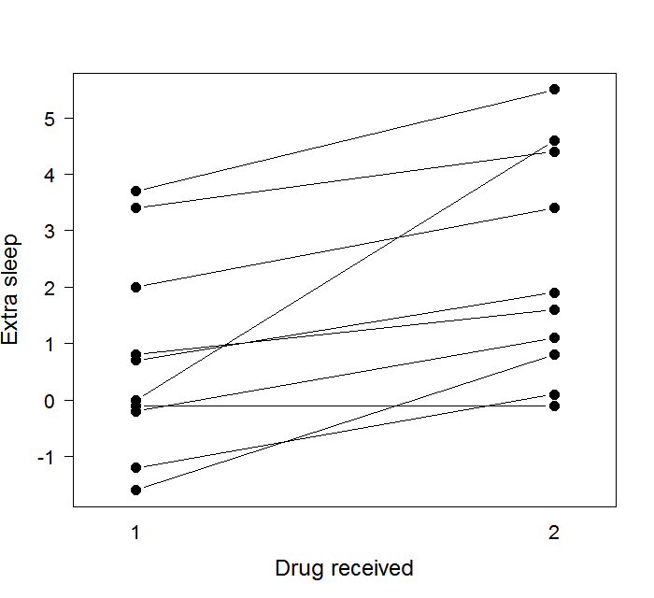
Paired data representation
>interaction.plot(response=sleep$extra, x.factor=sleep$group,
trace.factor=sleep$ID, legend=FALSE, type="b", lty=1, pch=16,
xlab="Drug received", ylab="Extra sleep")
Is the difference between the two treatments significant?
Notes:
stripchart produces one dimensional scatter plots (or dot plots) of the given data. These plots are a good alternative to boxplots when sample sizes are small.
Leonore, Oct 2020
Use interaction plot to draw a stripchart with connecting lines. This code does not require a for loop (which has not been covered in the course).
https://www.zoology.ubc.ca/~schluter/R/Display.html

Slide 22
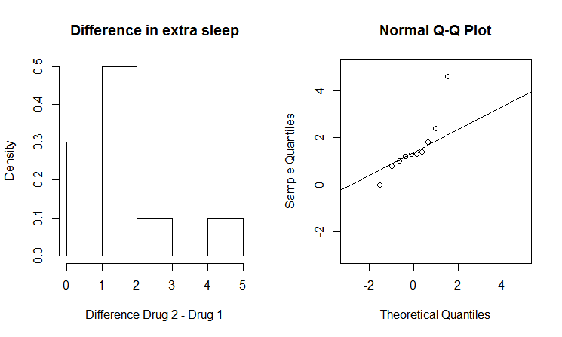
Check normality of the differences between pairs
>difference = sleep$extra[sleep$group==1]-sleep$extra[sleep$group==2]
>hist(difference, freq=FALSE, xlab="Difference Drug 2 - Drug 1", main="Difference in extra sleep", col="white")
>qqnorm(difference, xlim=c(-5, 2), ylim=c(-5, 2))
>qqline(difference)
Most points are close to the qqline but there is an outlier

Slide 23
Paired data representation
Are the two means significantly different?
Notes:
stripchart produces one dimensional scatter plots (or dot plots) of the given data. These plots are a good alternative to boxplots when sample sizes are small.
if true add the chart to the current plot.

Slide 24
Paired data representation
>par(mfrow=c(1,2))
>boxplot(extra ~ group, data=sleep, ylab="Extra sleep",
xlab="Drug received")
>points(extra ~ group, data=sleep, col="grey",pch=19)# adds on top of boxplot the scatter plot of the data
>for(ID in split(sleep, sleep$ID))
lines(extra ~ group, ID) # for each patient id, connects the paired values by a line
>stripchart(extra ~ group, data = sleep, pch=19, col="grey", add = FALSE, vertical=TRUE, ylab="Extra sleep", xlab="Drug received")
# scatter plot of the data
>for(ID in split(sleep, sleep$ID)) )
lines(extra ~ group, ID) # for each patient id, connects the paired values by a line
Notes:
stripchart produces one dimensional scatter plots (or dot plots) of the given data. These plots are a good alternative to boxplots when sample sizes are small.
if true add the chart to the current plot.

Slide 25
Paired t-test - P5S
Use a paired t-test when the data contains two measures for the same subject/entity.
>t.test(sleep$extra[sleep$group==1],
sleep$extra[sleep$group==2], paired=TRUE)
# paired values must be at the same position in the two vectors
# do not use formula notation (extra~sleep) for paired t-test
Paired t-test
data: sleep$extra[sleep$group == 1] and sleep$extra[sleep$group == 2]
t = -4.0621, df = 9, p-value = 0.002833
alternative hypothesis: true difference in means is not equal to 0
95 percent confidence interval:
-2.4598858 -0.7001142
sample estimates:
mean of the differences
-1.58
The difference between the two treatments is significant at alpha level 0.05

Slide 26
Non-parametric alternatives to the t-test
When the data deviates strongly from normality, a non-parametric test can be used in place of a t-test.
Non-parametric tests do not assume any particular distribution of the data.
Instead of t-test (without pairing), use Mann-Whitney U test.
>wilcox.test(sleep$extra[sleep$group==1],
sleep$extra[sleep$group==2])
>wilcox.test(extra~group, data=sleep) # equivalent
Instead of paired t-test, use Wilcoxon Signed Rank test.
>wilcox.test(sleep$extra[sleep$group==1],
sleep$extra[sleep$group==2], paired=TRUE)
These two tests have different names but are both implemented in the R function wilcox.test.

Slide 27
Function wilcox.test()
For the sleep data, a paired test is appropriate.
>wilcox.test(sleep$extra[sleep$group==1],
sleep$extra[sleep$group==2], paired=TRUE)
Wilcoxon signed rank test with continuity correction
data: sleep$extra[sleep$group == 1] and sleep$extra[sleep$group == 2]
V = 0, p-value = 0.009091
alternative hypothesis: true location shift is not equal to 0
The conclusion is the same as it was for the paired t-test.
The p-value is a little higher wilcox.test: 0.009091
t.test: 0.002833
The difference between the two treatments is significant at alpha level 0.05

Slide 28
Function wilcox.test(): warning messages about p-value computation
wilcox.test() implements two ways to compute p-values: exact and by approximation
The method can be selected with parameter exact=TRUE or exact=FALSE
The default is "exact" if sample size < 50 and there are no ties in the data. Otherwise it is by normal approximation.
If warning messages saying "cannot compute exact p-value" are displayed, then computation of exact p-value failed and a normal approximation was performed.

Slide 29
Function wilcox.test(): warning messages about p-value computation
wilcox.test() implements two ways to compute p-values: exact and by approximation
The method can be selected with parameter exact=TRUE or exact=FALSE
The default is "exact" if sample size < 50 and there are no ties in the data. Otherwise it is by normal approximation.
If warning messages saying "cannot compute exact p-value" are displayed, then computation of exact p-value failed and a normal approximation was performed.
Warning messages:
1: In wilcox.test.default(sleep$extra[sleep$group == 1], sleep$extra[sleep$group == :
cannot compute exact p-value with ties
2: In wilcox.test.default(sleep$extra[sleep$group == 1], sleep$extra[sleep$group == :
cannot compute exact p-value with zeroes
These warnings don't mean that there is an error in the result. An (approximated) p-value is still provided and can be reported.

Slide 30
Let’s practice - 10
Come back to the mice data-set stored in the "mice_data" data frame.
Considering WT mice weight and KO mice weight separately, check the assumption of normality graphically.
Make an appropriate plot to visualize the mouse weights grouped by genotype.
Perform a test to see whether the mouse weight is different between the two genotypes.
Repeat step 1 to 3 for the diet variable.

Slide 31
In a nutshell
R can help you to make a graphical representation of your hypothesis and to test it using the right model based on your data (check the assumptions).
R offers a wide range of functions for simple hypotheses testing such as:
t.test(): Student's t-test
wilcox.test(): Whitney Mann U and Wilcoxon Signed Rank tests (non-parametric)
Further examples not covered in this course:
var.test() : F test for equality of variances
fisher.test() : Fisher's exact test
chisq.test() : Chi-squared contingency tables tests and goodness-of-fit tests
ks.test() : Kolmogorov-Smirnov test (non parametric)
…
Notes:
Single factor (or one-way) analysis of variance
Parametric ( ANOVA)
Non parametric (
kal-Wallis)
Wilcox: t-test for non normal distributions (using ranks instead of values) . Use the Wilcoxon signed-rank test when you'd like to use the paired t–test, but the differences are severely non-normally distributed.
Kolmogorov-smirnov test (x,y) : a two-sample test of the null hypothesis that x and y were drawn from the same continuous distribution is performed.

Slide 32
Bivariate linear correlation
Goal: Quantify the strength of a linear correlation between two continuous variables
cor() computes a correlation between two variables.
Default: method="pearson" (linear correlation)
Other options: method="spearman", method="kendall"
(rank-based correlations)
cor.test() computes a correlation and performs a corresponding statistical test to obtain a p-value (for Pearson correlation: p-value from linear regression, same as lm() )
Notes:
does not distinguish between independent and dependent variables
The closer r is to –1 or 1, the more tightly the points on the scatterplot are clustered around a line
•The sign of r(+ or -) is the same as the sign of the slope of the line
•When r= 0, the points are not LINEARLY ASSOCIATED–this does NOT mean there is NO ASSOCIATION
Pearson's correlation only assess whether there is a linear correlation in the data.
Other types of correlation (robust methods) are available: most commonly, the Spearman and Kendall correlations

Slide 33
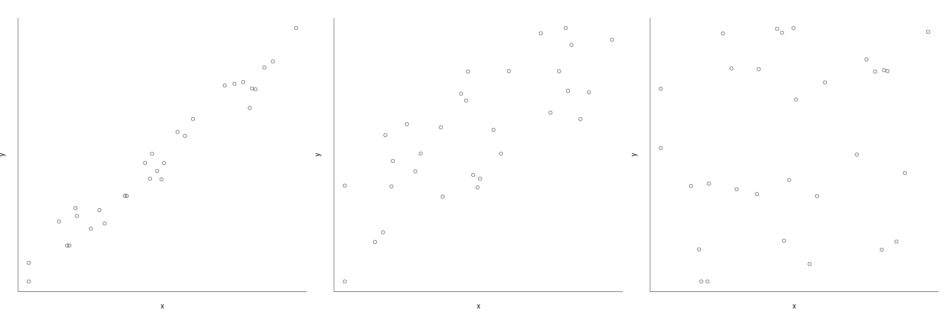
Scatter plots and correlation strength
Strong linear correlation: points are close to a straight line
Medium-strong linear correlation: points more or less follow a straight line
No correlation: Points have random pattern

Slide 34
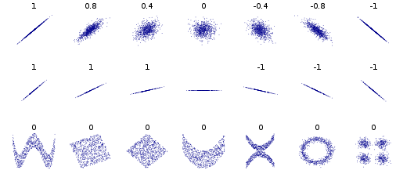
Several sets of (x, y) points, with the Pearson correlation coefficient of x and y for each set. Note that the correlation reflects the noisiness and direction of a linear relationship (top row), but not the slope of that relationship (middle), nor many aspects of nonlinear relationships (bottom).
Image credit: wikipedia user DenisBoigelot, under the CC0 1.0 license
Notes:
The closer r is to –1 or 1, the more tightly the points on the scatterplot are clustered around a line
•The sign of r(+ or -) is the same as the sign of the slope of the line
•When r= 0, the points are not LINEARLY ASSOCIATED–this does NOT mean there is NO ASSOCIATION
Pearson's correlation only assess whether there is a linear correlation in the data.
Other types of correlation (robust methods) are available: most commonly, the Spearman and Kendall correlations
Note, October 2020:
Hiding this slide – show fewer plots in next slide to not overwhelm beginners.

Slide 35
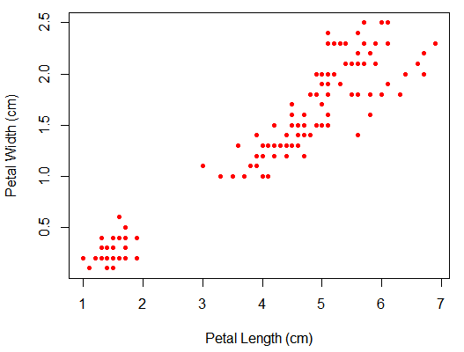
Scatter plot
> plot(iris$Petal.Length, iris$Petal.Width,
col="red", pch=20,
xlab="Petal Length", ylab="Petal Width")
Does a significant linear correlation exist between sepal length and width?

Slide 36
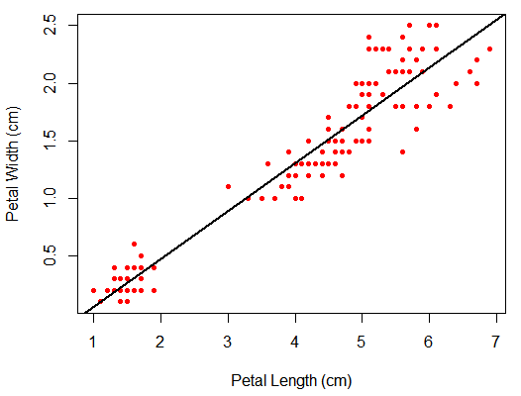
Scatter plot
> plot(iris$Petal.Length, iris$Petal.Width,
col="red", pch=20,
xlab="Petal Length", ylab="Petal Width")
> abline(lm(iris$Petal.Width~iris$Petal.Length),
col="black", lwd=2)
Does a significant linear correlation exist between sepal length and width?
Visual assessment: Points are close to trend line
Notes:
Null hypo: no correlation . Here we can reject the null hypo that there is no correlation
(TODO:
- legend could be added, as in the original slide from women data set
- Pearson correlation coefficient could be written into the plot using text)
Leonore Oct 2020

Slide 37
Linear correlation
>cor(iris$Petal.Length, iris$Petal.Width, method="pearson")
[1] 0.9628654
>cor.test(iris$Petal.Length, iris$Petal.Width, method="pearson")
Pearson's product-moment correlation
data: iris$Petal.Length and iris$Petal.Width
t = 43.387, df = 148, p-value < 2.2e-16
alternative hypothesis: true correlation is not equal to 0
95 percent confidence interval:
0.9490525 0.9729853
sample estimates:
cor
0.9628654
We can reject the null hypothesis that there is no association
Notes:
Null hypo: no correlation . Here we can reject the null hypo that there is no correlation

Slide 38
Linear regression
Goal: Determine the extent to which there is a linear relationship between an "outcome" variable (dependent variable) and one more "explanatory" variables (independent variables, predictor variables).
Can a significant part of the variability in the outcome be predicted/explained by the independent variables?
Outcome variable: continuous (e.g. weight, heart rate, blood sugar)
Explanatory variables: continuous OR categorical (e.g. gender)
In R, the linear regression model is specified by a model formula of the form:
outcome ~ explanatory variables
Notes:
The null hypothesis of correlation/linear regression is that the slope of the best-fit line is equal to zero; in other words, as the X variable gets larger, the associated Y variable gets neither higher nor lower.
Also, how strongly related to the DV is the beta coefficient for each IV?
Assumptions:
-normality and homoscedasticity of the variables (otherwise log transforme the data or use ranks)
-linearity (data fit a straight line) and independence of the observations
Fortunately, numerous simulation studies have shown that regression and correlation are quite robust to deviations from normality;

Slide 39
Simple linear regression
A simple regression model (one explanatory variable) is specified by
y = a + b*x+ err
a: Intercept
b: coefficient of explanatory var., x: explanatory var.
err: error term (=residuals)
Assumptions :
Homoscedasticity : independence between residual variance and variables
Linearity + absence of linear relationship between variables
independence of the observations.
Residuals centered around predicted value (mean=0)
+ normality of the residual’s mean
→ only used to assess parameters confidence interval
Otherwise : try log-transform (for heteroskedasticity) or non-parametric methods if the assumptions are not met.
Notes:
The null hypothesis of correlation/linear regression is that the slope of the best-fit line is equal to zero; in other words, as the X variable gets larger, the associated Y variable gets neither higher nor lower.
Also, how strongly related to the DV is the beta coefficient for each IV?
Assumptions:
Linear model assumes normality of the residuals.
It does NOT assume normality of the data.
This cannot be checked BEFORE we use lm. Check it afterwards.
Fortunately, numerous simulation studies have shown that regression and correlation are quite robust to deviations from normality;

Slide 40
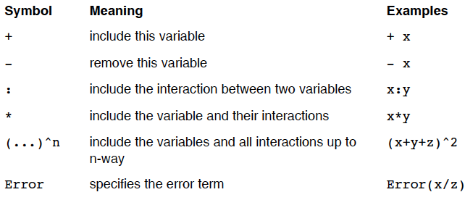
Some of the important symbols that can be used in the formula are :
Note: by default, the intercept is always included in a model. To remove it, a -1 term should be added to the formula : y ~ -1 + x1 + x2.
Notes:
Hide slide.
Leonore October 2020

Slide 41
Summary of the data
>class_data <- read.csv("class.csv") #dataset* of 19 students' measurements
>summary(class_data)
Gender Age Height Weight
F: 9 Min. :11.00 Min. :130.3 Min. :22.91
M:10 1st Qu.:12.00 1st Qu.:148.0 1st Qu.:38.22
Median :13.00 Median :159.5 Median :45.13
Mean :13.32 Mean :158.3 Mean :45.37
3rd Qu.:14.50 3rd Qu.:167.4 3rd Qu.:50.92
Max. :16.00 Max. :182.9 Max. :68.04
*CLASS dataset, from the program SAS (names removed and units have been modified from imperial to metric)

Slide 42
Representation of the data
Height~a+b1*Age+ err
>pairs(class_data)

Slide 43
The lm() Function
lm() : fitting a linear model.
Creates an R object which contains the regression result and can be stored or printed. Just printing the result provides only the regression coefficients.
The summary() and plot() functions can be used to provide more information, including diagnostic plots.
Many other functions can be applied to the regression objects:
residuals() extracts a vector containing the residuals (error)
coef() extracts the regression coefficients
anova() produces the corresponding ANOVA table (not covered

Slide 44
Simple linear regression
> model_height_age <- lm(Height~Age, data=class_data)
> model_height_age
Call:
lm(formula = Height ~ Age, data = class_data)
Coefficients:
(Intercept) Age
64.069 7.079
Notes:
1 st example continuous variable as a function of a continuous variable

Slide 45
Simple linear regression
> model_height_age<-lm(Height~Age, data=class_data)
> model_height_age
Call:
lm(formula = Height ~ Age, data = class_data)
Coefficients:
(Intercept) Age
64.069 7.079
Model: Height = 64.07 + 7.08 x Age
Height~a+b1*Age+ err
Notes:
1 st example continuous variable as a function of a continuous variable

Slide 46
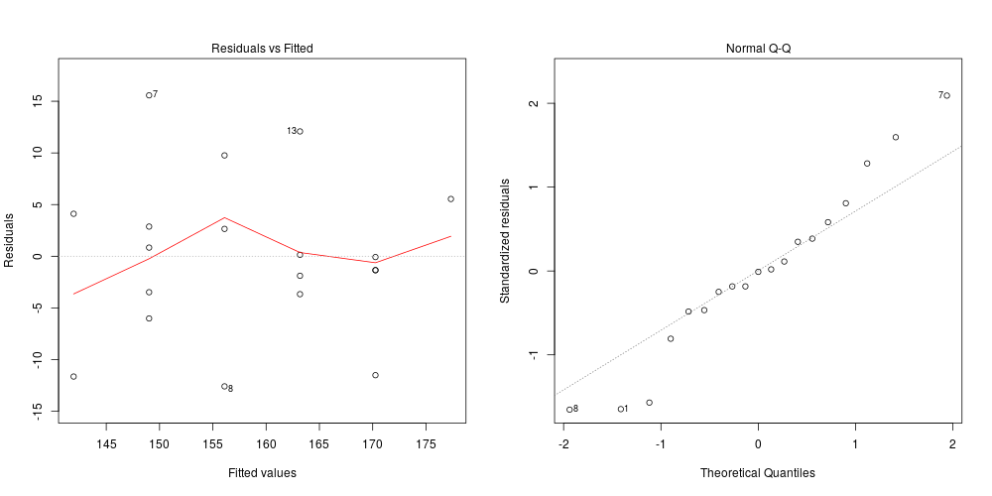
Check model assumptions
The output of lm() already contains some diagnostic plots:
> par(mfrow=c(1,2))
> plot(model_height_age, which=1)
> plot(model_height_age, which=2)

Slide 47
Check model assumptions
Left plot : homoscedasticity (variance or residual equal along axis)
+ mean of residuals at 0
Right plot : normality of residuals

Slide 48
Check model assumptions
Left plot : homoscedasticity (variance or residual equal along axis)
+ mean of residuals at 0
Right plot : normality of residuals
Some assumptions
can only be tested after the model is run.

Slide 49
Representation of the fit
>plot(Age~Height,data=class_data)
>abline(model_height_age, col="red", lwd=2)

Slide 50
Functions to extract data from lm object (I): coefficients
coefficients: y-intercept and slope of the regression line
#get the coefficients as vector
>coef(model_height_age)
(Intercept) Age
64.068667 7.079333
slope
of the line
y-intercept
of the line

Slide 51
Functions to extract data from lm object (II): 2) residuals - P5S
residuals: vertical distances of data points from the regression line
# get the residuals as vector
>residuals(model_height_age)
1 2 3 4 5
-11.6393 4.1087 -3.4787 2.8713 0.8393
6 7 8 9 10
-6.0187 15.5713 -12.5900 9.7620 2.6500
11 12 13 14 15
-3.6673 -1.8893 12.0807 0.1427 -11.5087
16 17 18 19
-1.3487 -0.0787 -1.3487 5.5420

Slide 52
>summary(model_height_age)
Call:
lm(formula = Height ~ Age, data = class_data)
Residuals:
Min 1Q Median 3Q Max
-12.5900 -3.5730 -0.0787 3.4900 15.5713
Coefficients:
Estimate Std. Error t value Pr(>|t|)
(Intercept) 64.069 16.565 3.868 0.00124 **
Age 7.079 1.237 5.724 2.48e-05 ***
---
Signif. codes: 0 ‘***’ 0.001 ‘**’ 0.01 ‘*’ 0.05 ‘.’ 0.1 ‘ ’ 1
Residual standard error: 7.832 on 17 degrees of freedom
Multiple R-squared: 0.6584, Adjusted R-squared: 0.6383
F-statistic: 32.77 on 1 and 17 DF, p-value: 2.48e-05
Height~a+b1*Age+ err
Error: Difference between the observed and the fitted points (line)
Significance of the parameters : Is Age different from 0? YES
F-test: Is the model significant compared to a model with just the intercept? YES
R²: Fraction of the variance explained by the model
Notes:
The method makes that the sum and mean of resiudals are 0. Can be seen with a boxplot. We assume the residuals are normally distributed around 0 with equal variance
The residual standard error is the standard deviation of the residuals (which we would usually like to be small). The numbers of degrees of freedom indicates the number of independent pieces of data that ara available to estimate the error (= # ob obsevations - # of parameters to estimate)
R2= r (correlation coeff) ^2 when it is a simple linear regression
Adj R2 takes into account the number of variable in the model
In the case of a simple regression, the F-test is eq to a t.test (same p-value)

Slide 53
cor.test() and lm() comparison
For a simple regression model, the t statistic and p-value from lm() are identical to those from cor.test() with method="pearson".
>summary(lm(Height~Age, data=class_data))
Estimate Std. Error t value Pr(>|t|)
(Intercept) 64.069 16.565 3.868 0.00124 **
Age 7.079 1.237 5.724 2.48e-05 ***
> cor.test(class_data$Height, class_data$Age)
t = 5.7245, df = 17, p-value = 2.48e-05
alternative hypothesis: true correlation is not equal to 0
95 percent confidence interval:
0.5657317 0.9247988
sample estimates:
cor
0.8114343

Slide 54
Simple linear regression – 2nd example
Height~a+b1*Gender+ err
Normality checks first
>shapiro.test(class_data$Height[class_data$Gender=="M"]) Shapiro-Wilk normality testdata: class_data$Height[class_data$Gender == "M"]
W = 0.95476, p-value = 0.7249
>shapiro.test(class_data$Height[class_data$Gender=="F"]) Shapiro-Wilk normality testdata: class_data$Height[class_data$Gender == "F"]
W = 0.93123, p-value = 0.4932
Notes:
If only doing 1 thing to assess normality, QQ plot would be more appropriate than Shapiro-Wilk test in my experience/opinion. Leonore, Oct 2020
Hiding all slides on the 2nd example (linear model with categorical variable) to save time!
Simultaneously, I changed the exercise slides to include a linear model with a continuous dependent variable instead of categorical dependent variable. This was to make the exercise match the slides and to add interest for students.
Leonore, Oct 2020

Slide 55
Height~a+b1*Gender+ err
> model_height_gender<-lm(Height~Gender, data=class_data)
> model_height_gender
Call:
lm(formula = Height ~ Gender, data = class_data)
Coefficients: (Intercept) GenderM
153.896 8.436
Notes:
1 st example continuous variable as a function of a dichotomous variable
Hiding all slides on the 2nd example (linear model with categorical variable) to save time! Leonore, Oct 2020

Slide 56
A model with one categorical is specified by: y ~ a+ b1*x1 (dich) + err Height~a+b1*Gender+ err
R turns categorical variables (here x1) into dummy variables (by default based on the alphabetic order)
Gender variable:
Female and Male will become respectively 1 and 2.
The model will say that "a" will be the baseline height for women. And "b1" will represent the increase/decrease of this baseline for men.
Notes:
Hiding all slides on the 2nd example (linear model with categorical variable) to save time! Leonore, Oct 2020

Slide 57
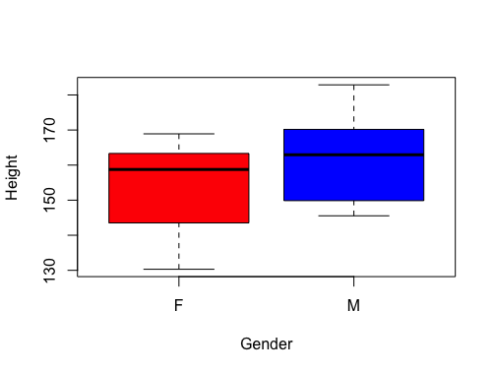
Representation of the data
>plot(Height~Gender,data=class_data)
Call:
lm(formula = Height ~ Gender,
data = class_data)
Coefficients: (Intercept) GenderM
153.896 8.436
Model : HeightM = 153.896 + 8.436 x GenderM
HeightF = 153.896
Notes:
The model will say that 153,896will be the baseline height for women. And 8.436 will represent the increase/decrease of this baseline for men.
Hiding all slides on the 2nd example (linear model with categorical variable) to save time! Leonore, Oct 2020

Slide 58
>summary(model_height_age)
Call:
lm(formula = Height ~ Gender, data = class_data)
Residuals:
Min 1Q Median 3Q Max
-23.594 -10.640 2.261 8.637 20.549
Coefficients:
Estimate Std. Error t value Pr(>|t|)
(Intercept) 153.896 4.213 36.529 <2e-16 ***
GenderM 8.436 5.807 1.453 0.165
---
Signif. codes: 0 ‘***’ 0.001 ‘**’ 0.01 ‘*’ 0.05 ‘.’ 0.1 ‘ ’ 1
Residual standard error: 12.64 on 17 degrees of freedom
Multiple R-squared: 0.1104, Adjusted R-squared: 0.05809 F-statistic: 2.11 on 1 and 17 DF, p-value: 0.1645
Height~a+b1*Gender+ err
Error: Difference between the observed and the fitted points
Significance of the parameters : Is GenderM different from 0? NO
R2: Total variance explained by the model
F-test: Is the model significant compared to a model with just the intercept? NO
Notes:
GenderM is not significantly different from 0. Difference in baseline for males compared to females
R2 is way maller than the one in the model with age (0.65) which means that Gender does not explain much of the height variability
Hiding all slides on the 2nd example (linear model with categorical variable) to save time! Leonore, Oct 2020

Slide 59
In a nutshell
R offers different ways to model your hypotheses. Choose one suited to your types of variables and your research question. Covered in this course:
Comparing two group means
t.test()
Testing linear correlation between continuous variables:
cor(), cor.test()
Building simple linear models between a continuous variable and a continuous or categorical variable.
lm()
Notes:
Next steps: multiple regressions, analysis of variance between a continuous variable and one or more continuous or categorical variables.

Slide 60
Taking advantage of R for your work
Tidying & data manipulation
Import in R
Exploration
Modelling
Export
Notes:
General workflow to take advantage of R for your work:
-specify your question very clearly.
Your Question, what hypothesis you're making, what data you will collect, coming from different type of experiment ( simulation study, field study, lab study, measurement machine ) – this will be your dataset(s)
-design your experiment very well
-format your dataset nicely
Tidy step: checking some variables are of the correct type, manipulating the structure of the data
Explore in terms of graph, table, summary stats to get an idea of the answer(s)
Stats will give you a reliable Answer to confirm the question, confirming that the graphs gave you a reliable answer
Communicate answer, data, graphs to colleagues, boss: report, publication , summary – reproducible research and it is essential otherwise the previous steps were meaningless

Slide 61
Summary - Overall analysis workflow
Specify your biological question and your experimental design very clearly, then collect your data.
Save your data into a csv format in a dedicated folder.
Start up RStudio , create an R project, open a new script file and save it where you save your data. Don't forget to annotate it and save it regularly.
Import your data into R. Check everything in your data. Make sure it is what you expect it to be.
Explore your data, first with R's plotting functions. Make an hypothesis. Try to guess the answer that your statistical test should give you.
Perform your test to confirm your answer.
Communicate your findings.
Make sure your files (data, scripts, figures, reports) are well organised in your folder.
Notes:
-specify your question very clearly.
Your Question, what hypothesis you're making, what data you will collect, coming from different type of experiment ( simulation study, field study, lab study, measurement machine ) – this will be your dataset(s)
Statistics to confirm your answer
-design your experiment very well
-format your dataset nicely
Tidy step: checking some variables are of the correct type, manipulating the structure of the data
Explore in terms of graph, table, summary stats to get an idea of the answer or the answer
Stats will give you a reliable Answer to confirm the question, confirming that the graphs gave you a reliable answer
Communicate answer, data, graphs to colleages, boss: report, publication , summary – reproducible research and it is essential otherwise the previous steps were meaningless

Slide 62
More to explore…
R manuals: http://cran.r-project.org/manuals.html
Datacamp free tutorials: https://www.datacamp.com/courses/free-introduction-to-r
STHDA (Statistical Tools for High Throughput Data Analysis) free tutorials: http://www.sthda.com/english/
Stackoverflow documentation, resources and user forum: http://stackoverflow.com/tags/r/info
Rseek - search engine on numerous online R resources: http://www.rseek.org
Notes:
Learning R is an ongoing process, there is always more to explore !

Slide 63
Credits and Acknowledgments
Content and slides developed by: Diana Marek, Geoffrey Fucile, Alex Smith, Linda Dib, Leonore Wigger, Wandrille Duchemin
Content inspired by material from:
Owen L. PETCHEY and “Getting started with R” book
Daniel WEGMANN and Frédéric SCHÜTZ
Robert STOJNIĆ and Ian ROBERTS
Jenny DRNEVICH
Thank you for your attention
http://www.sib.swiss/training Any questions? Contact training@sib.swiss

Slide 64
Let’s practice - 11
The data set "Pima" comes from a study on diabetes in women of Pima Indian heritage. We are using a subset (Pima.tr).
1) Load the package MASS using library(). (You may need to install it first). Load the dataset Pima.tr using data(). Use ? to get an idea which variables it contains.
2) Hypothesis: Blood glucose level (glu) is associated with diastolic blood pressure (bp). Run a linear model to test the hypothesis.
3) Visualize the fit with a scatter plot and a trend line.
4) Check assumptions of the model (homoscedasticity, mean of residual at 0, normality of the residuals) graphically.

