Slide 1


First steps with R in Life Sciences: Graphics
February, 2022 - Streamed
Wandrille Duchemin
-- with slides from Diana Marek, Wandrille Duchemin, Leonore Wigger

Slide 2
Exam – for 0.5 ECTS credit points
Take-home exam: data analysis tasks, available on course page.
Exam is graded as "pass" or "fail".
Submit analysis by February 23, 2022, 23:59:59
(e-mail in the chat + google doc).
You will receive a certificate of achievement from the SIB Training Team, which you can submit to your educational institution.
If you don't take the exam, you will receive a certificate of attendance.

Slide 3
Outline
Day 2
06
Building graphics in R (basic plotting)
07
Starting with statistics in R (hypothesis testing, simple linear regression)
Examples and exercises are integrated in the chapters

Slide 4
Taking advantage of R for your work
Communicate
Tidying & data manipulation
Scientific question
Formatted Data In R
Data representation
Statistical analysis
Import in R
Exploration
Modelling
Export
Notes:
General workflow to take advantage of R for your work:
-specify your question very clearly.
Your Question, what hypothesis you're making, what data you will collect, coming from different type of experiment ( simulation study, field study, lab study, measurement machine ) – this will be your dataset(s)
-design your experiment very well
-format your dataset nicely
Tidy step: checking some variables are of the correct type, manipulating the structure of the data
Explore in terms of graph, table, summary stats to get an idea of the answer(s)
Stats will give you a reliable Answer to confirm the question, confirming that the graphs gave you a reliable answer
Communicate answer, data, graphs to colleagues, boss: report, publication , summary – reproducible research and it is essential otherwise the previous steps were meaningless

Slide 5
Taking advantage of R for your work
Communicate
Tidying & data manipulation
Scientific question
Formatted Data In R
Data representation
Statistical analysis
Import in R
Exploration
Modelling
Export
Notes:
General workflow to take advantage of R for your work:
-specify your question very clearly.
Your Question, what hypothesis you're making, what data you will collect, coming from different type of experiment ( simulation study, field study, lab study, measurement machine ) – this will be your dataset(s)
-design your experiment very well
-format your dataset nicely
Tidy step: checking some variables are of the correct type, manipulating the structure of the data
Explore in terms of graph, table, summary stats to get an idea of the answer(s)
Stats will give you a reliable Answer to confirm the question, confirming that the graphs gave you a reliable answer
Communicate answer, data, graphs to colleagues, boss: report, publication , summary – reproducible research and it is essential otherwise the previous steps were meaningless

Slide 6
Building graphics in R
06

Slide 7
R graphics
R is powerful for plotting graphs and figures. It provides several plotting systems:
base (widely used, comes with basic R installation)
ggplot2 (widely used)
lattice (mainly used for specialized needs, e.g. 3D plots)
They have very different syntax, cannot be mixed, and need to be learned separately. This course gives an introduction to the R base plotting system
Notes:
Base plotting advantages and disadvantages
Advantage: Very flexible, high degree of control over appearance of graphical output
Disadvantage: More work is required to make plots aesthetically pleasing than with other plotting systems

Slide 8
R base plotting system
Plots are built up step-by-step with multiple function calls.
High level graphics functions:
Draw a new plot. Tailor its appearance with optional arguments.
Low level graphics functions:
Add graphical elements to an existing plot, piece by piece.

Slide 9
Plotting - the basics
The generic function to use is plot(), which plots a variable y against a variable x.
Takes the argument type to indicate the type of plot ("l" for lines, "p" for points and "b" for both). The default is points.
> x <- 1:100
> y <- log(x) + (x/100)^5
> plot(x,y) # equivalent to plot(x, y, type

Slide 10
Adding elements to a plot
Every time the plot function is called, a new plot is created.
In order to add more graphical elements to an already existing plot, low-level plotting commands can be used, such as:
points() to add points to an existing plot
lines() to add a line to an existing plot
The type argument can also be provided to those functions ("l" for lines, "p" for points and "b" for both). Default for points(): "p", default for lines(): "l".
>x <- seq(0,100, by=10)
>y <- log(x) + (x/100)^5
>plot(x,y)
>lines(x,y+1)
>points(x,y-1, type
Notes:
Type of plot = b for both = line + points (circles)
Note that the plot's range is NOT recalculated.

Slide 11
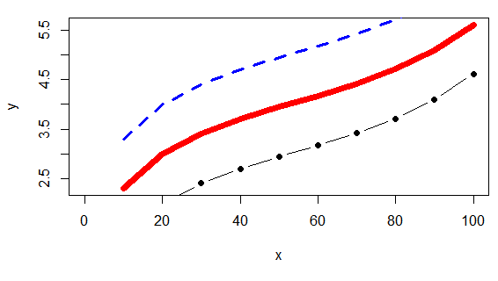
Customizing plots – Part 1
plot(), points() and lines() all take customizing arguments, including:
col indicating the colour
lwd indicating the line width
lty indicating the line type
pch indicating the plotting character (symbol)
>plot(x, y, type="l", col="red", lwd=7)
>lines(x, y+1,
col="blue",
lty="dashed")
>points(x, y-1, type="b",
pch=19)
Notes:
Line type here in blue is DASHED
Pch= 19 = SOLID CIRCLES
Line types can either be specified as an integer (0=blank, 1=solid (default), 2=dashed, 3=dotted, 4=dotdash, 5=longdash, 6=twodash) or as one of the character strings "blank", "solid", "dashed", "dotted", "dotdash", "longdash", or "twodash", where "blank" uses ‘invisible lines’
The line width, a positive number, defaulting to 1

Slide 12
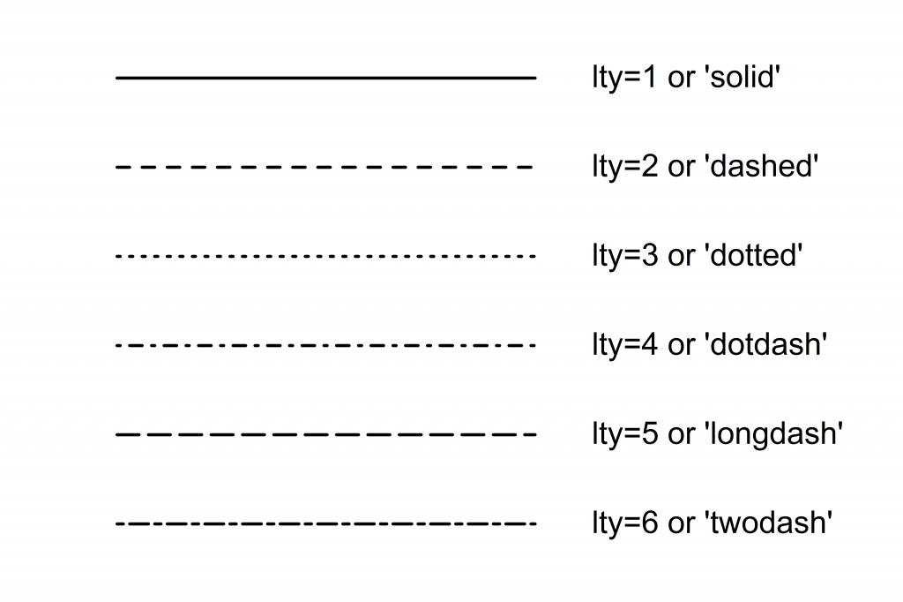
R line types, to use with lty

Slide 13
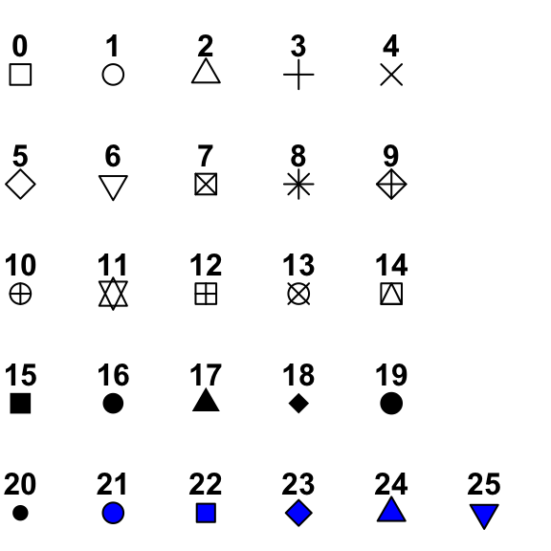
R plotting characters, to use with pch

Slide 14

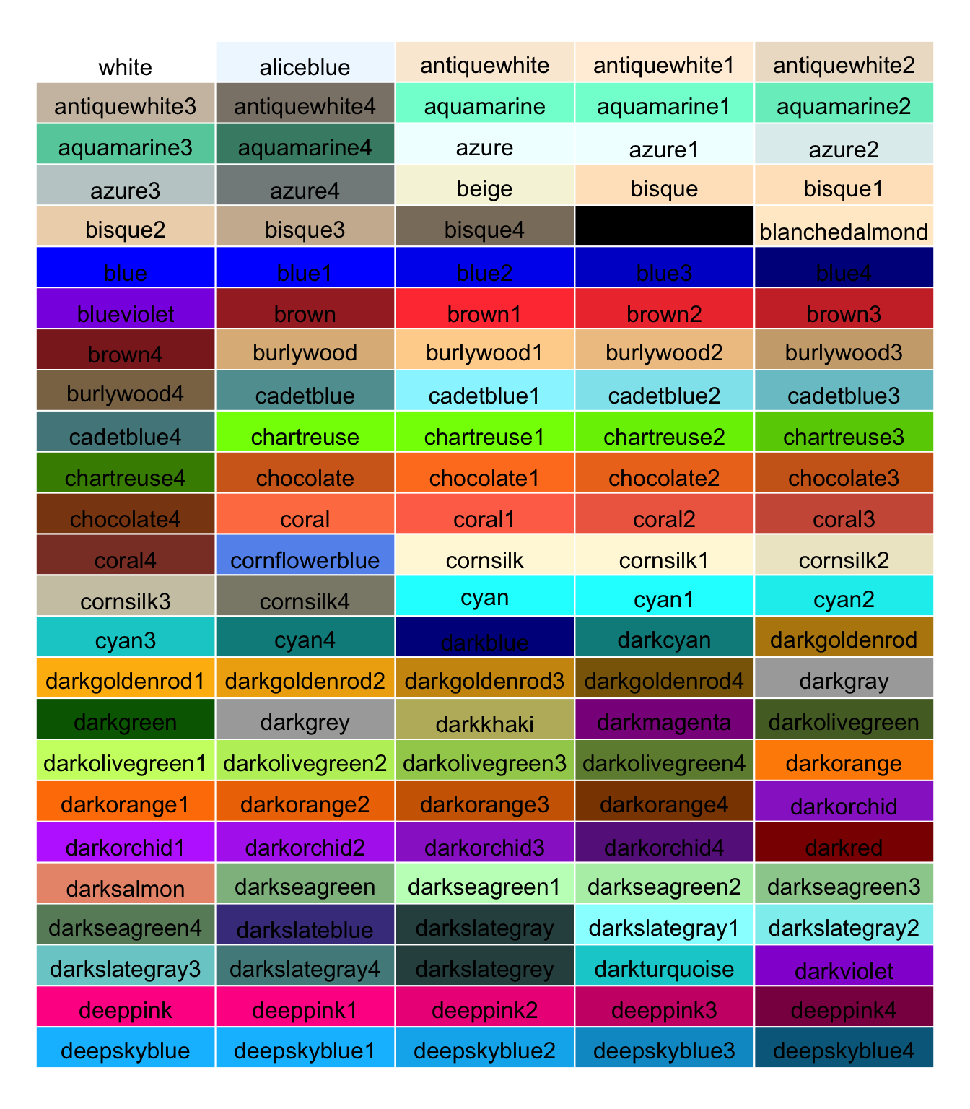
R color
default palette : 1 to 8
Hexadecimal :
“#1492AD”
“#BC520088” ← transparency
657 built-in color names,
here is a subset:
colors() will output a list
of all color names
See R color cheat sheet for the full color chart and other ways to define colors

Slide 15
Customizing plots – Part 2
The plot() command takes further arguments to customize the plotting area:
xlim and ylim to set the limits on the x- and y-axis, respectively
xlab and ylab to set the labels for the x- and y-axis, respectively
main to set a title
> x <- seq(0, 100, length.out=10)
> y <- log(x) + (x/100)^5
> plot(x,y, type="l", col="red", ylim=c(1,7),
xlab="The variable x", main ="x vs. y" )
> lines(x, y+1, lwd=3,lty="dashed", col="blue")
> points(x, y-1, type="b", pch=15)
Notes:
Ylim= y coordinates range
Pch= 15 = SOLID SQUARES

Slide 16
Customizing plots – Part 3
The legend() command can be used to add legends to plots:
x , y to set the numeric coordinates for positioning the legend.
x can be used by itself with a keyword for legend position: "bottomright", "bottom", "bottomleft", "left", "topleft", "top", "topright", "right", "center"
legend to set the text to appear in the legend
col , lty , lwd , pch : set graphical elements in the legend
bty for box type around the legend ("o" for box, "n" for no box)
bg for background color
> legend(x="bottomright",
legend=c("red line","blue line", "black line"),
lty=c(1,2,1),
pch=c(NA,NA,19),
col=c("red", "blue", "black"),
bg="gray90")
Notes:
Lty =c (1, 2, 1) eq to Lty =c (solid, dashed, solid)

Slide 17
How to get data for practicing and playing – Part 1
R contains many practice data sets (data frames), great for trying out plotting functions.
Display names of available data sets
>data() #data sets in standard packages
>data(package = .packages(all.available = TRUE)) #data sets in all installed packages
Load and use a data set
>data(iris) #load the iris data (overwrite existing variable)
>?iris #get information about the iris data
>head(iris) #display top few lines of the iris data frame
Sepal.Length Sepal.Width Petal.Length Petal.Width Species
1 5.1 3.5 1.4 0.2 setosa
2 4.9 3.0 1.4 0.2 setosa
3 4.7 3.2 1.3 0.2 setosa
4 4.6 3.1 1.5 0.2 setosa
5 5.0 3.6 1.4 0.2 setosa
6 5.4 3.9 1.7 0.4 setosa
Notes:
Data from standard packages are available without running data(name-of-dataset).
However, it is still recommended practice to use data(name-of-dataset) – see R help.
If there is already a variable of that name, it will be overwritten.

Slide 18
How to get data for practicing and playing
R can easily simulate data drawn from a given distribution. The function rnorm() generates normally distributed data.
Example:
>rnorm(10) #numeric vector with 10 values
#drawn from normal distribution,
#mean=0, standard deviation=1 (function defaults)
[1] 1.1053564 0.7937635 0.2743762 0.3574477 -0.7677099 [2] 0.5838973 0.6616164 0.1203090 -0.4060265 0.2778585
Notes:
Data is generated by a pseudo-random process and will be different each time when a function call is made to rnorm!
(For reproducibility, use set.seed. Not necessary for this course, not covered to save time.)

Slide 19
How to get data for practicing and playing
R can easily simulate data drawn from a given distribution. The function rnorm() generates normally distributed data.
Example:
>rnorm(10) #numeric vector with 10 values
#drawn from normal distribution,
#mean=0, standard deviation=1 (function defaults)
[1] 1.1053564 0.7937635 0.2743762 0.3574477 -0.7677099 [2] 0.5838973 0.6616164 0.1203090 -0.4060265 0.2778585
>rnorm(10, mean=10, sd=2) #customized mean and sd
[1] 6.253392 9.527140 9.398857 11.932284 11.472909
[2] 10.714245 7.656026 11.302829 9.332930 10.264157
If you want data from other distributions than normal:
rpois() for poisson, rbinom() for binomial (see R help)
Notes:
Data is generated by a pseudo-random process and will be different each time when a function call is made to rnorm!
(For reproducibility, use set.seed. Not necessary for this course, not covered to save time.)

Slide 20
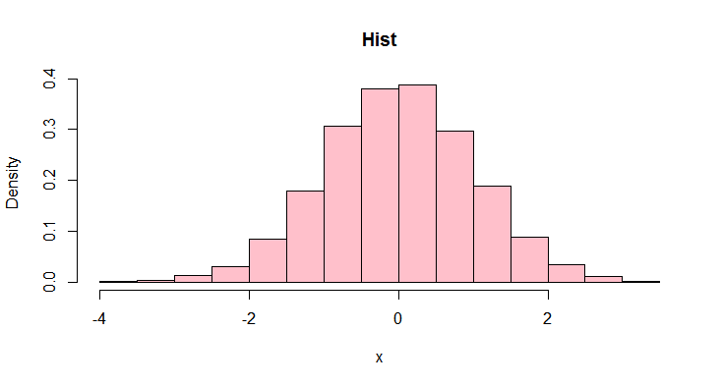
The hist() function
The function hist() produces a histogram, which counts the number of observations that fall into different ranges (bins)
Rough visual representation of the distribution of the data.
x vector of data values for which the histogram will be constructed
breaks either a vector indicating breakpoints between histogram bins, or a single number for the number of bins (used as suggestion)
freq logical. If TRUE, cell height represents counts per bin. If FALSE, cell height is the fraction of values that fall into each bin (probability density).
> x <- rnorm(10000)
> hist(x, breaks=20, freq=FALSE,
main="Hist", col="pink")
Notes:
hist (x, breaks= “ Sturges”, freq = NULL, main, xlab, ylab)
x: vector of data values for which the hist is to be constructed
Breaks: a vector giving the breakpoints between histo cells or a single number giving the number of cells for the hist
Freq: logical. If T, the histo graphic is a representation of the frequencies, the counts of data values in each cell of the histo. If F, the hist is the fraction of data within each hist cell (probability density)
The density describes the theoretical probability distribution of a variable

Slide 21
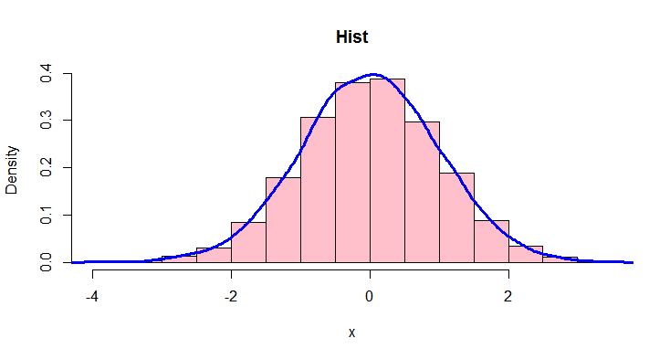
The hist() and density() functions
To add a smooth line to a histogram, use density(), which computes estimates of the probability density (kernel density estimates).
This works as a complementary representation of the histogram only when freq = FALSE
The line produced by density() often reflects the distribution better than a histogram.
Use lines() to plot the result as a line on top of the histogram.
> x <- rnorm(10000)
> hist(x, freq=FALSE,
main="Hist", col ="pink")
> lines(density(x),
col="blue", lwd=3)
Notes:
hist (x, breaks= “ Sturges”, freq = NULL, main, xlab, ylab)
x: vector of data values for which the hist is to be constructed
Breaks: a vector giving the breakpoints between histo cells or a single number giving the number of cells for the hist
Freq: logical. If T, the histo graphic is a representation of the frequencies, the counts of data values in each cell of the histo. If F, the hist is the fraction of data within each hist cell (probability density)
The density describes the theoretical probability distribution of a variable

Slide 22
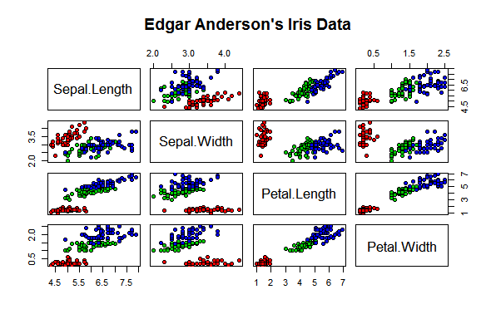
Draftsman's or Pairs Scatter Plots - P5S
If x is a matrix or a data frame, pairs() draws all possible bivariate plots between the columns of x.
> data(iris) #contains 4 measurements for 150 flowers from 3 species of iris (Iris setosa, versicolor and virginica)
> pairs(iris[,1:4], main="Edgar Anderson's Iris Data",
pch=21, bg=c("red", "green3", "blue")[iris$Species])
bg:
color fill of circles
Colors:
setosa in red
versicolor in green
virginica in blue
Notes:
This type of image is also called a Draftsman's display - it shows the possible two-dimensional projections of multidimensional data (in this case, four dimensional).
Setosa in red,
Versicolor in green
Virginica in blue
Bg is for the background colour of the points (filling color) , col can be used to only coloured the the empty circles
lower.panel, upper.panel: separate panel functions (or NULL) to be used below and above the diagonal respectively. To show eithe only the upper or lower panel

Slide 23
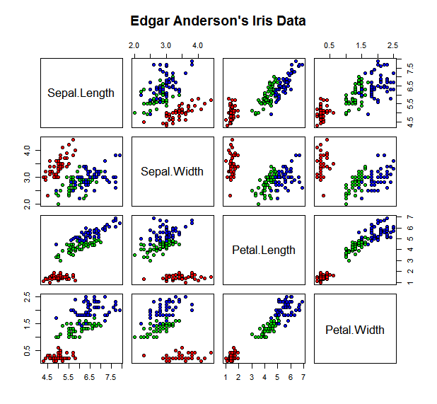
Colors:
setosa in red
versicolor in green
virginica in blue
Notes:
- Use this to see if there might be linear correlation (e.g. Petal.Length, Petal.Width)
- Use this to check which variables could be used together to predict the species
It looks like most of the variables could be used to predict the species - except that using the sepal length and width alone would make distinguishing Iris versicolor and virginica tricky (green and blue)

Slide 24
Excursus: Coloring data points in the iris data(I)
bg=c("red", "green3", "blue")[iris$Species]) #color fill
How does this work?
iris$Species #factor with 3 levels
[1] setosa setosa setosa setosa setosa setosa setosa setosa setosa setosa setosa setosa setosa
[14] setosa setosa setosa setosa setosa setosa setosa setosa setosa setosa setosa setosa setosa
[27] setosa setosa setosa setosa setosa setosa setosa setosa setosa setosa setosa setosa setosa
[40] setosa setosa setosa setosa setosa setosa setosa setosa setosa setosa setosa versicolor versicolor
[53] versicolor versicolor versicolor versicolor versicolor versicolor versicolor versicolor versicolor versicolor versicolor versicolor versicolor
[66] versicolor versicolor versicolor versicolor versicolor versicolor versicolor versicolor versicolor versicolor versicolor versicolor versicolor
[79] versicolor versicolor versicolor versicolor versicolor versicolor versicolor versicolor versicolor versicolor versicolor versicolor versicolor
[92] versicolor versicolor versicolor versicolor versicolor versicolor versicolor versicolor versicolor virginica virginica virginica virginica
[105] virginica virginica virginica virginica virginica virginica virginica virginica virginica virginica virginica virginica virginica
[118] virginica virginica virginica virginica virginica virginica virginica virginica virginica virginica virginica virginica virginica
[131] virginica virginica virginica virginica virginica virginica virginica virginica virginica virginica virginica virginica virginica
[144] virginica virginica virginica virginica virginica virginica virginica
Levels: setosa versicolor virginica
as.numeric(iris$Species) #factor coerced to numeric
[1] 1 1 1 1 1 1 1 1 1 1 1 1 1 1 1 1 1 1 1 1 1 1 1 1 1 1 1 1 1 1 1 1 1 1 1 1 1 1 1 1 1 1 1
[44] 1 1 1 1 1 1 1 2 2 2 2 2 2 2 2 2 2 2 2 2 2 2 2 2 2 2 2 2 2 2 2 2 2 2 2 2 2 2 2 2 2 2 2
[87] 2 2 2 2 2 2 2 2 2 2 2 2 2 2 3 3 3 3 3 3 3 3 3 3 3 3 3 3 3 3 3 3 3 3 3 3 3 3 3 3 3 3 3
[130] 3 3 3 3 3 3 3 3 3 3 3 3 3 3 3 3 3 3 3 3 3
Notes:
This type of image is also called a Draftsman's display - it shows the possible two-dimensional projections of multidimensional data (in this case, four dimensional).
Setosa in red,
Versicolor in green
Virginica in blue
Bg is for the background colour of the points (filling color) , col can be used to only coloured the the empty circles
lower.panel, upper.panel: separate panel functions (or NULL) to be used below and above the diagonal respectively. To show eithe only the upper or lower panel

Slide 25
Excursus: Coloring data points in the iris data (II)
The coloring strategy in the iris draftman's plot involves subsetting and coercion:
bg=c("red", "green3", "blue")[iris$Species]
is equivalent to
bg=c("red", "green3", "blue")[as.numeric(iris$Species)]
is equivalent to
bg=c("red","green3",blue")[c(1,1,1,1,1,1,1,1,1,1,1,1,1,1,1,1,1,1,1,1,1,1,1,1,1,1,1,1,1,1,1,1,1,1,1,1,1,1,1,1,1,1,1,1,1,1,1,1,1,2,2,2,2,2,2,2,2,2,2,2,2,2,2,2,2,2,2,2,2,2,2,2,2,2,2,2,2,2,2,2,2,2,2,2,2,2,2,2,2,2,2,2,2,2,2,2,2,2,2,3,3,3,3,3,3,3,3,3,3,3,3,3,3,3,3,3,3,3,3,3,3,3,3,3,3,3,3,3,3,3,3,3,3,3,3,3,3,3,3,3,3,3,3,3,3,3,3,3,3)]
Inside the square brackets [] , the factor is automatically coerced to a numeric

Slide 26
Excursus: Coloring data points in the iris data (III)
This results in a vector of color terms with 150 entries in the correct order.
> bg=c("red", "green3", "blue")[iris$Species] #color fill
> bg
[1] "red" "red" "red" "red" "red" "red" "red" "red" "red" "red" "red" "red" "red"
[14] "red" "red" "red" "red" "red" "red" "red" "red" "red" "red" "red" "red" "red"
[27] "red" "red" "red" "red" "red" "red" "red" "red" "red" "red" "red" "red" "red"
[40] "red" "red" "red" "red" "red" "red" "red" "red" "red" "red" "red" "green3" "green3"
[53] "green3" "green3" "green3" "green3" "green3" "green3" "green3" "green3" "green3" "green3" "green3" "green3" "green3"
[66] "green3" "green3" "green3" "green3" "green3" "green3" "green3" "green3" "green3" "green3" "green3" "green3" "green3"
[79] "green3" "green3" "green3" "green3" "green3" "green3" "green3" "green3" "green3" "green3" "green3" "green3" "green3"
[92] "green3" "green3" "green3" "green3" "green3" "green3" "green3" "green3" "green3" "blue" "blue" "blue" "blue"
[105] "blue" "blue" "blue" "blue" "blue" "blue" "blue" "blue" "blue" "blue" "blue" "blue" "blue"
[118] "blue" "blue" "blue" "blue" "blue" "blue" "blue" "blue" "blue" "blue" "blue" "blue" "blue"
[131] "blue" "blue" "blue" "blue" "blue" "blue" "blue" "blue" "blue" "blue" "blue" "blue" "blue"
[144] "blue" "blue" "blue" "blue" "blue" "blue" "blue"

Slide 27
Let’s practice - 7
Let's come back to the mice dataset stored in the "mice_data" data frame (Let’s practice – 3). If mice_data is not currently in your workspace, either get it back by loading the .Rdata file or import the data again from the original .csv file.
Check your data frame: did it load correctly? Make sure genotype and diet are factor variables.
Plot an histogram of mouse weight and customize it with colours, labels, title and represent the density line on top.
Make a scatter plot of mouse weights using the function plot(), with no additional arguments. (You do not need to define values for a second axis.) Inspect the plot - what appears on the two axes? Then re-do the plot by adding function arguments: Use solid circles as plotting symbol, add a title, customise the y-axis label, and colour the points by genotype. Add a legend.
Notes:
Careful, that genotype and diet should be factors to be coloured

Slide 28
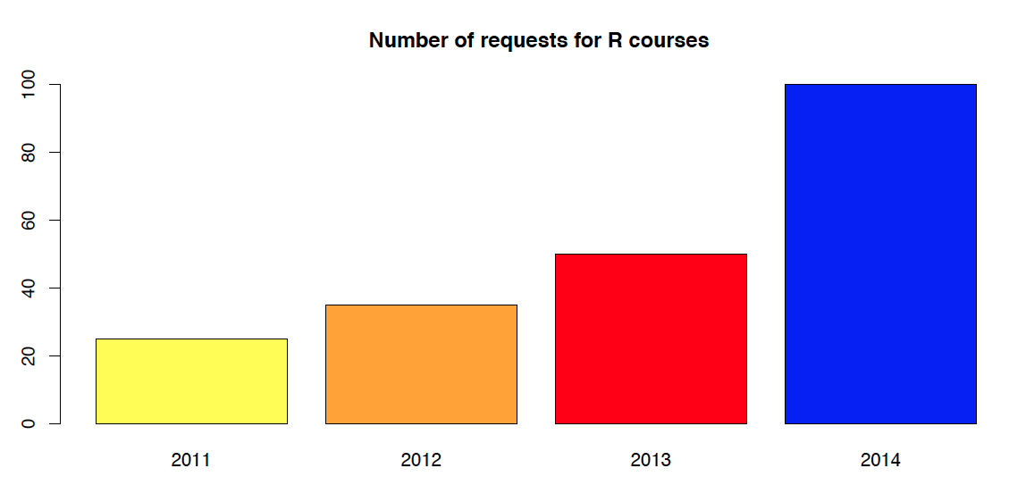
The barplot() function
Barplots allow simple visualization of counts or numeric data.
Optional arguments can be used to customize the plot.
>course_data <- c(yr2011=25, yr2012=35, yr2013=50, yr2014=100)
>barplot(course_data, main="Number of requests for R courses",
names.arg=c("2011", "2012","2013", "2014"),
col=c("yellow", "orange","red", "blue"))
Notes:
To use other colours, use the function rainbow or other colour palettes

Slide 29
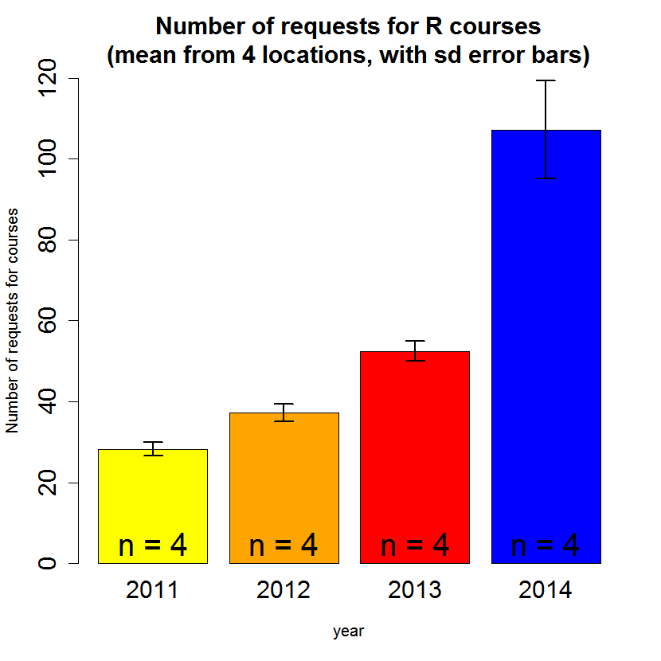
Customized barplot with sd error bars
Each year, R course requests were counted in 4 cities.
Bar heights: mean across all cities per year
Custom plotting using low level functions:
- add error bars (std dev.)
- add text to each bar (n=4)
Notes:
Other packages exist for error bars plotting
gplots
Hmisc
plotrix
ggplot2

Slide 30
Customized barplot with sd error bars (I)
# Create a data frame
df <- data.frame(
year = c("2011","2012","2013","2014",
"2011","2012","2013","2014",
"2011","2012","2013","2014",
"2011","2012","2013","2014"),
city = c("A","A","A","A", "B","B","B","B",
"C","C","C","C", "D","D","D","D"),
nb_requests_courses = c(30,36,50,98, 26,35,54,101,
28,38,51,105, 29,40,55,125))
# Check what is inside
> head(df)
year city nb_requests_courses
1 2011 A 30
2 2012 A 36
3 2013 A 50
4 2014 A 98
5 2011 B 26

Slide 31
Customized barplots with sd error bars (II)
Compute summary statistics
# Compute mean, sd, number of observations per year
mean_nb <- tapply(df$nb_requests_courses, df$year, mean)
sd_nb <- tapply(df$nb_requests_courses, df$year, sd)
n_values <- tapply(df$nb_requests_courses, df$year, length)
> mean_nb
2011 2012 2013 2014
28.25 37.25 52.50 107.25
> sd_nb
2011 2012 2013 2014
1.707825 2.217356 2.380476 12.175796
> n_values
2011 2012 2013 2014
4 4 4 4

Slide 32
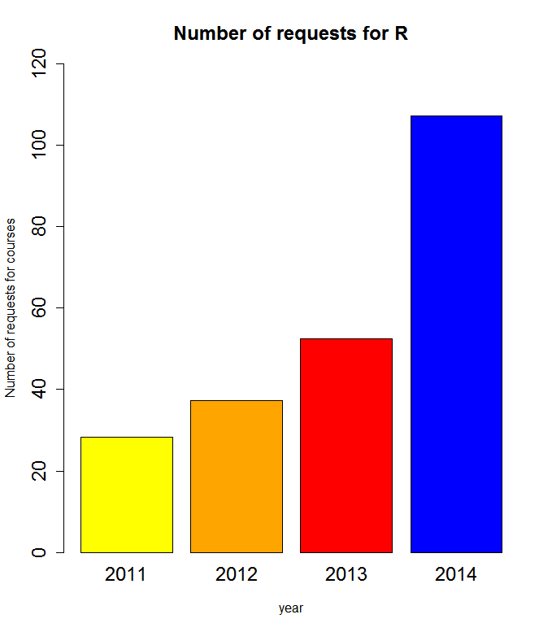
Customized barplots with sd error bars (III)
High-level: Generate plot
# Make a barplot using the means returned by tapply
mids <- barplot(mean_nb,
xlab="year",ylab="Number of requests for courses",
ylim=c(0,120),
col=c("yellow", "orange","red", "blue"),
cex=1.5, cex.axis=1.5, cex.main=1.5, cex.names=1.5,
main= "Number of requests for R")
# mids contains the location of the middle
of the bars on the x-axis
> mids
[,1]
[1,] 0.7
[2,] 1.9
[3,] 3.1
[4,] 4.3

Slide 33
Customized barplots with sd error bars (IV)
Low-level: Add elements (error bars and text)
# Use arrows() to put sd error bars on the plot
arrows(mids, mean_nb-sd_nb, # coordinates of lower point
mids, mean_nb+sd_nb, # coordinates of upper point
code=3, # type of arrow: "head at both ends" angle=90, # angle between shaft and head of arrow
length=0.1, # length of edges of arrow head
lwd=2) # line width
# Add text at the midpoints and at height 5 on the y-axis: number of observations
text(x=mids, y=5, paste("n =",n_values), cex=2
"arrow head"
"arrow shaft"
Notes:
Other packages exist for error bars plotting
gplots
Hmisc
plotrix
ggplot2
Code= 3 to tell R to draw arrows at both end (0: no arrow, 1: no upper arrow, 2: no lower arrow)
Angle=90 : make the arrow heads 90 degrees (flat)
Length : size of the arrows

Slide 34
Customized barplot with sd error bars
Notes:
Other packages exist for error bars plotting
gplots
Hmisc
plotrix
ggplot2
Code= 3 to tell R to draw arrows at both end (0: no arrow, 1: no upper arrow, 2: no lower arrow)
Angle=90 : make the arrow heads 90 degrees (flat)
Length : size of the arrows

Slide 35
Barplot digression…
Bar plots with error bars are widely used in biology
Be aware: different ways of calculating error bars (sd or sem*)
(standard deviation or standard error of the mean)
Often not the most informative way to look at the data, combine them with other plots (box plot, violin plots, scatter plot)
https://stekhoven.shinyapps.io/barplotNonsense/
*sd: standard deviation
sem: standard error of the mean
Notes:
Why barplots are (often) nonsense? Try the shiny app.

Slide 36
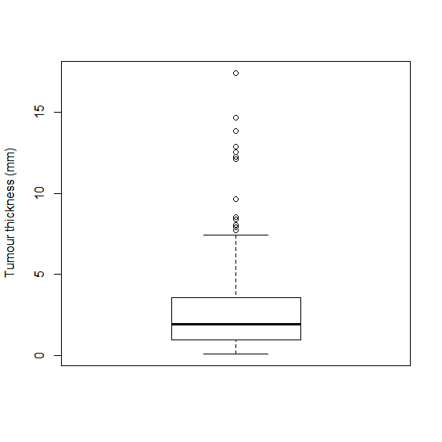
The boxplot() function
Convenient way of depicting the spread of numerical data
Box: Interquartile range (IQR), contains 50% of points
Whiskers: Extend from box, indicate variability outside upper and lower quartiles
Outliers: May be plotted as individual points
Example:
Melanoma thickness (mm)
in 205 patients
Outliers
Median
Notes:
It's a summary graphic of the distribution - more so than the histogram, less than the density estimate.
1 died from melanoma, 2 alive, 3 dead from other causes.
Pch= 19 = SOLID CIRCLES
#Use 'data(package = .packages(all.available = TRUE))'
#to list the data sets in all *available* packages.
Alternative :
boxplot(thickness ~ status, data=Melanoma, main= "Thickness of melanoma as function of patient status", xlab = "status", ylab= "Tumour thickness")
points(thickness ~ status, Melanoma, col="grey", pch = 19) #adds the actual data points onto the plot
Here we use a formula such as y ~ grp, where y is a numeric vector of data values to be split into groups according to the grouping variable grp (usually a factor)
boxplot(melanoma$thickness[melanoma$status=="1"],melanoma$thickness[melanoma$status=="2"],melanoma$thickness[melanoma$status=="3"],main= "Thickness of melanoma as function of patient status", xlab = "status", ylab= "Tumour thickness")

Slide 37
The boxplot() function
Convenient way of depicting the spread of numerical data
Box: Interquartile range (IQR), contains 50% of points
Whiskers: Extend from box, indicate variability outside upper and lower quartiles
Outliers: May be plotted as individual points
Example:
Melanoma thickness (mm)
in 205 patients
Outliers
Whisker: covers all points < Q3 + 1.5 * IQR
Median
Box: Interquartile range (Q1 to Q3)
Whisker: covers all points > Q1 - 1.5 * IQR
Notes:
It's a summary graphic of the distribution - more so than the histogram, less than the density estimate.
1 died from melanoma, 2 alive, 3 dead from other causes.
Pch= 19 = SOLID CIRCLES
#Use 'data(package = .packages(all.available = TRUE))'
#to list the data sets in all *available* packages.
Alternative :
boxplot(thickness ~ status, data=Melanoma, main= "Thickness of melanoma as function of patient status", xlab = "status", ylab= "Tumour thickness")
points(thickness ~ status, Melanoma, col="grey", pch = 19) #adds the actual data points onto the plot
Here we use a formula such as y ~ grp, where y is a numeric vector of data values to be split into groups according to the grouping variable grp (usually a factor)
boxplot(melanoma$thickness[melanoma$status=="1"],melanoma$thickness[melanoma$status=="2"],melanoma$thickness[melanoma$status=="3"],main= "Thickness of melanoma as function of patient status", xlab = "status", ylab= "Tumour thickness")

Slide 38
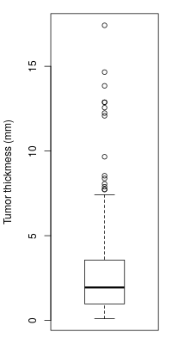
Boxplot: data and plotting code
>library(MASS)
>data(Melanoma) #Data from MASS package. 205 patients in Denmark with malignant melanoma
>head(Melanoma) #look inside the data set
time status sex age year thickness ulcer
1 10 3 1 76 1972 6.76 1
2 30 3 1 56 1968 0.65 0
3 35 2 1 41 1977 1.34 0
4 99 3 0 71 1968 2.90 0
5 185 1 1 52 1965 12.08 1
6 204 1 1 28 1971 4.84 1
>boxplot(Melanoma$thickness,
ylab="Tumour thickness (mm)")

Slide 39
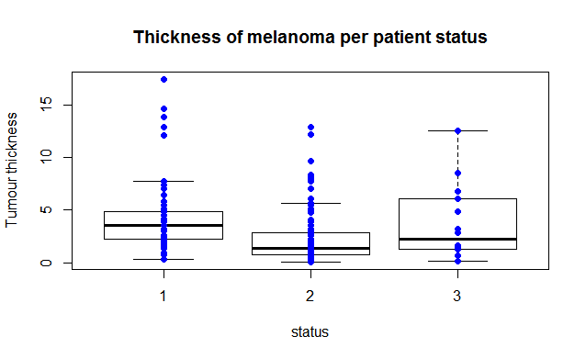
More boxplots
Make separate boxplots for subgroups of data
Plot individual data points as an overlay of the boxplots.
status: 1 died from melanoma, 2 alive, 3 dead from other causes

Slide 40
More boxplots: data preparation
#check if the grouping variable is a factor (it is not!)
>str(Melanoma)
'data.frame': 205 obs. of 10 variables:
$ time : int 10 30 35 99 185 204 210 232 232 279 ...
$ status : int 3 3 2 3 1 1 1 3 1 1 ...
$ sex : int 1 1 1 0 1 1 1 0 1 0 ...
$ age : int 76 56 41 71 52 28 77 60 49 68 ...
$ year : int 1972 1968 1977 1968 1965 1971 1972 1974
$ thickness: num 6.76 0.65 1.34 2.9 12.08 ...
$ ulcer : int 1 0 0 0 1 1 1 1 1 1
#coerce the grouping variable to factor
>Melanoma$status <- factor(Melanoma$status)
Notes:
It is good practice to convert the grouping variable to factor before making boxplots!
The melanoma example will still work if we don't do this, but only because the grouping variable "status" contains the integer values 1,2,3.

Slide 41
More boxplots: plotting code
Method 1: Data subsets
>boxplot(Melanoma$thickness[Melanoma$status=="1"],
Melanoma$thickness[Melanoma$status=="2"],
Melanoma$thickness[Melanoma$status=="3"],
main="Thickness of melanoma per patient status",
xlab="status", ylab="Tumour thickness",
names=c("1","2","3"))
>points(Melanoma$status, Melanoma$thickness,
col="blue",pch=19) #adds the actual data points to the plot
Method 2: Formulas
>boxplot(thickness ~ status, data=Melanoma,
main="Thickness of melanoma per patient status",
xlab="status", ylab="Tumour thickness")
>points(thickness ~ status, data=Melanoma,
col="blue", pch=19) #adds the actual data points to the plot
Notes:
boxplot(melanoma$thickness[melanoma$status=="1"],melanoma$thickness[melanoma$status=="2"],melanoma$thickness[melanoma$status=="3"],main= "Thickness of melanoma as function of patient status", xlab = "status", ylab= "Tumour thickness")
Alternative :
boxplot(thickness ~ status, data=Melanoma, main= "Thickness of melanoma as function of patient status", xlab = "status", ylab= "Tumour thickness")
points(thickness ~ status, Melanoma, col="grey", pch = 19) #adds the actual data points onto the plot
Here we use a formula such as y ~ grp, where y is a numeric vector of data values to be split into groups according to the grouping variable grp (usually a factor)

Slide 42
More boxplots: plotting code - P5S
Method 1: Data subsets – boxplot( df$y[df$x==’a’] ,
df$y[df$x==’b’])
Method 2: Formulas - boxplot( y ~ x , data=df)
→ give the same plot
Notes:
boxplot(melanoma$thickness[melanoma$status=="1"],melanoma$thickness[melanoma$status=="2"],melanoma$thickness[melanoma$status=="3"],main= "Thickness of melanoma as function of patient status", xlab = "status", ylab= "Tumour thickness")
Alternative :
boxplot(thickness ~ status, data=Melanoma, main= "Thickness of melanoma as function of patient status", xlab = "status", ylab= "Tumour thickness")
points(thickness ~ status, Melanoma, col="grey", pch = 19) #adds the actual data points onto the plot
Here we use a formula such as y ~ grp, where y is a numeric vector of data values to be split into groups according to the grouping variable grp (usually a factor)

Slide 43
The abline() function
abline() adds one or more straight lines through the current plot – vertical, horizontal or sloped.
Useful for
showing boundaries and cutoffs
fitting straight trend lines through the data (cf. ?lm)
Arguments:
abline(v=c(…) ): add vertical line(s) at the given x value(s)
abline(h=c(…) ): add horizontal line(s) at the given y value(s)
abline(a= ,b= ): add an affine line with intercept a and slope b
abline(reg=lm(…) ): add a trend line from a linear regression
equivalent to abline(lm(…))
Notes:
How to use abline():
v=c(…) : add vertical bars at the given x values
h=c(…) : add horizontal bars at the given y values
a=…,b=… : add an affine line with intercept a and slope b
lm(…): add a trend line from a linear regression

Slide 44
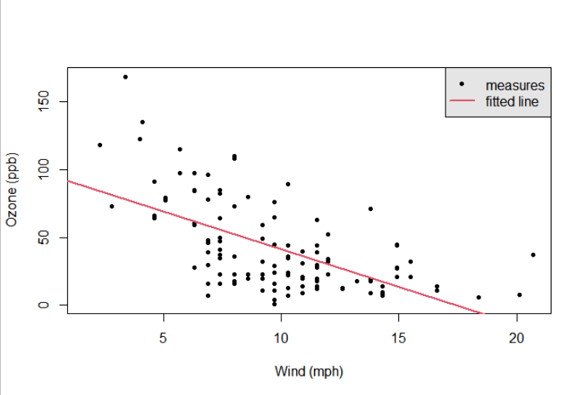
Example: Fitting a trend line (I)
Trend line example:
Plot data points (black), add a trend line (red)
Notes:
How to use abline():
v=c(…) : add vertical bars at the given x values
h=c(…) : add horizontal bars at the given y values
a=…,b=… : add an affine line with intercept a and slope b
lm(…): add a trend line from a linear regression

Slide 45
Example: Fitting a trend line (II)
> data(airquality) #Daily measurements
#in New York, May to September 1973
Plot ozone level against wind speed, then add a trend line
> plot(airquality$Wind, airquality$Ozone, pch=20,
xlab="Wind (mph)",ylab="Ozone (ppb)")
> abline(lm(airquality$Ozone ~ airquality$Wind),
col=2, lwd=2)
> legend("topright", legend= c("measures","fitted line"), pch= c(20, NA), lty = c(0, 1), lwd=c(NA, 2),
col = c(1, 2), bg = "
Notes:
How to use abline():
v=c(…) : add vertical bars at the given x values
h=c(…) : add horizontal bars at the given y values
a=…,b=… : add an affine line with intercept a and slope b
lm(…): add a trend line from a linear regression

Slide 46
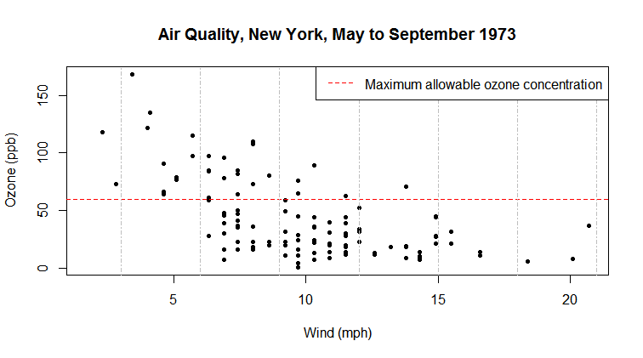
Example 1: Horizontal and vertical lines
> data(airquality) # Daily measurements, New York, May-Sept. 1973
> plot(airquality$Wind, airquality$Ozone, pch=20,
xlab= "Wind (mph)", ylab="Ozone (ppb)")
> abline(h=60, col="red", lty="dashed")
> abline(v=seq(3,21,3), col="grey", lty="dotdash")
> legend("topright", "Maximum allowable ozone concentration",
col="red", lty="dashed")
Notes:
How to use abline():
v=c(…) : add vertical bars at the given x values
h=c(…) : add horizontal bars at the given y values
a=…,b=… : add an affine line with intercept a and slope b
lm(…): add a trend line from a linear regression

Slide 47
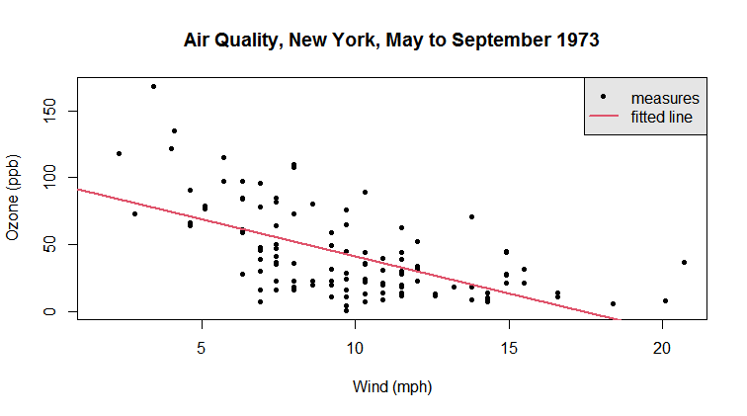
Example 2: Fitting a trend line
> plot(airquality$Wind, airquality$Ozone, pch=20,
xlab= "Wind (mph)", ylab="Ozone (ppb)")
> abline(lm(airquality$Ozone ~ airquality$Wind), col=2, lwd=2)
> legend("topright", legend= c("measures","fitted line"), pch= c(20, NA), lty = c(0, 1), lwd=c(NA, 2),
col = c(1, 2), bg = "gray90")
Notes:
How to use abline():
v=c(…) : add vertical bars at the given x values
h=c(…) : add horizontal bars at the given y values
a=…,b=… : add an affine line with intercept a and slope b
lm(…): add a trend line from a linear regression

Slide 48
Let’s practice - 8
Let's come back to the mice dataset stored in the "mice_data" data frame (Let’s practice – 3). If mice_data is not currently in your workspace, either get it back by loading the .Rdata file or import the data again from the original .csv file.
Make boxplots of weights from WT and KO mice. Customise with title, labels, colours.
Make a barplot of the mean weights of WT and KO mice, using the means returned by tapply(). Customise the barplot with title, labels, colours.
Optional: Add number of observations to each bar.
Optional: add errors bars.
Notes:
Careful, that genotype and diet should be factors to be coloured

Slide 49
Permanent Graphic Changes (I)
The function par() allows to change the default values of many plotting parameters. All future calls to graphics functions will be affected.
Example 1: set plotting colors and symbols
>par(col="red", pch=15)
Example 2: set margin widths for subsequent plots
mar sets plot margins in number of lines
mai sets plot margins in inches
use vectors of 4 values (c(0,1,1,2)) for the bottom, left, top, and right margins
>par(mar=c(5.1,4.1,4.1,2.1)) #set margins in lines
>par(mai=c(1.02,0.82,0.82,0.42)) #set margins in inches
Notes:
The “outer margin” (om_) specifies the distance between the edge of the device and the edge of the figure region whereas the “inner margin” (ma_) specifies the distance between the edge of the figure and the edge of the plot.
The third letter in each of these margin specifications tells you the units: lines of text (oma,mar), or inches (omi,mai). These are always specified as vectors of 4 values (c(0,1,1,2)) for the bottom, left, top, and right margins, respectively, so order is important!
mar: changing figure margins
a vector of 4 values (bottom, left, top, right), measured in “lines of text”, space around the outside of the plot “box”. Defaults to c(5,4,4,2)+0.1
A generally close-cutting setting for mar: par( mar=c(4,4,1.5,0.5) )
You can also experiment with argument pty, here is the extract from the par help:
"pty: A character specifying the type of plot region to be used; "s" generates a square plotting region and "m" generates the maximal plotting region."

Slide 50
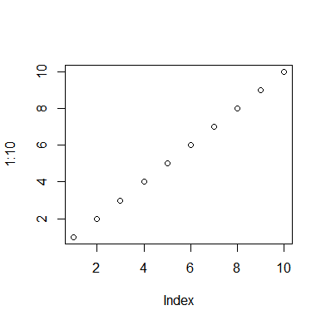
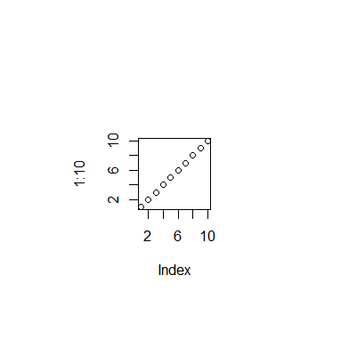
Normal Margins (bottom, left, top right):
>par(mar=c(5.1,4.1,4.1,2.1)) >plot(1:10)
Wide Margins (bottom, left, top, right):
>par(mar=c(8.1,8.1,8.1,8.1)) >plot(1:10)

Slide 51
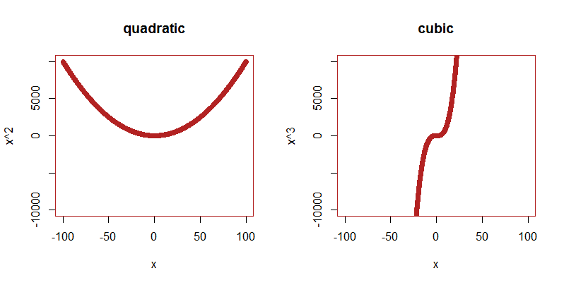
Permanent Graphic Changes (II)
Example 3: Generate multi-panel figures using par()
mfrow (or mfcol): A vector of the form c(nr, nc). Subsequent figures will be drawn in an nr-by-nc array by rows (or columns, respectively).
> par(mfrow=c(1,2),col="firebrick", pch=19) #1x2 plot array
> x <- seq(-100, 100, 0.1)
> plot(x, y=x^2, ylim = c(-10000,10000), "quadratic")
> plot(x, y=x^3, ylim = c(-10000,10000), "cubic")
Notes:
mfrow/mfcol: A vector of the form c(nr, nc). Subsequent figures will be drawn in an nr-by-nc array on the device by columns (mfcol), or rows (mfrow), respectively.
layout() is a more flexible alternative.
col : A specification for the default plotting colour
pch: Either an integer specifying a symbol or a single character to be used as the default in plotting points
pch=19 => SOLID circles . c.f. help(points)
A vector of the form c(nr, nc). Subsequent figures will be drawn in an nr-by-nc array on the device by columns (mfcol), or rows (mfrow), respectively.
Col : A specification for the default plotting colour
PCH: Either an integer specifying a symbol or a single character to be used as the default in plotting points
Pch= 19 = SOLID circles

Slide 52
Current settings of par() - P5S
Calling par() without parameters displays current settings
If you changed nothing, all parameters are at default values
Resetting par()
par() is automatically reset to defaults when you:
Restart R or close/switch Rstudio projects
Run dev.off(), which closes the most recent plot/plotting device
Run graphics.off(), which closes plots/plotting devices
In RStudio, clear all plots using the broom icon
Notes:
resetting par()
When you use the par() function, you are changing the default graphical settings that R uses to generate plots. Sometimes you will need to reset changes that you made previously!
0. Heavy-fisted way: restart R!
1. [specific to Rstudio]
Click the little broom in the plot panel to clear all plots and re-initialise graphical parameters.
2. quickest but least controlled way
run the command dev.off() to close existing plots & re-set par
3. re-set only those arguments that you need
Re-run par(), adding arguments to set the parameters previously changed to something you like better
4. the most general way
At the very beginning of your script, save a copy of the default graphical parameters by running this command:
op <- par(no.readonly=TRUE)
Then, everytime you need to reset your settings, you can run this:
par(op)
no.readonlylogical; if TRUE and there are no other arguments, only parameters are returned which can be set by a subsequent par() call on the same device.
Some of the graphical parameters cannot be changed (“read only”), so the
no.readonly = TRUE bit simply passes all of the par() settings that aren’t read only.

Slide 53
Saving figures to files
By default, R plots all graphics to the screen.
R offers functions to export graphics to many formats (pdf, postscript, bmp, jpeg, png, tiff). The basic concept is to redirect the graphics output to a different “device”.
Use pdf() to start redirection to a .pdf file, png() for a .png file, etc.
Use dev.off() to close the redirection.
> pdf(file="quadratic_cubic.pdf", width=10, height=5,
paper="a4")
> par(mfrow=c(1,2),col="firebrick", pch=19)
> x <- seq(-100, 100, 0.1)
> plot(x, y=x^2, ylim=c(-10000,10000), "quadratic")
> plot(x, y=x^3, ylim=c(-10000,10000), "cubic")
> dev.off()
Alternatively you can use the RStudio interface:
Plots > Export > Save as Image (PNG,JPEG,TIFF,BMP,…)
Plots > Save as PDF.
Notes:
Add a word about how RStudio handles graphics? (keeps all the graphics windows in one place, has refresh capacity, etc)
Major difference between these two formats, i.e. the former is vector graphics (pdf) and the second is raster (image matricielle) (png). This is important for the next slide
postscript(file="a_name.ps", …)
pdf(file="…pdf", …)
jpeg(file=" …jpg", …)
png(file=" ….png", …)
Each graphics device will have a specific set of arguments that dictate characteristics of the outputted file : height=, width=, horizontal=, res=, paper=, pointsize=
For pdf & ps (vector formats), the width and height of the graphics region are given in inches, default values are 7. A4 = 8.3" x 11.7“.
For png, jpeg (raster formats), the width and height of the graphics are given in pixels.

Slide 54
Arguments to graphics export functions
Use correct file extension:
postscript(file="a_name.ps", …)
pdf(file="…pdf", …)
jpeg(file=" …jpg", …)
png(file=" ….png", …)
Each graphics device has a specific set of arguments that dictate characteristics of the outputted file : height=, width=, horizontal=, res=, paper=, pointsize=
For png, jpeg, tiff (raster formats), the width and height of the graphics are given in pixels.
For pdf and postscript (vector formats), the width and height of the graphics region are given in inches. Default values are 7. (Tip: A4 = 8.3" x 11.7“; set the width and height a little smaller for printing to A4 size).
Only pdf() and postscript have an argument "paper". This can be set to common paper formats (paper="a4" for A4 in portrait orientation, paper="
Notes:
Add a word about how RStudio handles graphics? (keeps all the graphics windows in one place, has refresh capacity, etc)
Major difference between these two formats, i.e. the former is vector graphics (pdf) and the second is raster (image matricielle) (png). This is important for the next slide
Each graphics device will have a specific set of arguments that dictate characteristics of the outputted file : height=, width=, horizontal=, res=, paper=, pointsize=
For pdf & ps (vector formats), the width and height of the graphics region are given in inches, default values are 7. A4 = 8.3" x 11.7“.
For png, jpeg (raster formats), the width and height of the graphics are given in pixels.

Slide 55
Multi-page vs single page output
Files in png, jpeg, tiff (raster formats) can only have one page.
Files in pdf and postscript formats (vector format) receive multiple pages by default. You can deactivate this behaviour using the onefile argument.
One Multi-page file
> pdf(file="my_file.pdf")
... #make a few plots, each will go on a separate page #in the same file > dev.off()
Several one-page files > pdf(file="my_file_%d.pdf", onefile= FALSE )
... #make a few plots, each will go into its own file > dev.off()
The format specifier %d causes the resulting files to be numbered:
Notes:
You can tell R to put each page of output in a separate file. To send output to a series of files each representing a single page, use in the filename the printf format specifier "%d" (or its extended form like "%02d")
Don’t forget to close graphics devices (i.e. the file) by using dev.off()
[Note:
[Might be better to simplify this slide next time and not show the onefile argument. Just show different default behavior:
- Raster formats can have only 1 page in the file.
- pdf and postscript can have multiple pages.
This is relevant when making multiple plots between opening the file and calling dev.off().
]
Other things to mention:
Typically, call par() after opening the file. It will affect only the plot(s) in that file. Dev.off() close the file and restore default parameters.
- When dev.off is not called the file will not contain the graphics.

Slide 56
Choosing an image file format
Raster graphics (png, tiff, jpeg):
file sizes depend on the image size (number of pixels)
once created, stretching the image leads to poor quality
Vector graphics (pdf, ps, eps, svg):
file sizes depend on the number of drawing actions (e.g. number of points, lines,...)
all elements can be scaled as desired
Embedding image files in MS Office documents (Word, PowerPoint):
In Windows, png and tiff work best, pdf can get blurry.
In macOS, pdf works well.
Publication-quality figures:
Vector graphics (pdf, eps) tend to be easier to adapt as they can be resized
File size tip: pdfs can become large in file size and slow to display when a large number of points is plotted. When this is an issue, consider png.
Notes:
PDFs grow too large, in which case consider plotting to a raster graphics file (e.g. PNG).
PDFs created in R can later be further processed using another software, e.g., Adobe programs.
Likewise, PDFs created in R can later be converted to other file formats using another software.
The plotting device inside RStudio:
works well for resizing plots, works well for copying plots into pptx or word.
(if you do not need reproducibility)

Slide 57
Let’s practice – 9
Make a multi-panel figure with the four graphics on one page, exporting the figure to a png file. Set width and height arguments in the call to png() to make it look nice.
Optional: Perform the steps of the 2 previous practice sessions, but for diet in place of genotype. (Step 2 will not change). This time, make a pdf with two pages and two graphics on each page. Again, set width and height arguments in the call to pdf() to make it look nice.
Optional: Look at the multi-panel figures. Are your impressions about mouse weight from yesterday's exploration of data summaries confirmed by today's visualizations?
Notes:
The original data has been modified for the purpose of the course

Slide 58
Introduction to high-level and low-level plotting functions in R
plot(), lines(), points(), hist(), barplot(), boxplot() …
Customization of plotting functions
Colours, line types, line widths, plotting characters…
Titles, labels, legend…
Permanent graphic changes
Exporting graphics
In a nutshell

Slide 59
Taking advantage of R for your work
Tidying & data manipulation
Import in R
Exploration
Modelling
Export
Notes:
General workflow to take advantage of R for your work:
-specify your question very clearly.
Your Question, what hypothesis you're making, what data you will collect, coming from different type of experiment ( simulation study, field study, lab study, measurement machine ) – this will be your dataset(s)
-design your experiment very well
-format your dataset nicely
Tidy step: checking some variables are of the correct type, manipulating the structure of the data
Explore in terms of graph, table, summary stats to get an idea of the answer(s)
Stats will give you a reliable Answer to confirm the question, confirming that the graphs gave you a reliable answer
Communicate answer, data, graphs to colleagues, boss: report, publication , summary – reproducible research and it is essential otherwise the previous steps were meaningless

Slide 60
Taking advantage of R for your work
Communicate
Tidying & data manipulation
Scientific question
Formatted Data In R
Data representation
Statistical analysis
Import in R
Exploration
Modelling
Export
Notes:
General workflow to take advantage of R for your work:
-specify your question very clearly.
Your Question, what hypothesis you're making, what data you will collect, coming from different type of experiment ( simulation study, field study, lab study, measurement machine ) – this will be your dataset(s)
-design your experiment very well
-format your dataset nicely
Tidy step: checking some variables are of the correct type, manipulating the structure of the data
Explore in terms of graph, table, summary stats to get an idea of the answer(s)
Stats will give you a reliable Answer to confirm the question, confirming that the graphs gave you a reliable answer
Communicate answer, data, graphs to colleagues, boss: report, publication , summary – reproducible research and it is essential otherwise the previous steps were meaningless

