Slide 1

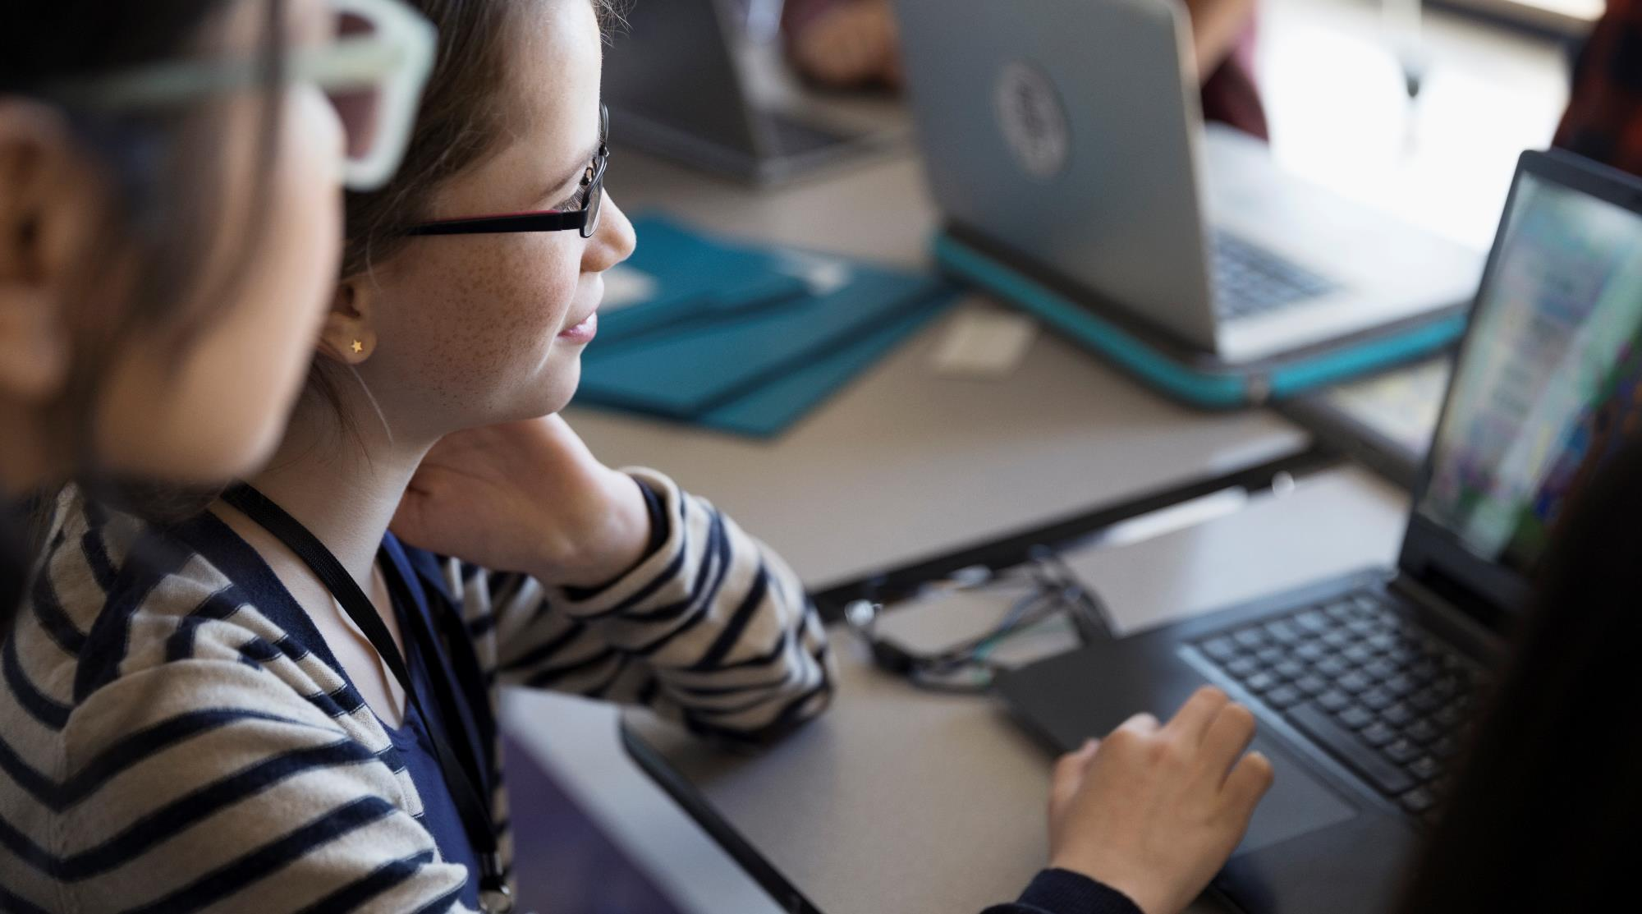
Entertainment for the visually impaired children
Diim, Touch to sight.
A new way to engage visually impaired children to interact with technology.

Slide 2
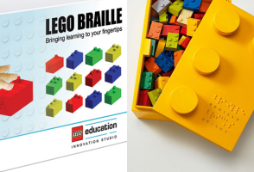
Braille brick
Competitor
Learning through Play -empowers children to become creative
Inclusive Learning - inclusive opportunity to teach blind, visually impaired and sighted children alongside each other by offering a fun and playful way to engage, interact and learn together.
Life Skills -ensuring they experience intellectual freedom
Fun & Fulfillment - learning and social interaction through playful games and innovative teaching methods paving the way for improved confidence, creativity, problem-solving and communication needed to support life goals.
The Lego Group, is a Danish toy production company based in Billund. They manufacture Lego-brand toys, consisting mostly of interlocking plastic bricks.
Touch to sight.

Slide 3
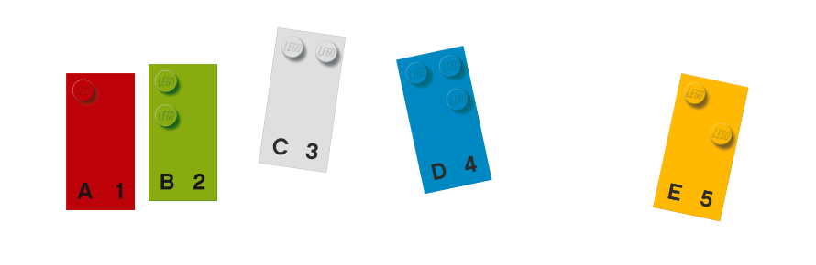
Braille Bricks is a playful tool to teach Braille to blind and visually impaired children.
The toolkit comprises of adjusted LEGO bricks that correspond to Braille.
Each colorful brick has a printed letter or symbol allowing the sighted and blind to interact and play on equal terms.

Slide 4
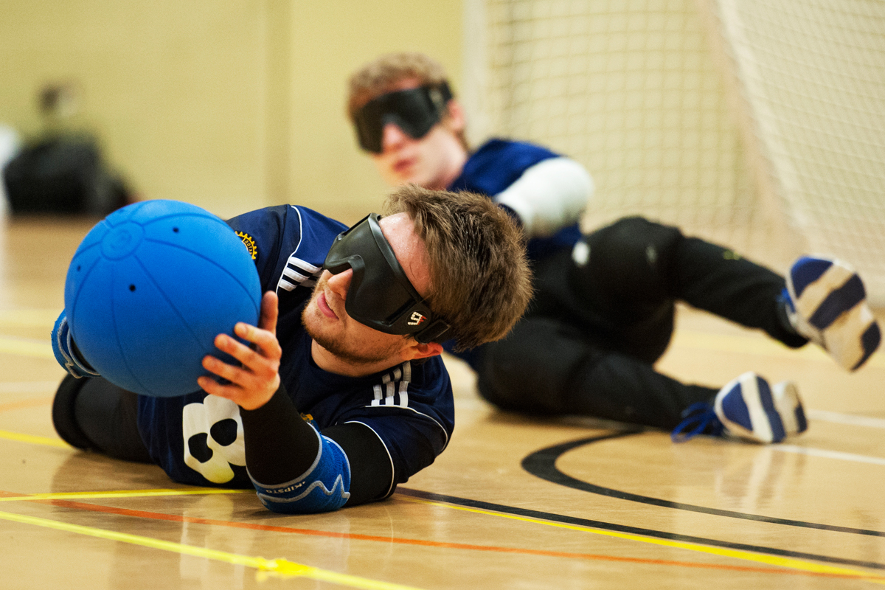
Goalfix
The ball has three metal bells inside which can be heard through eight holes in the rubber.
6 sound devices
Fine rattling sound
Strong limitation leather
Great for games and play for the visually impaired and Wheelchair Football.
£50.00
Goalfix Sports is a specialist supplier of disability sports equipment and high quality aluminum goals.

Slide 5
Goalfix works with governing bodies to supply disability sports equipment for key events including international competitions.
“Our eyeshades are suitable for blind and visually impaired participation sports and other team games where total light blackout is needed to restrict the vision of all athletes and ensure fair play for all”.
Goalfix eyeshades are trusted around the world in blind sports such as football, goalball, torball, cricket and tennis.

Slide 6
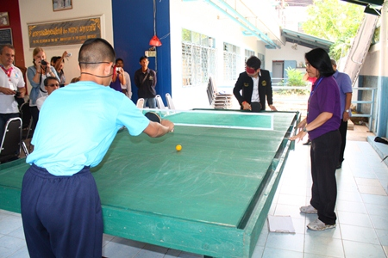
Showdown
Wooden table and aluminum construction ensures that the table is easily portable and well made.
At present, the table are made primarily with transparent central panel, which is transparent and unbreakable material.
£ 1,187.00
Showdown is applied table tennis for the blind and visually impaired.

Slide 7
Showdown is played by two players. It is played on a rectangular table at the rear of both sides are scoring well, in the middle of the center plate. Played with bats and balls, which were inserted into the stainless steel balls to the ball to hear. The goal is to hit the ball across the table, under the central board and the opponent's goal while the opponent tries to prevent it.

Slide 8
Feedback from our primary research
Response from the Teacher
visually impaired children have their own uniqueness and they are differently gifted
they are mostly exposed to the field
adaptation of learning and sensitize and clear the environment
learning barriers it believes its a cultures for us to see and there is a gap of making people to seeconcept of ste
same as other children same test given in written test
they have specialized learning tools like the Perkins braille machine and mobility white cane
they have specialized tools like the JUS but they are not locally available(tools)
adapted football
students strength and weakness are the same problems as visually able children
they adapt to normal environment
they also using abacus for students to enable easy learning for students
They also have pairing learning

Slide 9
COST FOR STARTING SEO
A one-time Projects : $5,000-$30,000
$750-$2,000/month based on the scope of the project
$80-$200/hour hourly rates for consultants fall between.

