Slide 1
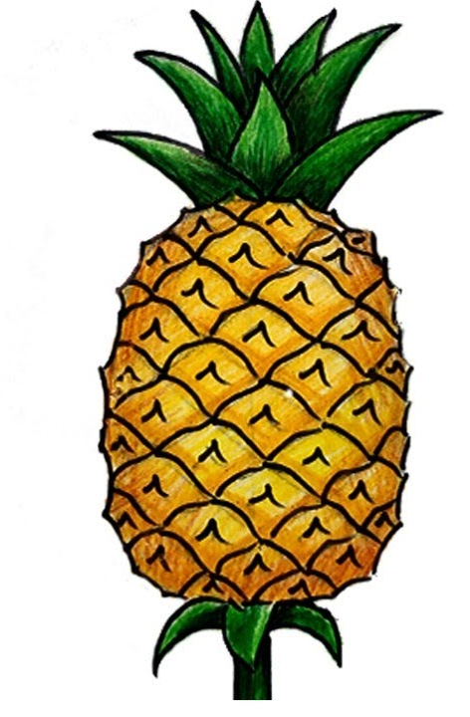
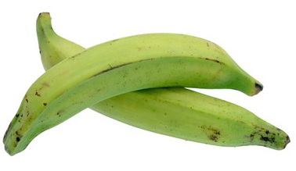
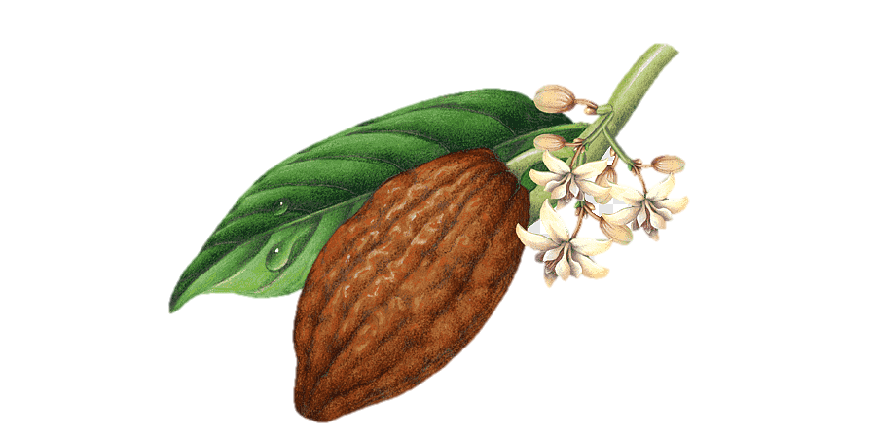
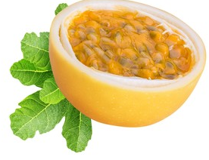
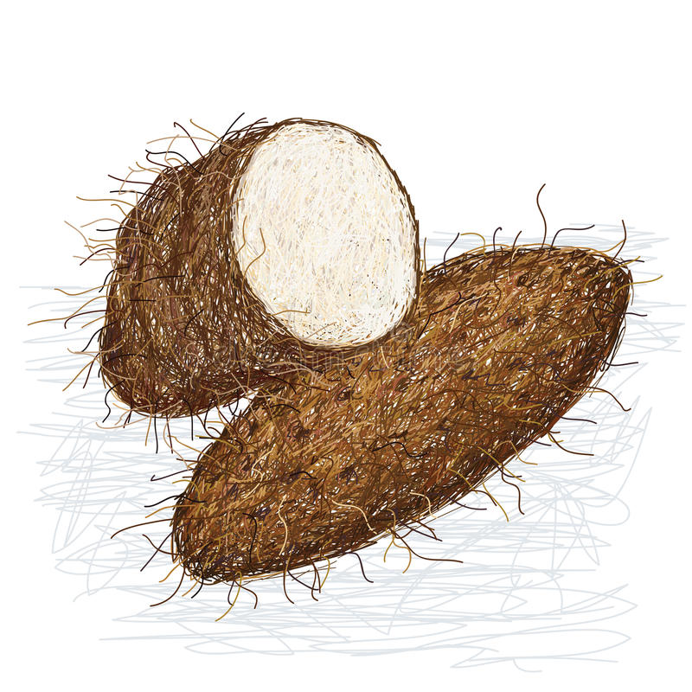
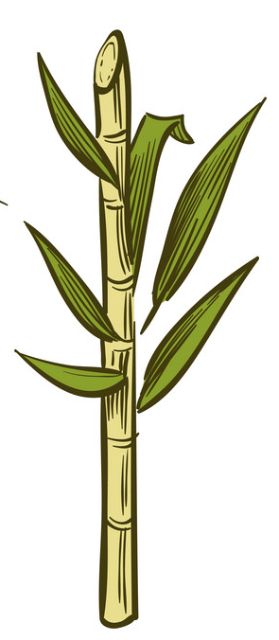
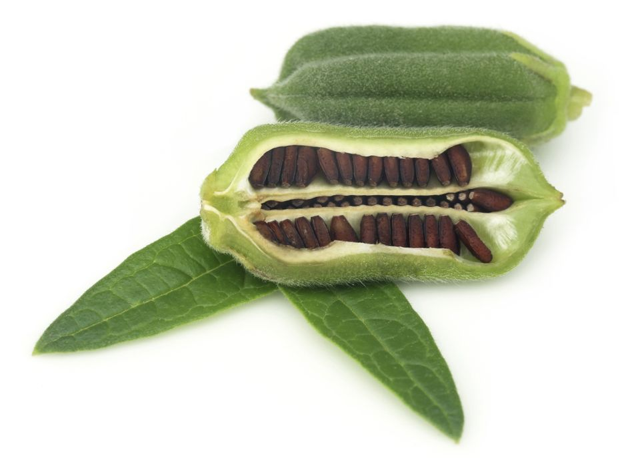
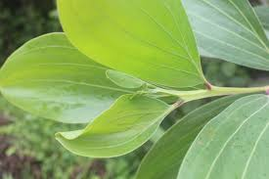
Herley Madrigal 2013
Jaime Coba 2013
Leidy Barrera 2013
Nelson Berdugo 2015
Juan C. Davila 2015
Miguel Ramos 2014
Frank Fierro 2015
Pompilio Acevedo 2015
Plantain/Banana
Pineapple
Alfredo Lozano 2014
Veronica Rivera 2015
Juan A. Becerra 2013
Passion fruit
Cacao
Jorge Velilla 2014
Juan de la Cruz 2014
Fredy Ruiz 2014
Sugar
cane
Amalia Aguilera 2015
Yam
Jose A. Vasquez 2015
Henry Casteblanco
Sesame
Acacia

