Slide 1
SWEWars
Project Presentation

Slide 2
Group Members

Slide 3
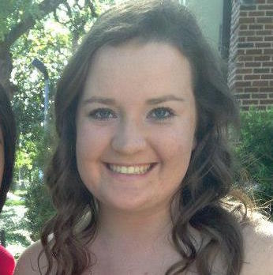
Diana Ruth
Non-graduating Senior
EE/CS Double Major
Hometown: Alpharetta, GA
Fun Fact: has a half-corgi named Ritz
Responsibilities:
UI
Implementing AngularJS
External Database Scraping

Slide 4
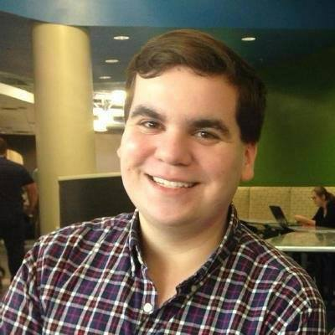
Clint Ascencio
Senior
Hometown: Austin, TX
Fun Fact: is a vampire
Responsibilities:
Docker/Carina
Created Models
Populated Database

Slide 5
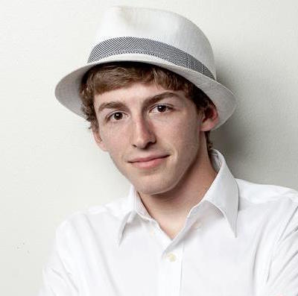
Tony Serino
Senior
Hometown: Austin, TX
Fun Fact: Once killed a man
Responsibilities:
Docker/Carina
Created Models
Populated Database

Slide 6
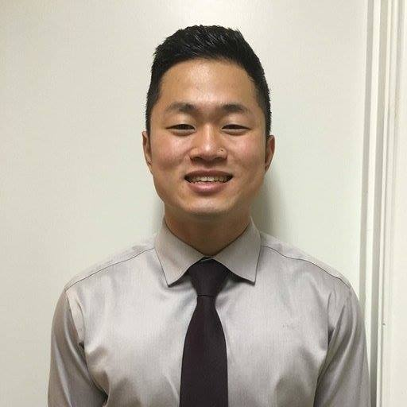
Jon Lim
Senior
Hometown: Seoul, South Korea
Fun Fact: Is Korean
Responsibilities:
Set up Unit Tests
Set up Database
Search Functionality

Slide 7
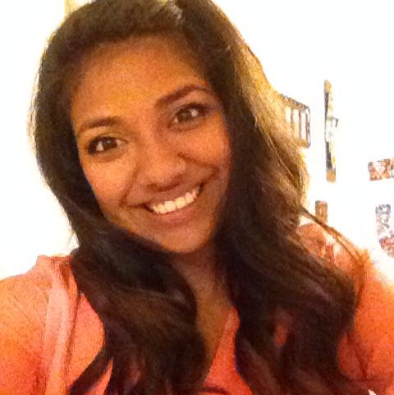
Jamie Barbosa
Senior
Hometown: Schertz, TX
Fun Fact: Was a broadway actress in a past life
Responsibilities:
UML
Front End with AngularJS
Exercised other group’s API

Slide 8
Demonstration
http://www.swewars.me/

Slide 9
Issue Tracker Statistics
Total Issues Opened:
Total Issues Closed:
Member Stats:
Diana:
Clint:
Tony:
Jon:
Jamie:

Slide 10
Unit Tests
Total Unit Tests:
Member Stats:
Diana:
Clint:
Tony:
Jon:
Jamie:

Slide 11
Return Of the API Critique
What did we do well?
What did we learn?
What can we do better?
What puzzles us?

Slide 12
CompRo DB Critique
What did they do well?
What did we learn from their website?
What can they do better?
What puzzles us about their website?

Slide 13
Run Unit Tests
http://www.swewars.me/

Slide 14
Questions?

