Slide 1
Ames Housing Market
Analysis and Sale Price Prediction
Diana Dent
December 23rd, 2022

Slide 2
Agenda
#4
#3
#2
Conclusions
Top Performing Model
Next steps
#1
Prediction Models
Linear Regression
KNN
Decision Tree
EDA
Data preprocessing
Feature engineering
EDA
Project Description
Dataset
Research quetions

Slide 3
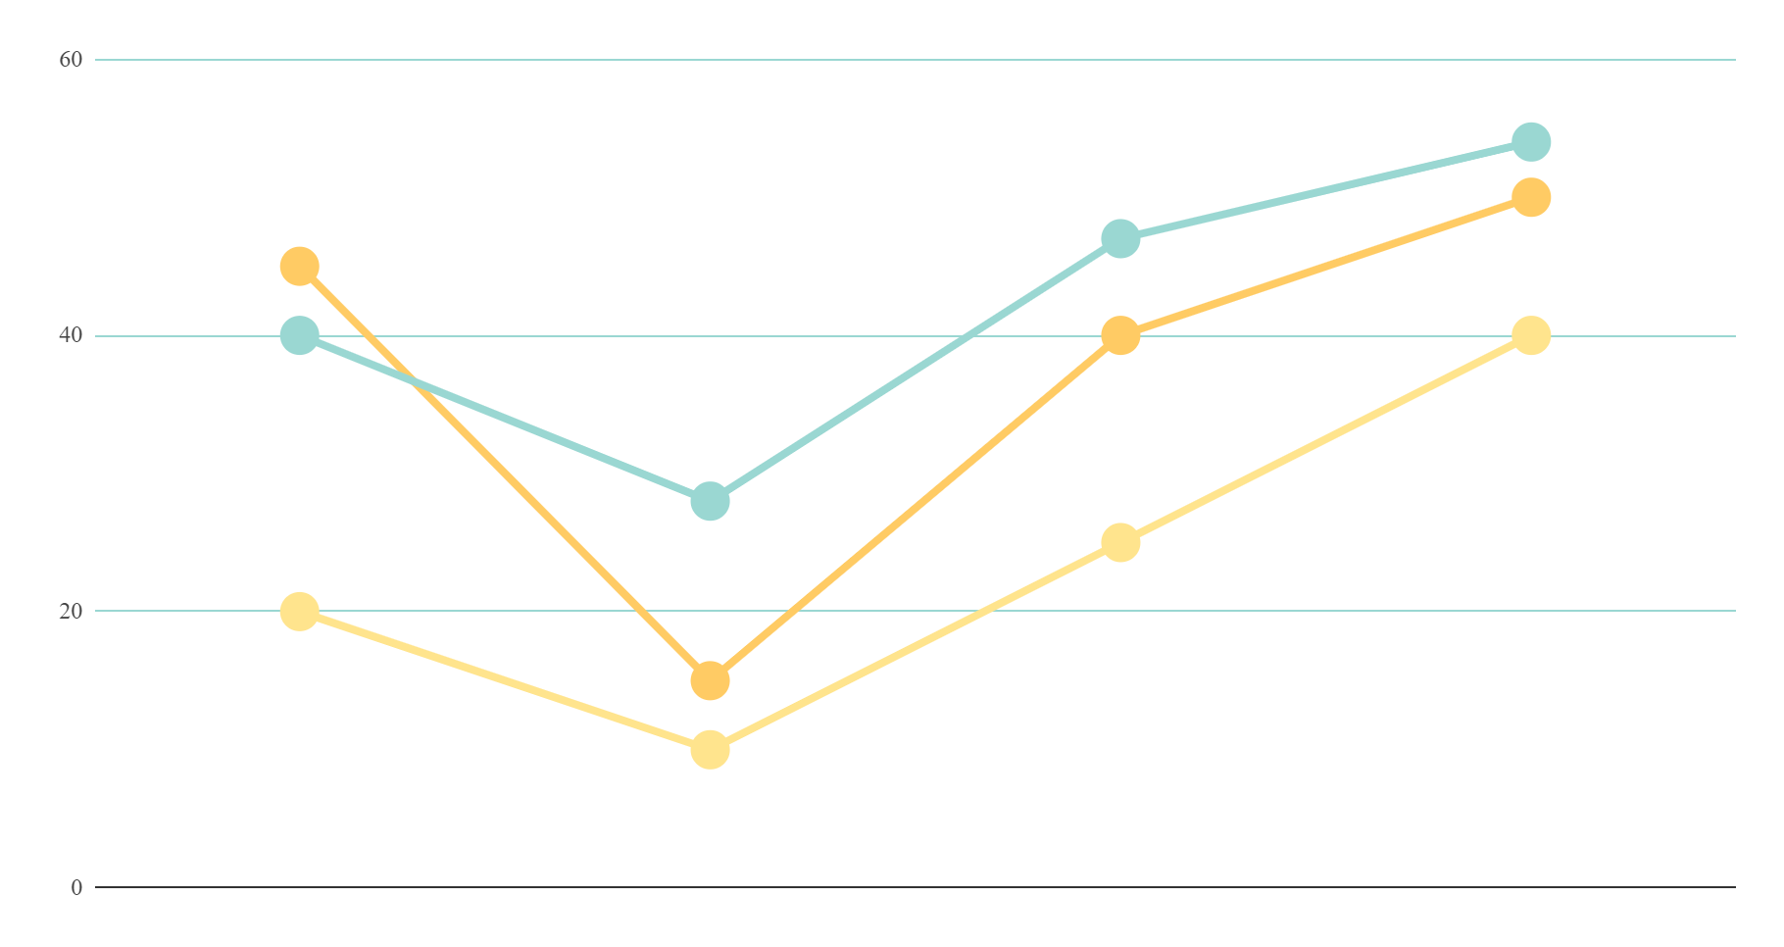
RESEARCH QUESTIONS
1
Exploratory data Analysis on the Ames, Iowa housing market
2
Predictive model for the House Sale Price

Slide 4
City of Ames, Iowa
Iowa State University
Half of the residents are students
Average Commute 16.1 min
Median Home Value $246,387
Med. Household Income $50,783
Total Population 66,361
https://livability.com/best-places/2022-top-100-best-places-to-live-in-the-us/top-100-2022-ames-ia/

Slide 5
DATASET
Columns
Rows
Target Variable
79 explanatory variables
2580 observations.
Many missing values
Sale Price
https://www.kaggle.com/competitions/house-prices-advanced-regression-techniques/overview

Slide 6
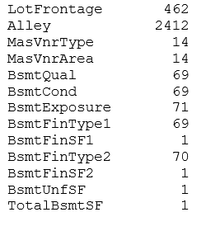
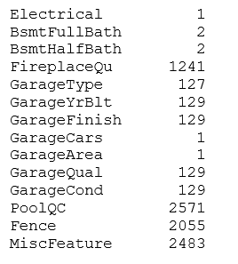
AMES Housing Data Set Missing Values:

Slide 7
Feature Engineering/ Imputed Features
Imputed Features:
'MasVnrType','BsmtQual','BsmtCond','BsmtExposure','BsmtFinType1','BsmtFinType2','FireplaceQu','GarageType','GarageFinish’,'GarageQual','GarageCond','PoolQC','Fence','MiscFeature' – None
"Electrical” – SBrkr
’MasVnrArea’ and ‘GarageYrBlt’ - 0
‘LotFrontage’ – median
Feature engineering:
TotalSF
Age (year sold – year built)

Slide 8
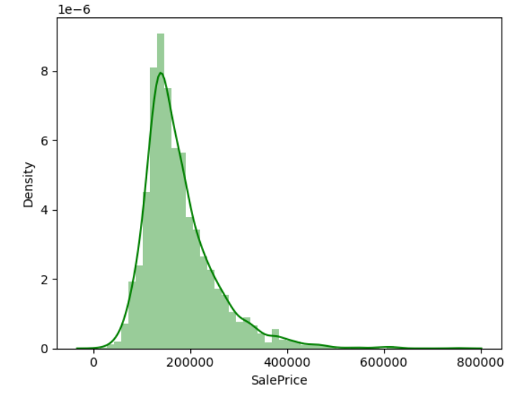
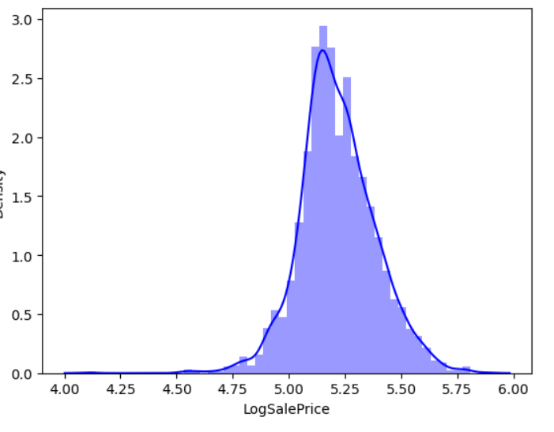
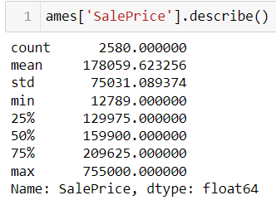
How much did it cost to buy a house in the city of Ames?

Slide 9
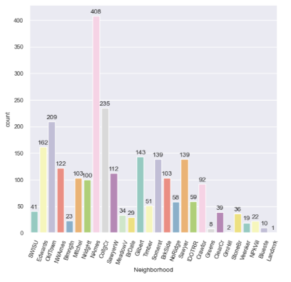
Most popular Neighborhoods in the city of Ames?

Slide 10
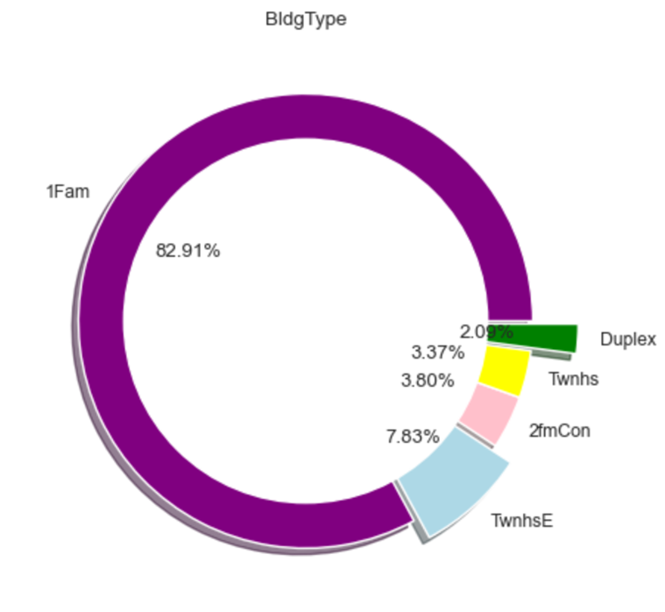
Most selling building types of house in the city of Ames

Slide 11
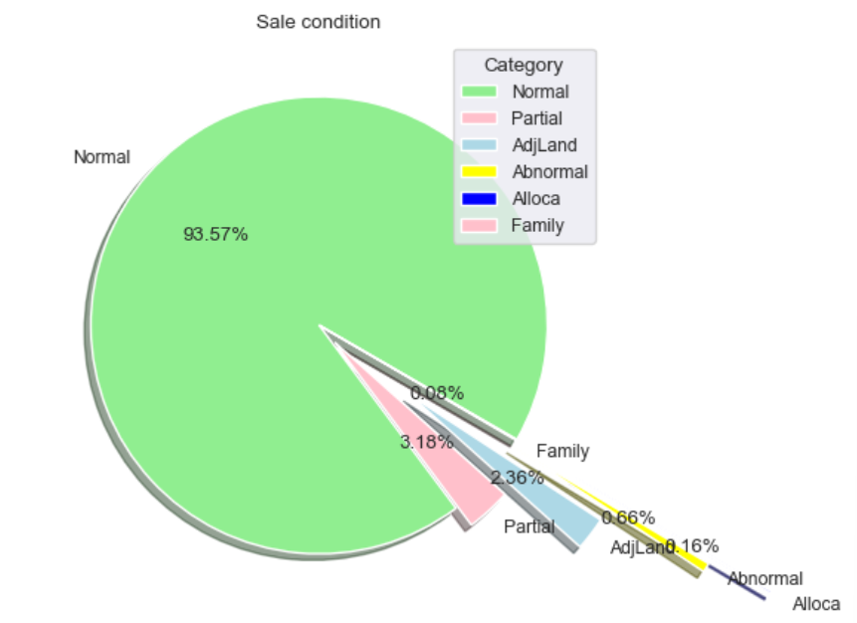
Conditions of Sold Houses in the city of Ames

Slide 12
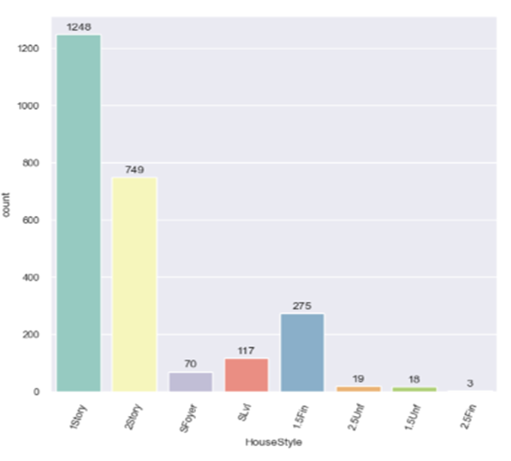
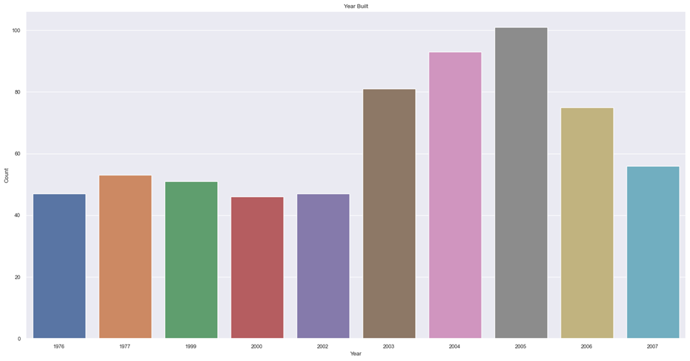
Styles and Year of Build sold homes in the city of Ames

Slide 13
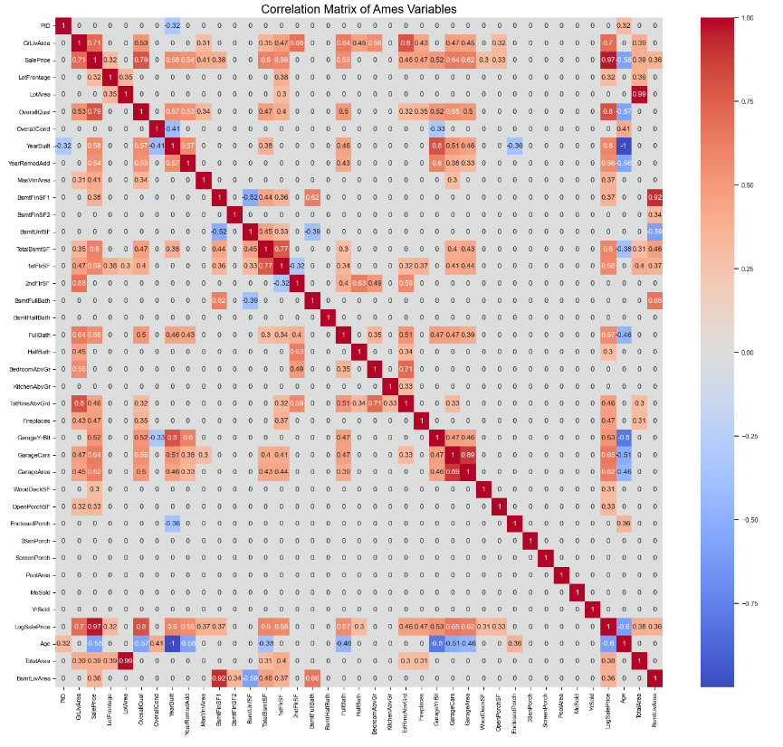
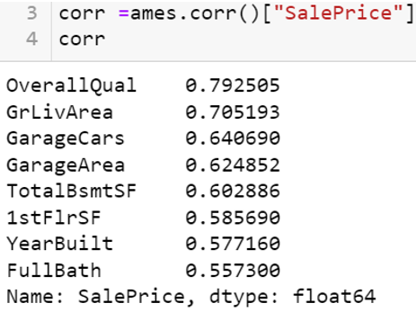
Correlation Analysis

Slide 14
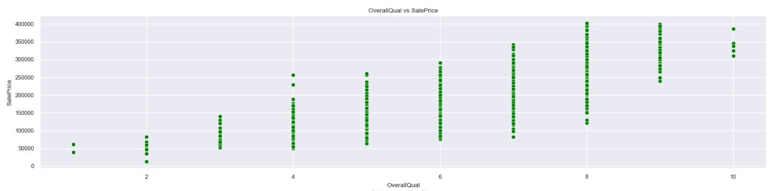
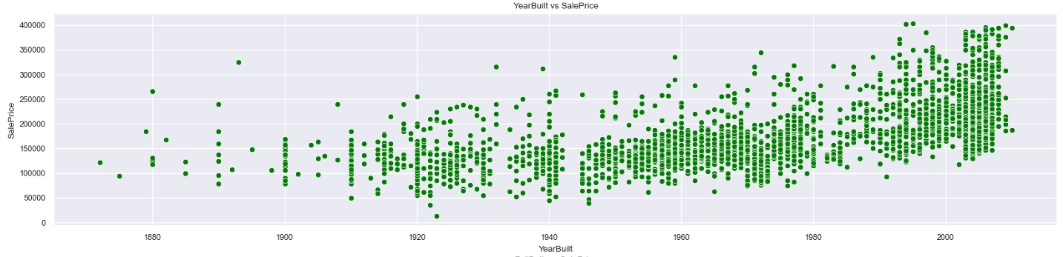
Correlation with Sale Price

Slide 15
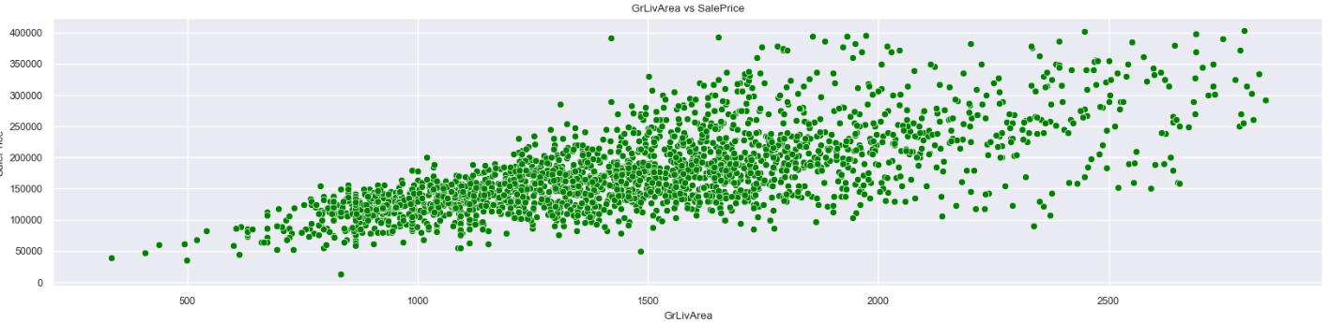
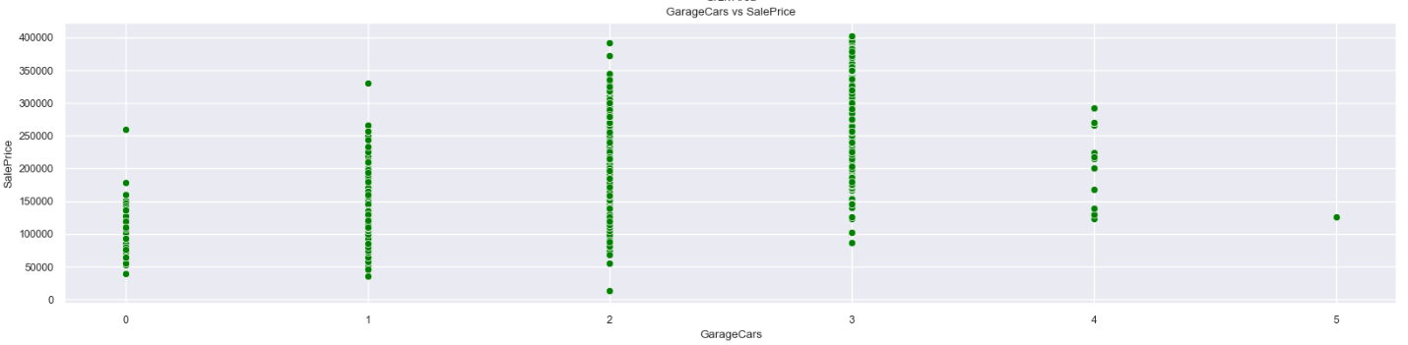
Correlation with Sale Price

Slide 16
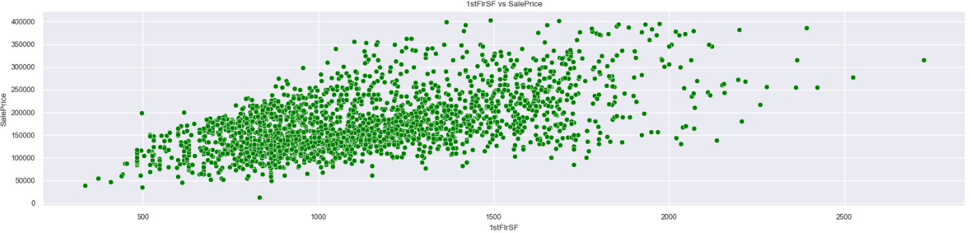
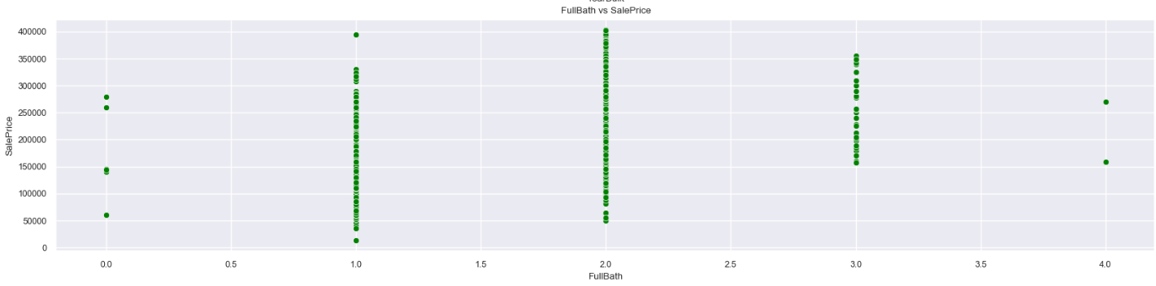
Correlation with Sale Price

Slide 17
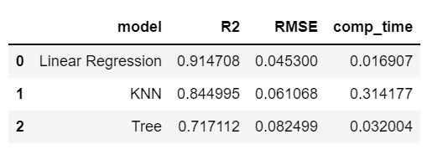
Price Prediction Modeling

Slide 18
Conclusions / Next Steps
Feature engineering refinement
Review Feature Selection
Revise multicollinearity treatment
New Features
Ensemble Modeling
Try new ML models
Hyperparameter tuning
We were able to predict home sale prices in Ames with 91.5% accuracy using our best machine learning model.

Slide 19
THANKS

