Slide 1
Uber vs Lyft Price Prediction
R Project
Diana Dent

Slide 2
Agenda
01
02
03
04
Project Description
EDA
Prediction Models
Conclusions
Dataset
Research Question
Data Cleaning
Initial Analysis
Top Performing Model
Next Steps
Regression Modeling

Slide 3
Research Question: What defines the cab price of Uber vs. Lyft?
UBER
LYFT
What is the need for this analysis?
Can I create a model to output the most important predictors of the price in a given dataset?
Insight into the cab price is valuable for everyone, because all of us are taxi customers in many different life situations.

Slide 4
The Dataset
01
02
03
Columns
Rows
Target variable
57 explanatory variables
693 071 observations. Some missing data.
Price
https://www.kaggle.com/datasets/brllrb/uber-and-lyft-dataset-boston-ma

Slide 5
EDA/Data Preprocessing
Step 1
Step 2
Step 3
Data Quality Assessment
EDA
Feature Engineering
Removed missing data (55 095 in Price, where Cab Type is not defined)
Explore all variables and their relationships to find general trends
Create new variables based off a given dataset and EDA

Slide 6
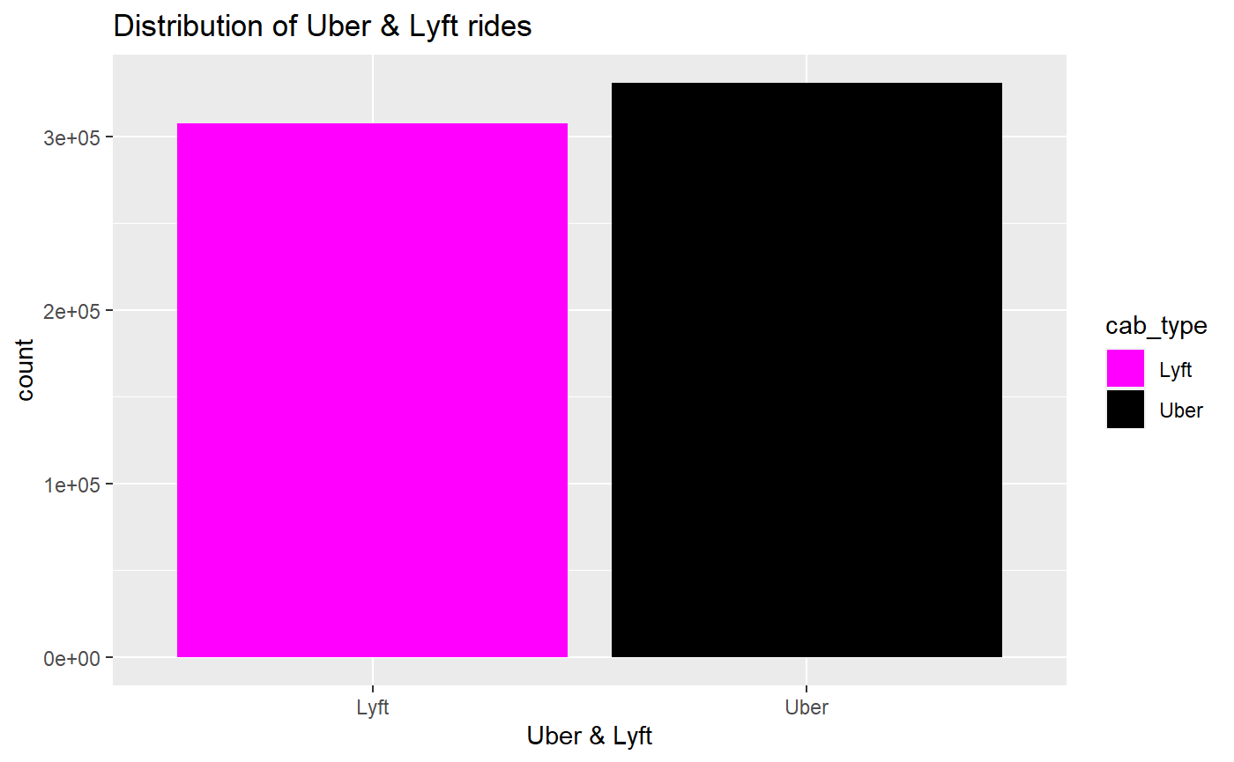
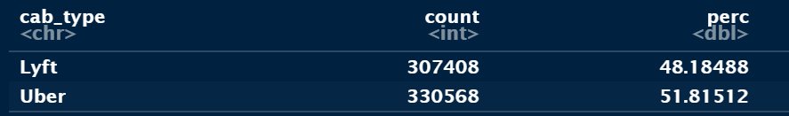

EDA – General trends

Slide 7

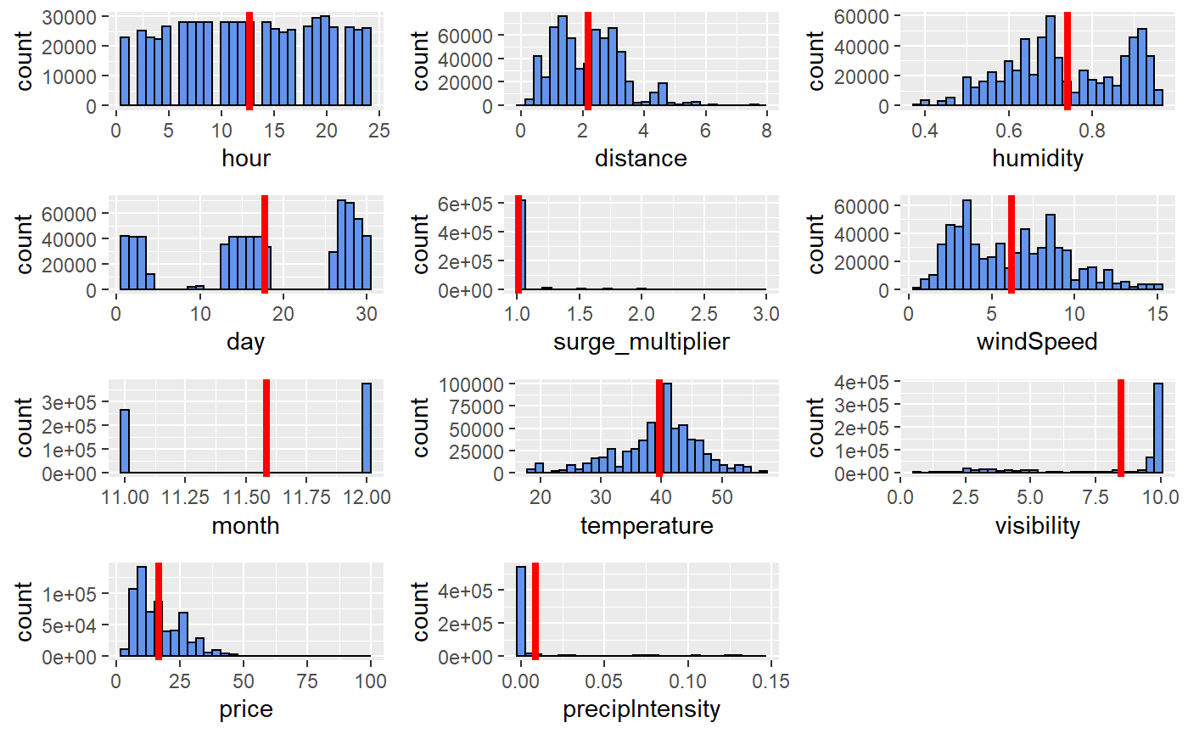
EDA - General Trends

Slide 8
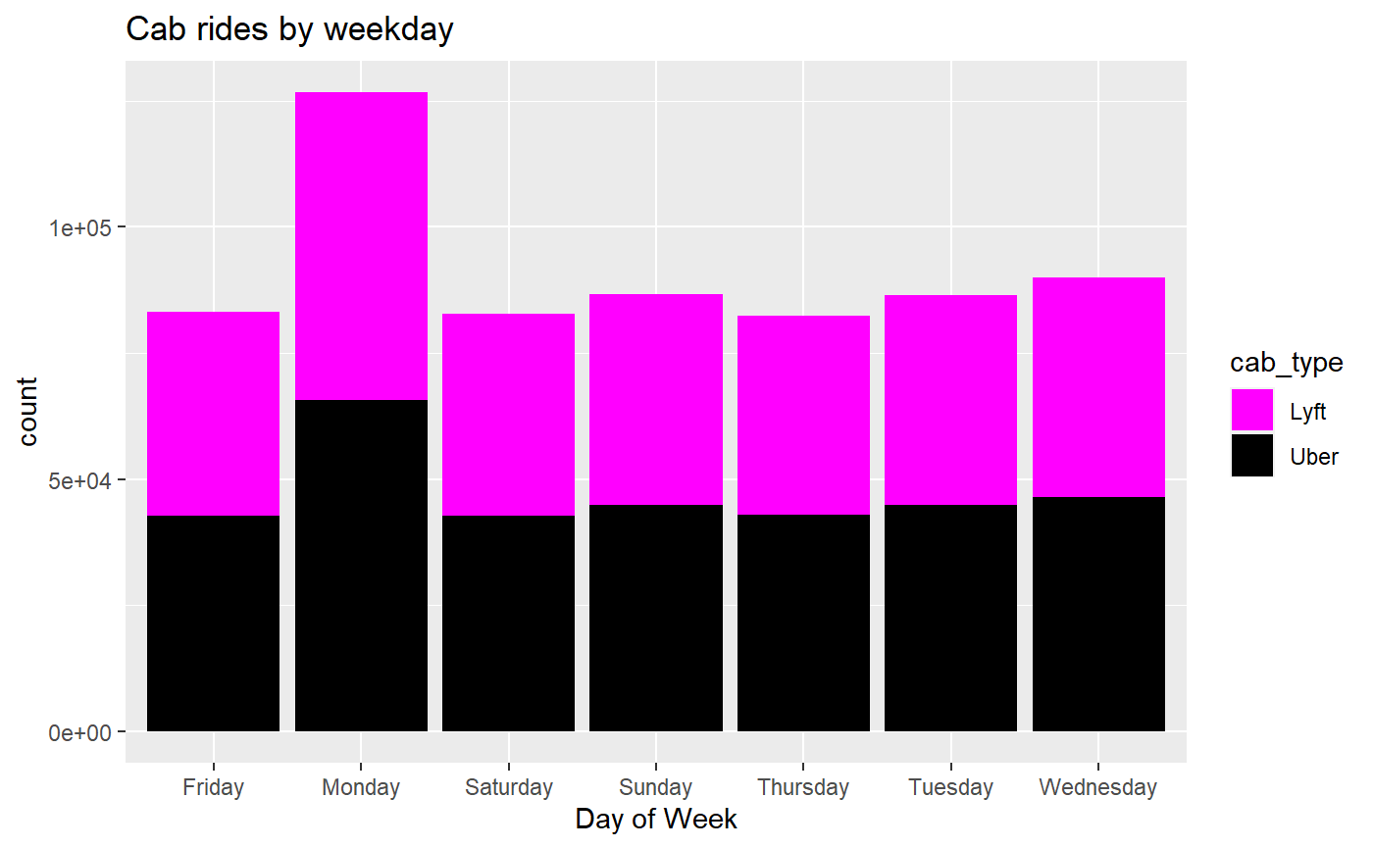
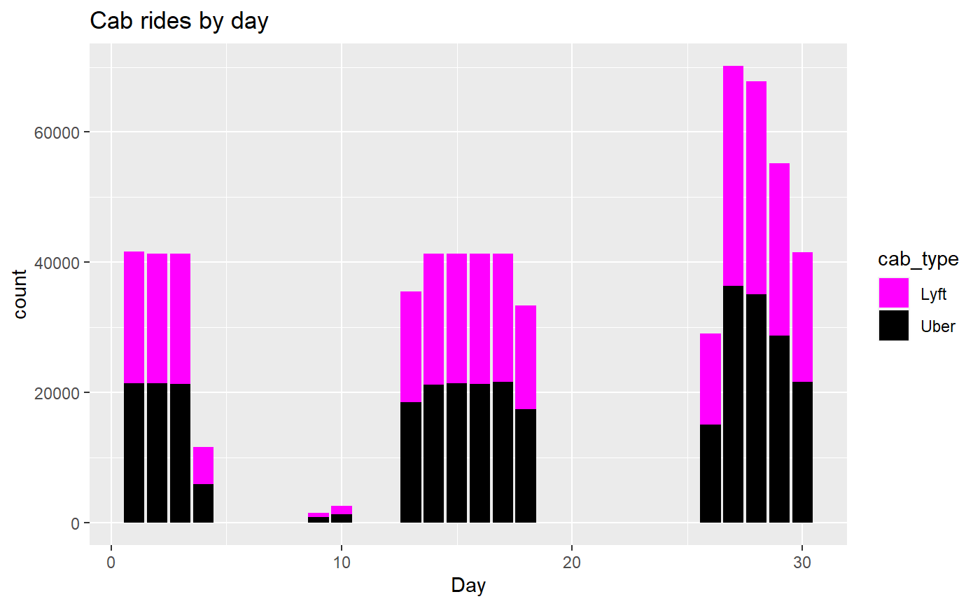
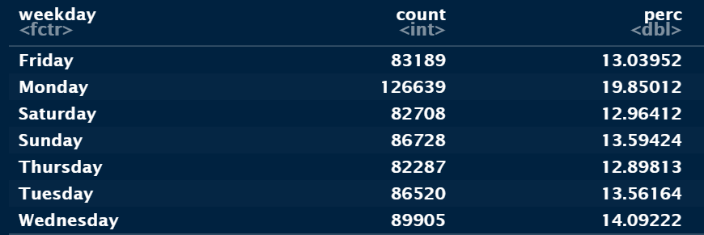
EDA – Day

Slide 9
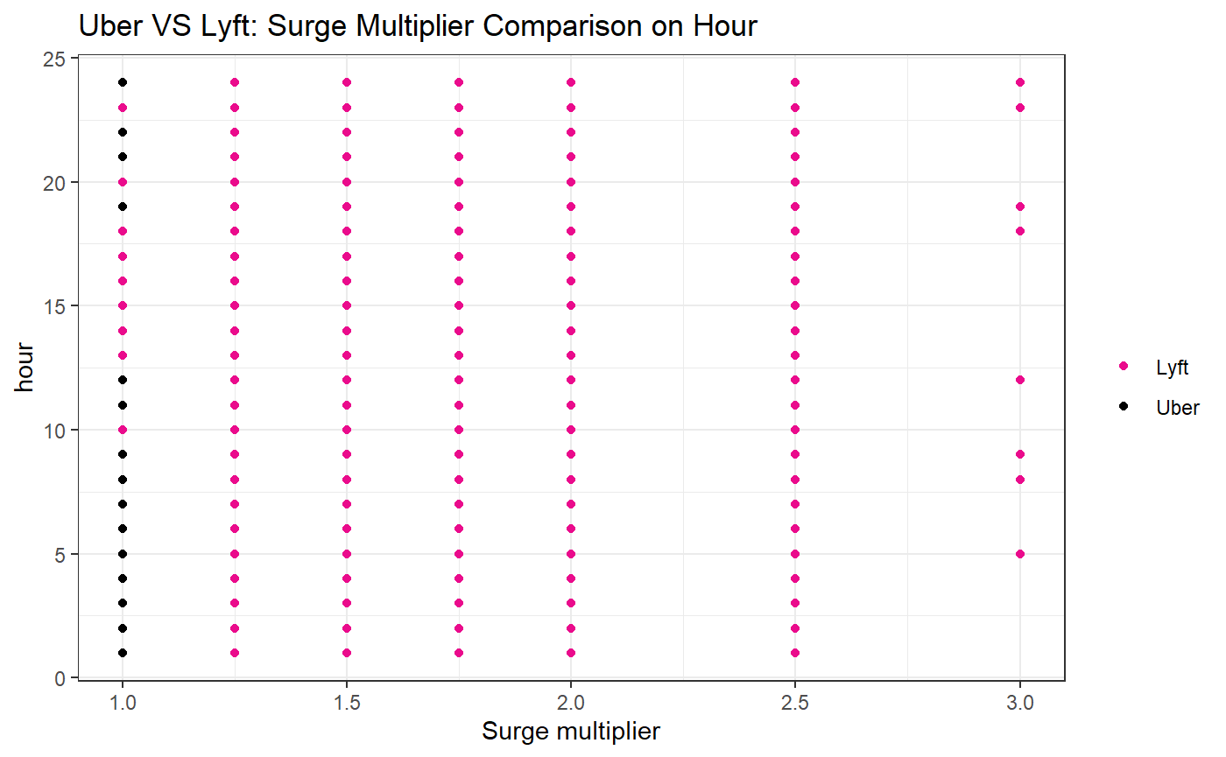
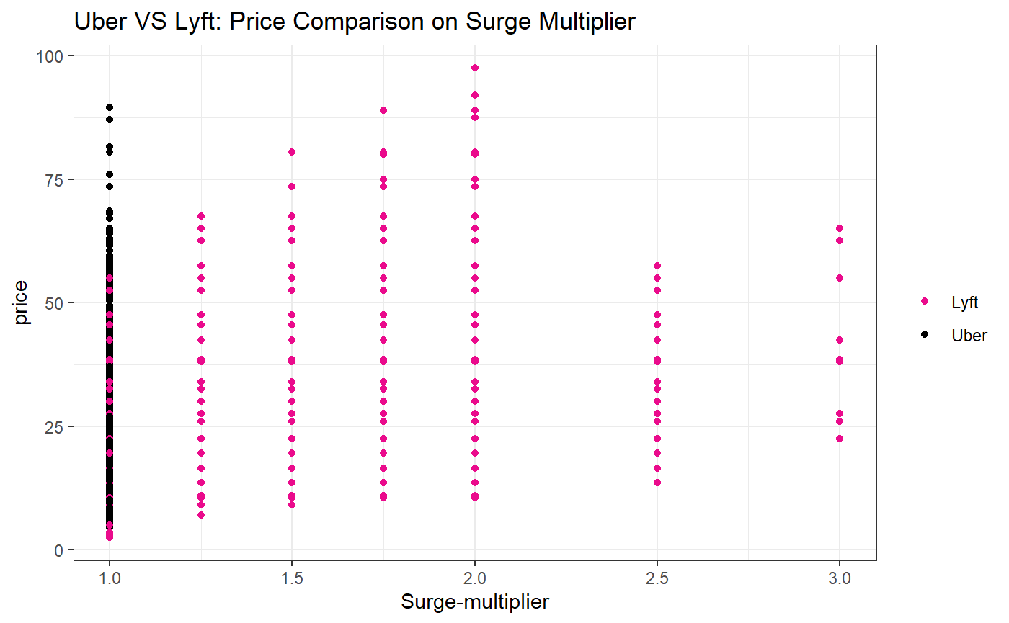
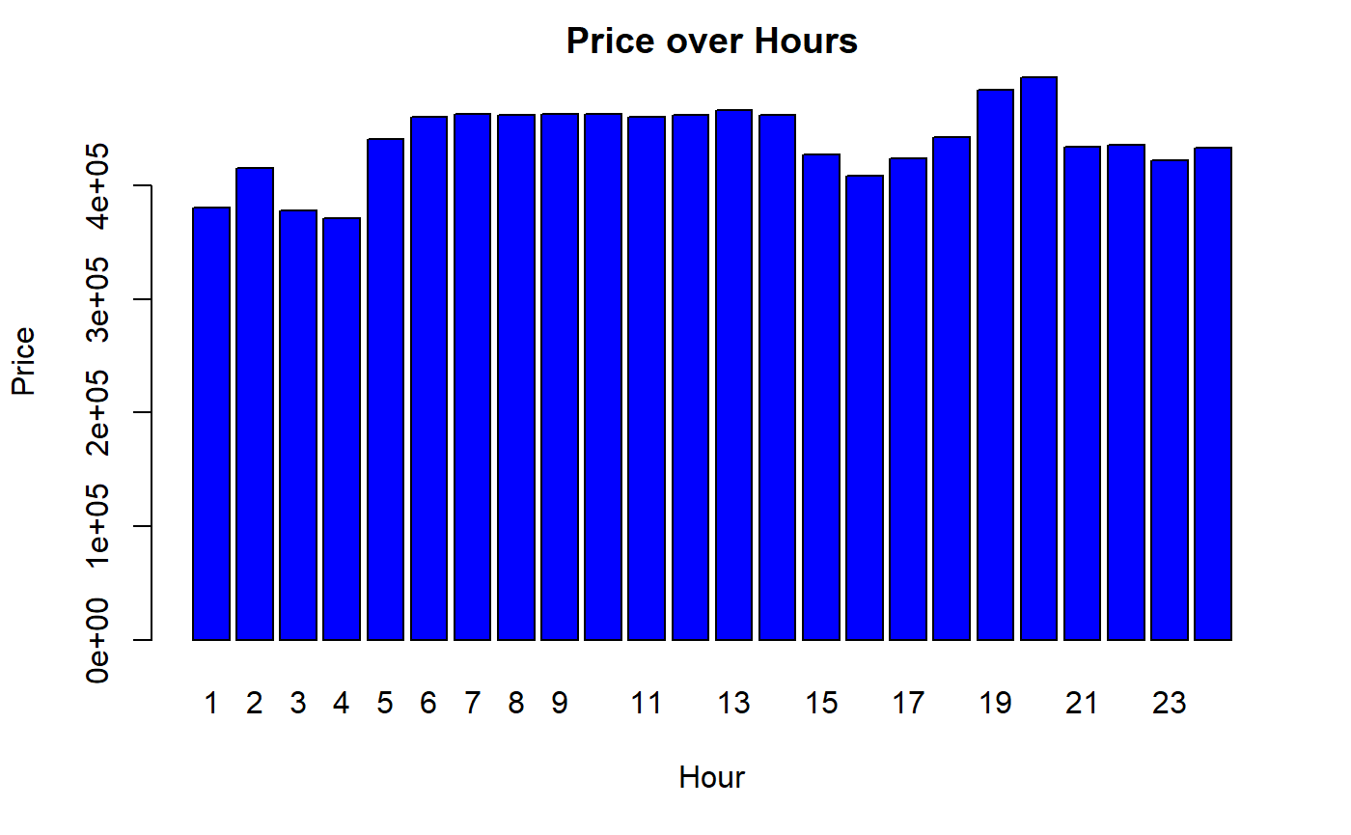
EDA – Surge Multiplier, Hour

Slide 10


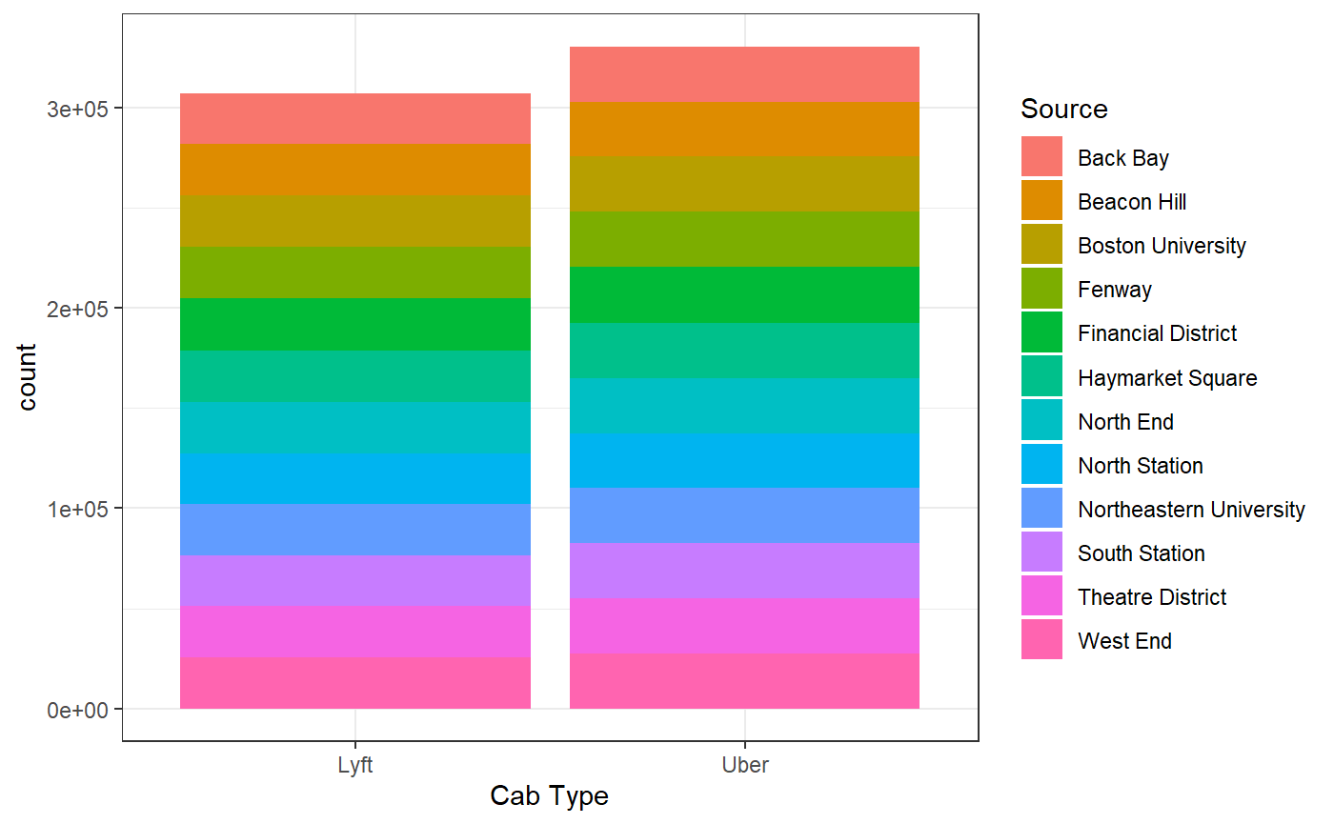
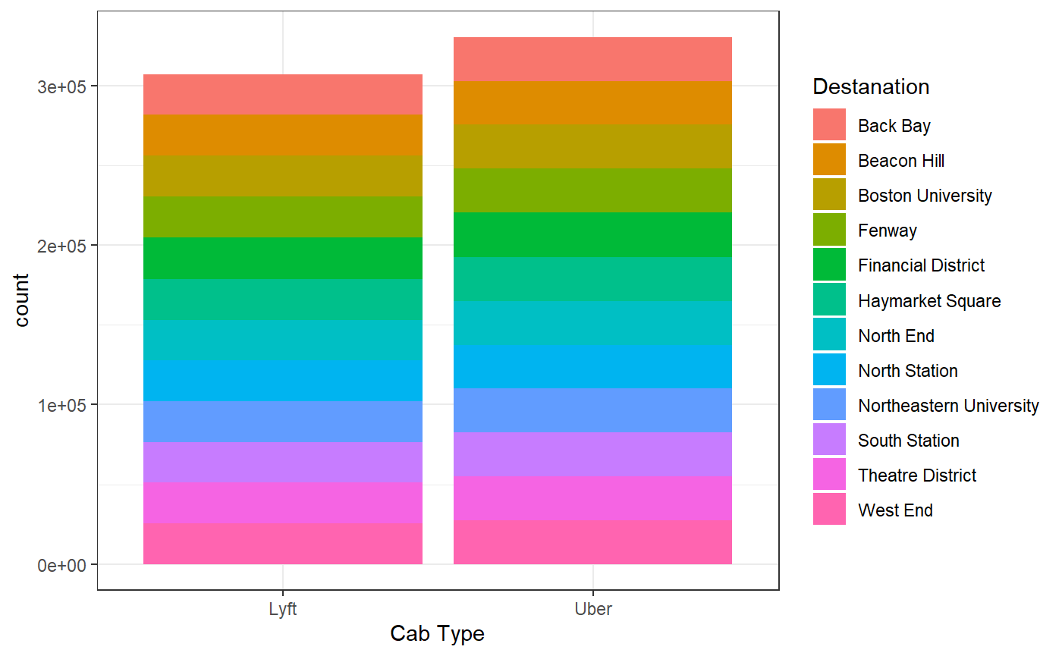
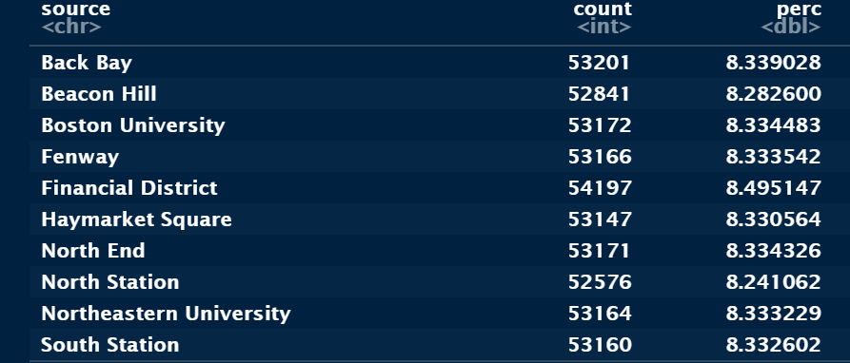
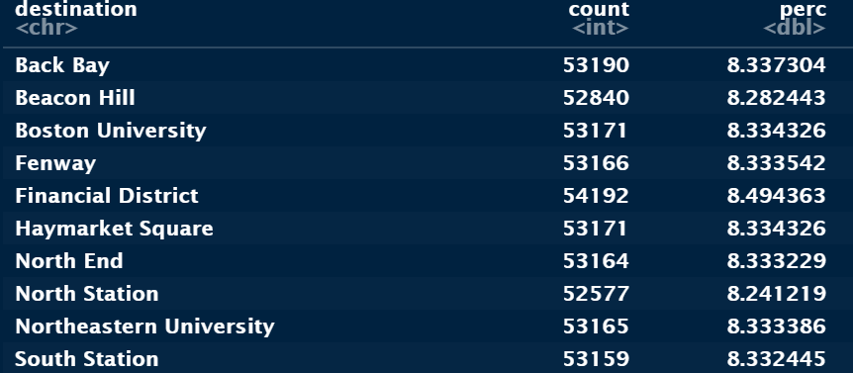
EDA – Source, Destination

Slide 11
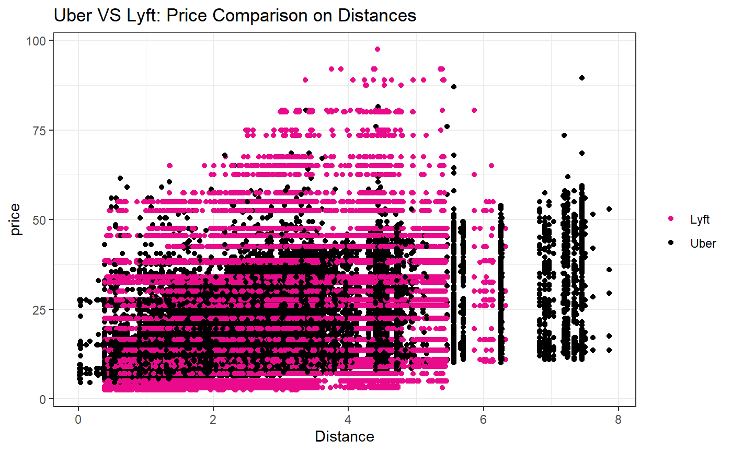
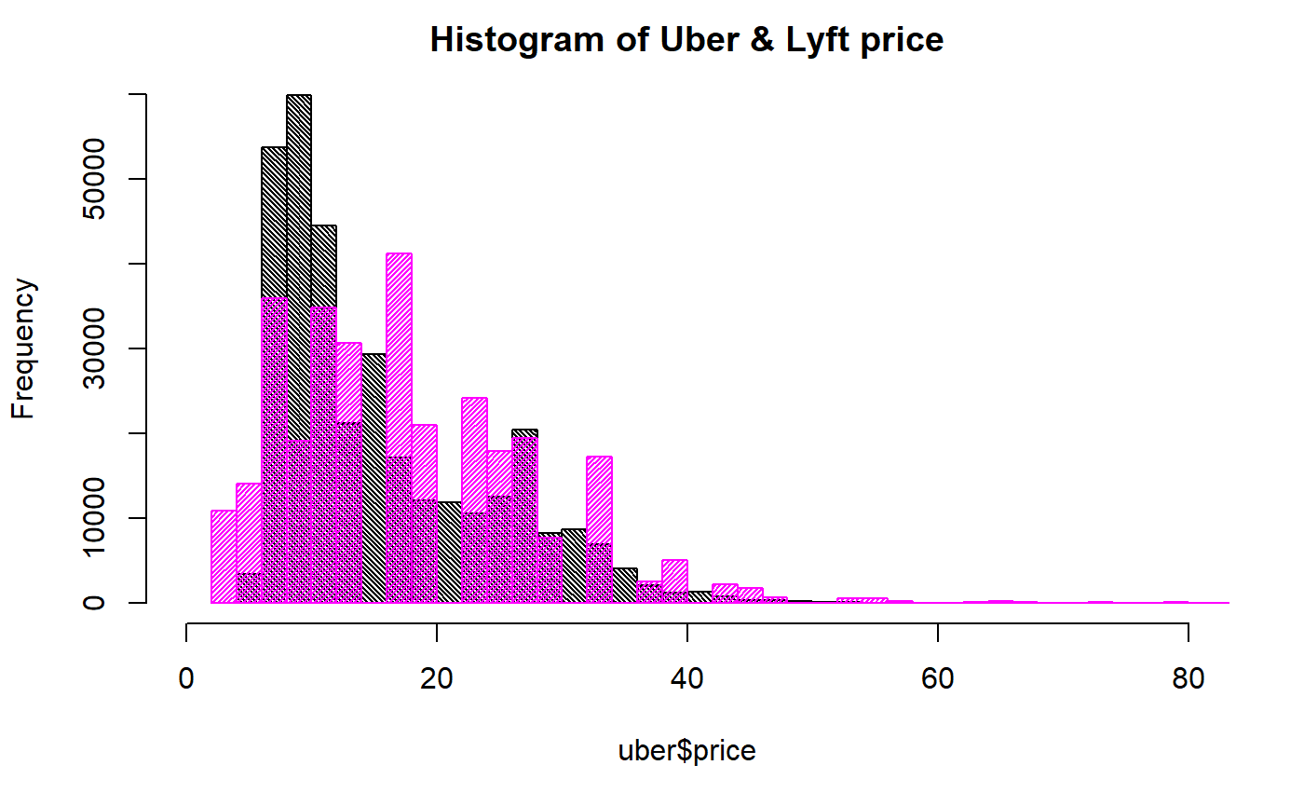
EDA - Price

Slide 12
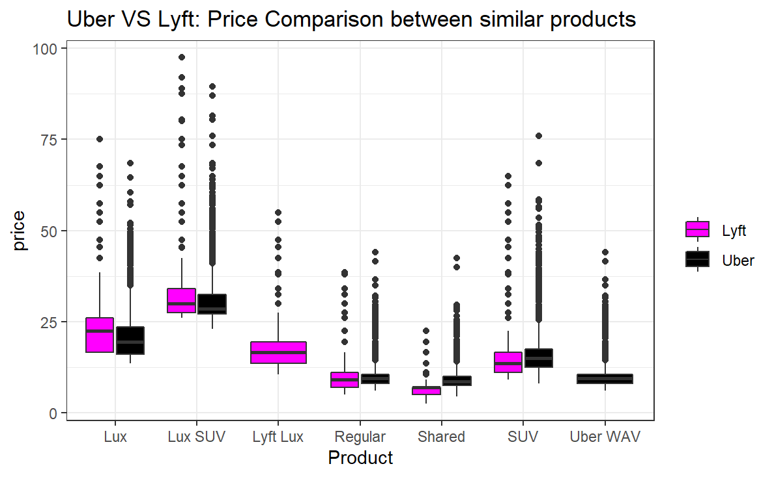
EDA - Price

Slide 13
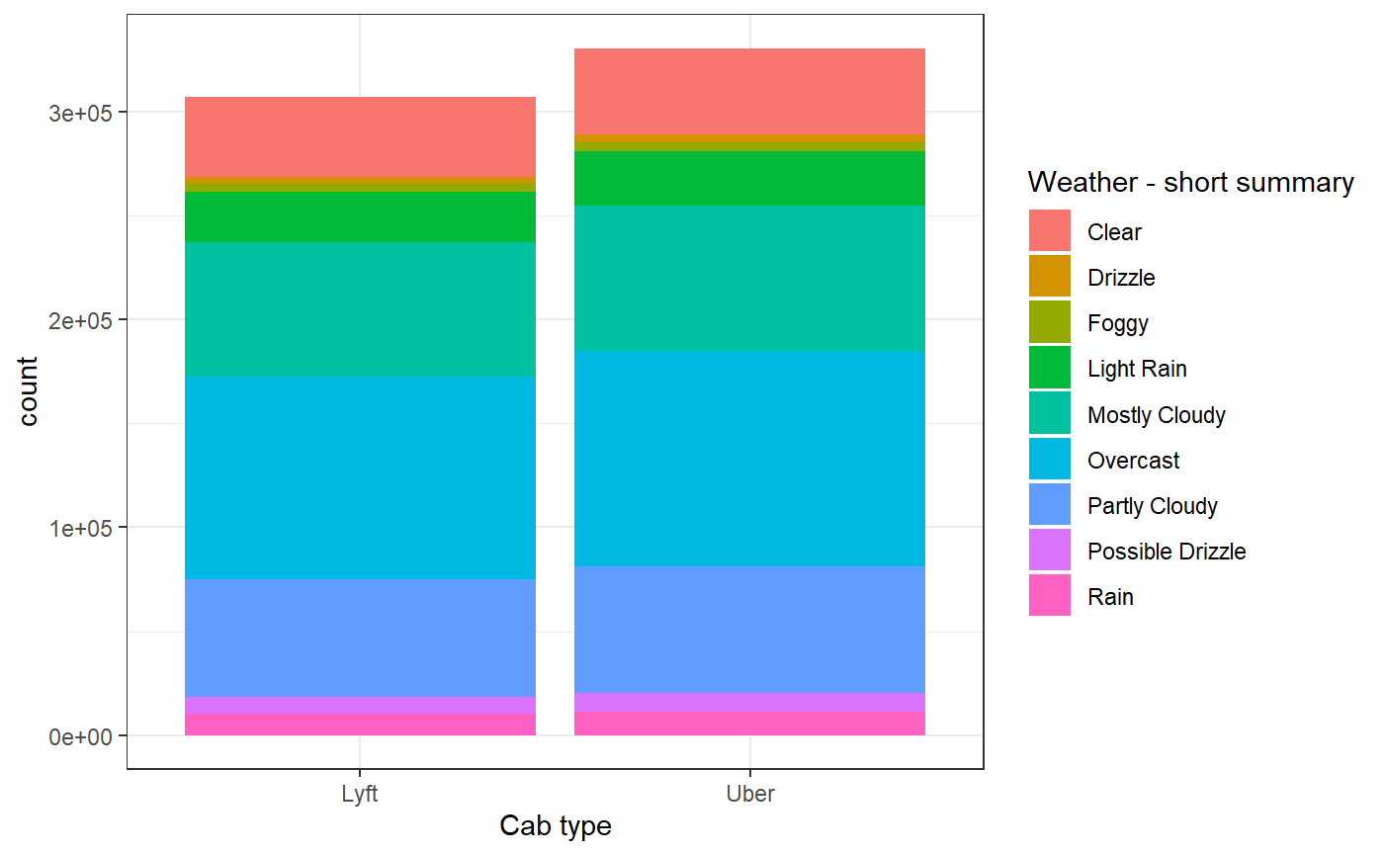
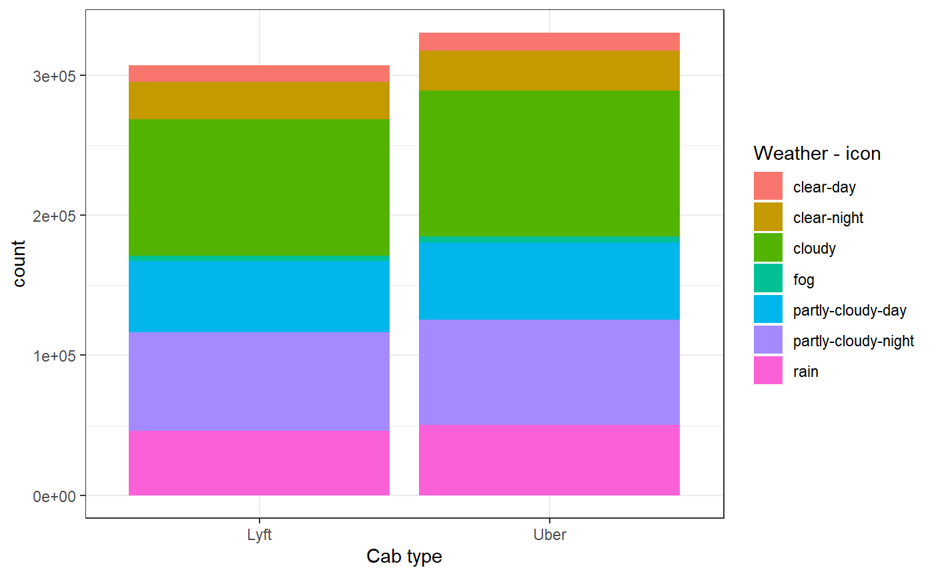
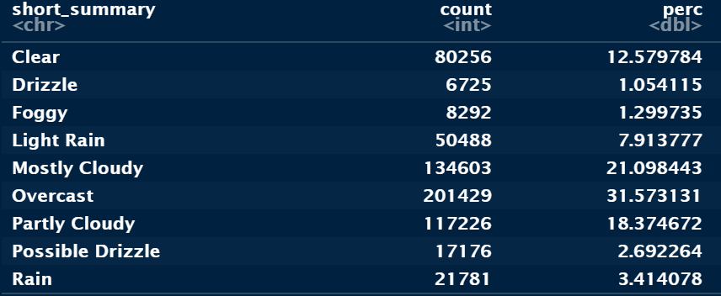
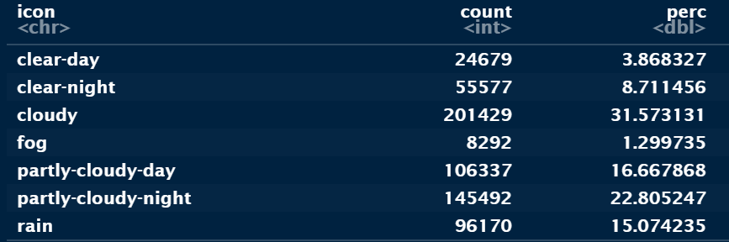
EDA – Weather Features

Slide 14
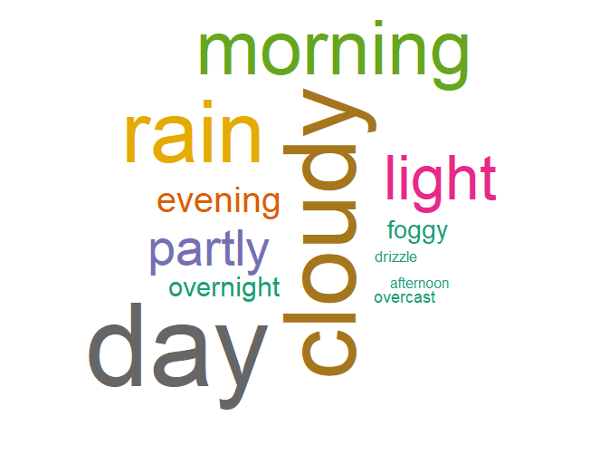


EDA – Weather WordCloud

Slide 15


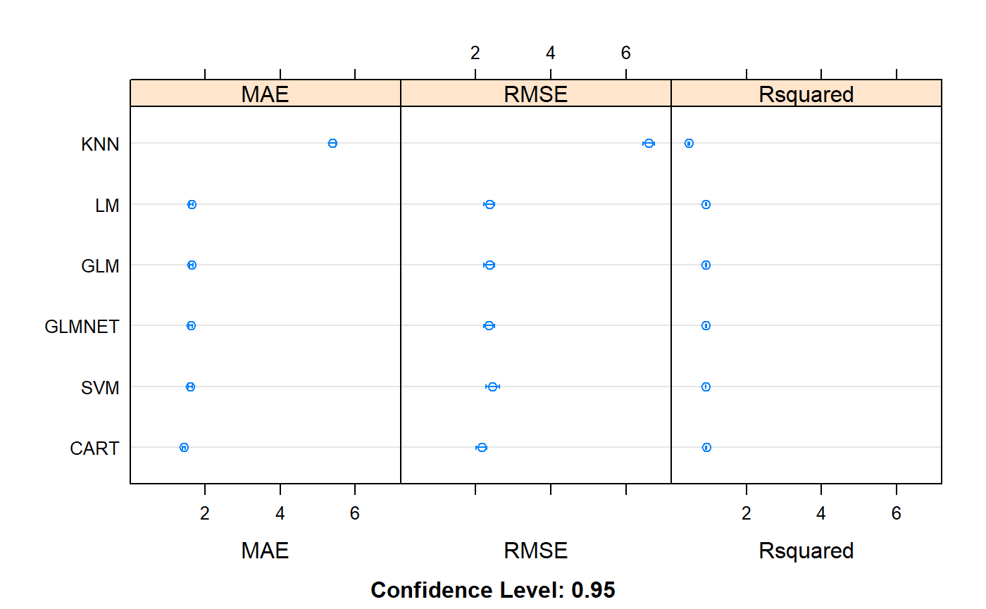
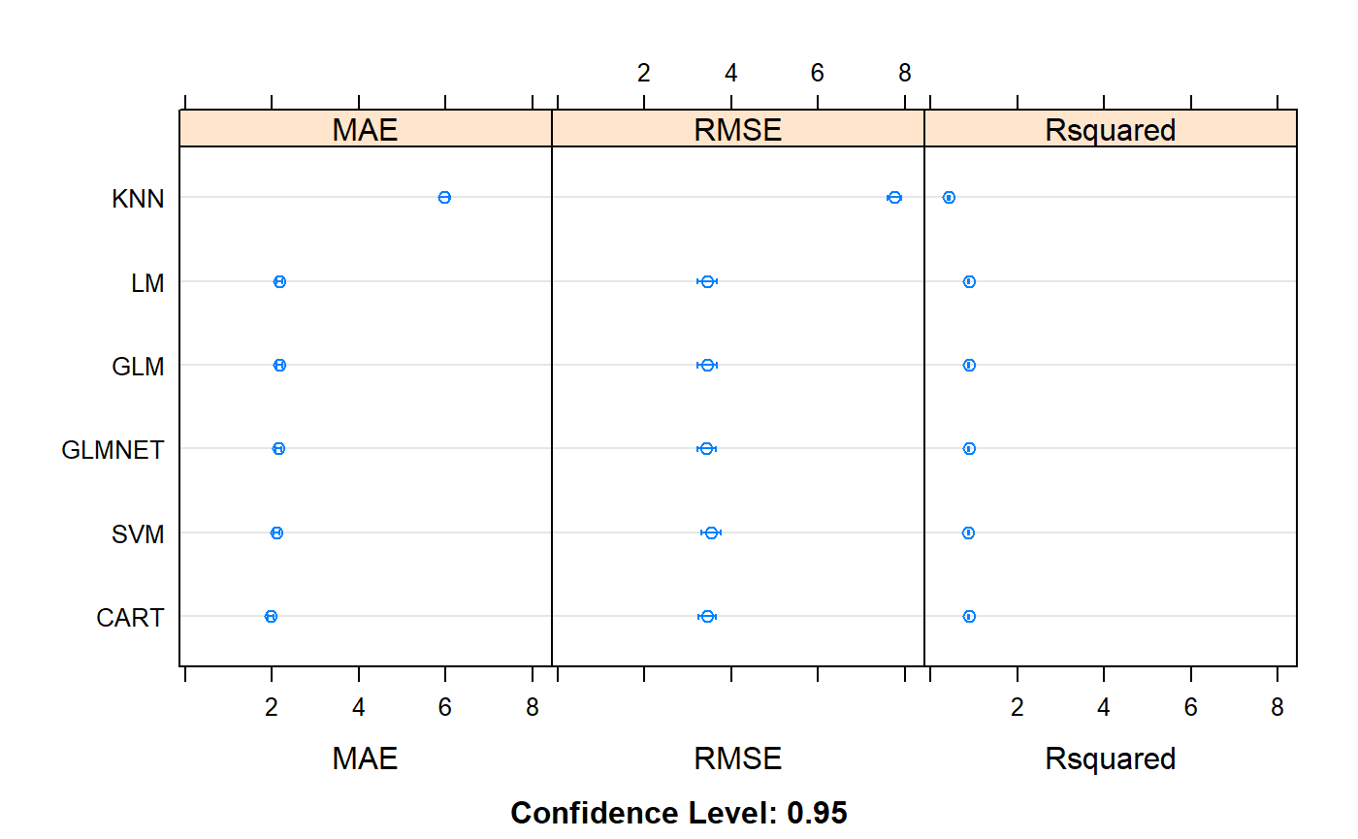


Evaluate Algorithms: Baseline
CART
RMSE 2.394598
Rsquared 0.9248029
CART
RMSE 3.260506
Rsquared 0.8909876

Slide 16
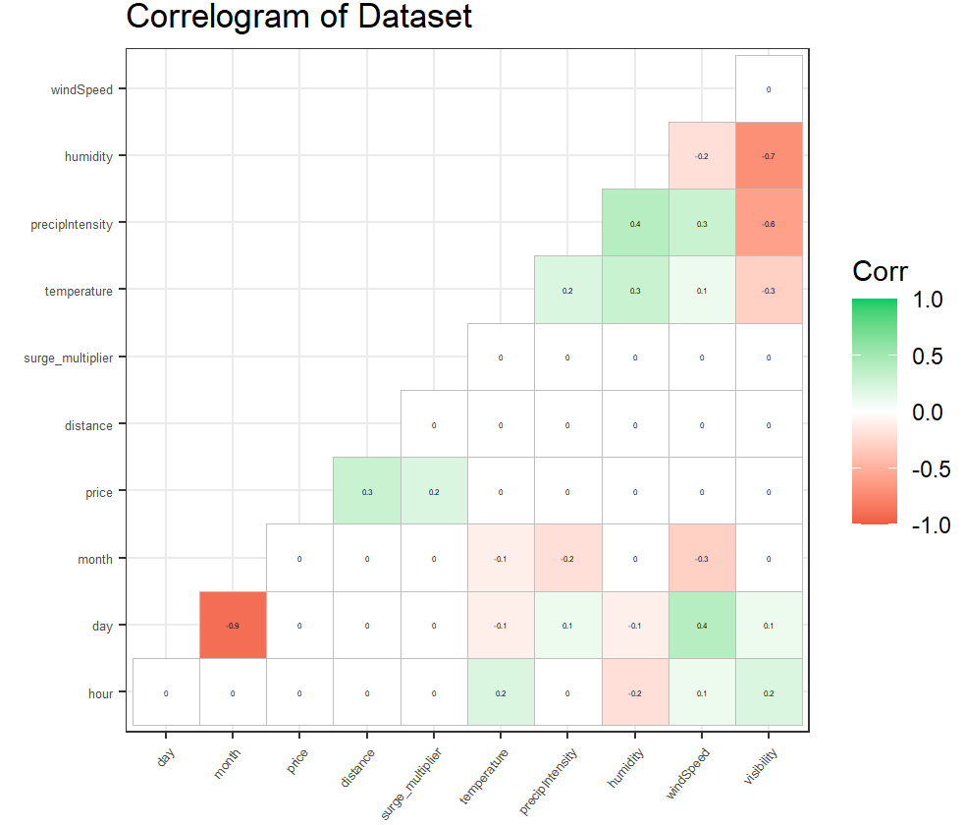

EDA – Correlation Matrix
High correlation:
Humidity & Visibility -0.7,
PrecipIntensity & Visibility -0.6,
Day & Month -0.9
Correlation of the target feature Price with:
Distance 0.3,
Surge Multiplier 0.2.

Slide 17


Evaluate Algorithms: Feature Selection
Three highly correlated predictors removed – Visibility, IconRain, Month .
CART
RMSE 2.385131
Rsquared 0.9251465
CART
RMSE 3.225329
Rsquared 0.8935963

Slide 18
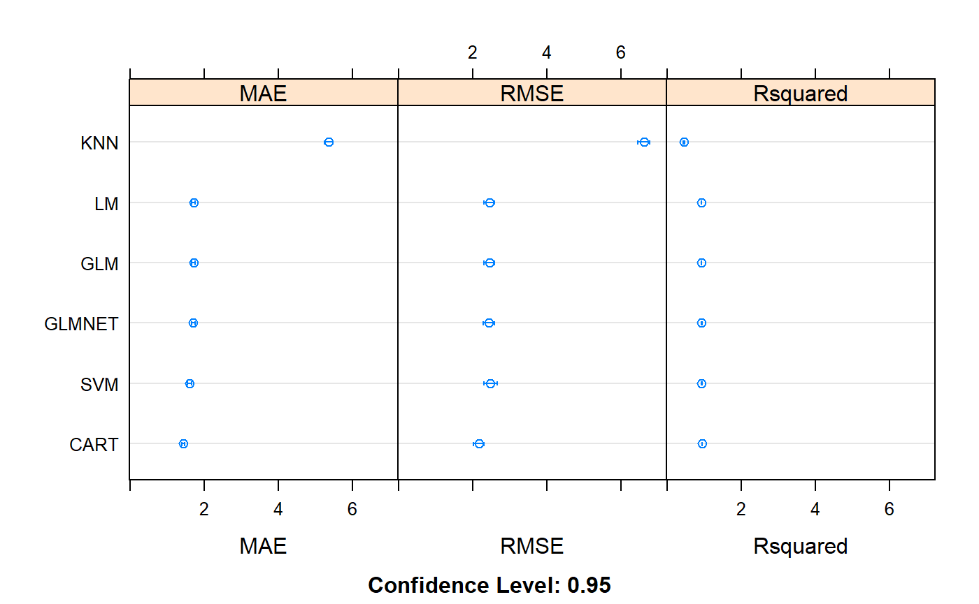


Evaluate Algorithms: Box-Cox Transform
CART
RMSE 2.394537
Rsquared 0.9248064
CART
RMSE 3.259883
Rsquared 0.8910397

Slide 19

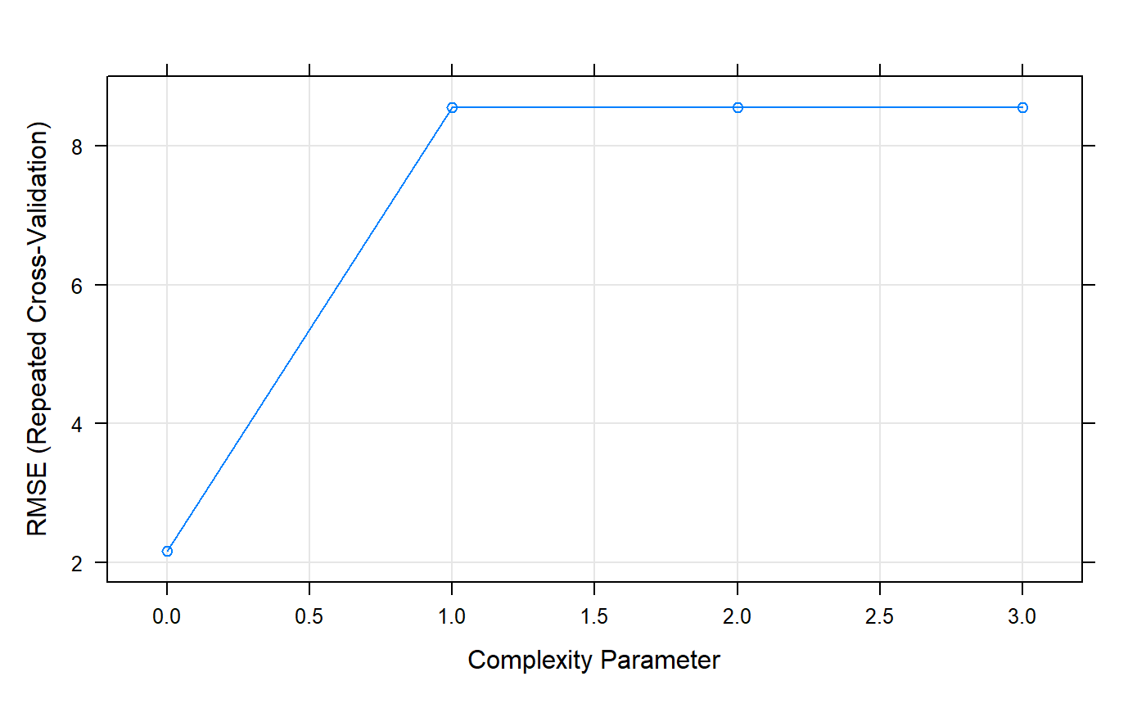
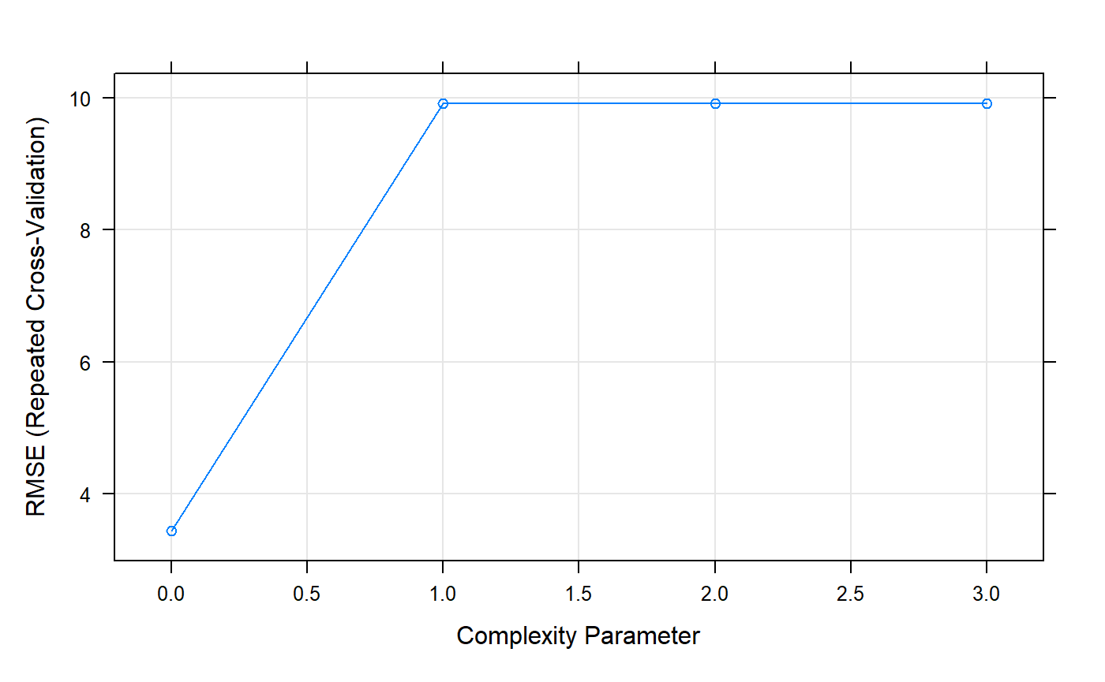
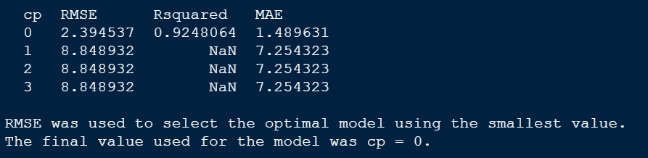
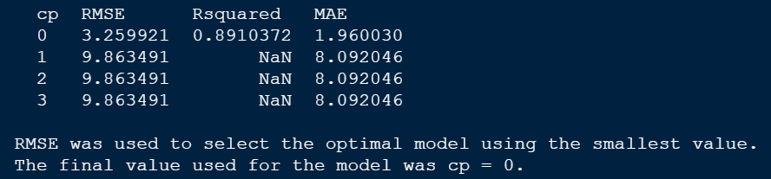
CART - Improve Results With Tuning

Slide 20
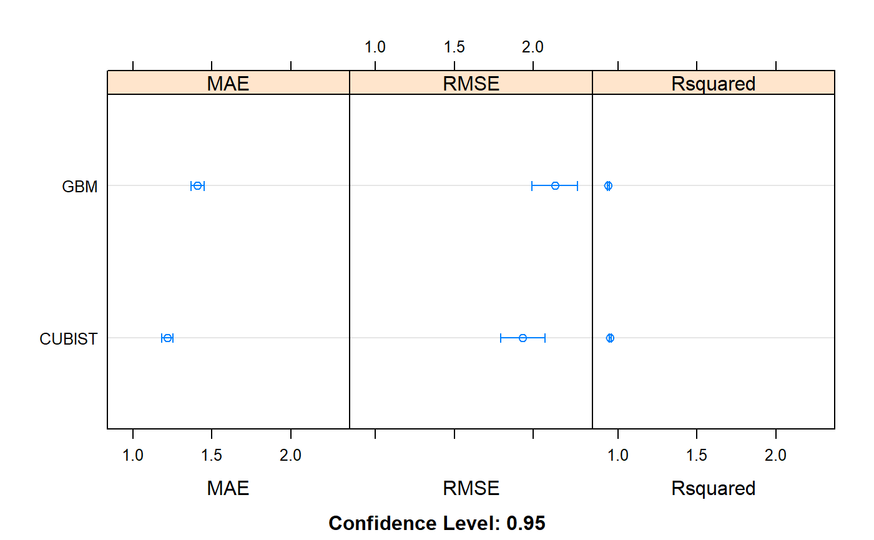
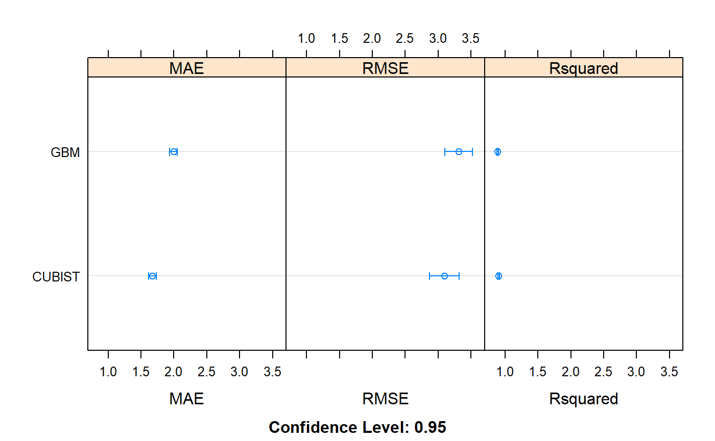

Ensemble Methods & Tuning – GBM, Cubist
Cubist
RMSE 2.153322
Rsquared 0.9385098
Cubist
RMSE 2.952509
Rsquared 0.9128920

Slide 21
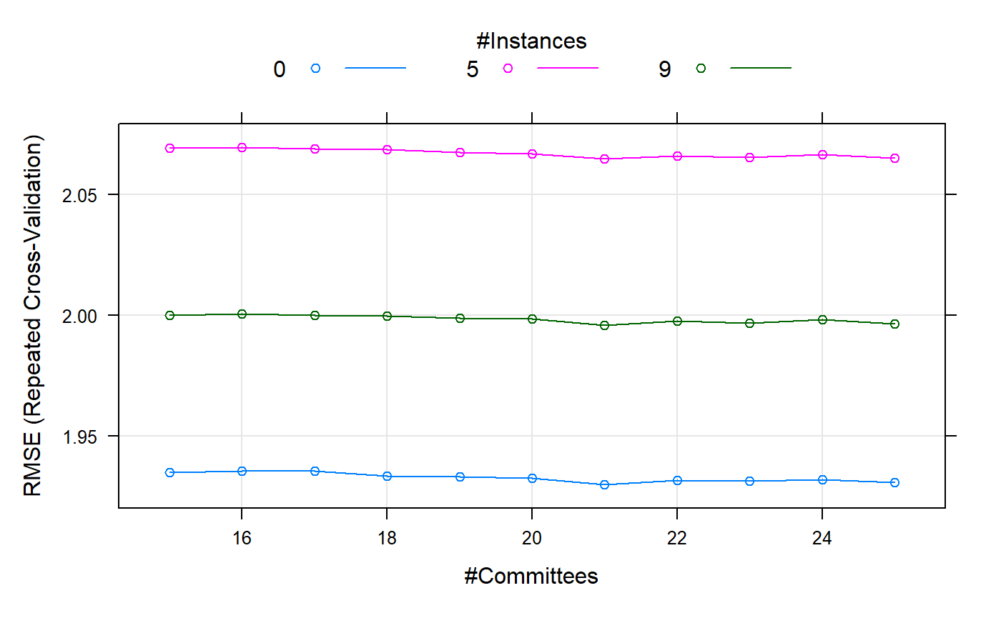
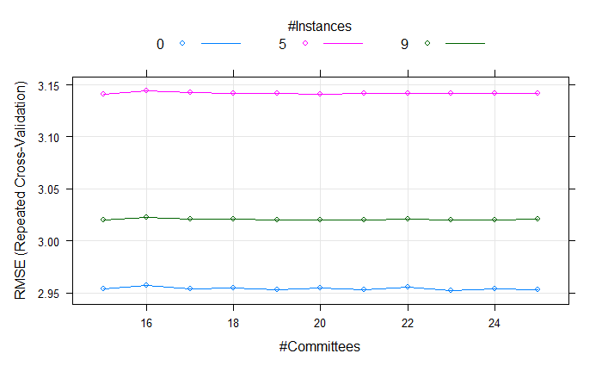
Top Performing Model Cubist
Cubist validation
RMSE 1.879026
Rsquared 0.9519049
Cubist validation
RMSE 3.135741
Rsquared 0.909245

Slide 22
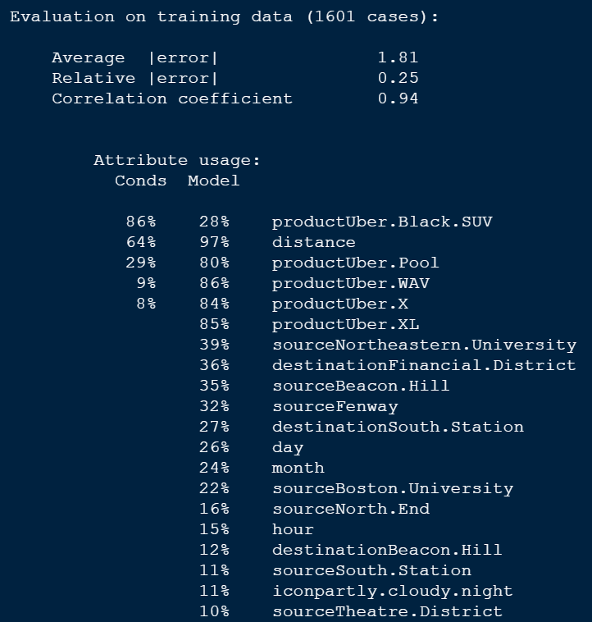
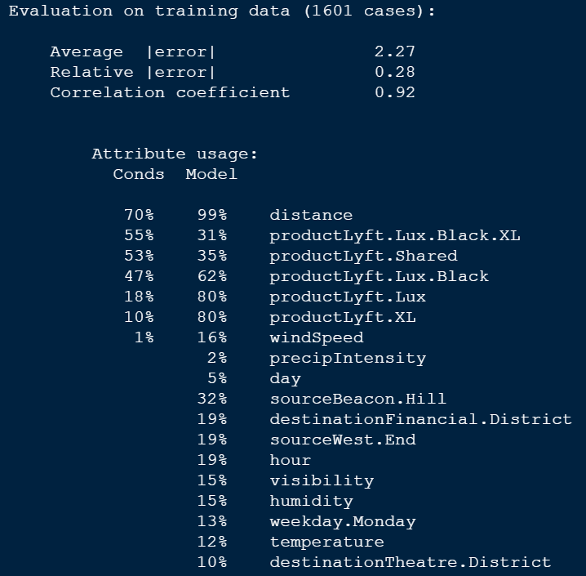
Top Performing Model - Cubist
Notes:
The percentage of times where each variable was used in a condition and/or a linear model. The percentages shown in the Cubist output reflects all the models involved in prediction

Slide 23
Conclusions
Cubist is the best ML model for Uber and Lyft.
UBER:
RMSE (train 2.153322, test 1.879026)
Rsquared (train 0.9385098, test 0.9519049)
LYFT:
RMSE (train 2.952509 , test 3.135741)
Rsquared (train 0.912892 , test 0.909245 )
Cubist for the sample of Uber dataset performed better than for Lyft.
Engineered features didn’t seem to perform in the sample of both dataset as well (weekday)
Cubist model was able to identify some important price features as Distance, Product, Hour, Day, Source, Destination, Cloudy Weather.

Slide 24
Next Steps/ Suggested Actions
01
02
03
04
When considering purchasing Uber service from Uber or Lyft, consider the most important drivers of cab price:
Develop a Shiny app for the EDA part of the project to hold a user-friendly speed.
The model’s refinement to improve accuracy, for example, consider the interactions between the variables and work on model stacking.
Incorporate additional features, for example traffic conditions.
Day and Hour are matter too. Demand for taxi during Holidays and Mondays are higher. The peak Hours are between 6 p.m. and 8 p.m. for the post-work crowd.
Taxi customers pay more for taxi with higher quality of products. Distance is the main driver of the taxi price.
Source and Destination are matter too. The cloudy weather seems an important driver for the taxi price too.
Based on a given dataset the Uber prices are sligtly lower than Lyft for Lux products. But Shared and SUV Products from Lyft are cheaper than similar products from Uber.

Slide 25
Thank you for listening!
A
A
B
Please, any questions?
B

Slide 26
Resources
“Practical Statistics for Data Scientists 50 Essential Concepts”,
by Peter Bruce & Anrew Bruce,
2017, O’REILLY
“Machine Learning Mastery with R”, by Jason Brownlee, 2016
https://towardsdatascience.com/
https://nycdatascience.com/blog/

