Slide 1
ITRI626 / Deep learning for image classification
Recognising materials
in Blender renders
Seven classes. Three model families.
Assessment on unseen source groups.
Group members:
1
Notes:
Introduce the problem as visual appearance classification in a controlled rendering setting. The practical aim is to assist material browsing or organisation. Leave the group-member fields blank until the presenters supply their names. This rehearsal plan is about ten minutes, not a lecturer-assigned duration.
Sources:
ITRI626 practical project brief, sections 2, 10 and 12.2
reports/v3/report.md, Abstract and section 1

Slide 2
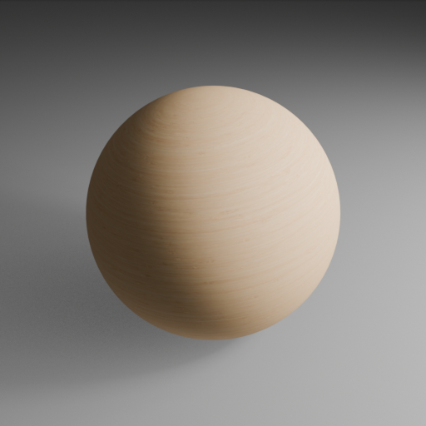
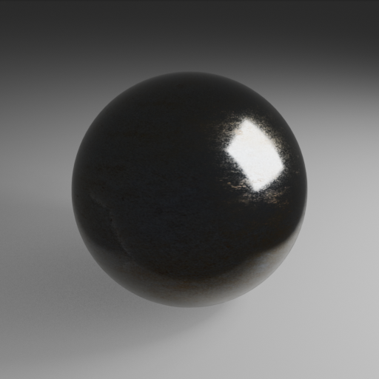
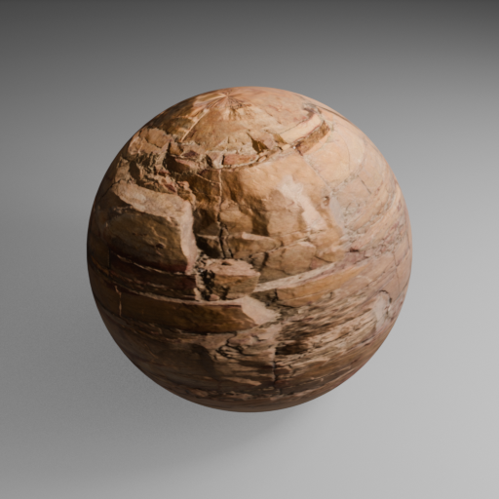
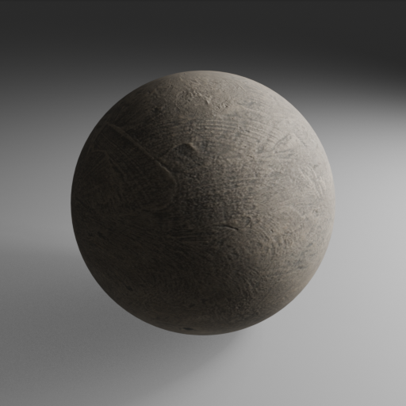
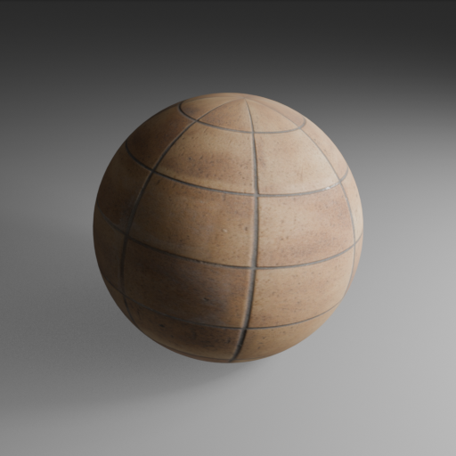
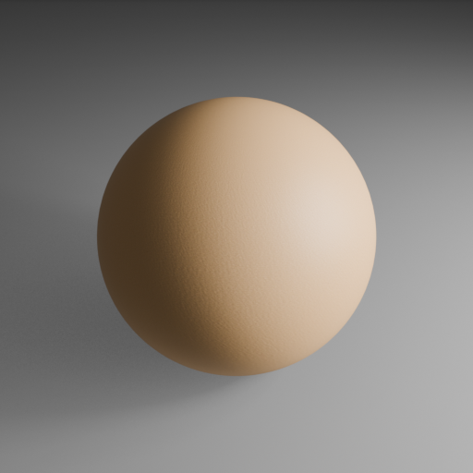
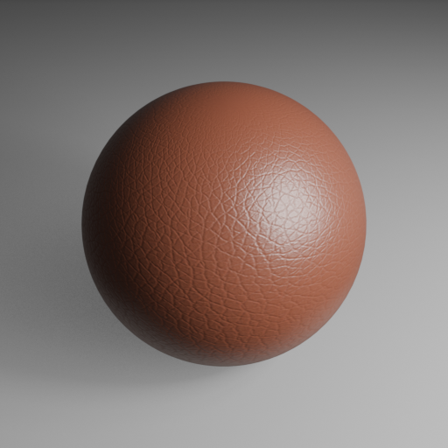
The problem and seven classes
Classify material appearance to support browsing of rendered assets
Wood
Metal
Stone
Concrete
Ceramic
Fabric
Leather
One RGB image, one label
Appearance categories do not establish physical composition.
2
Notes:
An image receives one of seven appearance labels. This could help search a rendered asset library. The categories are wood, metal, stone, concrete, ceramic, fabric and leather. Each picture is an actual held-out render selected by path, without filtering by correctness. The same sphere makes texture and reflectance informative, but this does not identify physical composition. In the development collection, ceramic includes mosaic or terrazzo-like appearances and concrete includes plaster or painted walls.
Sources:
reports/results/v3/report_inputs/gallery_selection.json
reports/v3/report.md, sections 1-2

Slide 3
Dataset provenance and group separation
Population | Images | Material IDs | Source groups
Development | 3,150 | 105 | 101
Fresh test | 630 | 21 | 21
30 views per material. Each class has 450 development + 90 test images.
Poly Haven + ambientCG CC0 texture assets
Scanned and procedural sources rendered in Blender
Known relatives stay together. Unknown physical ancestry remains a caveat.
3
Notes:
The study has 3,780 balanced RGB images at 512 by 512 pixels, with 30 rendered views per material. Development contains 450 images per class and the fresh holdout 90 per class. Source textures come from Poly Haven and ambientCG under CC0. They include scanned and procedural assets, so we do not describe all sources as independent physical scans. Labels follow audited asset identity and appearance. Known generator relatives are merged into groups. Thirty views of a texture remain correlated. No known development-to-holdout family or exact-map reuse remains, but unknown physical ancestry cannot be ruled out. The rendered-dataset release licence is still an owner decision.
Sources:
reports/results/v3/data_audit.json
metadata/v3_holdout/source_identity_audit.json
reports/results/v3/report_inputs/study_counts.csv
https://polyhaven.com/license
https://docs.ambientcg.com/license/

Slide 4
Three model families, four pipelines
Pipeline | Transfer learning | Input
Primary fusion | Frozen DINOv2 + ConvNeXt 3,072 features, logistic head | 224 + 336
ConvNeXt control | Frozen ConvNeXt-Tiny Logistic head | 224
Fixed ResNet-50 | ImageNet weights Adapt layer4 and classifier | 224
Fine-tuned DINOv2 | Pretrained ViT-S/14 + registers Adapt last two blocks and head | 336
Architecture, pretraining, resolution and adaptation budgets differ.
4
Notes:
ConvNeXt is a modern convolutional model, ResNet is a residual convolutional network, and DINOv2 uses a vision transformer. All use pretrained weights. A frozen ConvNeXt control and fixed ResNet baseline provide family comparisons. The primary fuses DINOv2 and ConvNeXt features and fits a scaled, class-balanced logistic classifier. DINO pools CLS, patch mean and patch standard deviation at two resolutions, excluding register tokens from patch pooling. The partially fine-tuned DINO model is exploratory. These are complete pipeline comparisons because pretraining data, resolution and compute budgets differ.
Sources:
reports/results/v3/frozen_initial/protocol.json
configs/v3/finetune.json
reports/results/v3/resnet_baseline/config.json
reports/v3/report.md, section 5
https://arxiv.org/abs/2304.07193
https://arxiv.org/abs/2201.03545
https://arxiv.org/abs/1512.03385

Slide 5
Experimental setup
Development and selection
Transfer and preprocessing
5 outer / 3 inner grouped folds
Frozen features + fold-local scaling
Representation and regularisation search
Seed 20261027
RGB, resize/crop, pretrained normalisation
Training only: crops, flips, mild colour jitter
ResNet: 10 fixed epochs
DINOv2: bounded search, 5 final epochs
Choose on development data. Lock every model. Evaluate once on the same 630 images.
DINOv2 adaptation is exploratory. Test ranking does not choose the primary.
5
Notes:
The frozen selection uses five outer source-group folds and three inner grouped folds, seed 20261027. Inner folds select five representations and C in 0.01, 0.1, 1 and 10 by Macro F1. The scaler and classifier are fitted inside each training partition. All original images are development data because the historical test had already been consulted. The neural comparison uses the same development pool and the same final holdout. DINO searches two learning rates in a bounded three-fold exploratory follow-up. Preprocessing converts to RGB, uses model-specific resize and centre crop and pretrained normalisation. Neural training alone adds small random crops, horizontal flips and mild colour jitter. ResNet uses AdamW with a cosine schedule for ten fixed epochs. DINO uses AdamW and development early stopping, then a fixed five-epoch final fit. Both have effective batch size 32, label-smoothed cross entropy and weight decay 0.01. Development Macro F1 selected the frozen primary before any fresh scores. Four fixed models then received one clean evaluation each.
Sources:
reports/results/v3/frozen_initial/protocol.json
configs/v3/finetune.json
reports/results/v3/resnet_baseline/config.json
reports/results/v3/model_choice.json
reports/results/v3/final_model_lock.json

Slide 6
Actual learning curves
DINOv2, selected learning rate 1e-5. Solid: training. Dashed: development validation.
Training fit improves faster than validation. Fresh test data never set epochs.
6
Notes:
These are the complete recorded histories for all three development folds at the selected DINO backbone learning rate of 1e-5. Solid curves show training and dashed curves development validation. No curve is a fresh-test result. The training fit becomes strong while validation varies by source fold. Validation chooses the learning rate and epoch count, so it is optimistic for that selection. The six-fit search also includes 3e-6, whose mean best development Macro F1 was 0.76250 versus 0.77248 at 1e-5. Best epochs 6, 5 and 3 imply five final epochs. ResNet has actual training-only logs for its fixed schedule and no epoch-wise validation curve. The frozen logistic head has regularisation-search diagnostics, not neural learning epochs.
Sources:
reports/results/v3/finetune_development/lr_1e-05_fold_0/progress.json
reports/results/v3/finetune_development/lr_1e-05_fold_1/progress.json
reports/results/v3/finetune_development/lr_1e-05_fold_2/progress.json
reports/results/v3/finetune_development/selection.json
reports/results/v3/resnet_baseline/final_history.csv

Slide 7
Clean test results on unseen sources
Pipeline | Accuracy | Macro P | Macro R | Macro F1
Primary frozen fusion | 80.16% | 0.812 | 0.802 | 0.7952
ConvNeXt control | 75.56% | 0.793 | 0.756 | 0.7566
Fixed ResNet-50 | 77.62% | 0.789 | 0.776 | 0.7665
Fine-tuned DINOv2 | 86.83% | 0.897 | 0.868 | 0.8631
Primary: 80.16% accuracy, 95% CI 66.03-93.65%
The 80% point target is met. The lower confidence bound is below 80%.
Exploratory DINOv2 advantage: +6.67 pp, paired 95% CI -2.06 to +16.19 pp.
Higher observed accuracy does not establish superiority.
7
Notes:
The primary achieves 505 correct images out of 630, or 80.16%, with Macro F1 0.7952. Its 95% source-group bootstrap interval is 66.03 to 93.65%. The point target of 80% is met but the lower bound is below 80%. Fine-tuned DINOv2 records 86.83% and Macro F1 0.8631. It stays an exploratory comparison. Its paired accuracy advantage over the primary is 6.67 percentage points with interval minus 2.06 to plus 16.19, which includes zero. Thus the ranking does not establish superiority. The control interval is 61.59 to 88.73%, ResNet 63.65 to 90.48%, and DINOv2 76.98 to 95.87%. Intervals use 10,000 class-stratified cluster draws over 21 sources, conditional on these saved predictions.
Sources:
reports/results/v3/fresh/frozen_selected/evaluation.json
reports/results/v3/fresh/frozen_control/evaluation.json
reports/results/v3/fresh/resnet_fixed/evaluation.json
reports/results/v3/fresh/dinov2_finetuned/evaluation.json
reports/results/v3/report_inputs/paired_fresh.csv

Slide 8
Primary errors and per-class performance
Confusion counts (90 per true class)
Precision, recall and F1
True / pred. | Wd | Mt | St | Co | Ce | Fa | Le
Wood | 90 | 0 | 0 | 0 | 0 | 0 | 0
Metal | 0 | 90 | 0 | 0 | 0 | 0 | 0
Stone | 12 | 0 | 60 | 0 | 0 | 0 | 18
Concrete | 18 | 6 | 2 | 61 | 0 | 0 | 3
Ceramic | 0 | 8 | 30 | 0 | 52 | 0 | 0
Fabric | 0 | 0 | 0 | 0 | 0 | 90 | 0
Leather | 0 | 0 | 0 | 22 | 0 | 6 | 62
Class | P | R | F1
Wood | 0.750 | 1.000 | 0.857
Metal | 0.865 | 1.000 | 0.928
Stone | 0.652 | 0.667 | 0.659
Concrete | 0.735 | 0.678 | 0.705
Ceramic | 1.000 | 0.578 | 0.732
Fabric | 0.938 | 1.000 | 0.968
Leather | 0.747 | 0.689 | 0.717
Wd wood Mt metal St stone Co concrete Ce ceramic Fa fabric Le leather
Ceramic to stone: 30 errors. Leather to concrete: 22 errors.
8
Notes:
Read the matrix by rows: true class first, prediction second. Every row has 90 images. Ceramic is often called stone, with 30 of its 90 images following that error. Leather is called concrete in 22 cases. Wood, metal and fabric reach perfect recall on the three sampled sources per class, which is not a population guarantee. Ceramic precision is 1.000 but recall is only 0.578, illustrating that missing many examples can coexist with few false positive labels. All values are saved point metrics, not newly scored results.
Sources:
reports/results/v3/fresh/frozen_selected/image_confusion_matrix.csv
reports/results/v3/fresh/frozen_selected/image_per_class.csv

Slide 9
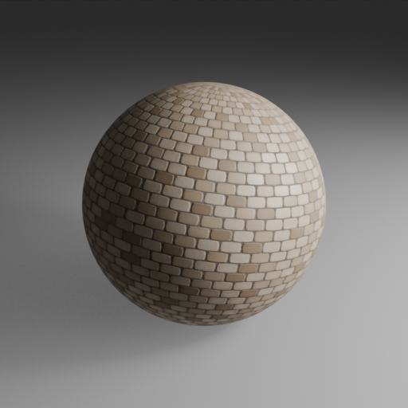
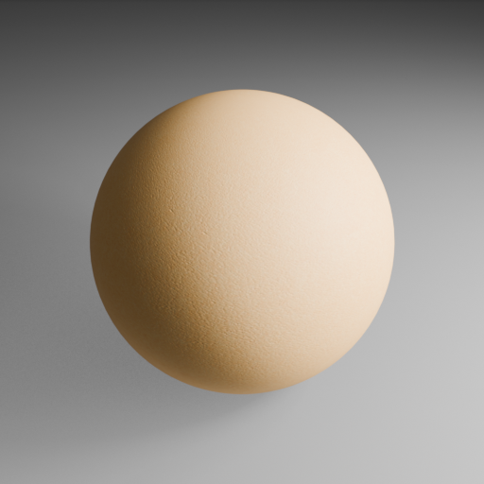
Correct and incorrect predictions
True: wood
True: metal
True: ceramic
True: leather
Predicted: wood
Predicted: metal
Predicted: stone
Predicted: concrete
Score: 99.5%
Score: 96.7%
Score: 96.9%
Score: 89.9%
A high predicted probability can accompany an incorrect label.
9
Notes:
These four examples use the saved primary predictions. The correct wood and metal examples are from the unfiltered class gallery. The ceramic and leather failures come from the report error gallery. They are selected illustrations rather than a representative performance estimate. Point to visual ambiguity in texture and reflectance as a plausible explanation, not a causal attribution. Model probabilities can be high for wrong answers and are not calibrated certainty. Show the predicted class and confidence for each.
Sources:
reports/results/v3/report_inputs/gallery_selection.json
reports/results/v3/fresh/frozen_selected/predictions.csv

Slide 10
JPEG compression exposes a weakness
Primary: 80.16% clean to 59.05% at JPEG quality 30
DINOv2 corruption results are a post hoc exploratory comparison.
10
Notes:
These saved corruption results use the same 630 images and five deterministic transforms. The primary drops from 80.16% clean accuracy to 59.05% at JPEG quality 30, a 21.11 percentage point loss. DINOv2 falls from 86.83% to 75.40%. Primary corruption tests were predeclared, whereas the DINOv2 corruption comparison was applied after observing clean and primary-corruption scores and is explicitly post hoc. Compression is the largest degradation here, but these tests do not substitute for new scenes or real-camera data.
Sources:
reports/results/v3/robustness/primary/comparison.csv
reports/results/v3/robustness/dinov2_exploratory/comparison.csv
reports/results/v3/exploratory_robustness_amendment.json

Slide 11
Efficiency and model recommendation
Pipeline | Warm median | Storage
Primary frozen fusion | 42.88 ms | 203.6 MB
ConvNeXt control | 14.20 ms | 115.3 MB
Fixed ResNet-50 | 9.46 ms | 95.3 MB
Fine-tuned DINOv2 | 13.86 ms | 88.0 MB
Provisionally recommend fine-tuned DINOv2 for classroom use
with comparable renders; retain fusion as the predeclared study primary;
independently confirm before broader deployment.
RTX 4070 Laptop GPU. Warm batch 1, predecoded RGB.
Includes preprocessing and probabilities, excludes disk I/O and decoding.
11
Notes:
On the recorded RTX 4070 Laptop GPU, ResNet has the lowest warm batch-one median latency. The primary is slower because it uses multiple backbone passes. Required storage includes the backbones, not just the small classifier head. Timing starts from predecoded RGB and includes preprocessing and probabilities, but excludes disk reading and decoding. These are CUDA measurements, not classroom CPU measurements. Provisionally recommend fine-tuned DINOv2 for classroom use with comparable renders; retain fusion as the predeclared study primary; independently confirm before broader deployment. DINOv2 has higher observed accuracy and lower measured latency than the primary, but the paired uncertainty does not establish superiority. Choose ResNet only if the speed trade-off is acceptable.
Sources:
reports/results/v3/benchmarks/frozen_selected/benchmark.json
reports/results/v3/benchmarks/frozen_control/benchmark.json
reports/results/v3/benchmarks/resnet_fixed/benchmark.json
reports/results/v3/benchmarks/dinov2_finetuned/benchmark.json

Slide 12
Limitations and next experiment
Few independent sources
Restricted domain
Three test groups per class
Related views share texture evidence
Unknown ancestry can remain
Scanned and procedural assets
Controlled Blender scenes
No real-photograph validation
Next: a fixed evaluation plan with more independent sources,
new scenes and photographs, and compression coverage.
Model comparisons do not isolate architecture or equal-compute effects.
12
Notes:
Only 21 new groups, three per class, give wide uncertainty despite 630 images. Asset provenance is audited but some common physical ancestry and backbone pretraining overlap may remain unknown. Sources combine scanned and procedural textures, and restricted class definitions and renderer differences affect transfer. No genuine photograph test has been performed. Pipeline comparison also combines architecture, resolution, pretraining and compute changes. The next experiment should be frozen before data collection, add more independent sources in ceramic, concrete, stone and leather, vary scene and camera, include real photographs, and test compression systematically. Reusing this now-scored holdout for tuning would require another fresh assessment.
Sources:
reports/v3/report.md, sections 3, 5 and 16
reports/results/v3/provenance_verification.json

Slide 13
Material Studio demo and conclusion
Classify
Study
Samples
Open image / Samples
Model menu, Classify
Class and confidence
Details: probabilities
Stored model comparison
Confusion matrices
Class-level errors
Browse the gallery
Inspect source variety
Explain group separation
The primary meets the clean point target.
Wide uncertainty and JPEG weakness limit the claim.
Offline fallback: show stored results, clearly labelled as stored.
13
Notes:
Use the separate classroom guide. Navigation is Classify, Study, Samples and About. Classify shows one image with a compact bottom toolbar: Open image, Samples, the model menu and Classify. Choose an image or sample and model, start classification, and let the loading state complete. Explain the concise class and confidence result, then open Details for the full probability distribution. Only call this a live prediction after the actual runtime has completed inference for that input. In Study, compare stored model metrics and confusions, then browse the class gallery in Samples. About is available in navigation. The redesigned minimal app has not yet been visually verified here. If runtime inference is unavailable, explicitly announce the offline fallback and use stored results or slide 9 examples. Conclude that source-aware evaluation supports the primary point target, but uncertainty and compression weakness limit broad claims.
Sources:
docs/CLASSROOM_DEMO.md
reports/results/v3/fresh/frozen_selected/evaluation.json

Slide 14
Sources
Oquab et al. (2024), DINOv2
arxiv.org/abs/2304.07193
Darcet et al. (2024), Vision Transformers Need Registers
arxiv.org/abs/2309.16588
Liu et al. (2022), A ConvNet for the 2020s
arxiv.org/abs/2201.03545
He et al. (2016), Deep Residual Learning
arxiv.org/abs/1512.03385
Cawley & Talbot (2010), Model selection bias
jmlr.org/papers/v11/cawley10a.html
Poly Haven and ambientCG, CC0 asset licences
polyhaven.com/license docs.ambientcg.com/license/
Study evidence: saved evaluations, predictions, training histories and source audits.
Exact local sources are cited in slide notes and the speaking guide.
14
Notes:
Experimental claims come from the saved evaluations, prediction tables, training histories and audit records cited in each slide note. These papers explain the model families and evaluation principles. Provider pages establish the source-texture licence, not a licence decision for the rendered collection. All presenters should be able to discuss the full study. Invite questions.
Sources:
ITRI626 practical project brief, sections 10 and 12.2
reports/v3/report.md, References

