Slide 1
Typograpy and transition
BY:
John Mark Español
Dian Caño

Slide 2

Introduction to Typography
Typography controls the visual style and layout of text in CSS. Includes various properties for setting fonts, sizes, alignment, spacing, and more.

Slide 3

Key Font Properties
font-style: Controls font style (italic, oblique).
font-variant: Displays text in normal or small-caps.
font-weight: Adjusts text boldness (e.g., bold, numeric from 100 to 900).
font-size: Sets the size of the text.
line-height: Adjusts the space between lines.
font-family: Specifies the typeface (e.g., Arial, sans-serif).
font-stretch: Adjusts the width of the font (e.g., normal, condensed, expanded).

Slide 4
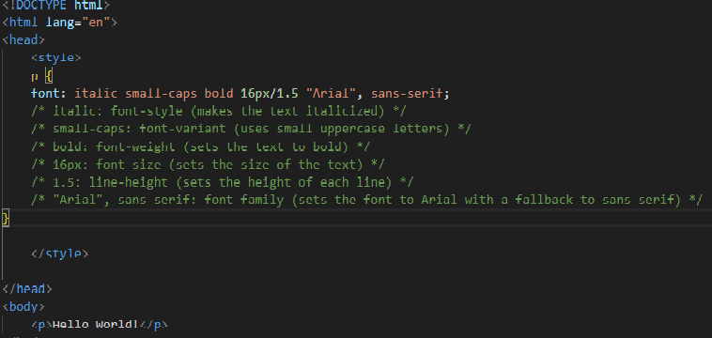

Font Shorthand
Combines multiple font properties into one declaration.
Syntax: element { font: [font-style] [font-variant] [font-weight] [font-size/line-height] [font-family]; }
EXAMPLE:

Slide 5

Font Size
Absolute Units:
px (pixels): Fixed size, which does not scale with user settings.
pt (points): Primarily used in print, with 1 point equal to 1/72 of an inch.
Inches (in): Represents physical inches
Relative Units:
em: Relative to the font size of the element's parent. If the parent has a font size of 16px, 1em equals 16px.
rem (root em): Relative to the font size of the root element (<html>). If the root font size is 16px, 1rem equals 16px regardless of the parent.
%: Percentage of the parent element's font size. 100% means the same size as the parent.

Slide 6
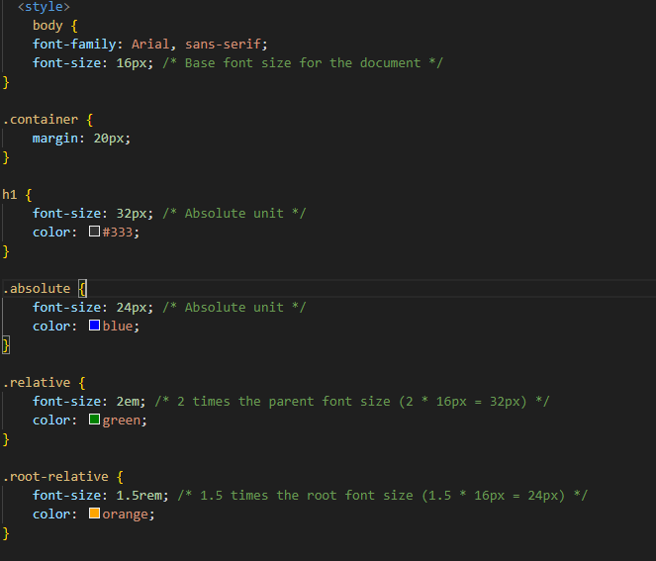
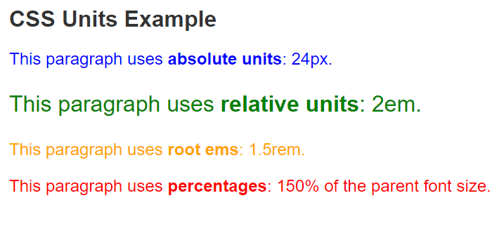
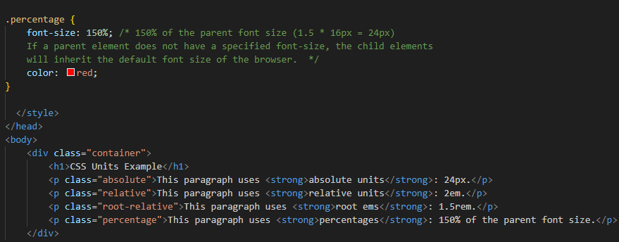
Example:

Slide 7
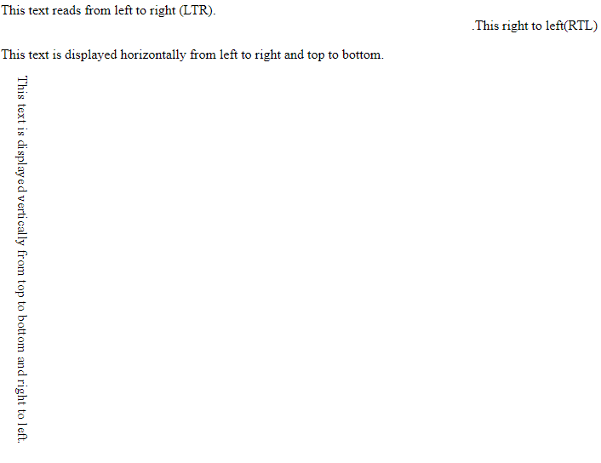
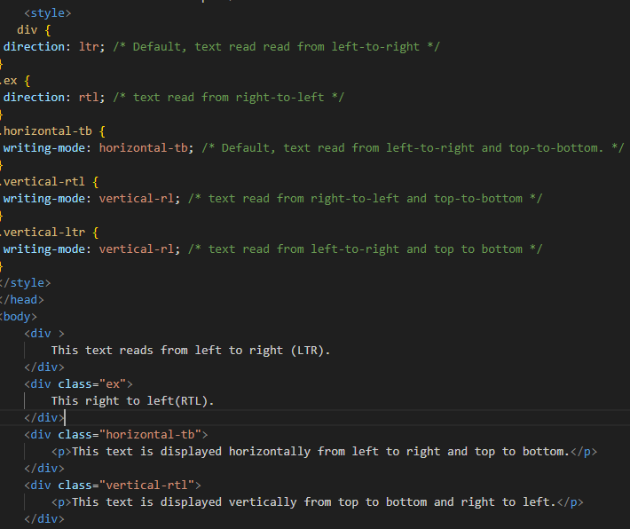
Text Direction
The direction property is used to change the horizontal text direction of an element.
EXAMPLE:

Slide 8
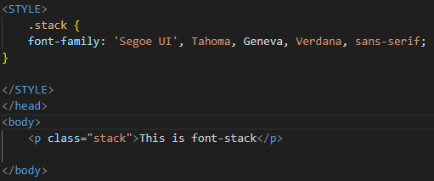
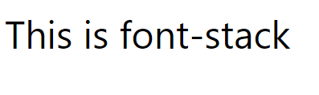
FONT STaCK
EXAMPLE:
A font stack is a list of font families defined in CSS that specifies which fonts should be used for rendering text, in order of preference. If the first font is unavailable, the browser will try the next one in the stack until it finds an available font.

Slide 9
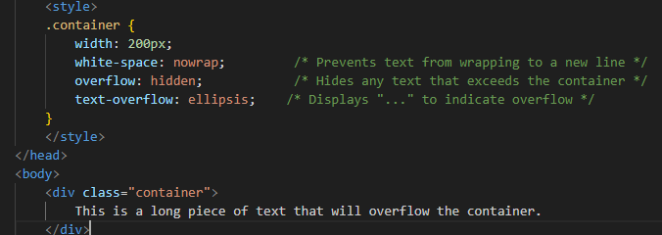
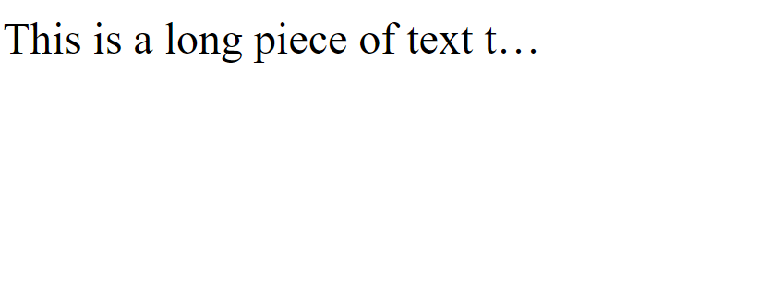
Text Overflow
Example:
Text overflow is a CSS property that controls how overflowed content that exceeds the bounds of a container is displayed, allowing you to specify how to indicate that text has been cut off or is hidden.

Slide 10

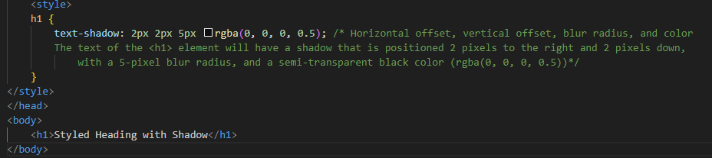
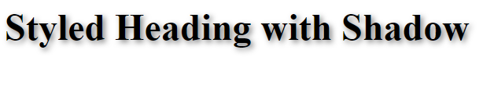
Text Shadow
Text shadow is a CSS property that adds a shadow effect to text, allowing you to specify the shadow's horizontal and vertical offsets, blur radius, and color, enhancing the visual appeal of the text.
Example:

Slide 11
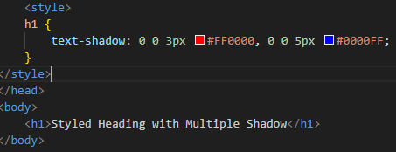
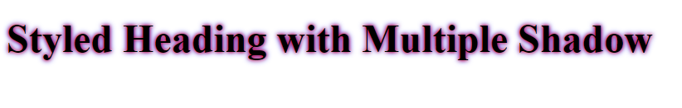
Multiple shadow
Multiple shadows in CSS allow you to apply more than one shadow effect to a text element, creating a more complex and visually interesting appearance. Each shadow is specified in a comma-separated list, allowing for different offsets, blur radii, and colors.
EXAMPLE:

Slide 12
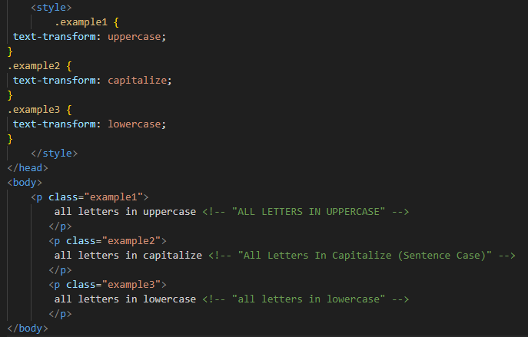
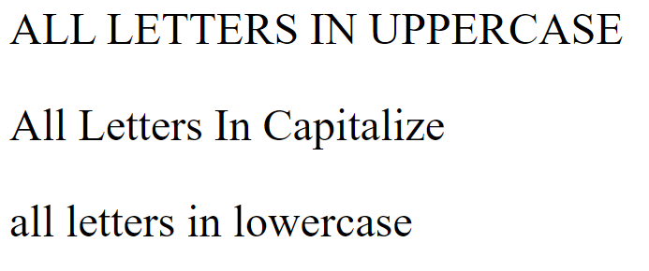
Text transform
The text-transform property allows you to change the capitalization of text. Valid values are: uppercase, capitalize, lowercase, initial, inherit, and none
EXAMPLE:

Slide 13
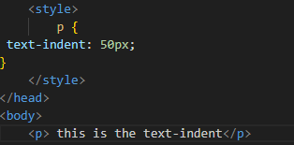
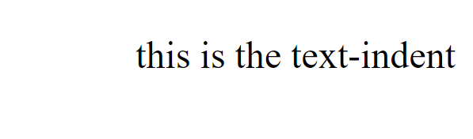
Text Indent
The text-indent property specifies how much horizontal space text should be moved before the beginning of the first line of the text content of an element.
EXAMPLE:

Slide 14
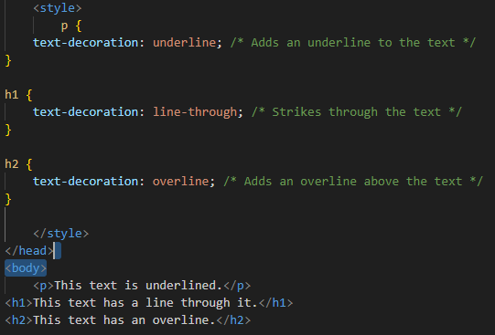
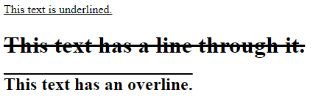
Text Decoration
Text decoration is a CSS property that allows you to add or remove decorations to text, such as underlines, overlines, and line-throughs, enabling you to enhance text visibility or convey meaning.

Slide 15
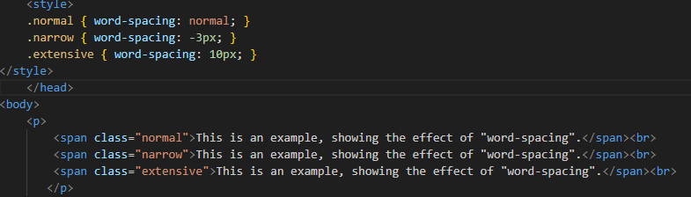
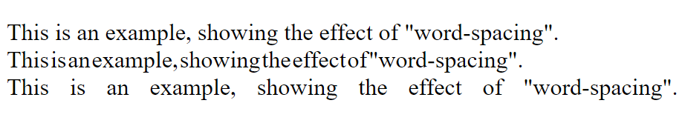
Word Spacing
The word-spacing property specifies the spacing behavior between tags and words
EXAMPLE:

Slide 16
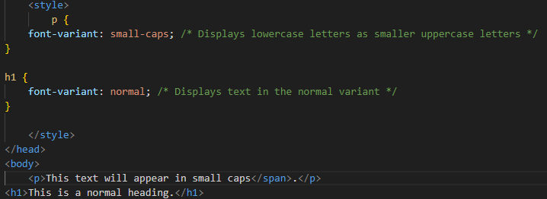
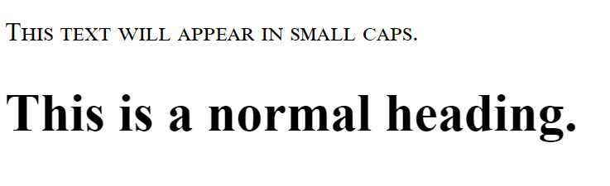
Font Variant
Font variant is a CSS property that allows you to control the stylistic variations of a font.
EXAMPLE:

Slide 17
INTRODUCTION TO TRASITION
CSS transitions enable smooth animations between different states of an element by gradually changing property values over a specified duration. This enhances user interaction and improves the overall experience on a webpage.

Slide 18
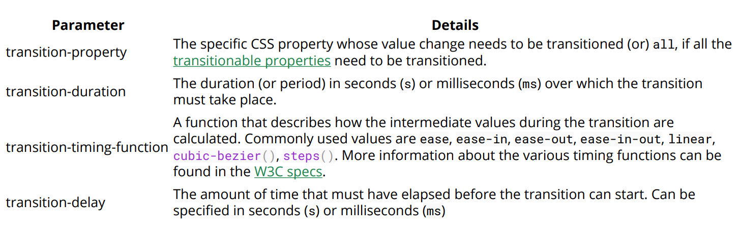
TRANSITIONS

Slide 19
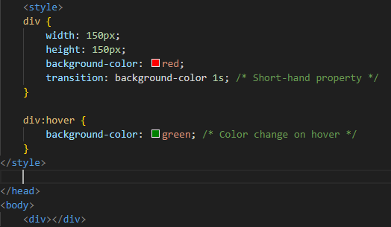


Transition shorthand
CURSOR OUTSIDE THE BOX
CURSOR HOVER IN THE BOX

Slide 20
cubic-bezier
Cubic-bezier is a CSS function used to define custom timing functions for transitions and animations, allowing developers to create smooth and complex movement effects by specifying control points on a two-dimensional graph.

Slide 21
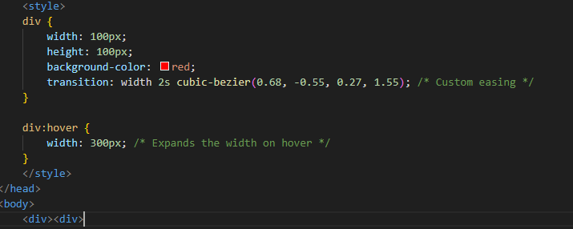
EXAMPLE:
Cursor hovering out side the box
Cusor hovering inside the box

Slide 22
Transition longhand
Transition longhand refers to the individual CSS properties that can be set to define transitions in a more explicit and detailed manner compared to the shorthand notation.
LONGHAND PROPERTIES:
1. transition-property: Specifies the CSS properties the transition effect is for.
In this case, the div will expand both horizontally and vertically when hovered.
2. transition-duration: Specifies the length of timea transition takes to complete. In the below example, the height and width transitions will take 1 second and 500 milliseconds respectively.
3. transition-timing-function: Specifies the speed curve of the transition effect. A linear value indicates the transition will have the same speed from start to finish.
4. transition-delay: Specifies the amount of time needed to wait before the transition effect starts. In this case, the height will start transitioning immediately, whereas the width will wait 1 second.

Slide 23
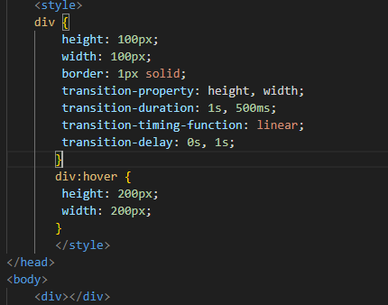
Transition longhand
EXAMPLE:
.

Slide 24
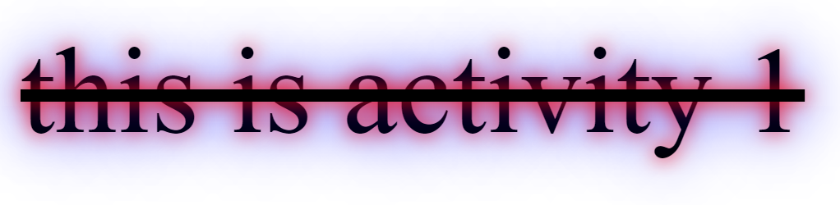
activity
font size 30px
Text shadow is 0px 0 px 15 red, 0px 0 px 15 blue
It is line through

Slide 25
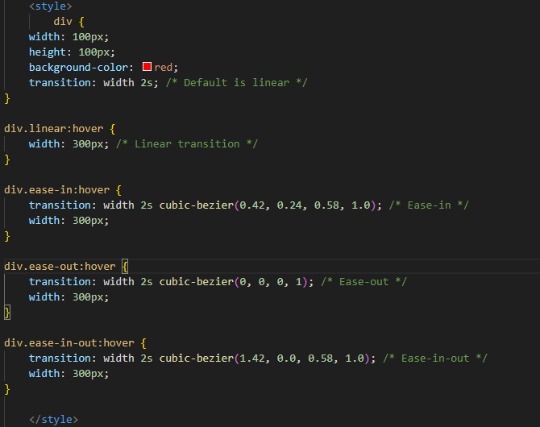

activity

