Slide 1
Mouth Travelers
Get Recipes from the world!

Slide 2
Why Another Recipe Website?
Because knowledge of a foreign cuisine is often limited to famous dishes
Because the cuisine reflects a part of the culture and history of a country
Because recipe websites can be overwhelming with their quantity of recipes
Because I love cooking
Because I love traveling
Because I want to share my knowledge and experience

Slide 3
The Idea
Recipes will be based on my own experience
A focus on the area and how to eat the dish
Target user is someone who wants to travel through food

Slide 4
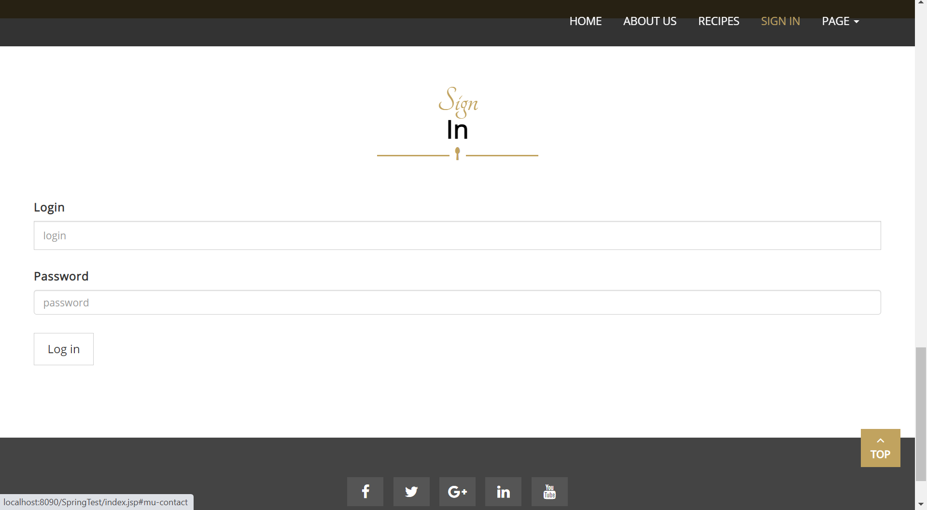
Functionalities

Slide 5
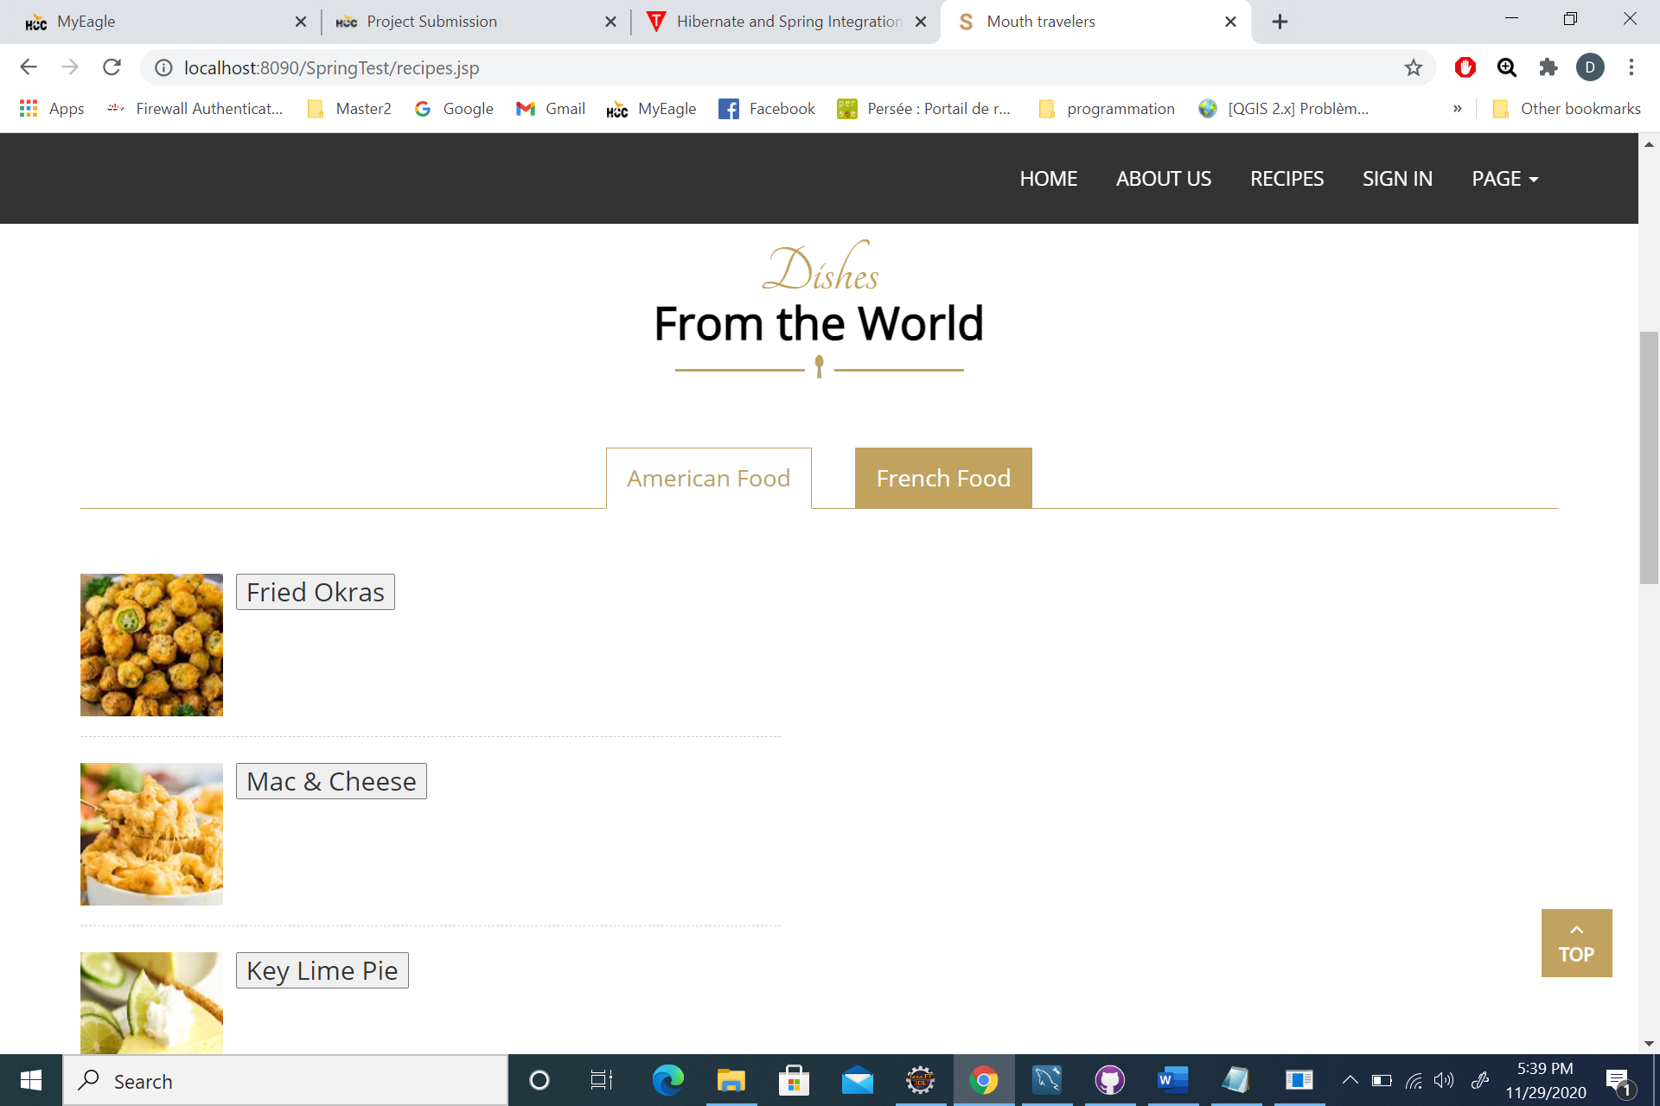
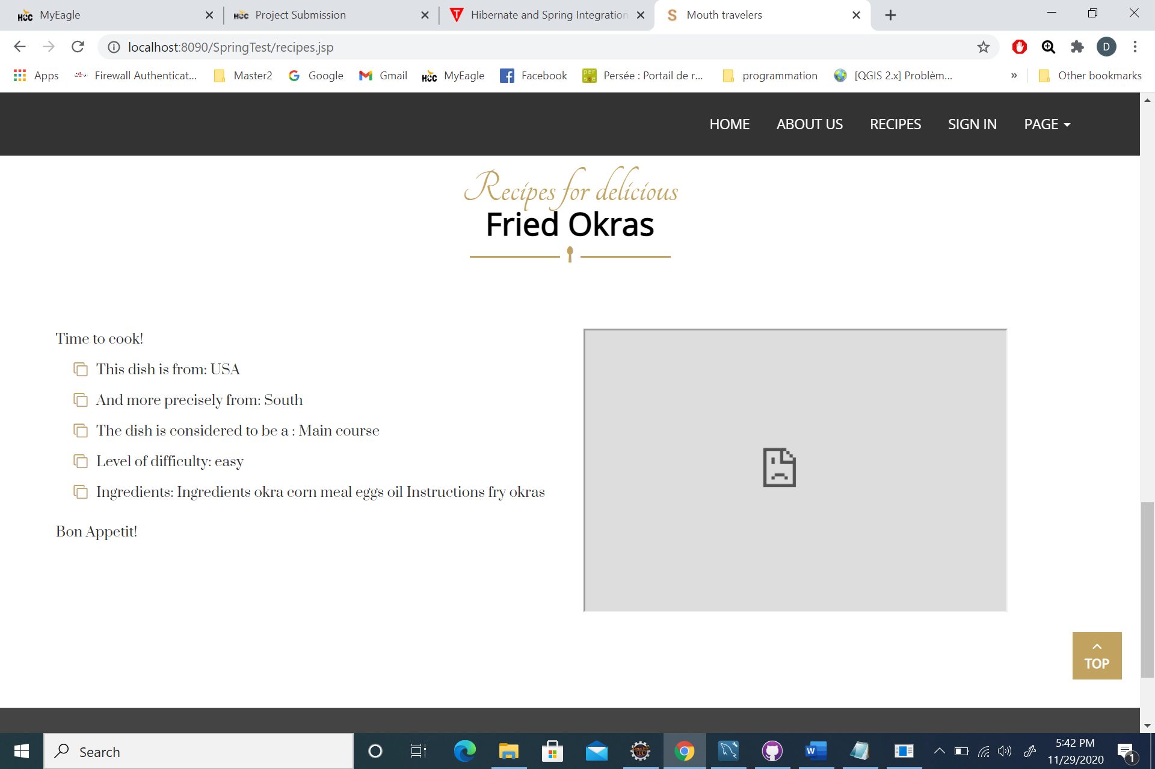
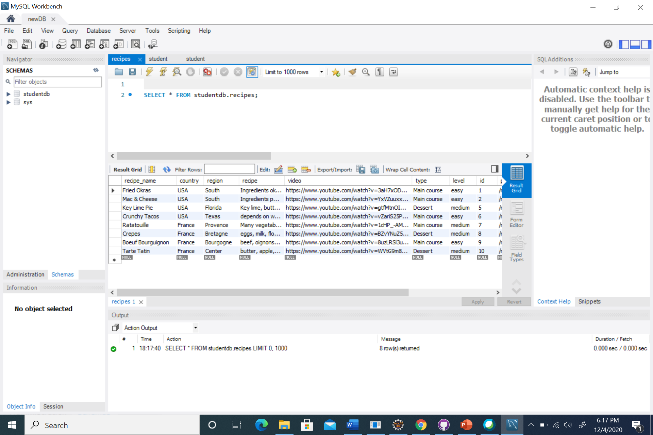
Functionalities

Slide 6
Current technical Challenges
Hibernate
Opening Youtube
Day countdown in banner

Slide 7
Content development
Need to work on the recipe information=> I must confirm with grandma for the French recipes
Review database information=> general information in text and ingredients as database
I should make my own cooking videos
Do I need a sign in functionality?

Slide 8
Applications to develop
User can adjust ingredient quantity with the number of servings
Button to print the recipe in a printer friendly way
Interactive map where the user clicks to see where the recipes are from => any idea of the best way to do that?

Slide 9
Mouth travelers
Let’s see the dynamic website

Slide 10
Thank you!

