Slide 1
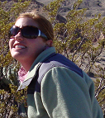
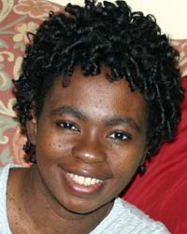

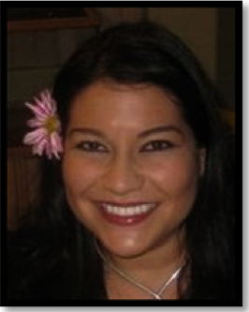
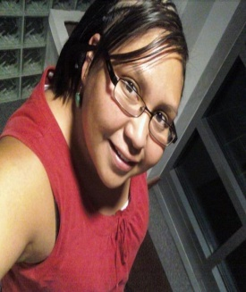

CEYH 2012
Licensed from the EYH Network
Keynote Panel
(from top)
Kimi Scheerer, Education Coordinator, Bosque Ecosystem Monitoring Program (BEMP)
Elebeoba (Chi-Chi) May, Computational Biologist, Sandia National Laboratories
Veronica Vigil, Project Engineer, Kirtland AFB
Jhana Gorman, Mechanical Engineer, Sandia National Laboratories
Presented by

Slide 2
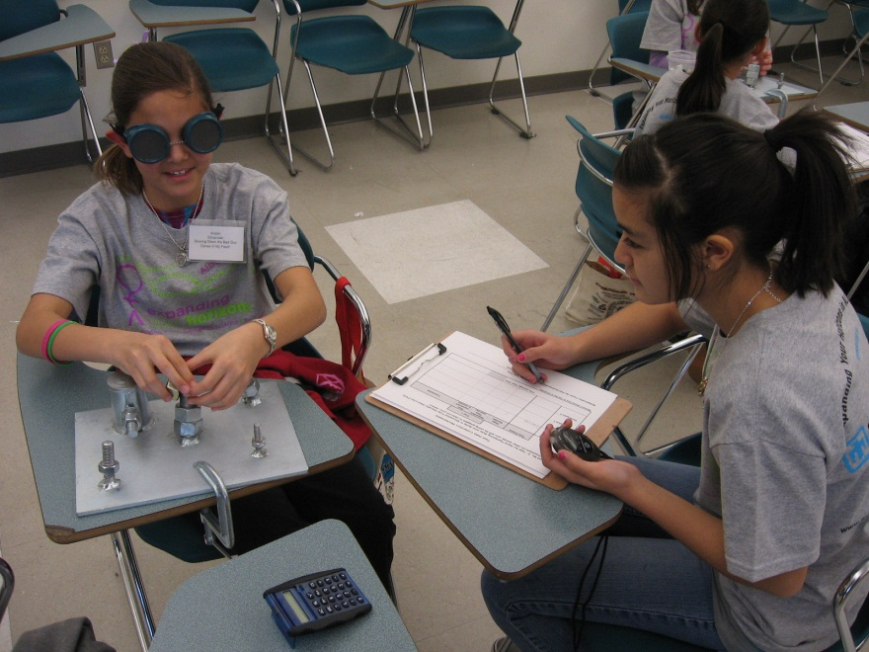
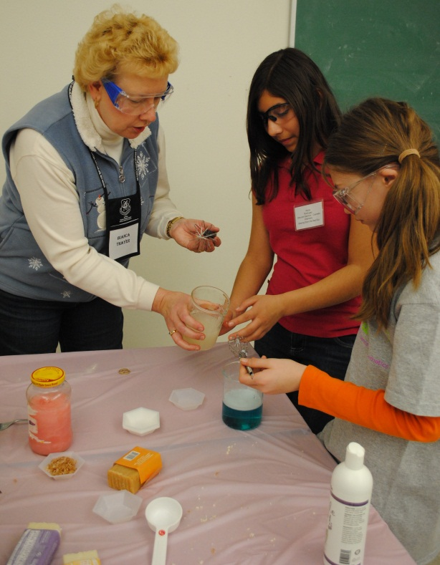
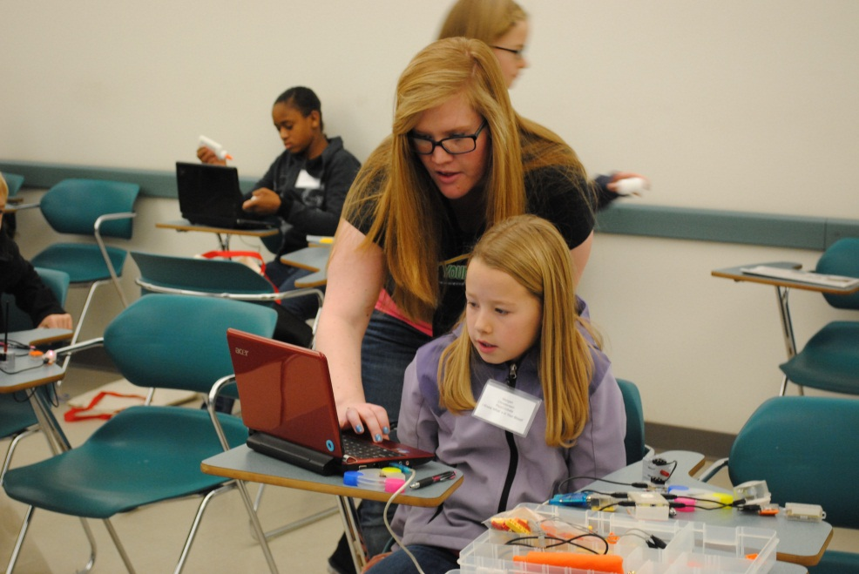
photo: 015.jpg
Slowing Down the Bad Guys
Learning how multiple layers of access delay can be used to slow down a bad guy
photo: Bianca Thayer, SNL
Cosmetic Chemistry – learning how chemistry and nanotechnology are used in the cosmetic industry
photo: DSC_0026
PicoCrickets – learn how to program PicoCricket robots

Slide 3
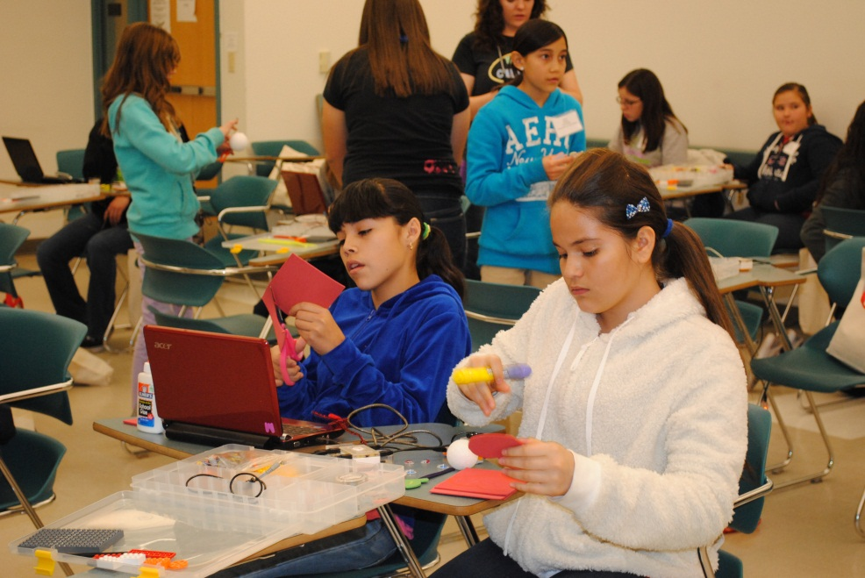
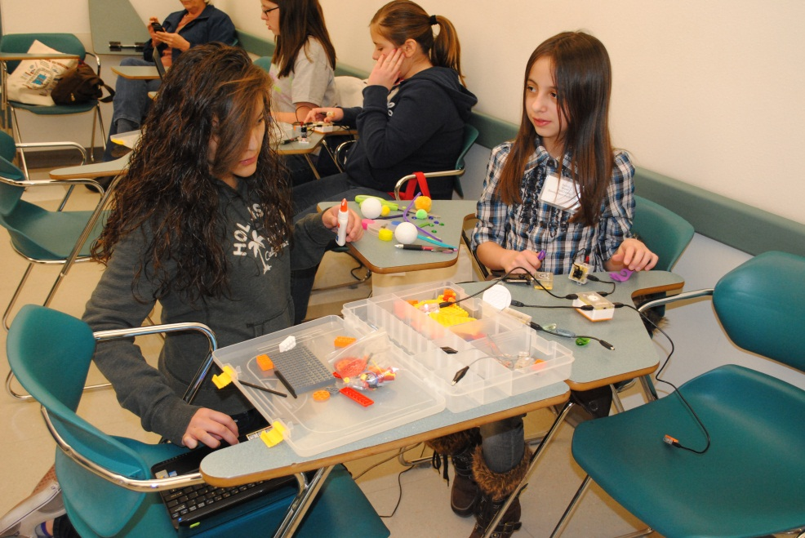
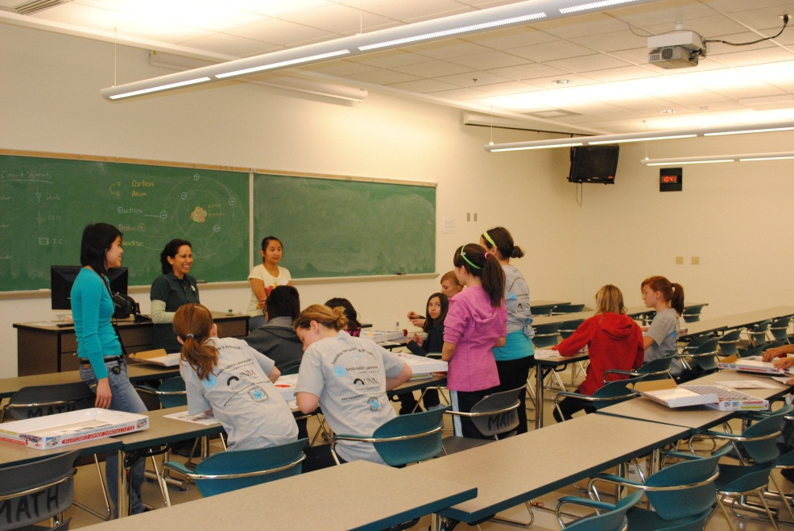
photo: DSC_0027
PicoCrickets
photo: DSC_0030
PicoCrickets
photo: DSC_0033
Loud and Flying Circuits

Slide 4
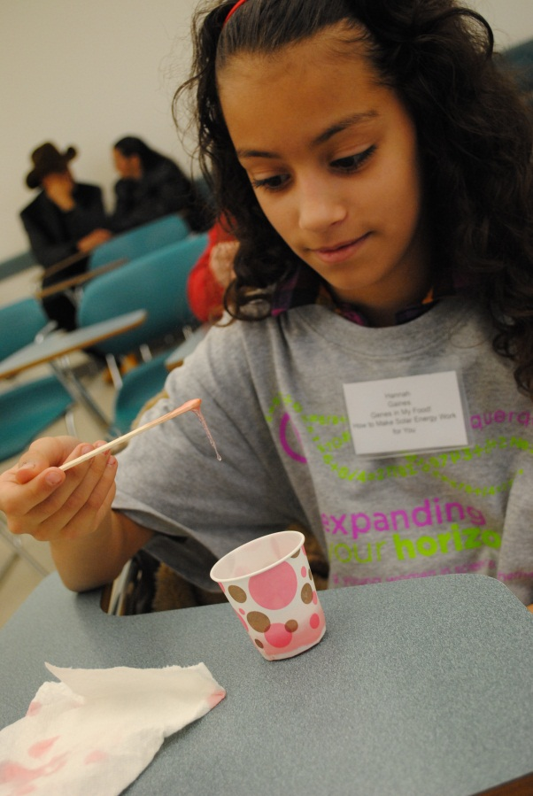
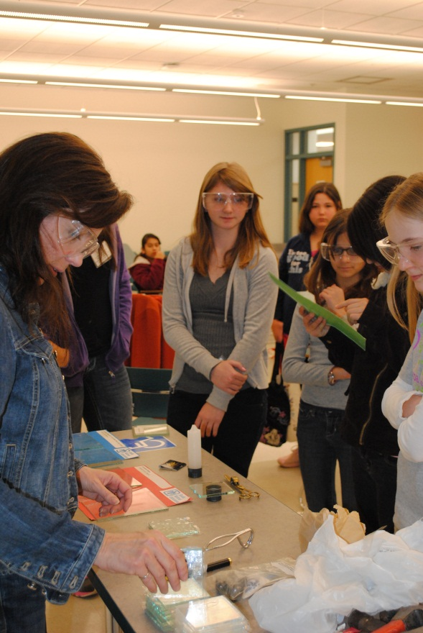
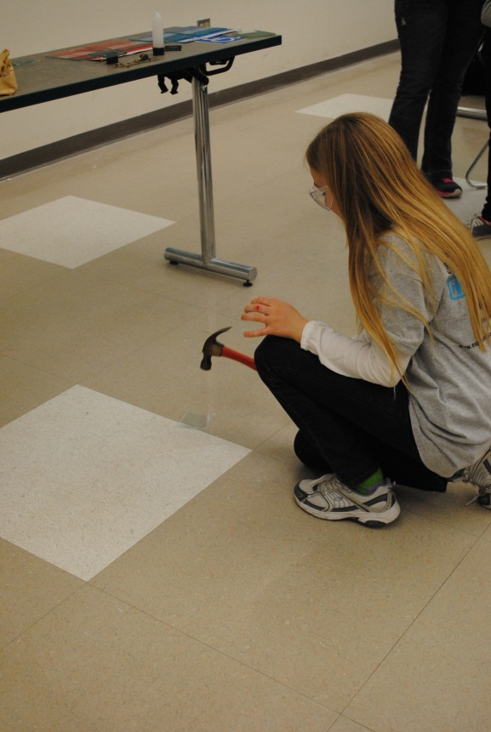
photo: DSC_0034
photo: DSC_0038
photo: DSC_0040
Breaking Glass – examine how glass breaks under different conditions and how it can be strengthened

Slide 5
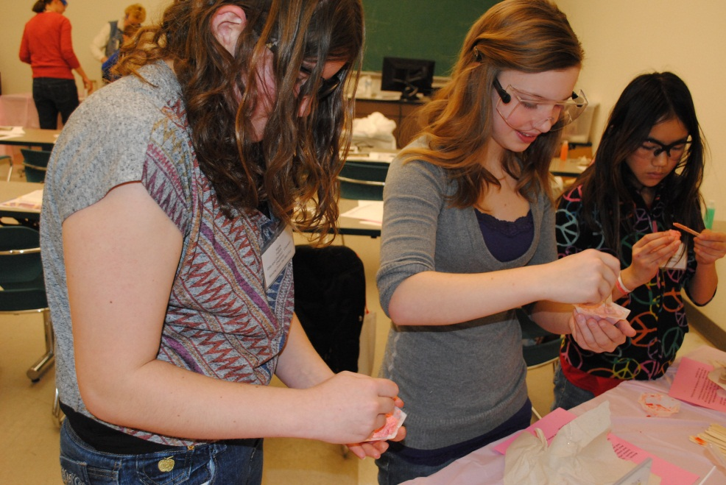
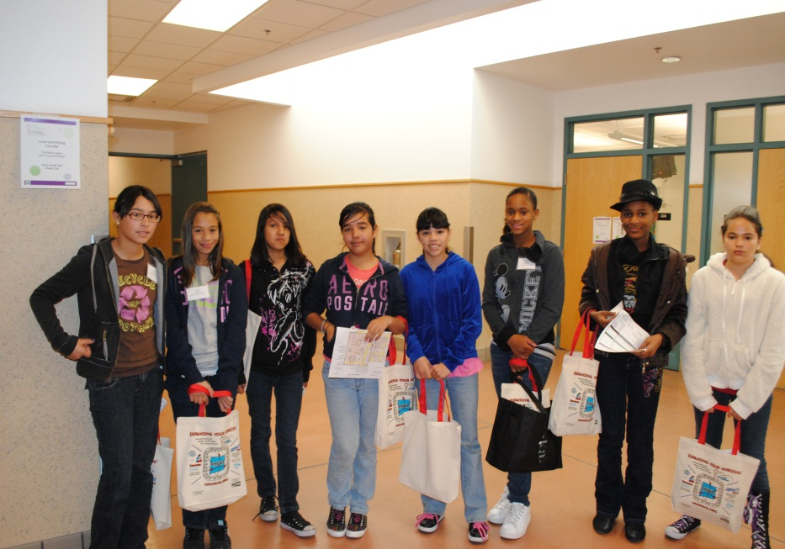
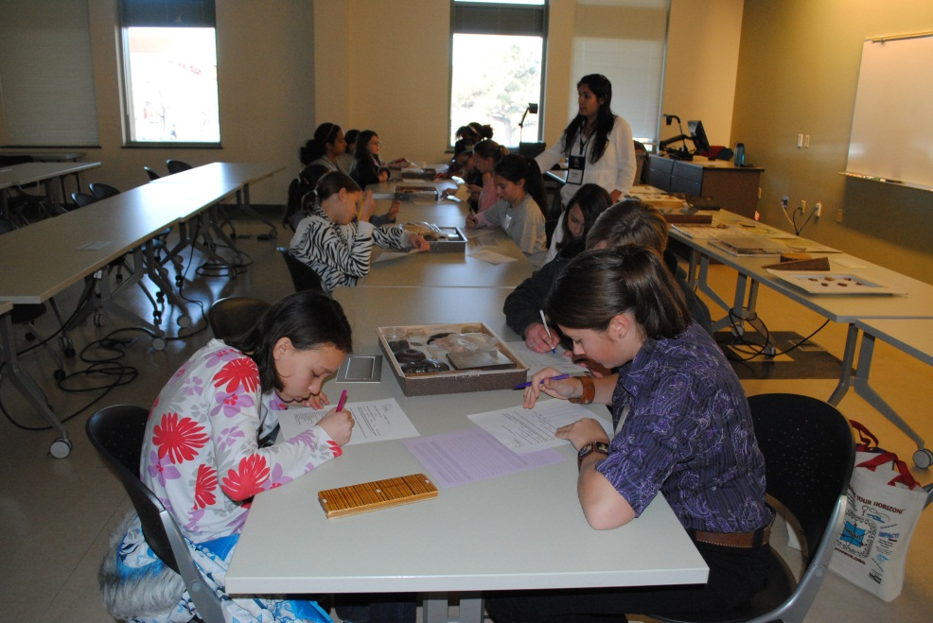
photo: DSC_0048
Cosmetic Chemistry
photo: DSC_0056
sign: ‘Loud and Flying Circuits’
photo: DSC_0068
Archaeology Detectives

Slide 7


CEYH 2012
CREDITS
A big “Thank You” to all the volunteers who made CEYH 2012 possible!
Sponsors
Photos by
Danae Davis

