Slide 1

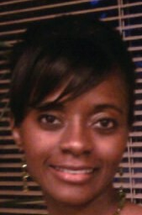
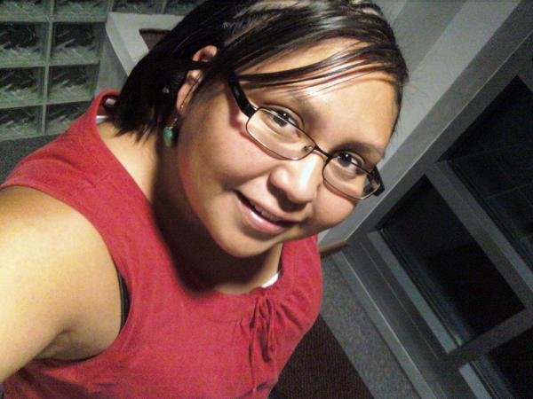
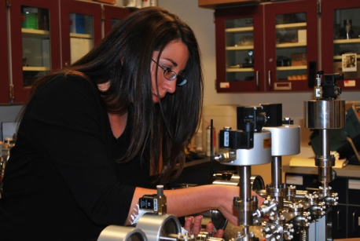
Expanding your Horizons 2010
Opening Session
Meet four dynamic young women who have chosen a technical career field
Tiffany Lampkin , General Engineer, Kirtland AFB
Tiffany enjoys an exciting career with the Air Force Nuclear Weapon Center's Engineering Directorate at Kirtland Air Force Base as a Defense Career Intern/General Engineer. She was introduced to engineering in a Diversified Technology course that she took in high school, and has completed a Bachelor's Degree in Industrial Engineering and a Master's Degree in Industrial and Systems Engineering. Tiffany serves as the center's Air Force Systems Engineering Assessment Model lead, developing operating instructions for the center, taking online courses at the Defense Acquisition University to further develop her professional skills, and serving in other roles that focus on continuous process improvement. Tiffany enjoys doing mission work, spending time with family, and inspiring others. Tiffany.Lampkin@kirtland.af.mil
Jhana Gorman, Mec hanical Engineer, Sandia National Laboratories
Jhana’s work Sandia National Laboratories consists of providing providing analytical and experimental expertise on structural and mechanical behavior of systems and says her experience has been phenomenal. She went to boarding school at Navajo College Preparatory School, followed by an associates degree from New Mexico Military Institute, and a Bachelor’s and Master’s Degree in Mechanical Engineering. Her advice – ““Aerodynamically, the bumblebee shouldn't be able to fly, but the bumble bee doesn't know it so it goes on flying anyway.” May Kay Ash. My own journey has been very tough, but it has been great. jgorma@sandia.gov
Rebecca Garcia, Geologist
Rebecca has been able to travel, study and work in many different places. After completing her Bachelor’s Degree in Geology, she began working on a Master’s in Geochronology and Thermochronology. Some of her many adventures include a summer internship with the US Forest Service, research experience on the Caribbean island of Dominica studying volcanoes, and a study abroad opportunity in Costa Rica. Rebecca’s current research has her climbing mountains in the Colorado Rockies in order to collect and date rocks for the purpose of uncovering when and how fast these mountains were created. rgarcia@nmt.edu
Kelly Gomez, Forensic Scientist, Albuquerque Police Department
Kelly is the Quality Manager for the Albuquerque Police Department’s Crime Laboratory. She has performed a variety of analyses on blood and various tissue samples in Driving While Intoxicated (DWI) and Office of the Medical Examiner (OMI) cases, trains law enforcement officers on the use of breath alcohol analyzers, and provides expert testimony . Kelly has completed a Bachelor’s Degree in Biology and a Master’s Degree in Forensic Science. kgomez@cabq.gov

