Slide 1
Problem Definition: Automated Summarization of Conversations
Cisco application: Support engineer can perform keyword search and the top results will have expandable summary attached
Real world example – smart google search (next slide)
Engineering approach: Python NLTK library, word stemming, tokenization and sentence scoring from tf-idf weights
Scalability: Python code easily portabale to spark MLLIB tf-idf
Future Improvements: Better stop word removal, tfidf wt tuning
© 2015, Cisco and/or its affiliates for the TEXATA 2015 Big Data Analytics World Championships. All rights reserved. Confidential.

Slide 2
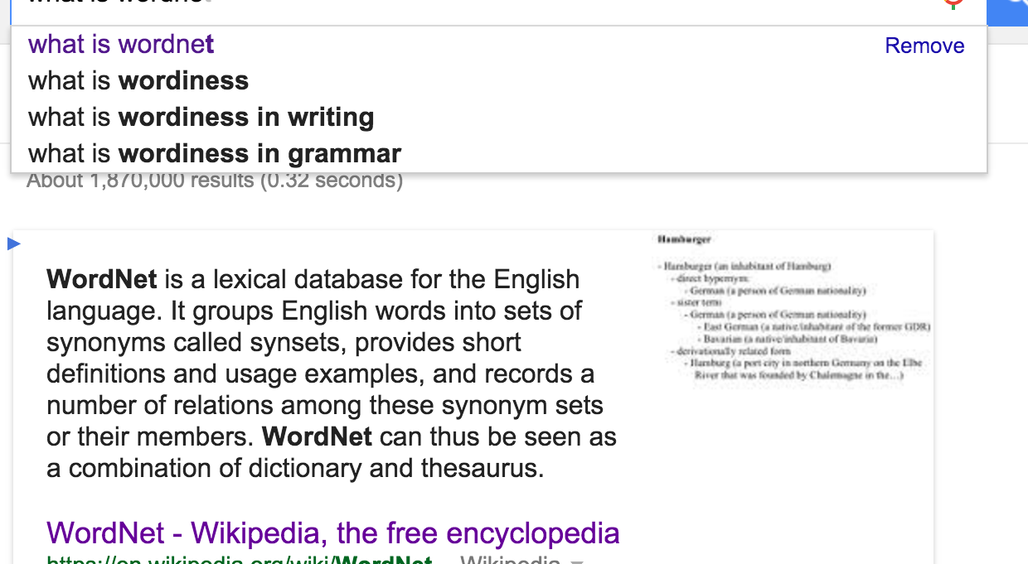

Slide 3
Auto-categorize posts into groups – auto-tagging into clusters
Cisco use case – Broadly categorize support forum posts from answers automatically into common categories like – 1) switch-issue 2) router-issue 3)user-issue
Real world example - auto-complete music artists/genres
Engineering approach – SVD, LSA, k-means

Slide 4
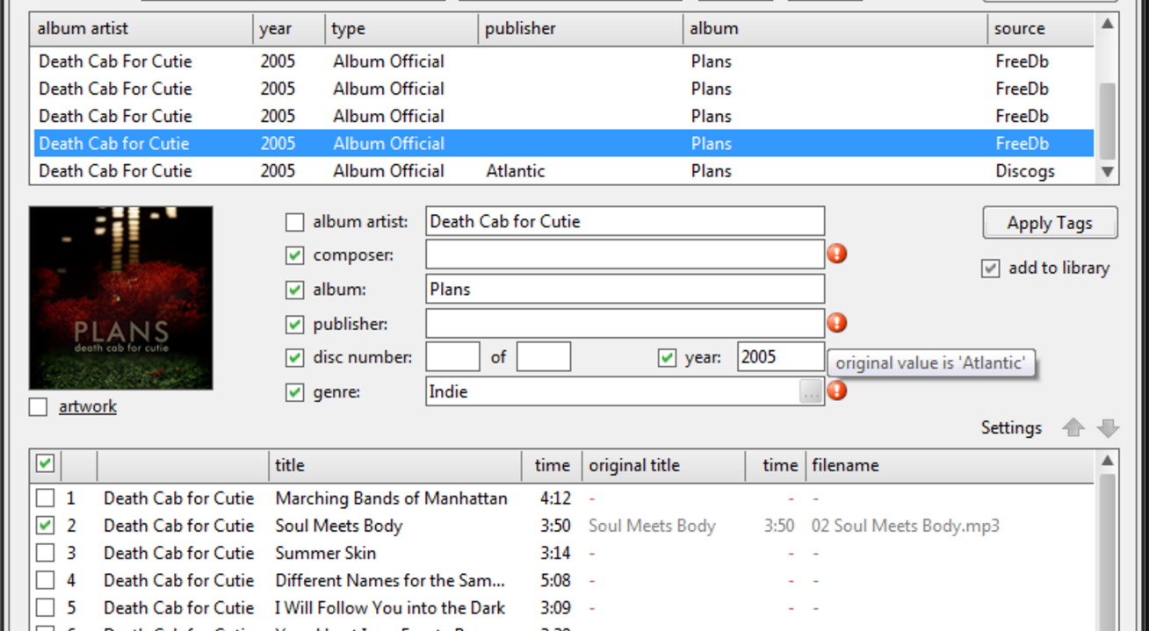

Slide 5
Find similar posts
Cisco application: Support engineer stumbles upon a some what relevant post and wants to explore similar topics
Real world example – Quora find similar questions, answers
Engineering approach – Cosine similarity based on current post being viewed

Slide 6
