Slide 1
The problem
CDETS data
Hybrid of Q2-4: summarization / clustering / recommendation
Data specs

Slide 2
Approach
Python:
XML parsing
Regex
R:
NLP techniques
ML algorithms
visualizations

Slide 3
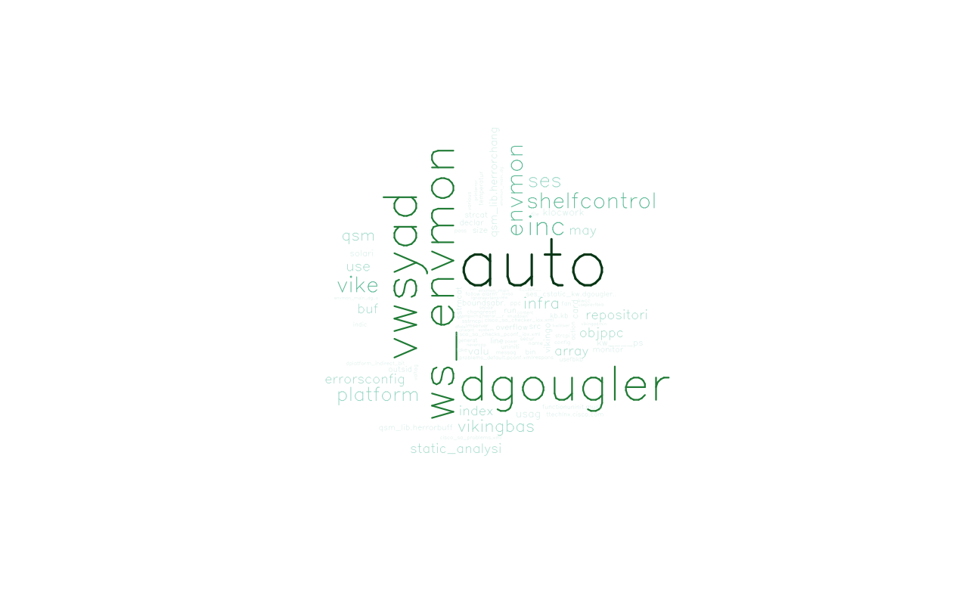

Slide 4
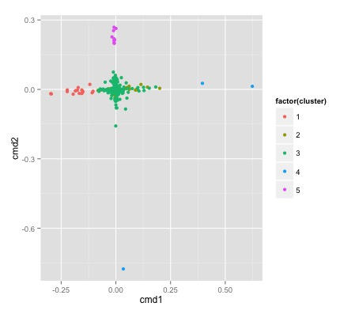

Slide 5
Impact and recommendation
P1: visualization - subsettable wordcloud
P2: document projection
P3: per-user recommendation of documents / groups
Minimal infrastructure, scalable

