Slide 1
Graduate College Rankings Map
January 11, 2020
Diane Scherpereel, Gabriel de Souza Franco, Roger J. Albarran

Slide 2
Theme
Graduate College Rankings Map (github page)
Decisions (which programs to include?)
→ U.S. News & World Report
Notes:
News was a major motivation
Read the null

Slide 3
Coding Approach
Webscraping: Python, Pandas, Beautiful Soup, Selenium
scraped U.S. News & World Report Graduate College Rankings
Data join: from data.gov Postsecondary School Location 2016-2017 + several look-ups
join in SQL using PGAdmin, save to CSV
CSV to geoJSON: online converter
Webpages: JavaScript, Leaflet, Mapbox, HTML, CSS, jQuery, github page
Data conversion CSV to HTML: Python
Notes:
News was a major motivation
Read the null

Slide 4
Data Munging
Postsecondary School Location 2016-2017: CSV with LAT/LON
7521 rows – delete beauty, cosmetology, hair, barber, salon, spa, golf, community coll.
5676 rows
After scraping: match names from scraped data to Postsecondary data
e.g The University of Texas at Austin, Washington University in St . Louis
Data cleaning again after SQL join
Back to U.S. News & World Report – schools TIED with 20th school
- added an additional 21 schools (ALWAYS CHECK YOUR DATA!)
Notes:
News was a major motivation
Read the null

Slide 5
Final Visualization
→ github page
Notes:
News was a major motivation
Read the null

Slide 6
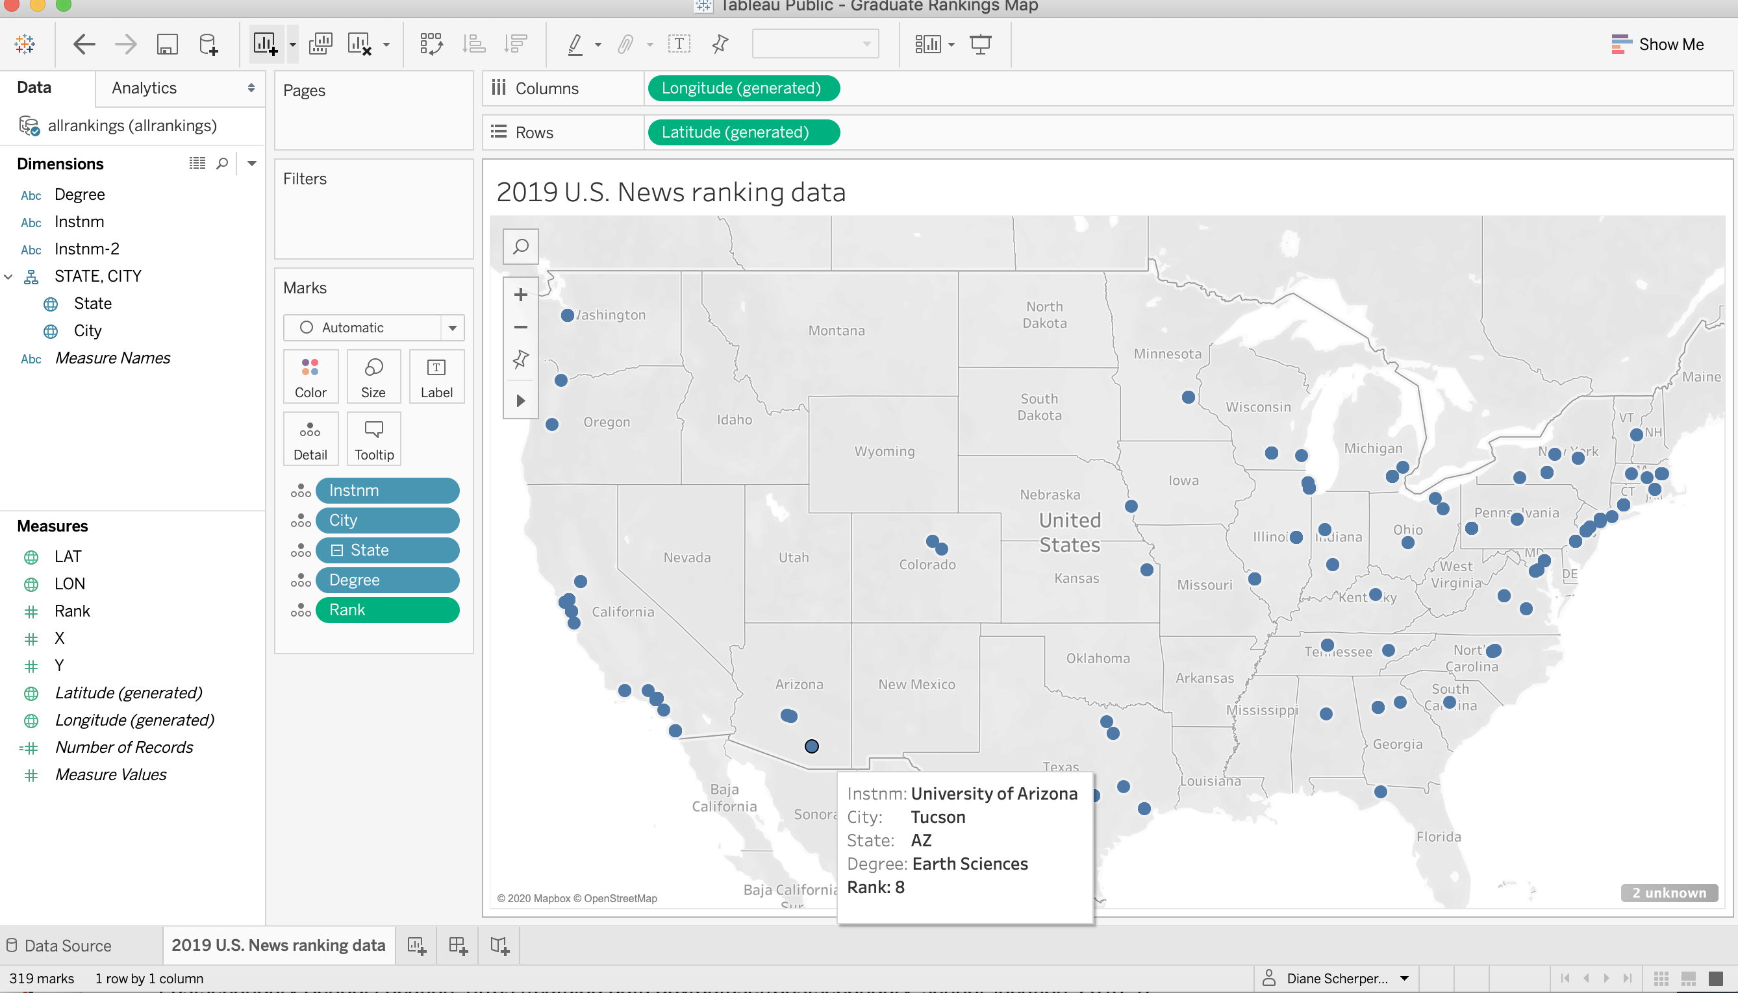
Final Visualization
→ github page
Notes:
News was a major motivation
Read the null

