Slide 1

Identifying Risk of Stroke Using Predictive Modelling
Presented by: Diane Yeo Su Ting
Student PI No.: H1882431
Supervisor: Dr. Wang Di
Examiner: Mr. Chua Poh Chai

Slide 2
Outline
Topic Introduction
Related Work
CRISP-DM
Initial Model Evaluation
Conclusion
Further Work and Limitation(s)

Slide 3



Introduction
Neurological attack whereby the brain is deprived of blood flow and oxygen to function.
Worrying health issue
Stroke moved up from 3rd to 2nd largest cause of death.
Problem Statement
Reduce misdiagnosis in Emergency Rooms (ERs) and Primary Care Doctors (PCDs)

Slide 4



Related Work
Age
Older, higher risk of stroke (Khan & Vohra, 2006)
Smoker
1.5-2.9x more at-risk (Khan & Vohra, 2006)
At-risk 10 years earlier (Frank et al., 2021)
Heart disease & Diabetes
Past ischemic attack history (Khan & Vohra, 2006)
Diabetic individuals, especially females (Khan & Vohra, 2006)
(Roy-O Reilly & McCullough, 2018)

Slide 5
CRISP-DM
Business Understanding
What does the business need?
Data Understanding
What data do we need? Is the data clean?
Data Preparation
How is the data prepped for modelling?
Modelling
Which models should we apply?
Evaluation
Which model best meets the business objectives?
Cross-Industry Standard Process for Data Mining

Slide 6
Business Understanding
Business Problem
Identify individuals who are at-risk of incidence of stroke, provide them with the necessary treatments ASAP.
Business Analytics Problem
Build and identify the best performing predictive model to predict individuals at-risk of incidence of stroke
Based on:
Demographical profile
Medical History
Conditions

Slide 7
Data Understanding
Features | Description | Data Type | Values
id | Patient record id | Int | 9046
gender | Patient gender | Object | Male
age | Patient age | Float | 67.0
hypertension | Whether patient has hypertension | Int | 0
heart_disease | Whether patient has/had heart disease(s) | Int | 1
ever_married | Patient marital status | Object | Yes
work_type | Patient employment type | Object | Private
Residence_type | Patient residential area | Object | Urban
avg_glucose_level | Patient glucose reading | Float | 228.69
bmi | Patient BMI reading | Float | 36.60000
smoking_status | Patient smoking status | Object | formerly smoked
stroke | Occurrence of stroke | Int | 1
5,110 Samples
11 Input Features
Target Variable

Slide 8
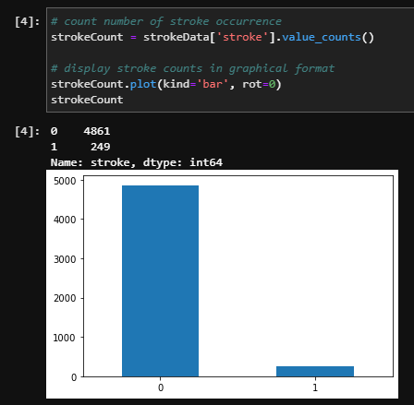
Data Exploration
Stroke
Rare event
Largely imbalanced
Skewed towards non-incidence of stroke
‘0’ (no stroke): 4,861
‘1’ (stroke): 249

Slide 9
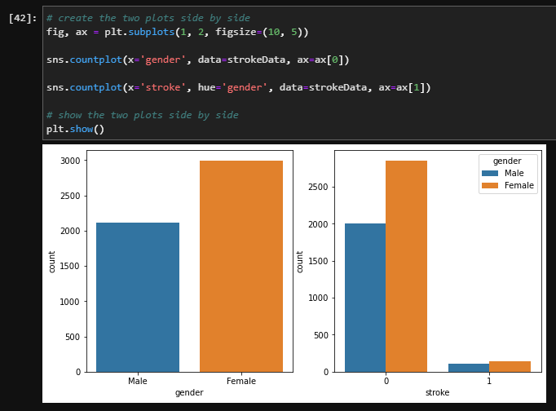
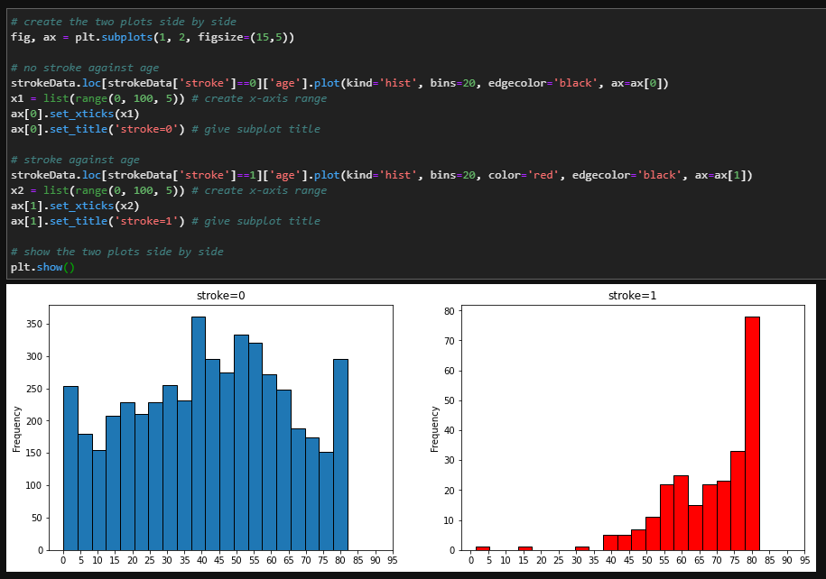
Data Exploration
Gender
Age

Slide 10
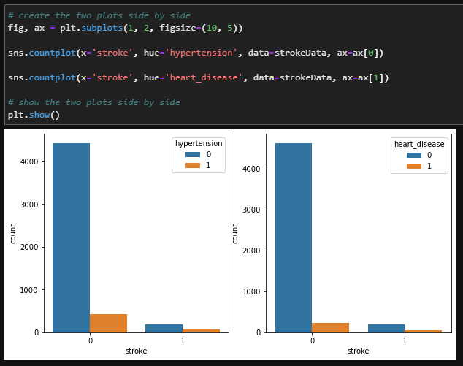
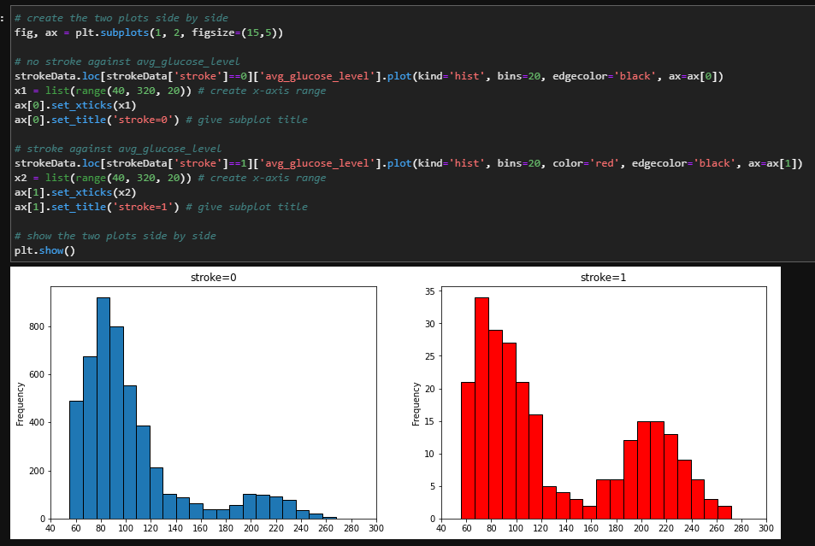
Data Exploration
Hypertension & Heart Disease
Glucose Levels

Slide 11
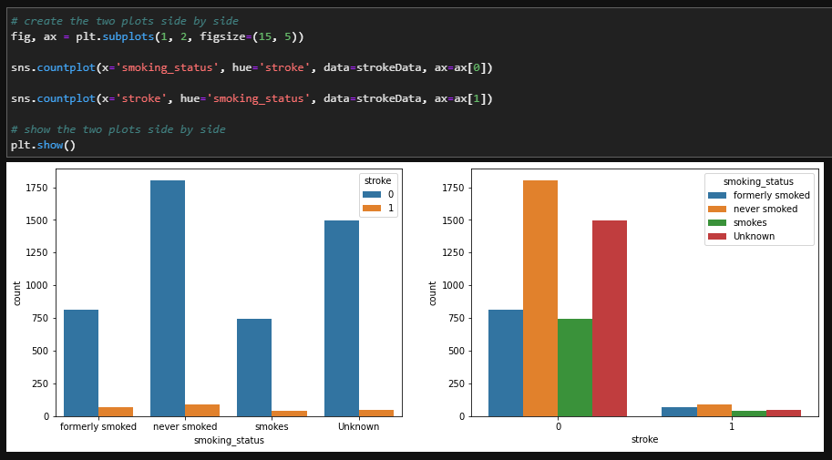
Data Exploration
Smoking Status

Slide 12




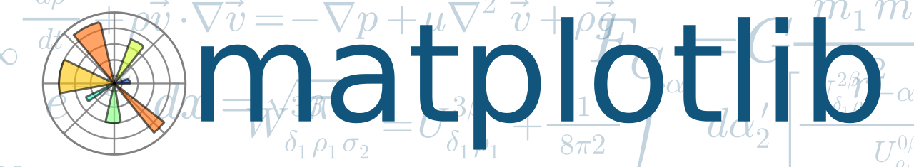
Tools Used
Python
Why?
Versatile (many libraries)
Challenge myself
IBM SPSS Modeler not widely used outside

Slide 13
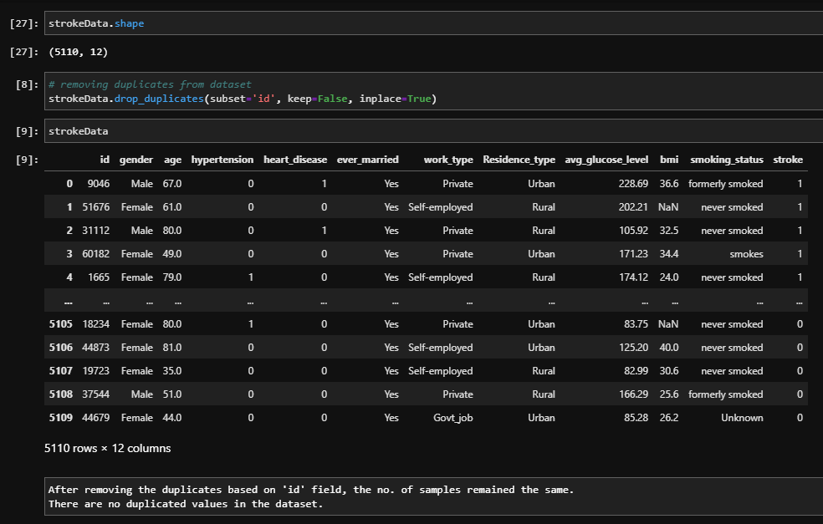
Data Preparation
Removing Duplicated Samples
All samples are unique
5,110 samples

Slide 14
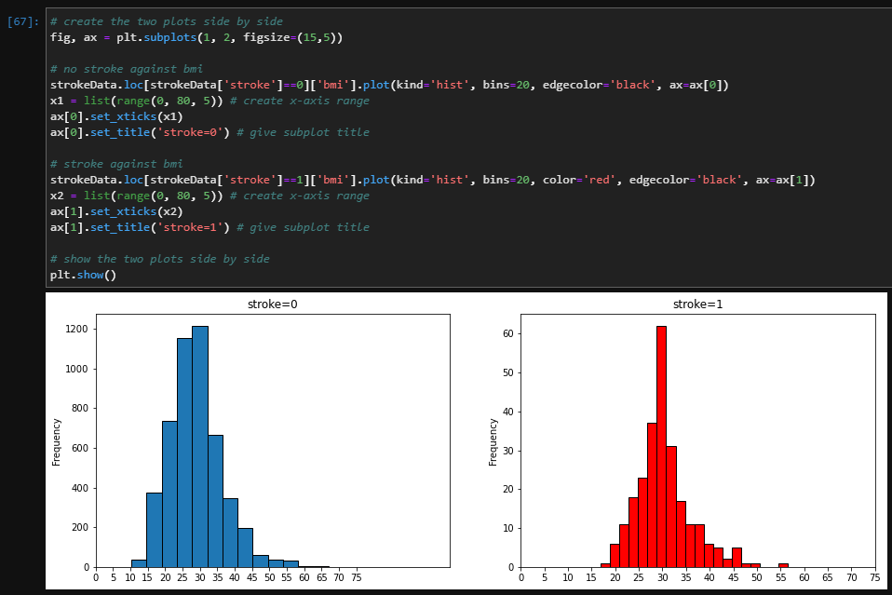
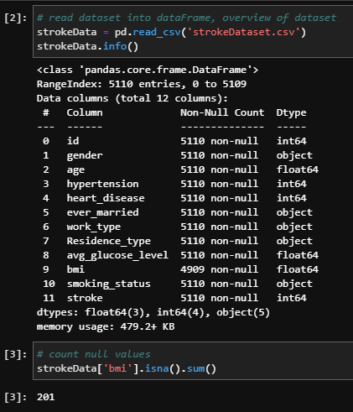
Data Preparation
Replace Missing Values
BMI has 201 missing values
40 had stroke
Features | Count
id | 5,110
gender | 5,110
age | 5,110
hypertension | 5,110
heart_disease | 5,110
ever_married | 5,110
work_type | 5,110
Residence_type | 5,110
avg_glucose_level | 5,110
bmi | 4,909
smoking_status | 5,110
stroke | 5,110

Slide 15
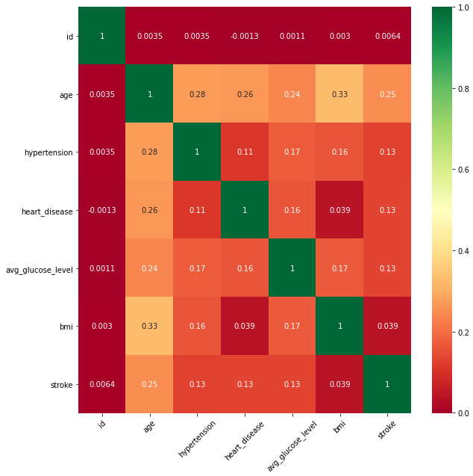
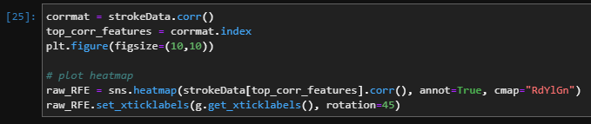
Data Preparation
Replace Missing Values (cont’d)
BMI has 201 missing values
40 had stroke
 | id | bmi
0 | 9046 | 36.600000
1 | 51676 | NaN
 | id | bmi
0 | 9046 | 36.600000
1 | 51676 | 28.893237
before
after

Slide 16
Data Preparation
Features | Data Type
age | Float
hypertension | Int
heart_disease | Int
avg_glucose_level | Float
bmi | Float
stroke | Int
gender_Female | Float
gender_Male | Float
married_No | Float
married_Yes | Float
work_Govt_job | Float
work_Never_worked | Float
work_Private | Float
work_Self-employed | Float
work_children | Float
residence_Rural | Float
residence_Urban | Float
smoke_Unknown | Float
smoke_formerly smoked | Float
smoke_never | Float
smoke_smokes | Float
Transforming Categorical Features
Scikit-learn
Cannot take categorical features
OneHotEncoder
Categorical → Numeric
Each entry would be a feature on its own
 | gender
0 | Male
1 | Female
2 | Male
 | gender_Female | gender_Male
0 | 0.0 | 1.0
1 | 1.0 | 0.0
2 | 0.0 | 1.0
before
after

Slide 17
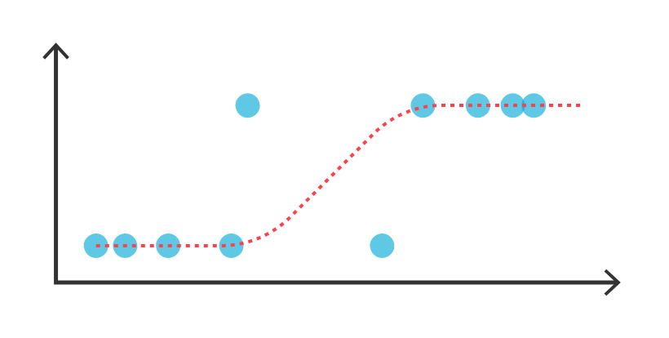
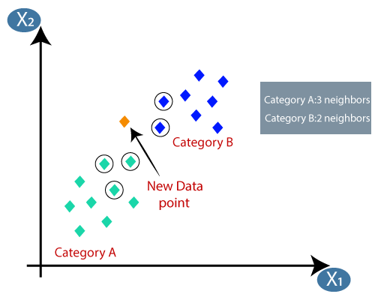
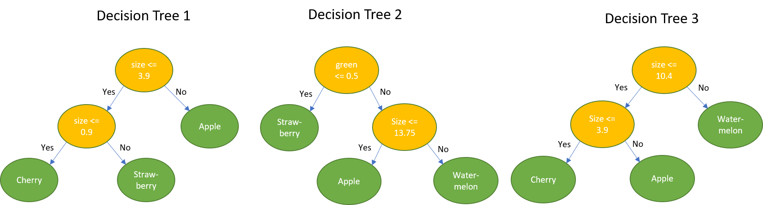
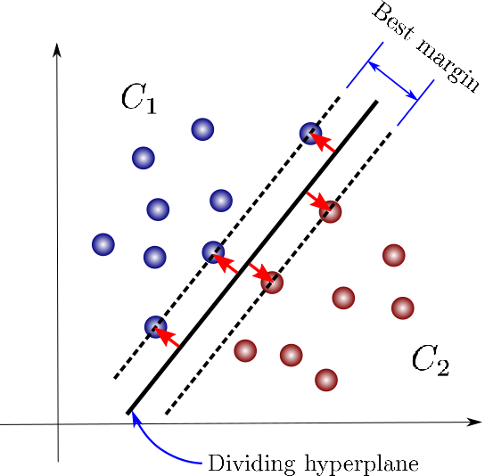
Models
Logistic Regression (LR)
K-Nearest Neighbours (kNN)
Random Forest (RF)
Support Vector Machines (SVM)

Slide 18
Train-Test Split
Train – 70%
Test – 30%
Incidence of Stroke | Count
0 | 4,861
1 | 249
IMBALANCED
Incidence of Stroke | Count
0 | 3,403
1 | 3,403
Possible Solutions
Oversampling
Under-sampling
Combination
?
Incidence of Stroke | Count
0 | 160
1 | 160

Slide 19
Evaluation Metrics
Accuracy
How accurate the model is
Precision rate
Correctly predicted at-risk vs. not at-risk
Recall rate
aka Sensitivity rate
How accurate the model is able to identify relevant data
True Positives
F1-score
Harmonic mean
Precision and Recall equally important

Slide 20
Imbalanced Dataset Results
LR | Precision | Recall | F1-score | Support
noStroke | 0.95 | 1.00 | 0.98 | 1,458
stroke | 1.00 | 0.01 | 0.03 | 75
accuracy |  |  | 0.95 | 1,533
macro avg | 0.98 | 0.51 | 0.50 | 1,533
weighted avg | 0.95 | 0.95 | 0.93 | 1,533
kNN | Precision | Recall | F1-score | Support
noStroke | 0.95 | 1.00 | 0.97 | 1,458
stroke | 0.00 | 0.00 | 0.00 | 75
accuracy |  |  | 0.95 | 1,533
macro avg | 0.48 | 0.50 | 0.49 | 1,533
weighted avg | 0.90 | 0.95 | 0.93 | 1,533
RF | Precision | Recall | F1-score | Support
noStroke | 0.95 | 1.00 | 0.97 | 1,458
stroke | 0.00 | 0.00 | 0.00 | 75
accuracy |  |  | 0.95 | 1,533
macro avg | 0.48 | 0.50 | 0.49 | 1,533
weighted avg | 0.90 | 0.95 | 0.93 | 1,533
SVM | Precision | Recall | F1-score | Support
noStroke | 0.95 | 1.00 | 0.97 | 1,458
stroke | 0.00 | 0.00 | 0.00 | 75
accuracy |  |  | 0.95 | 1,533
macro avg | 0.48 | 0.50 | 0.49 | 1,533
weighted avg | 0.90 | 0.95 | 0.93 | 1,533

Slide 21
Oversampling Dataset Results
LR | Precision | Recall | F1-score | Support
noStroke | 0.98 | 0.75 | 0.85 | 1,458
stroke | 0.12 | 0.69 | 0.21 | 75
accuracy |  |  | 0.74 | 1,533
macro avg | 0.55 | 0.72 | 0.53 | 1,533
weighted avg | 0.94 | 0.74 | 0.82 | 1,533
kNN | Precision | Recall | F1-score | Support
noStroke | 0.98 | 0.68 | 0.81 | 1,458
stroke | 0.11 | 0.79 | 0.20 | 75
accuracy |  |  | 0.69 | 1,533
macro avg | 0.55 | 0.73 | 0.50 | 1,533
weighted avg | 0.94 | 0.69 | 0.78 | 1,533
RF | Precision | Recall | F1-score | Support
noStroke | 0.96 | 0.97 | 0.96 | 1,458
stroke | 0.26 | 0.23 | 0.24 | 75
accuracy |  |  | 0.93 | 1,533
macro avg | 0.61 | 0.60 | 0.60 | 1,533
weighted avg | 0.93 | 0.93 | 0.93 | 1,533
SVM | Precision | Recall | F1-score | Support
noStroke | 0.98 | 0.74 | 0.84 | 1,458
stroke | 0.12 | 0.72 | 0.21 | 75
accuracy |  |  | 0.74 | 1,533
macro avg | 0.55 | 0.73 | 0.53 | 1,533
weighted avg | 0.94 | 0.74 | 0.81 | 1,533

Slide 22
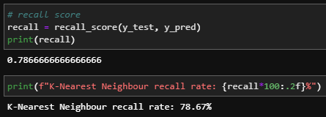
Conclusion
kNN | Precision | Recall | F1-score | Support
noStroke | 0.98 | 0.68 | 0.81 | 1,458
stroke | 0.11 | 0.79 | 0.20 | 75
accuracy |  |  | 0.69 | 1,533
macro avg | 0.55 | 0.73 | 0.50 | 1,533
weighted avg | 0.94 | 0.69 | 0.78 | 1,533
Choice of model for oversampling: K-Nearest Neighbours
Highest Recall rate: 78.67%

Slide 23
Future Work
Under-sampling
Combination
Further fine-tuning of parameters
More models
Decision Trees, Neural Networks
Compare Results
Find out which feature/s affects incidence of stroke
Limitation
Missing BMI cannot simply be replaced by mean or median
Dealing with an actual human

Slide 24
Thank You!

