Slide 1
FARM DATABASE
Group 4
Shuning Pan 6522054
Ang Ding 6522104
Chonghan Chen 6522098
Wenhao Du 6522028
Haoyang Li 6522041

Slide 2
Introduction
This database system application, designed specifically for modern farms and those having close relationship with the market, can be a helpful management tool. With this system employed, farm managers should be able to get instant access to a wide range of data, for example, when and where a certain type of crop should be planted.
The database holds data about a variety of agricultural related elements of the farm, ranging from farmers and grow plans to product buyers and storage.

Slide 3
Functional Requirements
1.The production of the farm is grouped by farmland.
2.We want to have a record of the ID, the area, the farmer who works on it, and the soil type of each piece of land.
3.Each piece of land can only be planted one kind of crop at a time (one piece of land may be planted different crops in different seasons). We want to keep track of when a kind of crop is planted for each piece of land.
4.Each piece of land is taken care of exactly by one farmer. However, one farmer can be responsible for several pieces of land.
5.Each farmer may have at most one direct team leader. A leader may have many group members under his or her leadership. We need to know each farmer’s direct team leader.
6.A portion of the products are stored in barns. Each barn has its own ID, storage capacity and administrator. A barn is in the charge of exactly one administrator, and one administrator is only responsible for one barn.
7. In case of emergency, we want to record each administrator’s name, ID, gender, and phone number.

Slide 4
Functional Requirements
8.Each barn is divided into many sections, each having a section number.
9.For each section, only one type of product can be stored. We want to know the product by its name, and the amount of the product that is stored in the section. However, one type of product can be stored in many different sections.
10.Since the environment in each section is controlled by modern facilities for the storage of a specific type of product, we shall record its humidity and temperature.
11.For management purposes, we need to store every farmer’s basic personal data, including name, ID, gender, birthdate and phone number.
12.Each company purchases some of our products. Thus, for each of the companies, we need to record its name, address, contact name & phone number, contract start & end date, and the amount and unit price for each of the products specified in the contract.
13.For each crop, we need to know its maximum storage time, the expected yield, grow time, and when and where it is planted. Also, the type of fertilizer used in each plant plan shall be recorded. In addition, we want to know the brand of each type of seed.

Slide 5
Entity List & Inferences
FARMLAND
LID, Area, SoilType, FarmerID, {Plant(CropName, TimeOfYear, Fertilizer)}
CROP
Cname, MaxStorageTime, YieldExp, GrowTime, SeedBrand
FARMER
Name, FID, Gender, Bdate, PhoneNo, LeaderID
PURCHASER
Company, Address, Contact, PhoneNO, StartOfContract, EndOfContract, {Purchase(Crop, Quantity, UnitPrice)}
BARN
BID, Capacity, AdministratorID
BARNADMIN
Name, AdminID, Gender, Pnumber
SECTION
BarnID, SectionNo, CropName, Temp, Humidity, stock

Slide 6
Inferences: FARMLAND
REQ2: ‘We want to have a record of the ID, the area, the farmer who works on it, and the soil type of each piece of land’.
According to this requirement, we add the entity FARMLAND with attributes ‘LID’ (short for land ID), ‘ Area’, and ’SoilType’.
REQ3: ‘Each piece of land can only be planted one kind of crop at a time(one piece of land may be planted different crops in different seasons). We want to keep track of when a kind of crop is planted for each piece of land’.
REQ13: ‘For each crop, we need to know its maximum storage time, the expected yield, grow time, and when and where it is planted. Also, the type of fertilizer used in each plant plan shall be recorded’.
This is the reason why we have a set of composite attribute , for which we created a new table PLANT with attribute ‘LandID’, ‘CropName’, ‘TimeOfYear’ and ‘Fertilizer’.

Slide 7
Inferences: CROP
REQ13: ‘For each crop, we need to know its maximum storage time, the expected yield, grow time, and when and where it is planted. Also, the type of fertilizer used in each plant plan shall be recorded. In addition, we want to know the brand of each type of seed’.
This explains the reason why we have an entity called ‘CROP’, and attributes ‘Cname’ (short for ‘crop name’), ‘MaxStorageTime’, ‘YieldExp’ (short for ‘yield expectation’), ‘GrowTime’, and ‘SeedBrand’.

Slide 8
Inferences: FARMER
REQ13: ‘For management purposes, we need to store every farmer’s basic personal data, including name, ID, gender, birthdate and phone number’.
This is why we have an entity ‘FARMER’, and the attributes ‘Name’, ‘FID’ (short for farmer ID), ‘Gender’, ‘Bdate’ (short for birth date) and PhoneNo.
REQ5: ‘Each farmer may have at most one team leader. A leader may have many group members under his or her leadership. We need to know each farmer’s team leader’.
Thus, we add an attribute ‘LeaderID’.

Slide 9
Inferences: PURCHASER
REQ12: ‘Each company purchases some of our products. Thus, for each of the companies, we need to record its name, address, contact name & phone number, contract start & end date, and the amount and unit price for each of the products specified in the contract’.
That is the reason for the entity ‘PURCHASER’ and attributes ‘Company’, ‘Address’, ‘Contact’, ‘PhoneNo’, ‘StartOfContract’, ‘EndOfContract’. In addition, we have a set of composite attribute ‘Purchase(Crop, Quantity, UnitPrice)’, since each company may buy many types of product in different quantity and price.

Slide 10
Inferences: BARN
REQ6: ‘A portion of the products are stored in barns. Each barn has its own ID, storage capacity and administrator.
This explains why we have ‘BARN’ as an entity, with attributes ‘BID’ (short for Barn ID), ‘Capacity’ and ‘AdministratorID’.
REQ6: ‘A barn is in the charge of exactly one administrator, and one administrator is only responsible for one barn’.
This is the reason why we don’t have multivalued attribute, since the relation between barn and the administrator is one-to-one.

Slide 11
Inferences: BARNADMIN
REQ7: ‘In case of emergency, we want to record each administrator’s name, ID, gender, and phone number’.
This is why we have entity ‘BARNADMIN’, and the attributes ‘Name’, ‘AdminID’, ‘Gender’ and ‘Pnumber’ (short for phone number).

Slide 12
Inferences: SECTION
REQ8: ‘Each barn is divided into many sections, each having a section number’.
So, the entity ‘SECTION’ is created, with the first two attributes ‘BarnID’ and ‘SectionNo’. This is a weak entity.
REQ9: ‘For each section, only one type of product is stored. We want to know the product by its name, and the amount of the product that is stored in the section. However, one type of product can be stored in many different sections’.
This gives us the attributes ‘CropName’ and ‘stock’.
REQ10: ‘Since the environment in each section is controlled by modern facilities for the storage of a specific type of product, we shall record its humidity and temperature’.
Attributes ‘Humidity’ and ‘Temp’ (short for temperature) are also added.

Slide 13
Weak Entity List
SECTION
BarnID, SectionNo, CropName, Temp, Humidity, stock
Primary Key: {BarnID, SectionNo}
Foreign Key: BarnID
This entity relies on the entity ‘BARN’.

Slide 14
List of Keys
Entity | Candidate Key(s) | Primary Key | Foreign Key(s) | Composite Key(s)
FARMLAND | FarmerID, LID | LID | FarmerID
CROP |  | Cname
FARMER | FID, PhoneNo | FID | LeaderID
PURCHASER | Company, PhoneNo | Company
BARN | BID, Administrator | BID | Administrator
BARNADMIN | AdminID, PNumber | AdminID
SECTION |  | {BarnID, SectionNo} | CropName BarnID | {BarnID, SectionNo}

Slide 15
Relationship Type
Relationship | Type | From | To
PLANT | N:M | FARMLAND | CROP
TAKE_CARE | 1:N | FARMER | FARMLAND
LEADERSHIP | 1:N | FARMER | FARMER
STORE | 1:N | CROP | SECTION
SECTION_OF | 1:N | BARN | SECTION
PURCHASE | N:M | PURCHASER | CROP
ADMIN | 1:1 | BARN | BARNADMIN

Slide 16
Referential Integrity Constraint Diagram
PURCHASER
Company | Address | PhoneNo | Contact | StartOfContract | EndOfContract
CROP
PURCHASE
Cname | YieldExp | MaxStorageTime | GrowTime | SeedBrand
Purchaser | Crop | Quantity | UnitPrice
PLAN
FARMLAND
LandID | CropName | Fertilizer | TimeOfYear
LID | Area | Soil | FarmerID
FARMER
Fname | Minit | Lname | FID | Gender | Bdate | PhoneNo | LeaderID
SECTION
BARN
BarnID | SectionID | Temp | Humidity | CropName | Stock
BID | Capacity | Administrator
BARNADMIN
FirstName | Mid | LastName | AdminID | Gender | PNumber

Slide 17
Entity-Relationships Diagram
LEADERSHIP
member
leader
1
N
LID
Area
SoilType
Lname
FARMLAND
TAKE_CARE
FARMER
N
1
Name
Minit
N
PhoneNo
FID
Fname
Address
company
Quantity
PLAN
Fertilizer
TimeOfYear
Bdate
Gender
BID
PhoneNo
M
PURCHASER
PURCHASE
CROP
STORE
SECTION
SECTION_OF
BARN
N
M
1
N
N
1
Capacity
Contact
1
Cname
SeedBrand
SectionNo
ADMIN
StartOfContract
UnitPrice
Temp
PNumber
Stock
Humidity
1
EndOfContract
BARNADMIN
Gender
MaxStorageTime
GrowTime
YieldExp
Name
AdminID
Lastname
Firstname
Mid

Slide 18
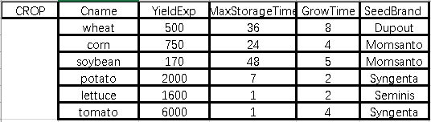
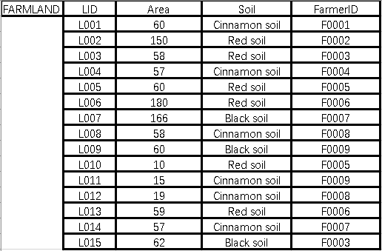
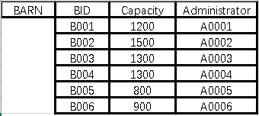
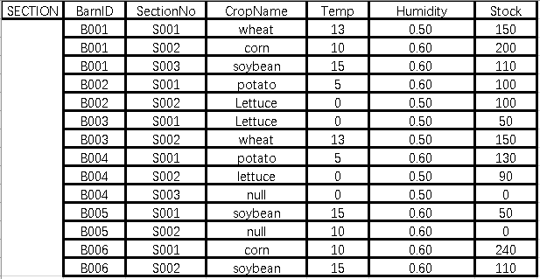
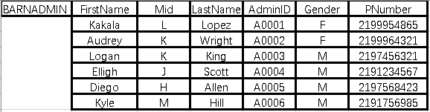
Database Extension

Slide 19
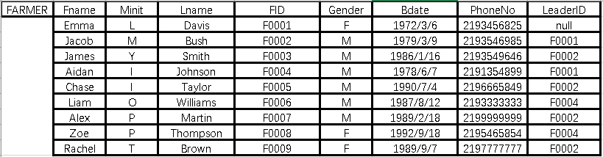
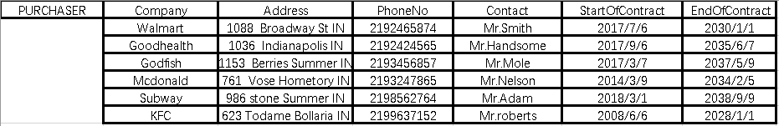
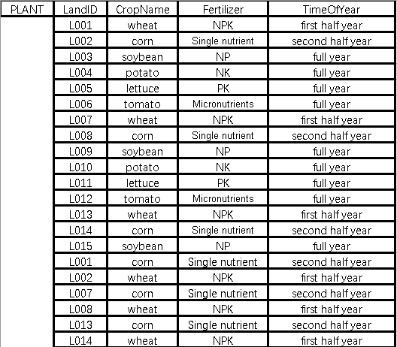
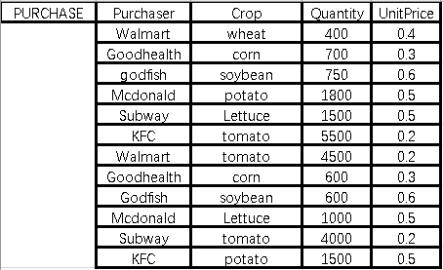
Database Extension

Slide 20
SQL Statements
CREATE TABLE FARMER (
Fname VARCHAR(15) NOT NULL,
Minit CHAR,
Lname VARCHAR(15) NOT NULL,
FID CHAR(5) NOT NULL,
Gender CHAR NOT NULL,
Bdate VARCHAR(10),
PhoneNo CHAR(10) NOT NULL,
LeaderID CHAR(5));

Slide 21
SQL Statements
CREATE TABLE FARMLAND(
LID CHAR(4) NOT NULL,
Area INT NOT NULL,
FarmerID CHAR(5) NOT NULL,
Soil VARCHAR(20));

Slide 22
SQL Statements
CREATE TABLE BARNADMIN (
FirstName VARCHAR(15) NOT NULL,
Mid CHAR,
LastName VARCHAR(15) NOT NULL,
AdminID CHAR(5) NOT NULL,
Gender CHAR NOT NULL,
PNumber CHAR(10) NOT NULL);

Slide 23
SQL Statements
CREATE TABLE BARN(
BID CHAR(4) NOT NULL,
Capacity INTEGER NOT NULL,
Administrator CHAR(5) NOT NULL);

Slide 24
SQL Statements
CREATE TABLE CROP(
Cname VARCHAR(15) NOT NULL,
YieldExp INTEGER,
MaxStorageTime INTEGER,
GrowTime INTEGER,
SeedBrand VARCHAR(15));

Slide 25
SQL Statements
CREATE TABLE PURCHASER(
Company VARCHAR(15) NOT NULL,
Address VARCHAR(50),
PhoneNo CHAR(10) NOT NULL,
Contact VARCHAR(15) NOT NULL,
StarOfContract VARCHAR(10) NOT NULL,
EndOfContract VARCHAR(10)) NOT NULL;

Slide 26
SQL Statements
CREATE TABLE SECTION(
BarnID CHAR(4) NOT NULL,
SectionNo CHAR(4) NOT NULL,
CropName VARCHAR(15),
Temp INTERGE,
Humidity DEMICAL(3,2)
Stock INTERGE);

Slide 27
SQL Statements
CREATE TABLE PLANT(
LandID CHAR(4) NOT NULL,
CropName VARCHAR(15) NOT NULL,
Fertilizer VARCHAR(20),
TimeOfYear VARCHAR(20) NOT NULL);

Slide 28
SQL Statements
CREATE TBALE PURCHASE(
Purchaser VARCHAR(15) NOT NULL,
Crop VARCHAR(15) NOT NULL,
Quantity INTERGE,
UnitPrice DEMICAL(3,1));

