Slide 1
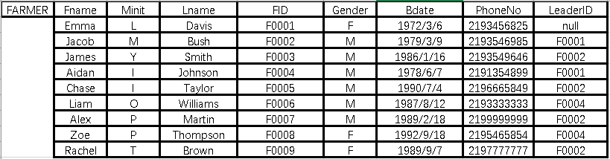
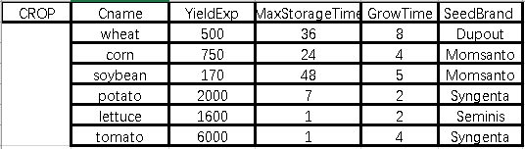
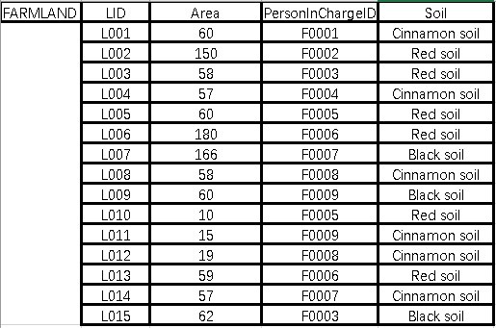
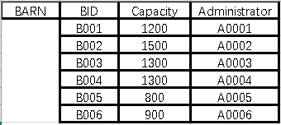
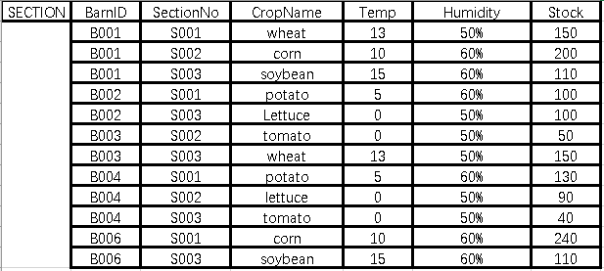
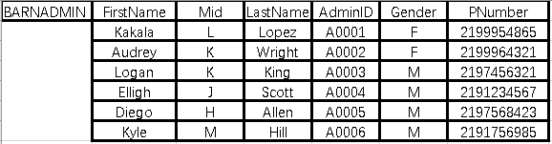

Slide 2
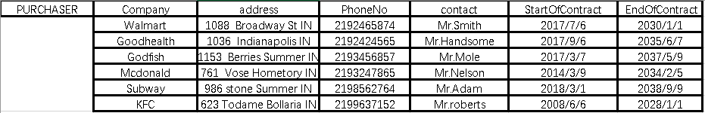
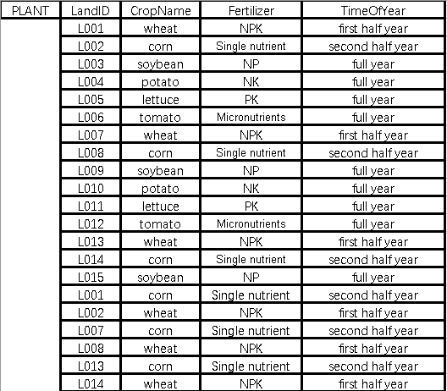
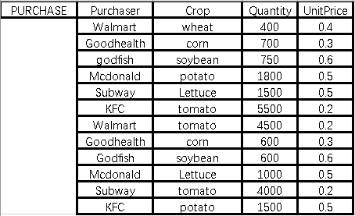

Slide 3
CREATE TABLE SECTION(
BarnID CHAR(4),
SectionNo CHAR(4),
CropName VARCHAR(15),
Temp INTERGE,
Humidity CHAR(4),
Stock INTERGE);
CREATE TABLE PLANT(
LandID CHAR(4),
CropName VARCHAR(15),
Fertilizer VARCHAR(20),
TimeOfYear VARCHAR(20));

Slide 4
CREATE TBALE PURCHASE(
Purchaser VARCHAR(15),
Crop VARCHAR(15),
Quantity INTERGE,
UnitPrice DEMICAL(3,1));

