Slide 1
FARM DATABASE
Group 4
Shuning Pan 6522054
Ang Ding 6522104
Chonghan Chen 6522098
Wenhao Du 6522028
Haoyang Li 6522041

Slide 2
Referential Integrity Constraint Diagram
PURCHASER
Company | Address | PhoneNo | Contact | StartOfContract | EndOfContract
CROP
PURCHASE
Cname | YieldExp | MaxStorageTime | GrowTime | SeedBrand
Purchaser | Crop | Quantity | UnitPrice
PLANT
FARMLAND
LandID | CropName | Fertilizer | TimeOfYear
LID | Area | Soil | FarmerID
FARMER
Fname | Minit | Lname | FID | Gender | Bdate | PhoneNo | LeaderID
SECTION
BARN
BarnID | SectionID | Temp | Humidity | CropName | Stock
BID | Capacity | Administrator
BARNADMIN
FirstName | Mid | LastName | AdminID | Gender | PNumber

Slide 3
Entity-Relationships Diagram
LEADERSHIP
member
leader
1
N
LID
Area
SoilType
Lname
FARMLAND
TAKE_CARE
FARMER
N
1
Name
Minit
N
PhoneNo
FID
Fname
Address
company
Quantity
PLAN
Fertilizer
TimeOfYear
Bdate
Gender
BID
PhoneNo
M
PURCHASER
PURCHASE
CROP
STORE
SECTION
SECTION_OF
BARN
N
M
1
N
N
1
Capacity
Contact
1
Cname
SeedBrand
SectionNo
ADMIN
StartOfContract
UnitPrice
Temp
PNumber
Stock
Humidity
1
EndOfContract
BARNADMIN
Gender
MaxStorageTime
GrowTime
YieldExp
Name
AdminID
Lastname
Firstname
Mid

Slide 4
List of Keys
Entity | Candidate Key(s) | Primary Key | Foreign Key(s) | Composite Key(s)
FARMLAND | FarmerID, LID | LID | FarmerID， LID
CROP |  | Cname | Cname
FARMER | FID, PhoneNo | FID | LeaderID, FID
PURCHASER | Company, PhoneNo | Company | Company
BARN | BID, Administrator | BID | Administrator, BID
BARNADMIN | AdminID, PNumber | AdminID | AdminID
SECTION |  | {BarnID, SectionNo} | CropName BarnID | {BarnID, SectionNo}

Slide 5
Relationship Type
Relationship | Type | From | To
PLANT | N:M | FARMLAND | CROP
TAKE_CARE | 1:N | FARMER | FARMLAND
LEADERSHIP | 1:N | FARMER | FARMER
STORE | 1:N | CROP | SECTION
SECTION_OF | 1:N | BARN | SECTION
PURCHASE | N:M | PURCHASER | CROP
ADMIN | 1:1 | BARN | BARNADMIN

Slide 6
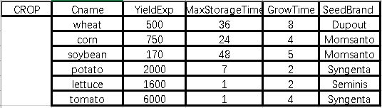
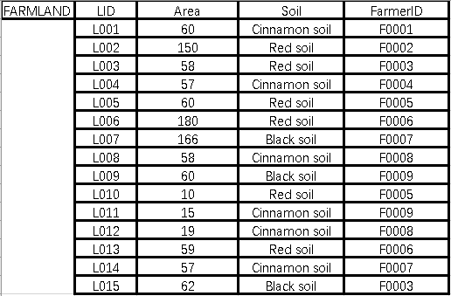
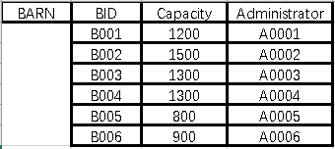
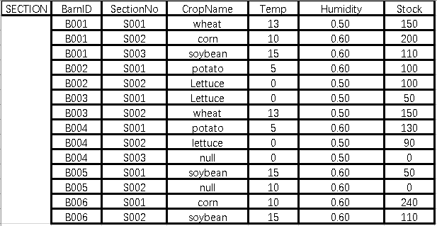
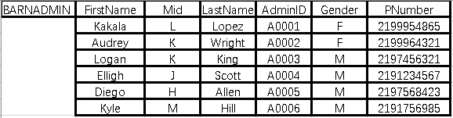
Database Extension

Slide 7
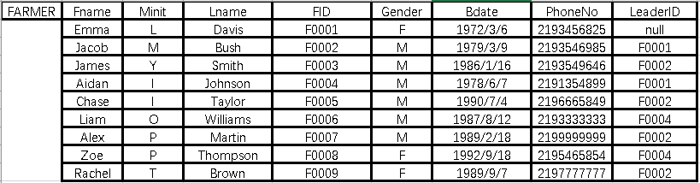
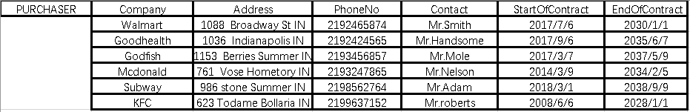
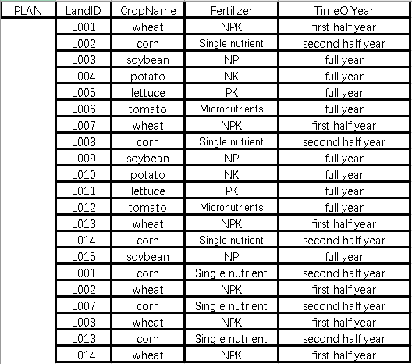
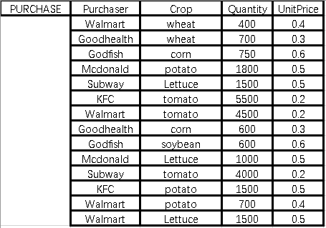
Database Extension

Slide 8
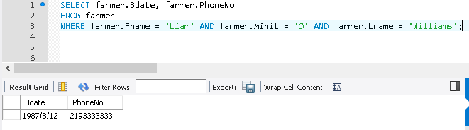
Query 0
Retrieve the birth date and the phone number of the farmer(s) whose name is ‘Kakala L. Lopez’.
SELECT farmer.Bdate, farmer.PhoneNo
FROM farmer
WHERE farmer.Fname = 'Liam' AND farmer.Minit = 'O’ AND farmer.Lname = 'Williams‘;

Slide 9
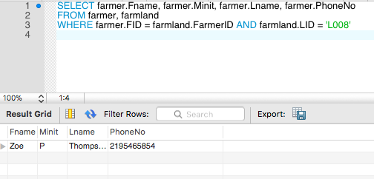
Query 1
Retrieve the name and phone number of the farmer who takes charge of the land of which the ID is L008.
SELECT farmer.Fname, farmer.Minit, farmer.Lname, farmer.PhoneNo
FROM farmer, farmland
WHERE farmer.FID = farmland.FarmerID AND farmland.LID = 'L008'

Slide 10
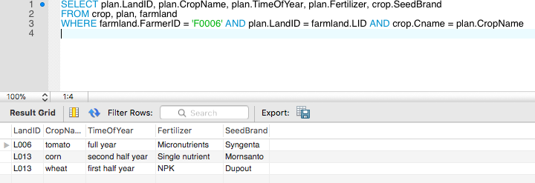
Query 2
For every planting plan of farmlands which are in the charge of the farmer whose ID is F0006, list the land ID, crop name, time of the year, fertilizer, and the seed brand it is using.
SELECT plan.LandID, plan.CropName, plan.TimeOfYear, plan.Fertilizer, crop.SeedBrand
FROM crop, plan, farmland
WHERE farmland.FarmerID = 'F0006' AND plan.LandID = farmland.LID AND crop.Cname = plan.CropName

Slide 11
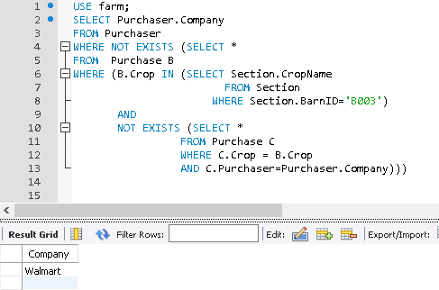
Query 3
Retrieve the company who buy all kind of corns stored in barn B001.
SELECT Purchaser.Company
FROM Purchaser
WHERE NOT EXISTS (SELECT *
FROM Purchase B
WHERE (B.Crop IN (SELECT Section.CropName
FROM Section
WHERE BarnID=’B003’)
AND
NOT EXISTS (SELECT *
FROM Purchase C
WHERE C.Crop = B.Crop
AND C.Purchaser=Purchaser.Company)))

Slide 12
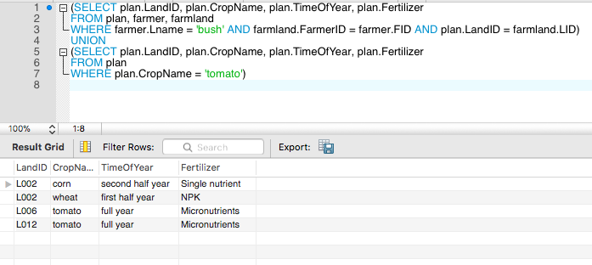
Query 4
Make a list of the land ID, crop name, time of the year, and the fertilizer of each planting plan either in the charge of a farmer whose last name is ‘Bush’, or plant tomato any time of the year.
(SELECT plan.LandID, plan.CropName, plan.TimeOfYear, plan.Fertilizer
FROM plan, farmer, farmland
WHERE farmer.Lname = 'bush' AND farmland.FarmerID = farmer.FID AND plan.LandID = farmland.LID)
UNION
(SELECT plan.LandID, plan.CropName, plan.TimeOfYear, plan.Fertilizer
FROM plan
WHERE plan.CropName = 'tomato')

Slide 13
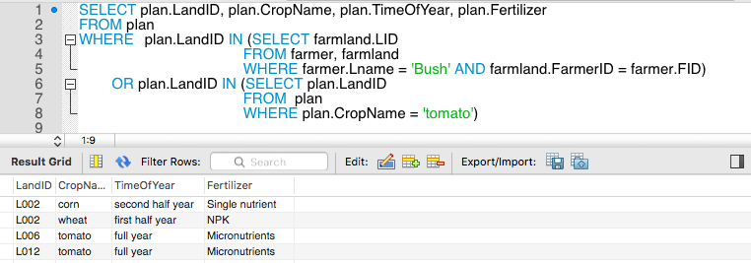
Query 4A
Make a list of the land ID, crop name, time of the year, and the fertilizer of each planting plan either in the charge of a farmer whose last name is ‘Bush’, or plant tomato any time of the year.
SELECT plan.LandID, plan.CropName, plan.TimeOfYear, plan.Fertilizer
FROM plan
WHERE plan.LandID IN (SELECT farmland.LID
FROM farmer, farmland
WHERE farmer.Lname = 'Bush' AND
farmland.FarmerID = farmer.FID)
OR plan.LandID IN (SELECT plan.LandID
FROM plan
WHERE plan.CropName = 'tomato')

Slide 14
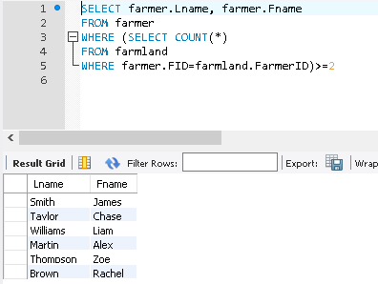
Query 5
Retrieve the names of all farmers who take care of two or more farmlands.
SELECT farmer.Lname, farmer.Fname
FROM farmer
WHERE (SELECT COUNT(*)
FROM farmland
WHERE farmer.FID=farmland.FarmerID)>=2

Slide 15
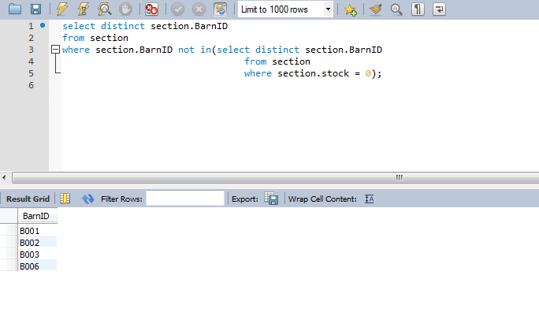
Query 6
Retrieve the IDs of barns of which the sections are all occupied.
SELECT * FROM section;
select distinct section.﻿BarnID
from section
where section.﻿BarnID not in(select distinct section.﻿BarnID
from section
where section.﻿stock = 0);

Slide 16
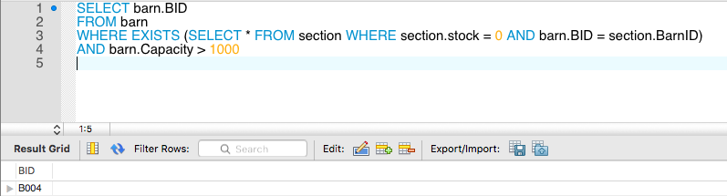
Query 7
List the ID of the barns which has at least one empty section and having a capacity greater than 1000.
SELECT barn.BID
FROM barn
WHERE EXISTS (SELECT * FROM section WHERE section.stock = 0 AND barn.BID = section.BarnID)
AND barn.Capacity > 1000

Slide 17
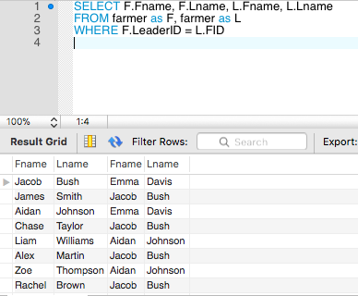
Query 8
For each farmer, retrieve his or her first and last name and the first and last name of his or her immediate Leader.
SELECT F.Fname, F.Lname, L.Fname, L.Lname
FROM farmer as F, farmer as L
WHERE F.LeaderID = L.FID

Slide 18
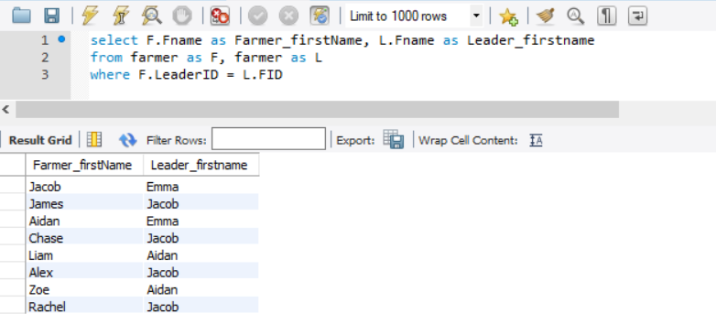
Query 8A
For each farmer, retrieve his or her first name and the first name of his or her immediate Leader.
select F.Fname as Farmer_firstName, L.Fname as Leader_firstname
from farmer as F, farmer as L
where F.LeaderID = L.FID

Slide 19
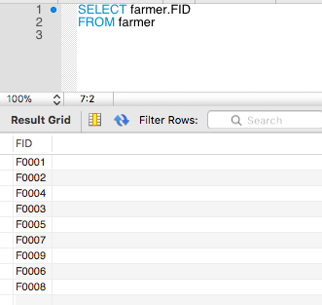
Query 9
Select the ID of all the farmers.
SELECT farmer.FID
FROM farmer

Slide 20
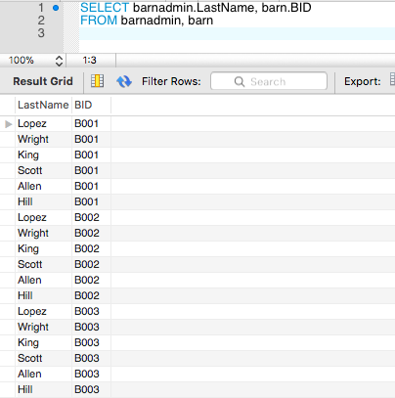
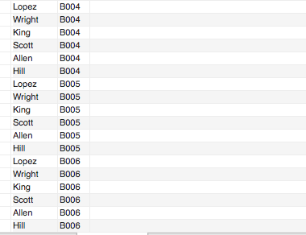
Query 10
Select all combinations of barn administrator’s last name and the id of the barn that he or she takes charge of.
SELECT barnadmin.LastName, barn.BID
FROM barnadmin, barn

Slide 21
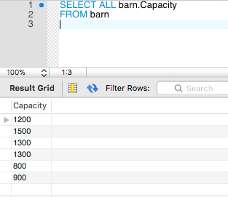
Query 11
Retrieve the capacity of all barns
SELECT ALL barn.Capacity
FROM barn

Slide 22
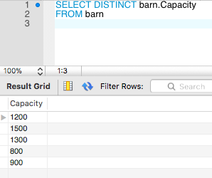
Query 11A
Retrieve the capacity of all barns
SELECT DISTINCT barn.Capacity
FROM barn

Slide 23
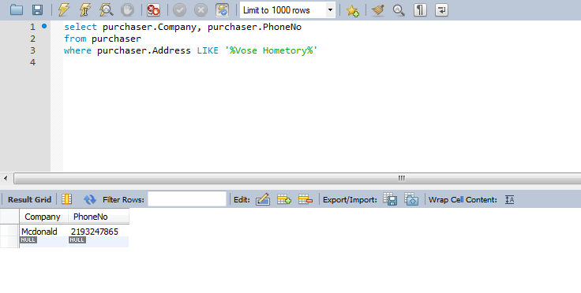
Query 12
Retrieve all company and their phone, whose address is in “Vose Hometory”.
select purchaser.Company, purchaser.PhoneNo
from purchaser
where purchaser.Address LIKE '%Vose Hometory%'

Slide 24
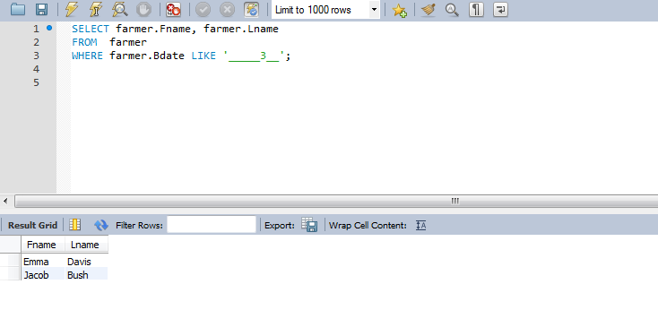
Query 12A
Find all the farmer whose birthdate is in March.
SELECT farmer.Fname, farmer.Lname
FROM farmer
WHERE farmer.Bdate LIKE '_____3__';

Slide 25
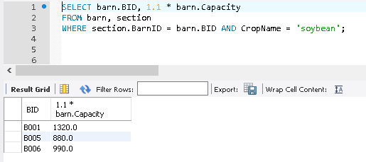
Query 13
Show the result of the capacity if every barn involved in soybean storage is expanded by 10 percent.
SELECT barn.BID, 1.1 * barn.Capacity
FROM barn, section
WHERE section.BarnID = barn.BID AND CropName = 'soybean';

Slide 26
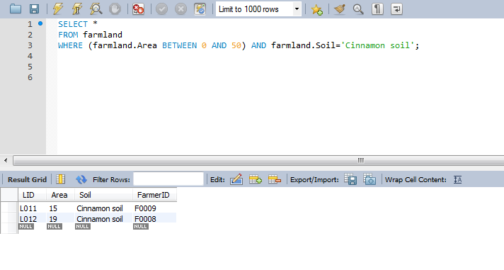
Query 14
Retrieve all farmland which has ‘Cinnamon soil’ and the area of land is between 0 and 50.
SELECT *
FROM farmland
WHERE (farmland.Area BETWEEN 0 AND 50) AND farmland.Soil='Cinnamon soil';

Slide 27
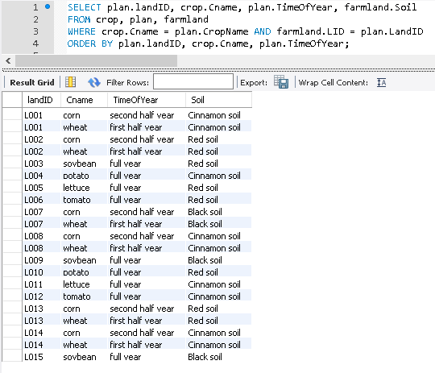
Query 15
For each piece of land, retrieve the landID, crop name, the soil type of the land, and the grow time of the crops, ordered by land ID, and, for each piece of land, ordered alphabetically by crop name, then grow time.
SELECT plan.landID, crop.Cname, plan.TimeOfYear, farmland.Soil
FROM crop, plan, farmland
WHERE crop.Cname = plan.CropName AND farmland.LID = plan.LandID
ORDER BY plan.landID, crop.Cname, plan.TimeOfYear;

Slide 28
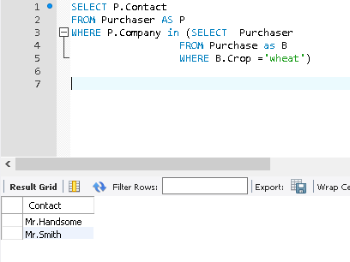
Q16.
Retrieve the contacts of purchasers who buy wheat.
SELECT P.Contact
FROM Purchaser AS P
WHERE P.Company in (SELECT Purchaser
FROM Purchase as B
WHERE B.Crop ='wheat')

Slide 29
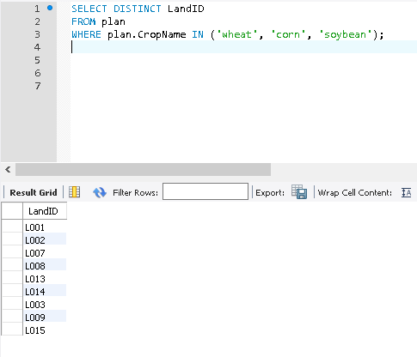
Query 17
Retrieve the LandID of all farmland where is planted wheat, corn or soybean any time of a year.
SELECT DISTINCT LandID
FROM plan
WHERE plan.CropName IN ('wheat', 'corn', 'soybean');

Slide 30
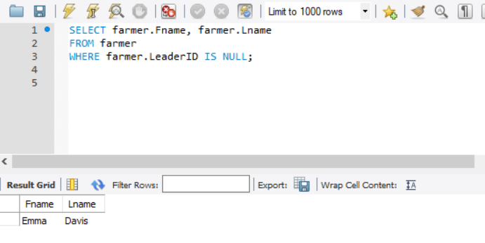
Query 18
Retrieve the names of all famers who do not have supervisors.
SELECT farmer.Fname, farmer.Lname
FROM farmer
WHERE farmer.LeaderID IS NULL;

Slide 31
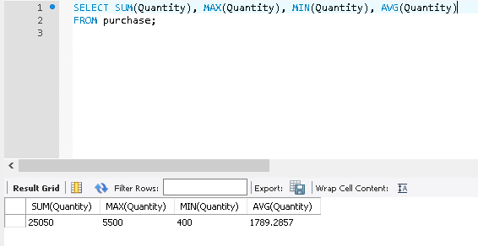
Query 19
Find the sum of the purchase quantity of all purchasers, the maximum quantity, the minimum quantity, and the average quantity. (i.e. maximum, minimum and average quantity refer to quantity of one kind of corn bought by one purchaser)
SELECT SUM(purchase.Quantity), MAX(purchase.Quantity), MIN(purchase.Quantity), AVG(purchase.Quantity)
FROM purchase;

Slide 32
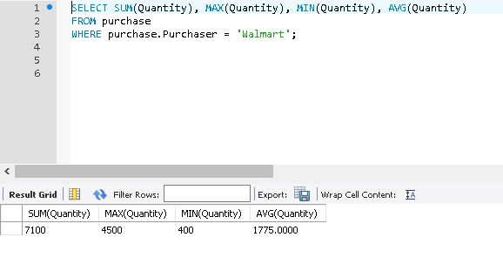
Query 20
Find the sum of the purchase quantity of Walmart, as well as the maximum quantity, the minimum quantity, and the average quantity. (i.e. maximum, minimum and average quantity refer to quantity of one kind of corn bought by Walmart)
SELECT SUM(purchase.Quantity), MAX(purchase.Quantity), MIN(purchase.Quantity), AVG(purchase.Quantity)
FROM purchase
WHERE purchase.Purchaser = 'Walmart';

Slide 33
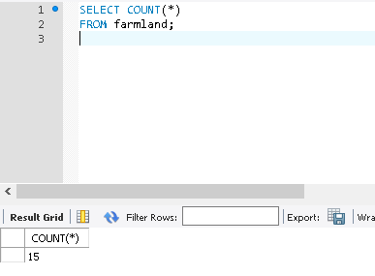
Query 21
Retrieve the total number of farmlands of the farm.
SELECT COUNT(*)
FROM farmland;

Slide 34
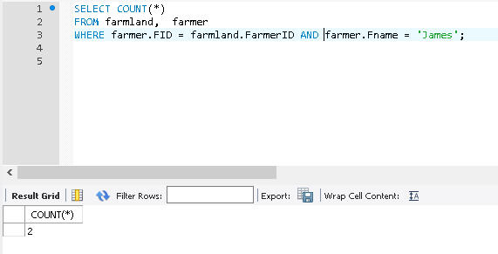
Query 22
Retrieve the number of farmlands taken care of by the farmer whose firstname is ‘Emma’.
SELECT COUNT(*)
FROM farmland, farmer
WHERE farmer.FID = farmland.FarmerID AND farmer.Fname = 'James';

Slide 35
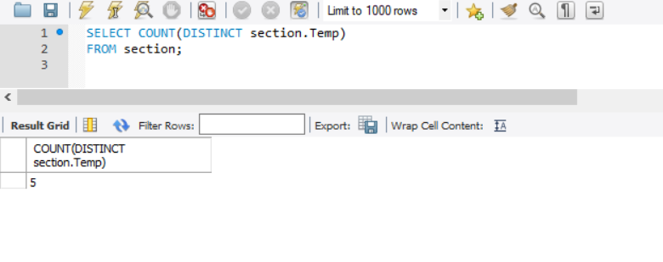
Query 23
Count the number of distinct temperature values of sections
SELECT COUNT(DISTINCT section.Temp)
FROM section;

Slide 36
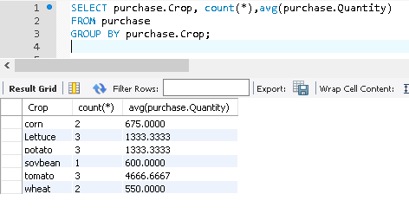
Query 24.
For each purchased crop, list the number of company purchasing it, along with the average quantity.
SELECT purchase.Crop, count(*),avg(purchase.Quantity)
FROM purchase
GROUP BY purchase.Crop;

Slide 37
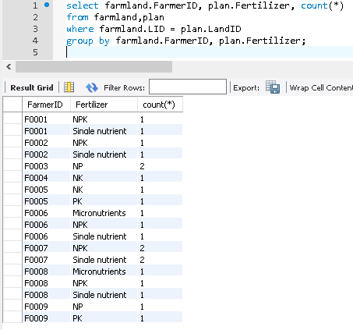
Query 25
For each farmer being in charge of a piece of land, list his or her ID, the fertilizers used in the land, and how many times each fertilizer is used.
select farmland.FarmerID, plan.Fertilizer, count(*)
from farmland,plan
where farmland.LID = plan.LandID
group by farmland.FarmerID, plan.Fertilizer;

Slide 38
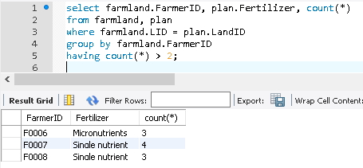
Query 26
For each plan on which more than two types of fertilizer are used, retrieve the crop name, farmer ID and the number of fertilizer.
select farmland.FarmerID, plan.Fertilizer, count(*)
from farmland, plan
where farmland.LID = plan.LandID
group by farmland.FarmerID
having count(*) > 2;

Slide 39
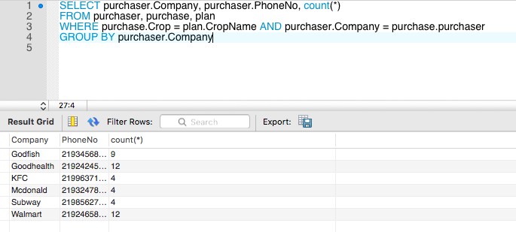
Query 27
For each purchaser, retrieve the company name, the phone number, and the number of plans its purchase involves. (i.e. how many plans can potentially yield the product it desires)
SELECT purchaser.Company, purchaser.PhoneNo, count(*)
FROM purchaser, purchase, plan
WHERE purchase.Crop = plan.CropName AND purchaser.Company = purchase.purchaser
GROUP BY purchaser.Company

Slide 40
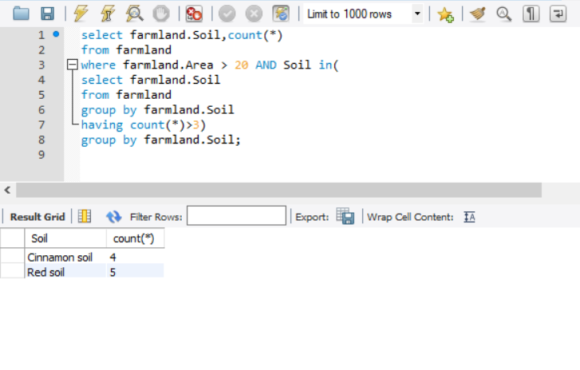
Query 28
Retrieve the farmland soil, the farmland area which greater than 20 and the number of soil which greater than 3.
select farmland.Soil,count(*)
from farmland
where farmland.Area > 20 AND Soil in(
select farmland.Soil
from farmland
group by farmland.Soil
having count(*)>3)
group by farmland.Soil;

