Slide 1
Welcome & Workshop Overview
What we learn today:
Set up Git and VS Code
Track and manage code with version control
Back up your project
Share code with others
No prior experience necessary!
Workshop materials are available at: https://github.com/dianita956/git_vscode_wrkshp26

Slide 2
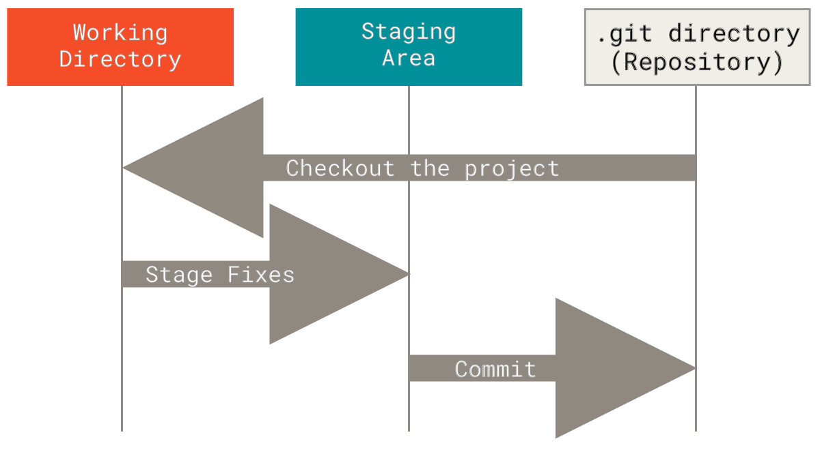
What is Git?
Git = A version control system that:
Tracks changes to your files over time
Lets you experiment safely
Helps you collaborate with others
Keeps a history of all your work
Think of it as “Track Changes” for code!

Slide 3

What’s is VS Code?
Visual Studio Code = A powerful code editor with:
- Built-in Git support
- Syntax highlighting
- Extensions and customization
- Integrated terminal
- Cross-platform (Windows, Mac, Linux)

Slide 4
Key Terms- Directories and Folders
Directory and Folder
Used interchangeably in Git
Both mean: a container for files and other folders

Slide 5
The three sections of Git Workflow
1. Working Directory
  where you edit files
2. Staging Area
- where you prepare changes
3. .git directory
- where commits are stored

Slide 6
The three states of Git
State | Description
Modified | You’ve changed the file
Stage | Modified file(s) are ready for commit
Committed | The file’s snapshot is stored in the Git database

Slide 7
Git Workflow image

Slide 8

Understanding Branches
main or master
The default branch (primary version of your project)
Branch
Pointers to different parts of a project
lets you try or test code without affecting main
Remote
- A version of your repository hosted on GitHub

Slide 9
Basic terminal Commands
Show current working directory:
Windows: `cd` (without argument)
Mac/Linux: `pwd`
Navigates:
`cd <directory>` - changes to new working directory/folder
Initialize Git:
`git init` - initiate Git repository

Slide 10
Installation

Slide 11

Installing GIT
Install Git:
- Visit: https://git-scm.com
- Download Git Executable file for windows operating system: https://git-scm.com/install/windows
- Follow the installation wizard

Slide 12
Alternative method to Install GIT on MAc
Step | Command | Purpose
1 | /bin/bash -c "$(curl -fsSL https://raw.githubusercontent.com/Homebrew/install/HEAD/install.sh)" | Install Homebrew
2 | brew install git | Install Git
3 | git --version | Verify installation (Latest: 2.52.0)
4 | brew upgrade git | Update Git

Slide 13
Install VS code
- Visit: https://code.visualstudio.com/
- Download for your operating system
- Install and launch

Slide 14
Getting started with Git and Vs Code
Hands on activity

Slide 15
Follow along as we
*refer to activity steps Handout
create a repository
make changes to files
stage and commit changes
view our Git history

Slide 16
command line activity
Basic Git Commands:
git init # Initialize repository
git status # Check status
git add <file> # Stage files
git commit -m "msg" # Commit changes
git log # View history

Slide 17
Using git in vs Code
VS Code makes Git visual!
Source Control panel:
see modified files at a glace
stage changes with one click
write commit message in the user interface (UI)
view Git history with extensions

Slide 18
Best practices
Do
commit often with descriptive message
use branches for new features
pull before you push
review changes before committing
Don’t
commit sensitive information (passwords, keys, tokens)
use vague commit message like “fixed stuff” or “wishing for the best”
work directly on main for big changes

Slide 19
Resources
Official Documentation:
- Git https://git-scm.com
- VS Code https://code.visualstudio.com/
- Pro Git Book https://git-scm.com/book/en/v2
- Git Cheat Sheet https://git-scm.com/cheat-sheet
Available at UTSA:
- Vibe Coding with GitHub Copilot https://utsa.primo.exlibrisgroup.com/permalink/01UTXSANT_INST/k74a8h/alma9939412878204621

Slide 20
Contact Information
Diane López, Information Specialist
  email: diane.lopez2@utsa.edu
Community Engaged Digital Scholarship Hub
  CEDISH email: cedish@utsa.edu

Slide 21
Q&A and Next steps
Questions?
Continue Learning:
- Practice with your own projects
- Explore GitHub for collaboration
- Try branching and merging
- Join coding communities
Thank you for attending!

Slide 22
Thank you
-UTSA Libraries
diane.lopez@utsa.edu
Cedish@utsa.edu

