Slide 1
Planning as Autoregressive Sequence Modelling: Decoding Strategies
By Dian Kruger
Supervised by Shane Josias

Slide 2
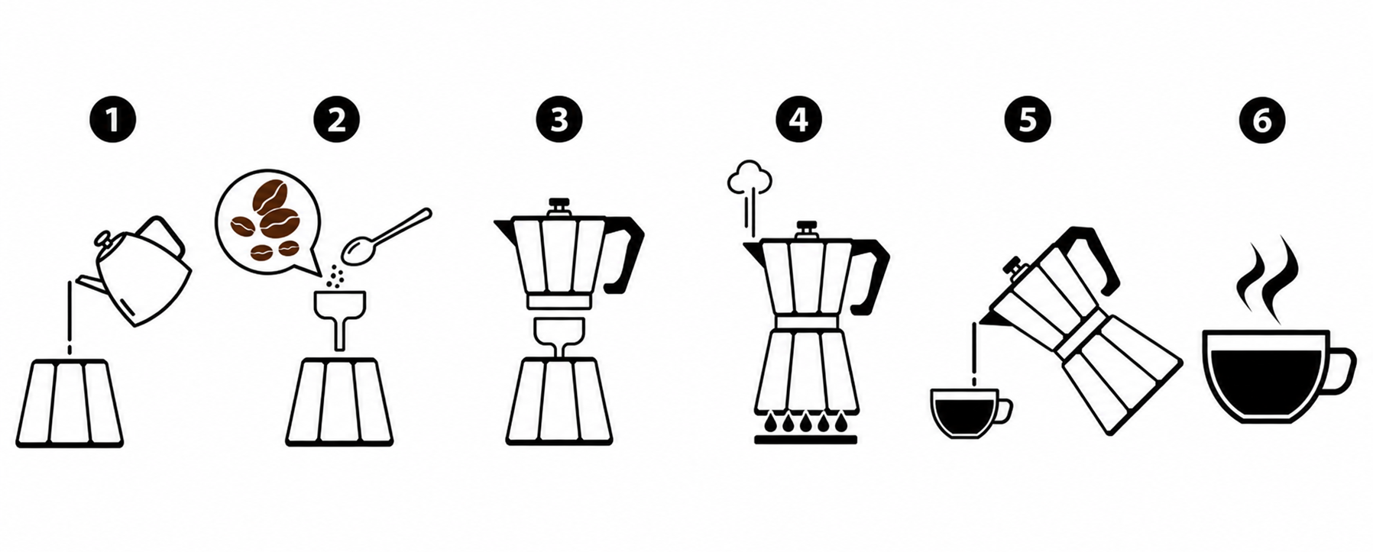

What is planning?
Planning is deciding which actions to take, and in what order so that an environment changes from the initial state to the goal state.

Slide 3
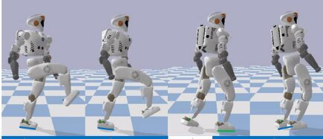

Why learn to plan from data?
Machines can learn to automatically solve planning problems.
This can be done through trial and error, using techniques like reinforcement learning.
Learning through trial and error can be risky in safety-critical or expensive settings.

Slide 4
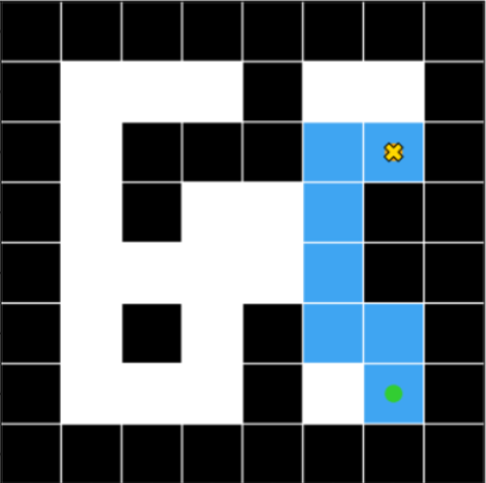
Our planning problem
The environment is a discrete 2D maze represented as a grid.
A move can go only up, down, left, or right.
A start square and a goal square are given.
The objective is to generate a valid sequence of moves that reaches the goal without passing through walls.

Slide 5
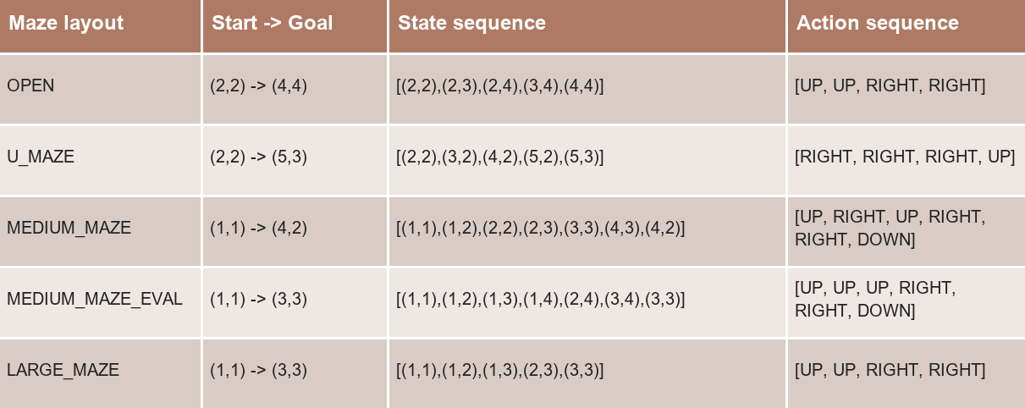
Imitation learning in the maze

Slide 6

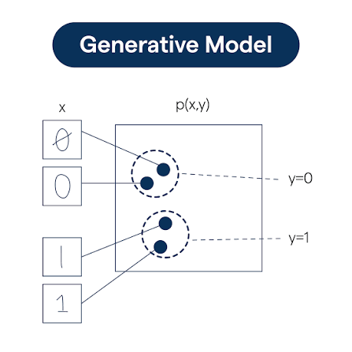
Generative modelling

Slide 7
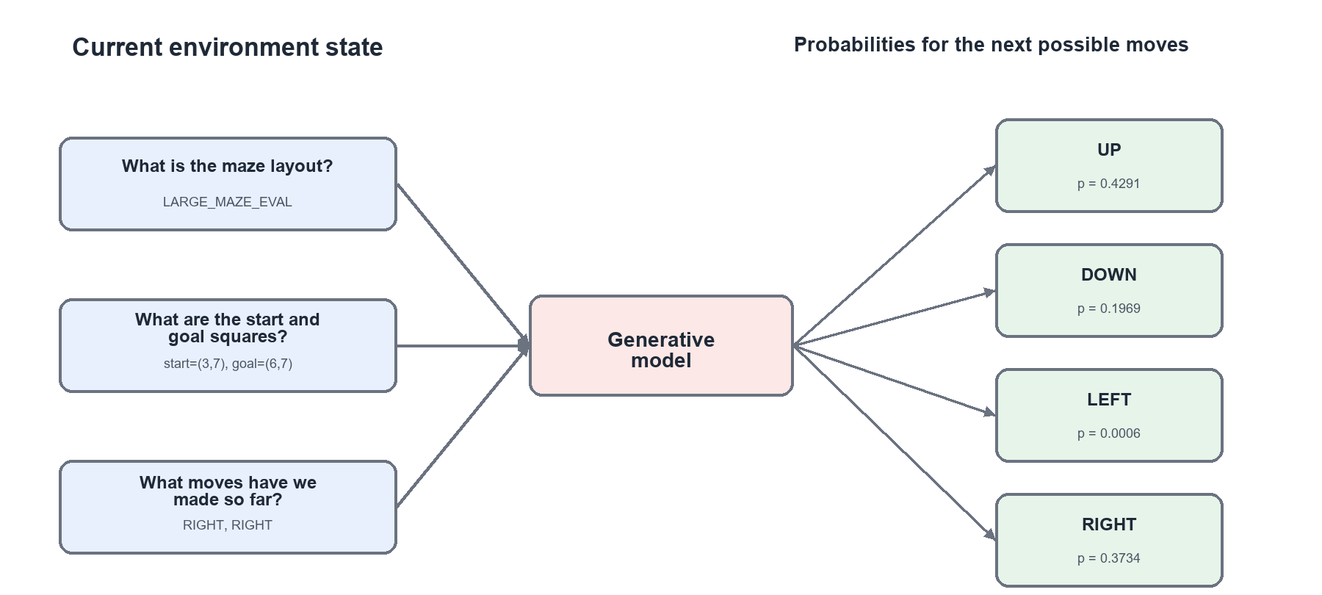
Autoregressive sequence modelling

Slide 8
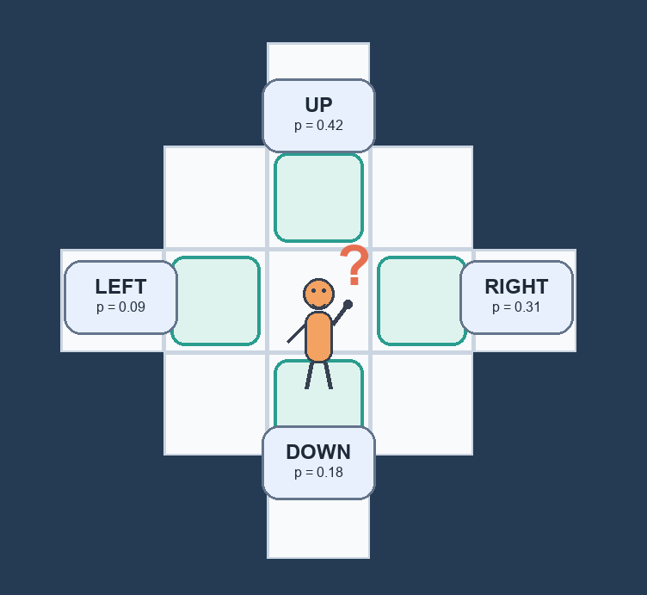
Decoding algorithms

Slide 9
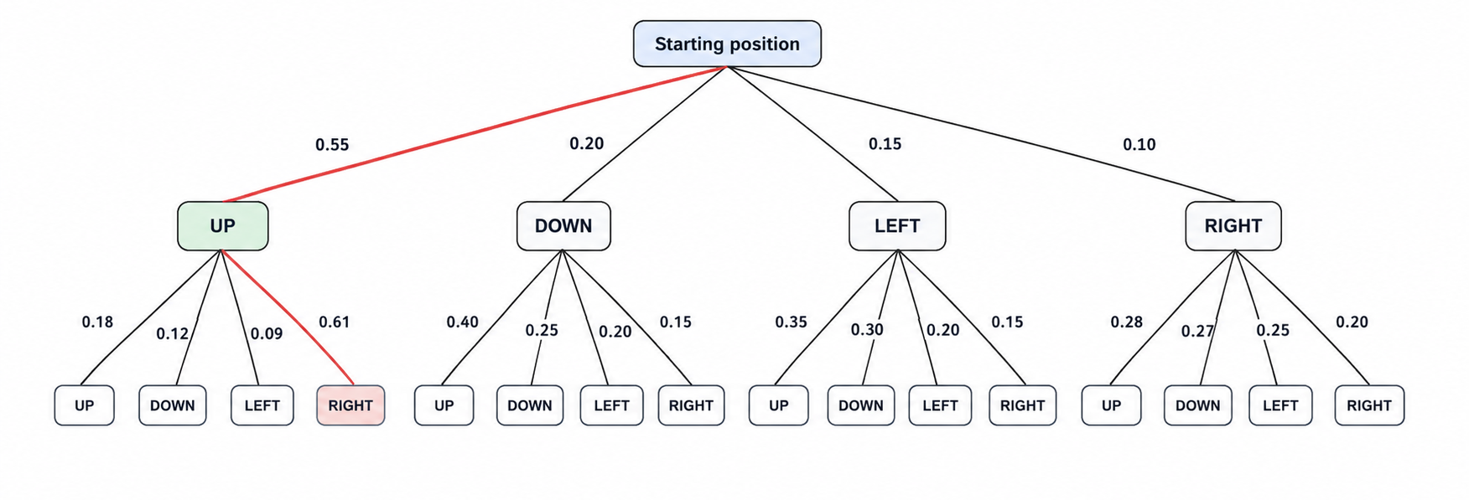
Greedy decoding

Slide 10
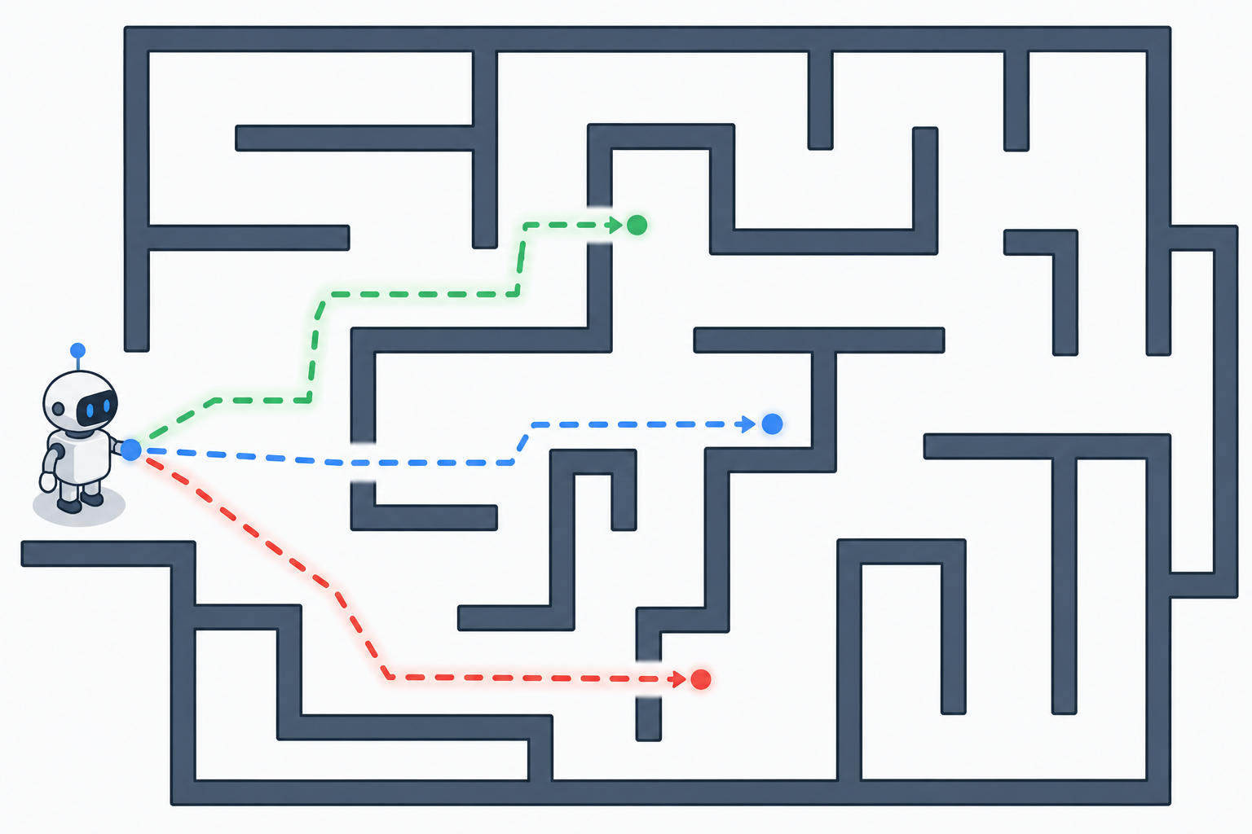
Beam search

Slide 11

Evaluation metrics
Completion Rate
Average Steps to Goal
Average Compute Time
Average Time per Step

Slide 12
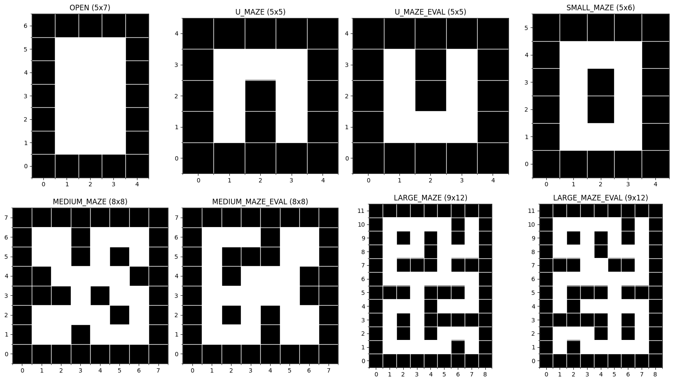

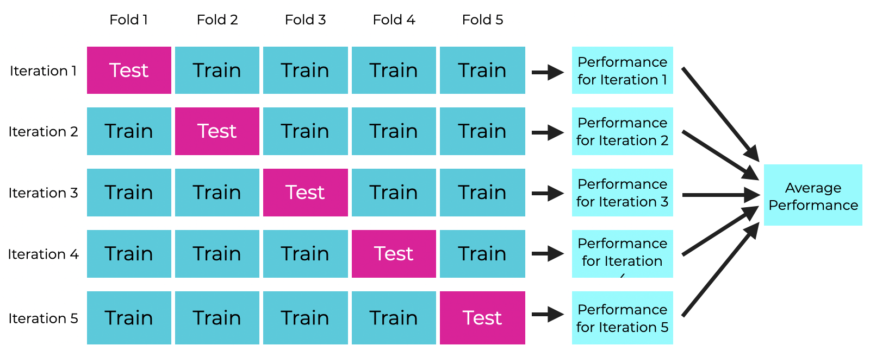
Dataset and evaluation approach
The eight maze layouts
example of a training trajectory
5-fold cross validation

Slide 13
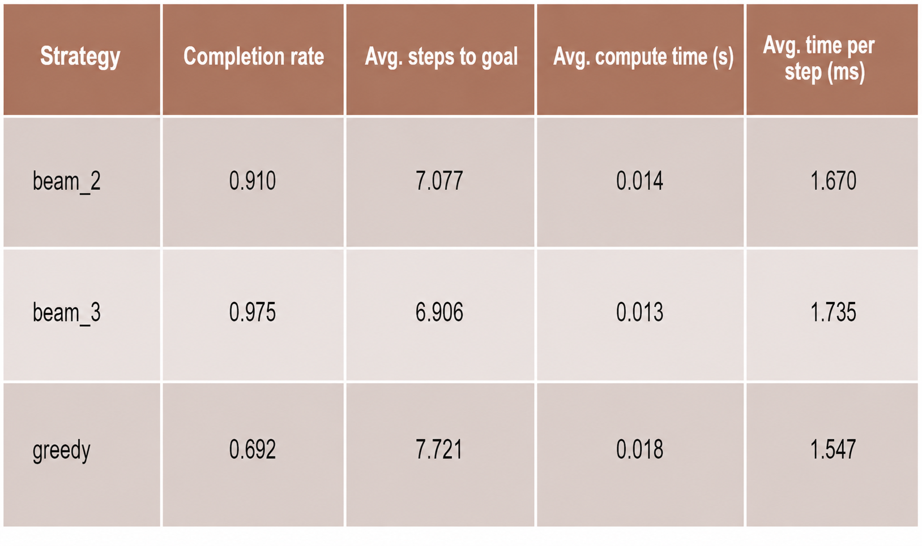
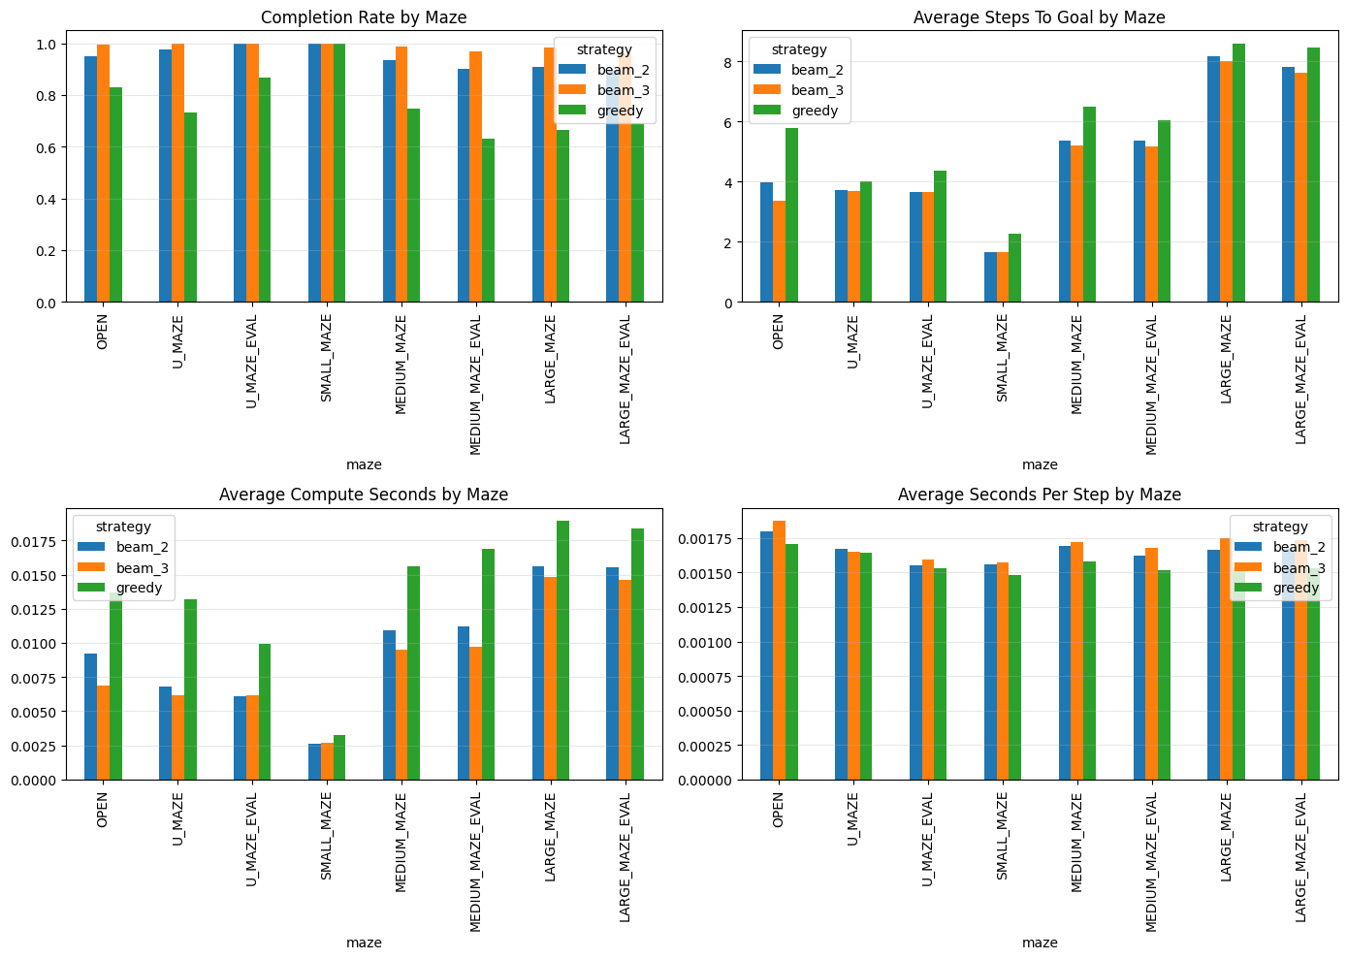
results

Slide 14
Future work
Test how strongly the results depend on training on optimal trajectories.
Compare additional decoding strategies beyond greedy and beam search.
Explore combining model probabilities with reward-based guidance during decoding.

Slide 15
Q&A

