Slide 1

Diana Postica
Movie Rental Analysis
Rockbuster Stealth

Slide 2




Answer business questions to help Rockbuster company create its 2020 strategy plan to launch an online video rental service to stay competitive.
Goal

Slide 3
Business Questions
Which movies contributed the most/least to revenue gain?
What was the average rental duration for all videos?
Which countries are Rockbuster customers based in?
Where are customers with a high lifetime value based?
Do sales figures vary between geographic regions?

Slide 4

At First Glance
2 Stores
20 Categories
109 Countries
599 Customers
1000 Movies
16044 Rentals
61312 $ Revenue

Slide 5
Rental Rate
Maximum
4,99 $
Minimum
0,99 $
Average
2,98 $
Rental Duration
Maximum
7 day
Minimum
3 days
Average
5 days
Length
Maximum
185 min
Minimum
46 min
Average
115 min
Replacement Cost
Maximum
29,99 $
Minimum
9,99 $
Average
19,98 $
Movie Rental Summary

Slide 6
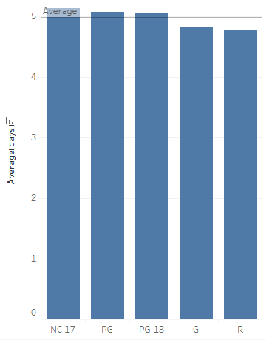
Average Rental Duration for All Videos by Rating
Average rental duration for all movies is 5 days.
Above average rental movie ratings:
NC-17 (No Children Under 17 Admitted)
PG (Parental Guidance Suggested)
PG-13 (Parents Strongly Cautioned)
Below average rental movie ratings:
G (General Audiences)
R (Restricted)

Slide 7
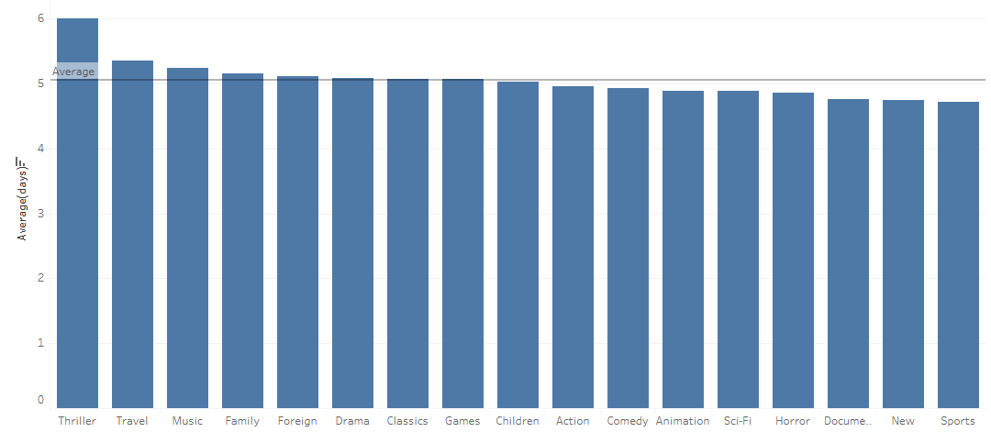
Average Rental Duration by Genre
Top 3 Categories rented for longer than average:
Thriller
Travel
Music
Categories rented with a duration less than average:
Documentary
News
Sports

Slide 8
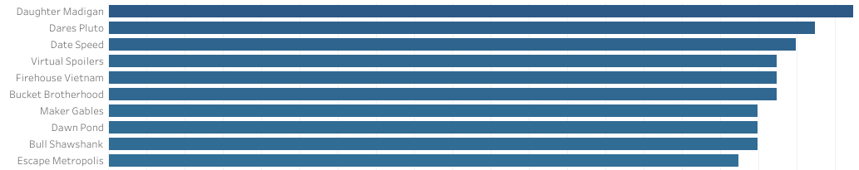
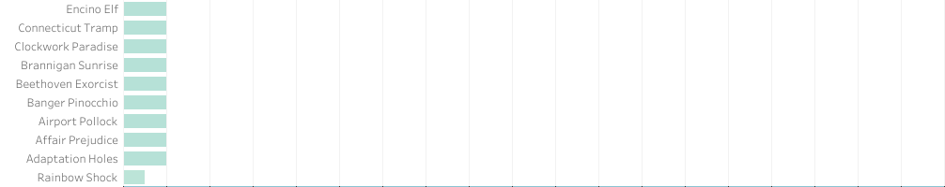
Most/Least Movie Contribution to Revenue
AVERAGE
35,16 $
AVERAGE
1,88 $

Slide 9
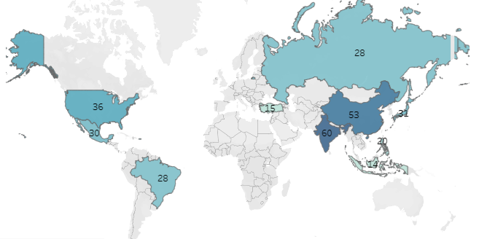
Customer Distribution in the World
Country | Total Clients | % of the Total
India | 60 | 10.0%
China | 53 | 8.8%
United States | 36 | 6.0%
Japan | 31 | 5.2%
Mexico | 30 | 5.0%
Russian Federation | 28 | 4.7%
Brazil | 28 | 4.7%
Philippines | 20 | 3.3%
Turkey | 15 | 2.5%
Indonesia | 14 | 2.3%

Slide 10
Top 10 in the World
Top 10 CITIES in the top 10 Countries
Aurora
Acua
Citrus Heights
Iwaki
Ambattur
Shanwei
So Leopoldo
Teboksary
Tianjin
Cianjur
Top 10 COUNTRIES
India
China
United States
Japan
Mexico
Brazil
Russian Federation
Philippines
Turkey
Indonesia

Slide 11
Top 5 Customers
Top 5 Customers in the TOP 10 CITIES | Total Amount Paid
Arlene Harvey | 111,76 $
Kyle Spurlock | 109,71 $
Marlene Welch | 106,77 $
Glen Talbert | 100,77 $
Clinton Aurora | 98,76 $
Top 5 Customers in the WORLD | Total Amount Paid
Eleanor Hunt | 211,55 $
Karl Seal | 208,58 $
Marion Snyder | 194,61 $
Rhonda Kennedy | 191,62 $
Clara Shaw | 189,6 $
The average total amount paid by each customer is 102 $
Top 10 customers in the world are not the same as the top 10 customers in the top 10 cities.
Some of the top 5 customers in the top 5 cities have spent a total amount less than average!

Slide 12
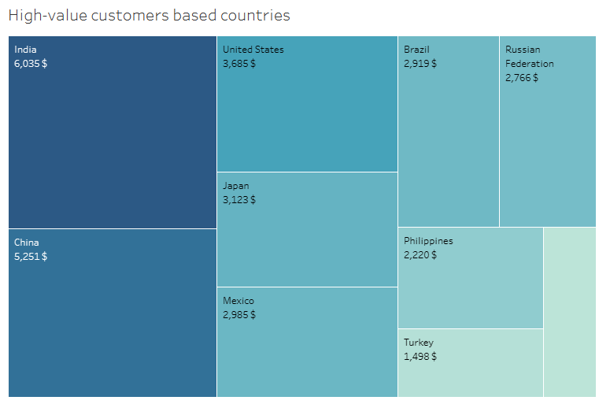
Variation of Sales Figures by Countries
Sales figures vary between geographic regions
The top 10 countries’ total revenue makes up 52% of the total gain.
Top 3 in the top 10:
India – 9,8 %
China – 8,5 %
USA – 6%

Slide 13
Films contributed the most, with an average of 35.16$, and the least with an average of 1.88$.
Movies are rented for an average of five days.
Countries with high lifetime value customers are also the countries with the highest number of customers.
The sales figures are not the same between the countries.
Insights

Slide 14
Create different memberships with different discounts and special offers for different customer segments. This way the loyal customers will be rewarded and the regular customer will be encouraged to become loyal.
Promote movies that bring the least revenue.
Create customized content for customers depending on the country they are in.
Add new movies in categories and ratings that are more popular.
Develop strategies to enter new potential markets, like Europe, Canada, African and South American countries.
Recomm-endations

Slide 15

Diana Postica posticadiana94@gmail.com
Thank you

