Slide 1

Unplug Your Refrigerator...
Entering the Internet of Things (IoT) space and looking at its implications on cybersecurity using Shodan.io
By:
Diante Jackson, CougarCS InfoSec Workshop Lead
Amani Jackson, Fortune 100 Cyber Strategy Consultant

Slide 2

Table of Contents
Intro
What is IoT?
What is Shodan?
Demos
North Korea
I C U ^_^
Passwords? Nah I'm Good
Serious Implications
Outro

Slide 3
Introduction to IoT
What is the Internet of Things? Why does it matter?

Slide 4
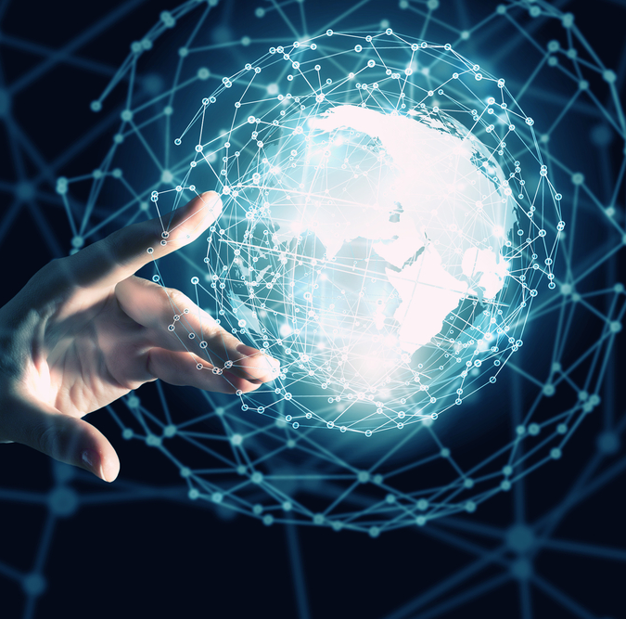
IoT
The Internet of Things (IoT) refers to the online networks of interconnected devices which communicate with other devices in their surrounding environments. These connections are remotely facilitated via data centers, resulting in increased reactivity and responsiveness.

Slide 5

What is Shodan and Why Use It?
Shodan, short for Sentient Hyper-Optimized Data Access Network, is a search engine for internet-connected devices. From routers and servers to energy plants and transportation systems, Shodan can provide details on the device's location, what organization owns it, protocols in use, and other technical measures.
Cybersecurity professionals may leverage Shodan to discover vulnerable devices on the web. When dealing with corporate networks, the time it would take to run scans manually is greatly reduced. When dealing with zero-day vulnerabilities, researchers may use Shodan to gather large-scale information on impacted devices with minimal impact.

Slide 6
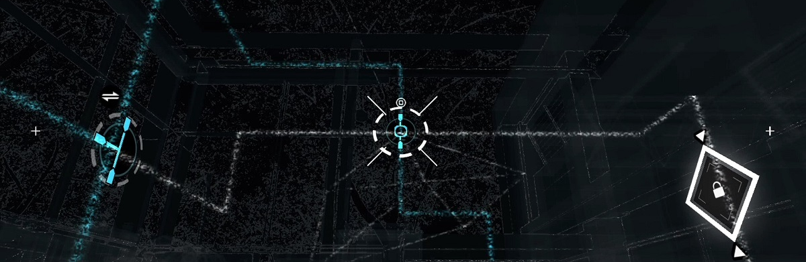
So... Let Me Show You Why This Matters!
Let's evaluate the inherent issues that Shodan allows us to observe!
This Photo by Unknown author is licensed under CC BY.
Notes:
Have you guys ever played Watchdogs? Yes? Well what if I told you that that game has a strong basis in reality. We may not have some screwed up, centralized network like ctOS within the game, but because of the inherent accessibility that IoT and the internet in general provides, we can still replicate most, if not all of the attacks or intelligence collection techniques within the game. Scary right? Let's take it further...

Slide 7

North Korea is not safe from IoT...
It's a common misconception that the DPRK has little to no modern infrastructure regarding the internet. You'd be shocked to find that not only do they possess many devices operating within their limited space, but that we can collect intelligence on those devices!
Let's explore the results.
Notes:
https://www.shodan.io/search?query=net%3A175.45.176.0%2F22%2C210.52.109.0%2F24
This query specifies the known IP range that possesses North Korean devices and infrastructure.

Slide 8

I C U ^_^ <3
Yeah... Um... Cringe...
Guys. If you EVER have an IP camera... scratch that... ANY camera... please don't make it internet accessible.
We can see you bruh...
I'm literally watching TV with you right now...
Let's watch other people now too! (in a totally non-illegal way I promise)
This Photo by Unknown author is licensed under CC BY-NC-ND.
Notes:
https://www.shodan.io/search?query="Server%3A+IP+Webcam+Server"+"200+OK"
Nothing was breached while developing this demonstration.

Slide 9
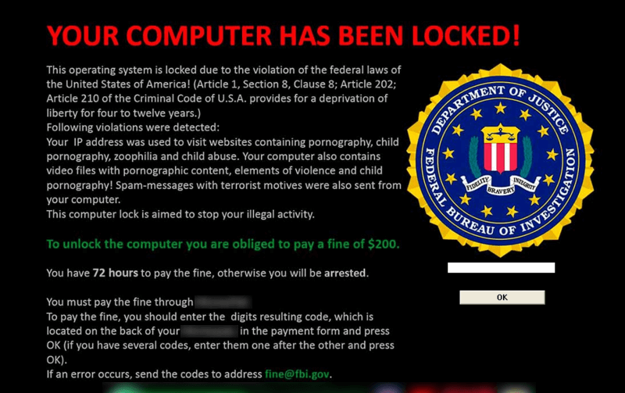
Doomed Desktops (guys... seriously... passwords...)
Guys... I just told you quit making stuff accessible...
Leaving your Remote Desktop of ALL things not only accessible to IoT, but without a password or any form of authentication, is a surefire way to compromise your network.
Actually... Burn everything. Break your hard drives. By the time I see it on here you've already been hacked by half of the world.
Half of the middle east has been watching cooking tutorials with you...
Anyways, let's go be peeping toms again!
This Photo by Unknown author is licensed under CC BY-NC-ND.
Notes:
https://www.shodan.io/search?query="authentication+disabled"+"RFB+003.008"
We won't connect, for obvious reasons. We'll let the shodan screenshots do the talking.

Slide 10
Let's Get Serious
Although we have been joking about spying and peeping on unsuspecting victims, it's still a very serious topic. There have been numerous instances of so-called "smart homes" and "security systems" being leveraged against themselves and exposing one's family, assets and secrets to surveillance that you would NEVER expect.
As a security professional, these risks go further than just simple surveillance. Let's look further.

Slide 11
Exposing Assets
Apache Directory Listing Dorks
When an index(.html/.php) file is not present, Apache lists directory contents by default, presenting an opportunity for attackers to search for specific filenames/types and attack.
SMB (Samba File Share) (most common port[s]: 445, 139)
Samba is a file share protocol which is EXTREMELY dangerous to leave unsecured, as it can be enumerated to give critical system information as well as potentially leaking sensitive files.
WordPress Misconfigurations:
Misconfigurations or human error during WordPress installations can lead to a leak of database credentials and code execution.
Telnet (most common port: 23) IMPORTANT!!!
Telnet is a protocol used for terminal-to-terminal communication, which commonly presents itself as an interactive shell. We can leverage this to completely control a system and/or network.
Notes:
Apache: https://www.shodan.io/search?query=http.title%3A%22Index+of+%2F%22+http.html%3A%22.pem%22
SMB: https://www.shodan.io/search?query=%22Authentication%3A+disabled%22+port%3A445
WP: https://www.shodan.io/search?query=http.html%3A"*+The+wp-config.php+creation+script+uses+this+file"
Telnet: https://www.shodan.io/search?query="root%40"+port%3A23+-login+-password+-name+-Session

Slide 12

Outro
Are you using passwords yet??????

Slide 13
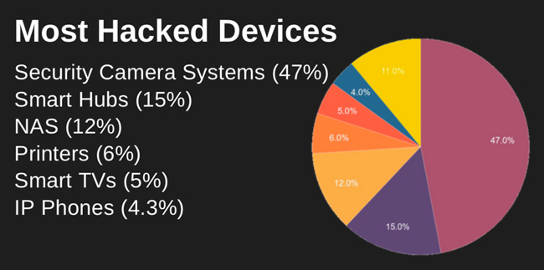
What have we learned?
So...yeah. I hope you learned a little something about Shodan and think about just how secure the internet-connected devices all around us really are. They aren't.
Security professionals have been forced to adapt and are failing continuing to find ways to protect everyday individuals and corporations alike from the issues that arise from oversharing, human error, and poor policy enforcement.
We also learned to stop port-forwarding and to use passwords! I hope... right?
This Photo by Unknown author is licensed under CC BY-SA.

Slide 14
Exploitation & Tools
My team, the Rolan Group (formerly DeleteHumanity/L33TSTR33T), has leveraged CVE's and Shodan's search engine to develop tools & exploits targeting IoT devices. These are some examples:
Sanduuz – SHET (Smart Home Exploitation Tool)
https://github.com/Sanduuz/SHET
Leverages a Proof-of-Concept RCE vulnerability and automates the exploitation of Contec Intelligent Housing smart homes and devices.
J4ck – DeepHeat
https://github.com/j-4ck/DeepHeat/
Exploits a sensitive data disclosure vulnerability to dump Heatmiser thermostat/temperature control logins.
DeleteHumanity – WePrint
No longer hosted on GitHub.
Automates flooding internet-accessible printer queues with an image and scheduling it to print, all while unauthenticated.

Slide 15
Thanks To:
Amani Jackson, Cyber Strategy Consultant and UTSA Alumna
Developed demonstrations.
Aided in presentation development.
Jake Jarvis, https://github.com/jakejarvis/
Provided a GitHub repository for fun Shodan queries, on top of what we already knew. Check it out for more!
https://github.com/jakejarvis/awesome-shodan-queries

Slide 16
Thanks for participating!
Hack the Planet (in Minecraft) (also in GTA)!

