Slide 1
Hidden Markov Models
Bonnie Dorr Christof Monz
CMSC 723: Introduction to Computational Linguistics
Lecture 5
October 6, 2004

Slide 2
Hidden Markov Model (HMM)
HMMs allow you to estimate probabilities of unobserved events
Given plain text, which underlying parameters generated the surface
E.g., in speech recognition, the observed data is the acoustic signal and the words are the hidden parameters

Slide 3
HMMs and their Usage
HMMs are very common in Computational Linguistics:
  Speech recognition (observed: acoustic signal, hidden: words)
  Handwriting recognition (observed: image, hidden: words)
  Part-of-speech tagging (observed: words, hidden: part-of-speech tags)
  Machine translation (observed: foreign words, hidden: words in target language)

Slide 4
Noisy Channel Model
In speech recognition you observe an acoustic signal (A=a₁,…,a_{n}) and you want to determine the most likely sequence of words (W=w₁,…,w_{n}): P(W | A)
Problem: A and W are too specific for reliable counts on observed data, and are very unlikely to occur in unseen data

Slide 5
Noisy Channel Model
Assume that the acoustic signal (A) is already segmented wrt word boundaries
P(W | A) could be computed as
Problem: Finding the most likely word corresponding to a acoustic representation depends on the context
E.g., /'pre-z&ns / could mean “presents” or “presence” depending on the context

Slide 6
Noisy Channel Model
Given a candidate sequence W we need to compute P(W) and combine it with P(W | A)
Applying Bayes’ rule:
The denominator P(A) can be dropped, because it is constant for all W

Slide 7

Noisy Channel in a Picture

Slide 8
Decoding
The decoder combines evidence from
  The likelihood: P(A | W)
  This can be approximated as:
  The prior: P(W)
  This can be approximated as:

Slide 9
Search Space
Given a word-segmented acoustic sequence list all candidates
Compute the most likely path
'bot | ik-'spen-siv | 'pre-z&ns
boat | excessive | presidents
bald | expensive | presence
bold | expressive | presents
bought | inactive | press

Slide 10
Markov Assumption
The Markov assumption states that probability of the occurrence of word w_{i} at time t depends only on occurrence of word w_{i-1} at time t-1
  Chain rule:
  Markov assumption:

Slide 11
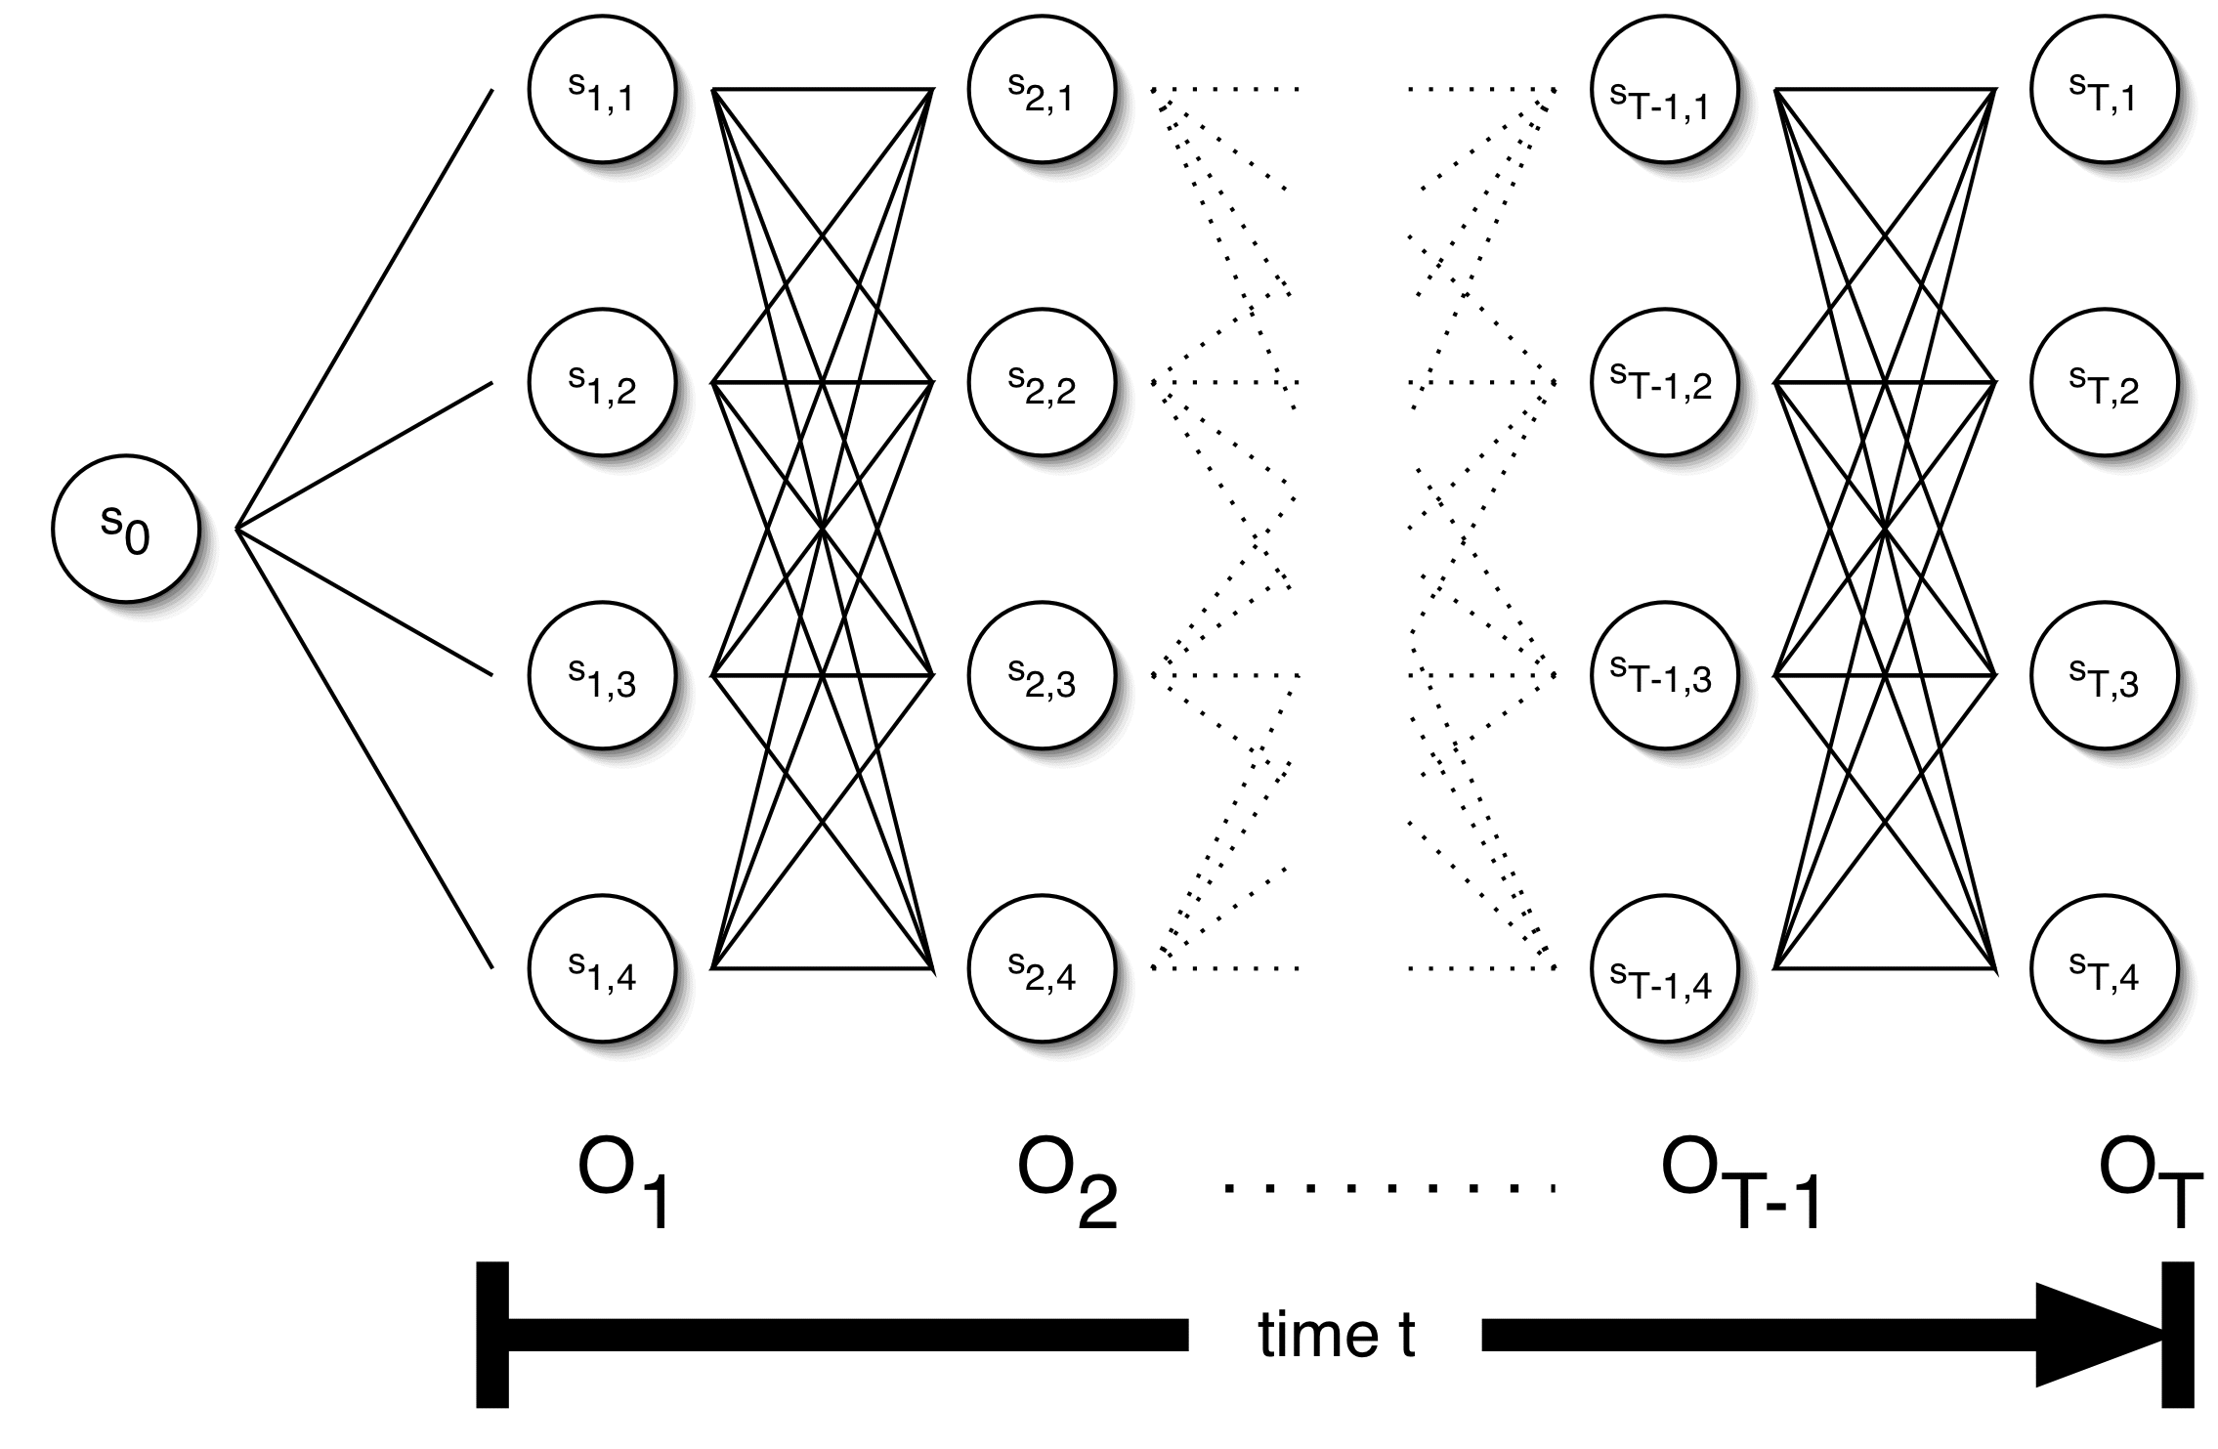
The Trellis

Slide 12
Parameters of an HMM
States: A set of states S=s₁,…,s_{n}
Transition probabilities: A= a_{1,1},a_{1,2},…,a_{n,n} Each a_{i,j} represents the probability of transitioning from state s_{i} to s_{j}.
Emission probabilities: A set B of functions of the form b_{i}(o_{t}) which is the probability of observation o_{t} being emitted by s_{i}
Initial state distribution: is the probability that s_{i} is a start state

Slide 13
The Three Basic HMM Problems
Problem 1 (Evaluation): Given the observation sequence O=o₁,…,o_{T} and an HMM model
, how do we compute the probability of O given the model?
Problem 2 (Decoding): Given the observation sequence O=o₁,…,o_{T} and an HMM model
, how do we find the state sequence that best explains the observations?

Slide 14
The Three Basic HMM Problems
Problem 3 (Learning): How do we adjust the model parameters , to maximize ?

Slide 15
Problem 1: Probability of an Observation Sequence
What is ?
The probability of a observation sequence is the sum of the probabilities of all possible state sequences in the HMM.
Naïve computation is very expensive. Given T observations and N states, there are N^{T} possible state sequences.
Even small HMMs, e.g. T=10 and N=10, contain 10 billion different paths
Solution to this and problem 2 is to use dynamic programming

Slide 16
Forward Probabilities
What is the probability that, given an HMM , at time t the state is i and the partial observation o₁ … o_{t} has been generated?

Slide 17
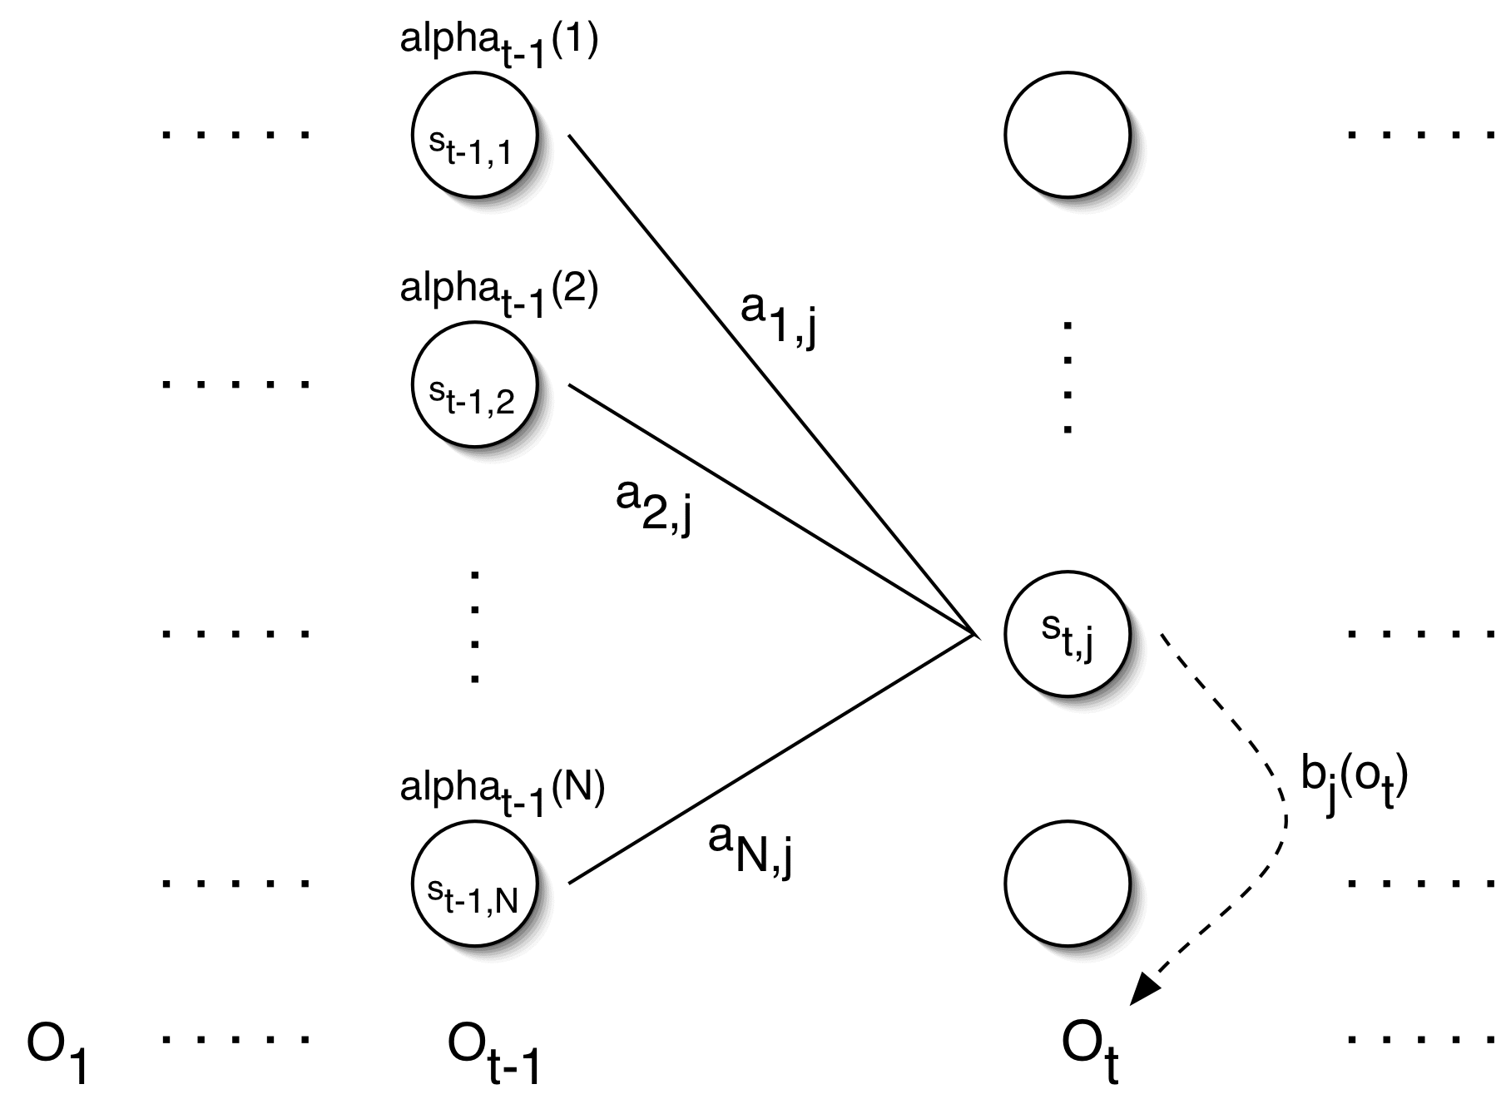
Forward Probabilities

Slide 18
Forward Algorithm
Initialization:
Induction:
Termination:

Slide 19
Forward Algorithm Complexity
In the naïve approach to solving problem 1 it takes on the order of 2T*N^{T} computations
The forward algorithm takes on the order of N²T computations

Slide 20
Backward Probabilities
Analogous to the forward probability, just in the other direction
What is the probability that given an HMM and given the state at time t is i, the partial observation o_{t+1} … o_{T} is generated?

Slide 21
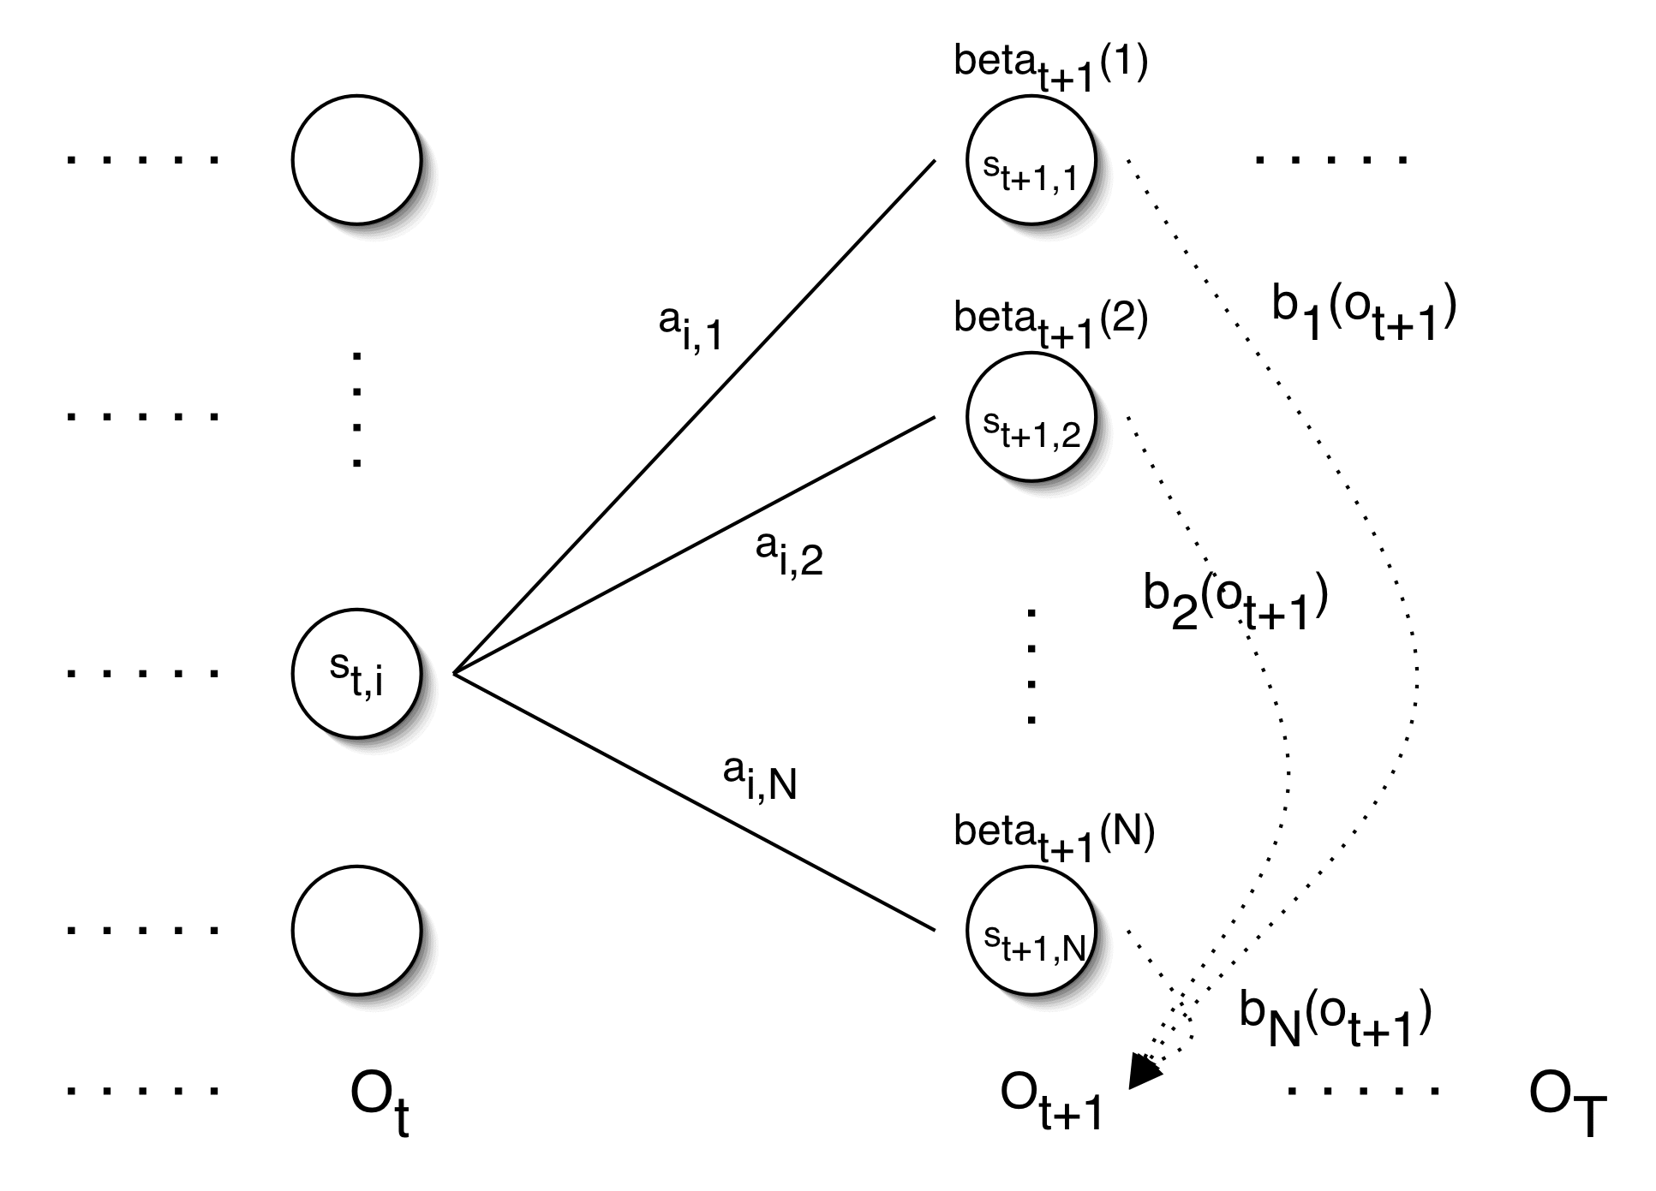
Backward Probabilities

Slide 22
Backward Algorithm
Initialization:
Induction:
Termination:

Slide 23
Problem 2: Decoding
The solution to Problem 1 (Evaluation) gives us the sum of all paths through an HMM efficiently.
For Problem 2, we wan to find the path with the highest probability.
We want to find the state sequence Q=q₁…q_{T}, such that

Slide 24
Viterbi Algorithm
Similar to computing the forward probabilities, but instead of summing over transitions from incoming states, compute the maximum
Forward:
Viterbi Recursion:

Slide 25
Viterbi Algorithm
Initialization:
Induction:
Termination:
Read out path:

Slide 26
Problem 3: Learning
Up to now we’ve assumed that we know the underlying model
Often these parameters are estimated on annotated training data, which has two drawbacks:
  Annotation is difficult and/or expensive
  Training data is different from the current data
We want to maximize the parameters with respect to the current data, i.e., we’re looking for a model , such that

Slide 27
Problem 3: Learning
Unfortunately, there is no known way to analytically find a global maximum, i.e., a model , such that
But it is possible to find a local maximum
Given an initial model , we can always find a model , such that

Slide 28
Parameter Re-estimation
Use the forward-backward (or Baum-Welch) algorithm, which is a hill-climbing algorithm
Using an initial parameter instantiation, the forward-backward algorithm iteratively re-estimates the parameters and improves the probability that given observation are generated by the new parameters

Slide 29
Parameter Re-estimation
Three parameters need to be re-estimated:
  Initial state distribution:
  Transition probabilities: a_{i,j}
  Emission probabilities: b_{i}(o_{t})

Slide 30
Re-estimating Transition Probabilities
What’s the probability of being in state s_{i} at time t and going to state s_{j}, given the current model and parameters?

Slide 31
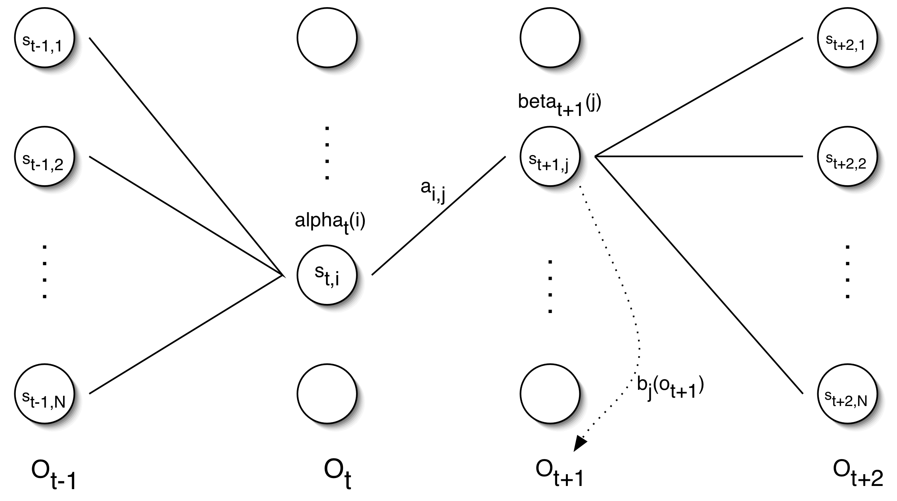
Re-estimating Transition Probabilities

Slide 32
Re-estimating Transition Probabilities
The intuition behind the re-estimation equation for transition probabilities is
Formally:

Slide 33
Re-estimating Transition Probabilities
Defining
As the probability of being in state s_{i}, given the complete observation O
We can say:

Slide 34
Review of Probabilities
Forward probability:
The probability of being in state s_{i}, given the partial observation o₁,…,o_{t}
Backward probability:
The probability of being in state s_{i}, given the partial observation o_{t+1},…,o_{T}
Transition probability:
The probability of going from state s_{i}, to state s_{j}, given the complete observation o₁,…,o_{T}
State probability:
The probability of being in state s_{i}, given the complete observation o₁,…,o_{T}

Slide 35
Re-estimating Initial State Probabilities
Initial state distribution: is the probability that s_{i} is a start state
Re-estimation is easy:
Formally:

Slide 36
Re-estimation of Emission Probabilities
Emission probabilities are re-estimated as
Formally:
Where
Note that here is the Kronecker delta function and is not related to the in the discussion of the Viterbi algorithm!!

Slide 37
The Updated Model
Coming from we get to
by the following update rules:

Slide 38
Expectation Maximization
The forward-backward algorithm is an instance of the more general EM algorithm
  The E Step: Compute the forward and backward probabilities for a give model
  The M Step: Re-estimate the model parameters

