Slide 1
Probabilistic Robotics
Mapping with Known Poses

Slide 2
Why Mapping?
Learning maps is one of the fundamental problems in mobile robotics
Maps allow robots to efficiently carry out their tasks, allow localization …
Successful robot systems rely on maps for localization, path planning, activity planning etc.

Slide 3
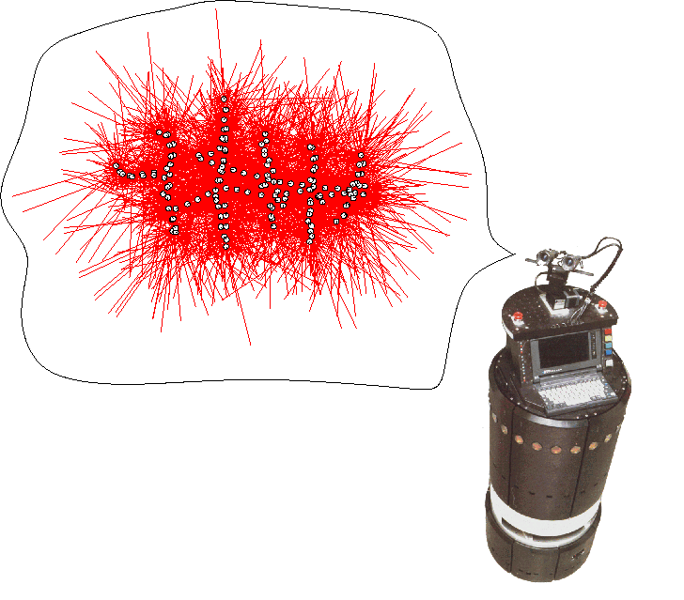
The General Problem of Mapping
What does the environment look like?

Slide 4
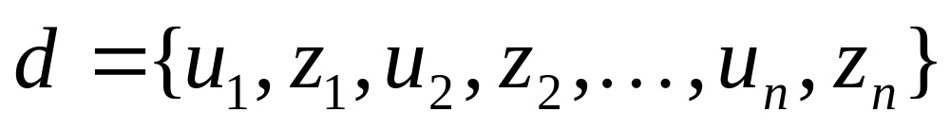
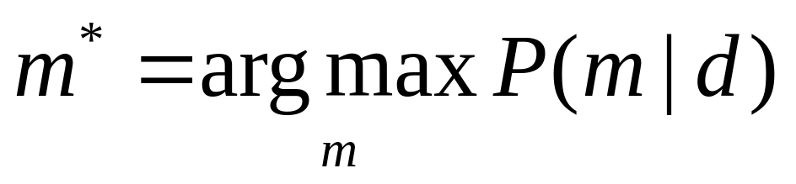
The General Problem of Mapping
Formally, mapping involves, given the sensor data,
to calculate the most likely map

Slide 5
Mapping as a Chicken and Egg Problem
So far we learned how to estimate the pose of the vehicle given the data and the map.
Mapping, however, involves to simultaneously estimate the pose of the vehicle and the map.
The general problem is therefore denoted as the simultaneous localization and mapping problem (SLAM).
Throughout this section we will describe how to calculate a map given we know the pose of the vehicle.

Slide 6
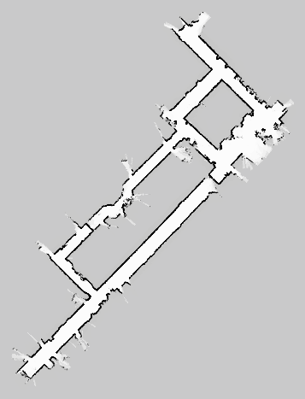
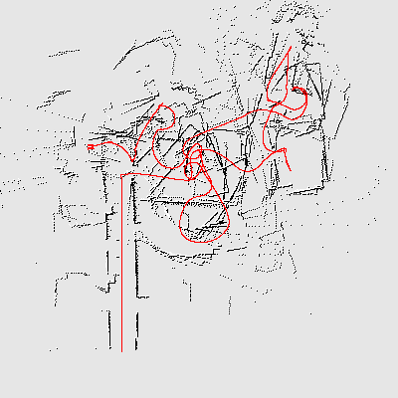
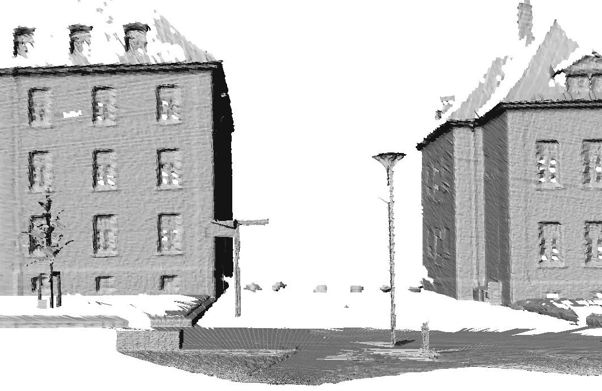
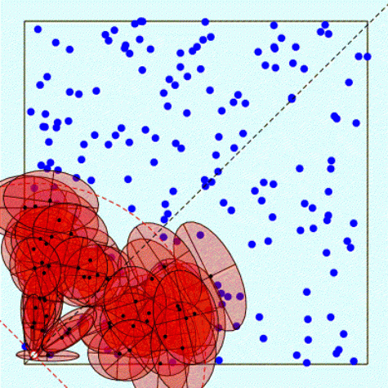
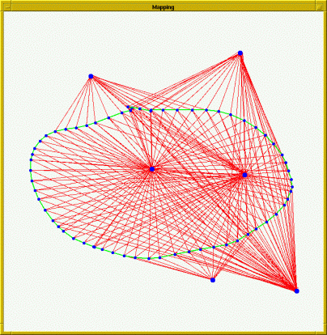
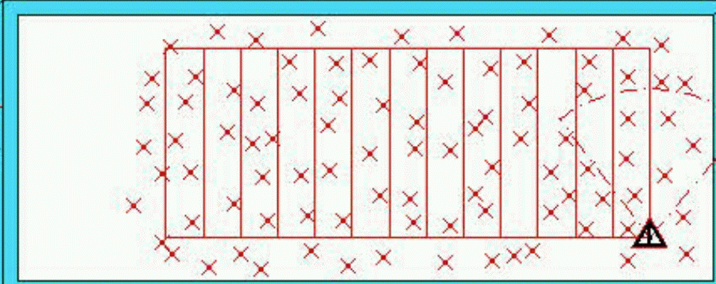
Types of SLAM-Problems
Grid maps or scans
[Lu & Milios, 97; Gutmann, 98: Thrun 98; Burgard, 99; Konolige & Gutmann, 00; Thrun, 00; Arras, 99; Haehnel, 01;…]
Landmark-based
[Leonard et al., 98; Castelanos et al., 99: Dissanayake et al., 2001; Montemerlo et al., 2002;…

Slide 7
Problems in Mapping
Sensor interpretation
  How do we extract relevant information from raw sensor data?
  How do we represent and integrate this information over time?
Robot locations have to be estimated
  How can we identify that we are at a previously visited place?
  This problem is the so-called data association problem.

Slide 8
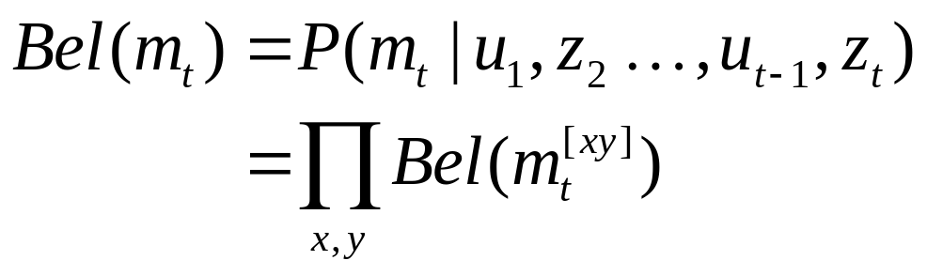
Occupancy Grid Maps
Introduced by Moravec and Elfes in 1985
Represent environment by a grid.
Estimate the probability that a location is occupied by an obstacle.
Key assumptions
  Occupancy of individual cells (m[xy]) is independent
  Robot positions are known!

Slide 9
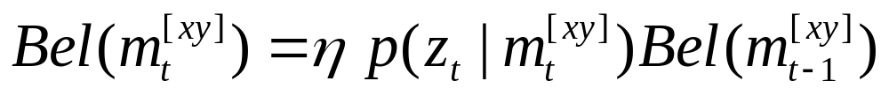
Updating Occupancy Grid Maps
Idea: Update each individual cell using a binary Bayes filter.
Additional assumption: Map is static.

Slide 10
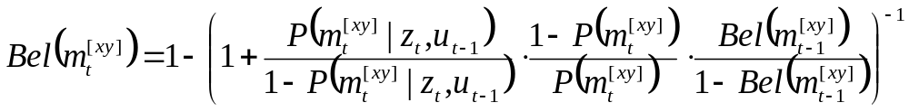



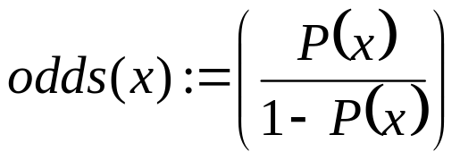

Updating Occupancy Grid Maps
Update the map cells using the inverse sensor model
Or use the log-odds representation

Slide 11
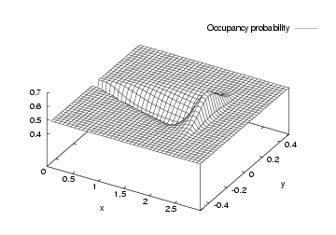
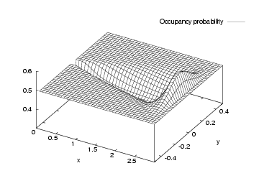
Typical Sensor Model for Occupancy Grid Maps
Combination of a linear function and a Gaussian:

Slide 12
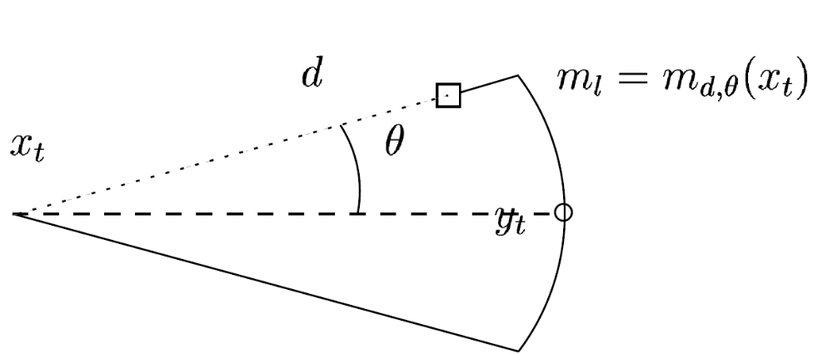
Key Parameters of the Model

Slide 13
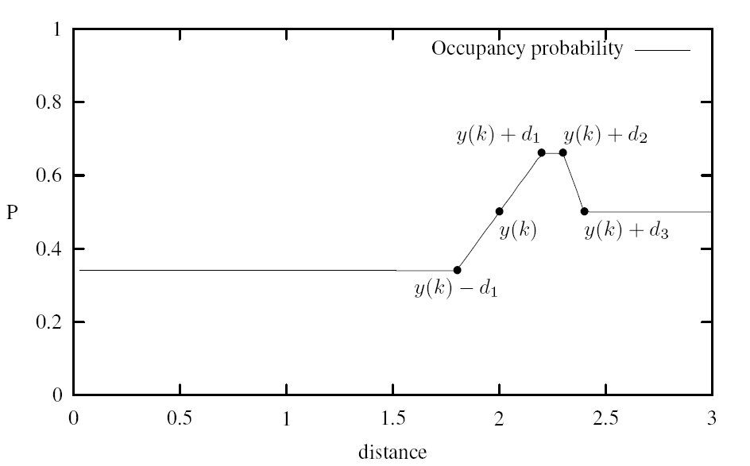
Occupancy Value Depending on the Measured Distance
z+d₁
z+d₂
z
z+d₃
z-d₁

Slide 14
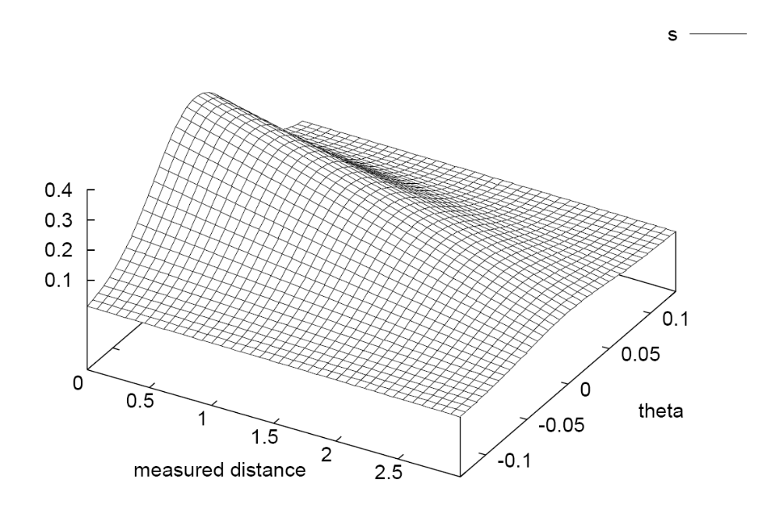
Deviation from the Prior Belief
(the sphere of influence of the sensors)

Slide 15
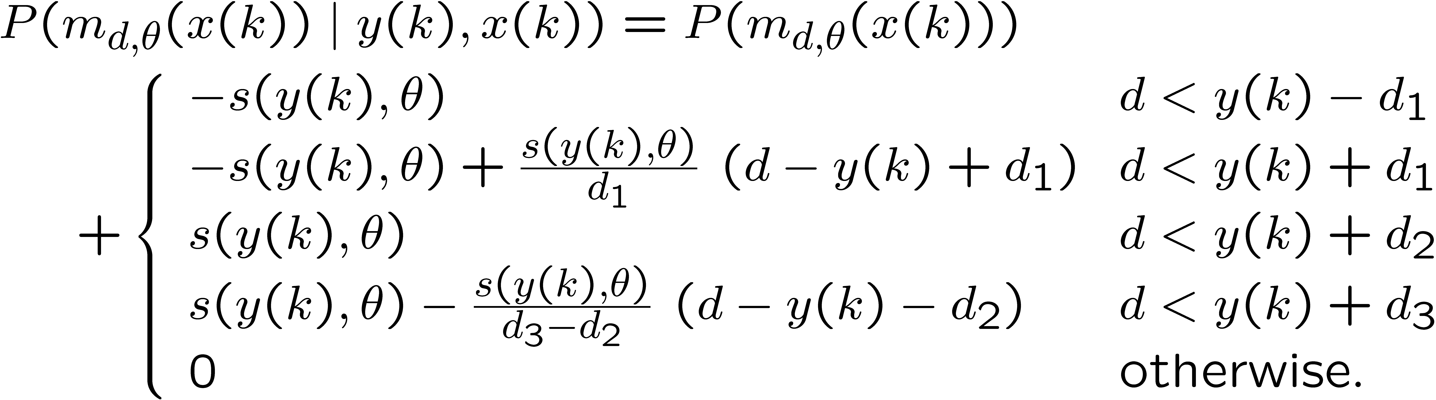
Calculating the Occupancy Probability Based on Single Observations

Slide 16
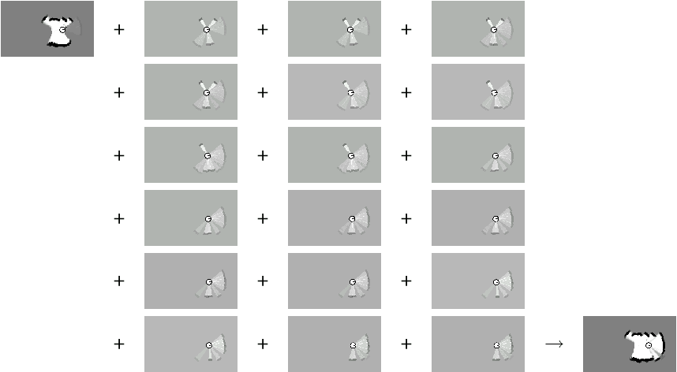
Incremental Updating of Occupancy Grids (Example)

Slide 17
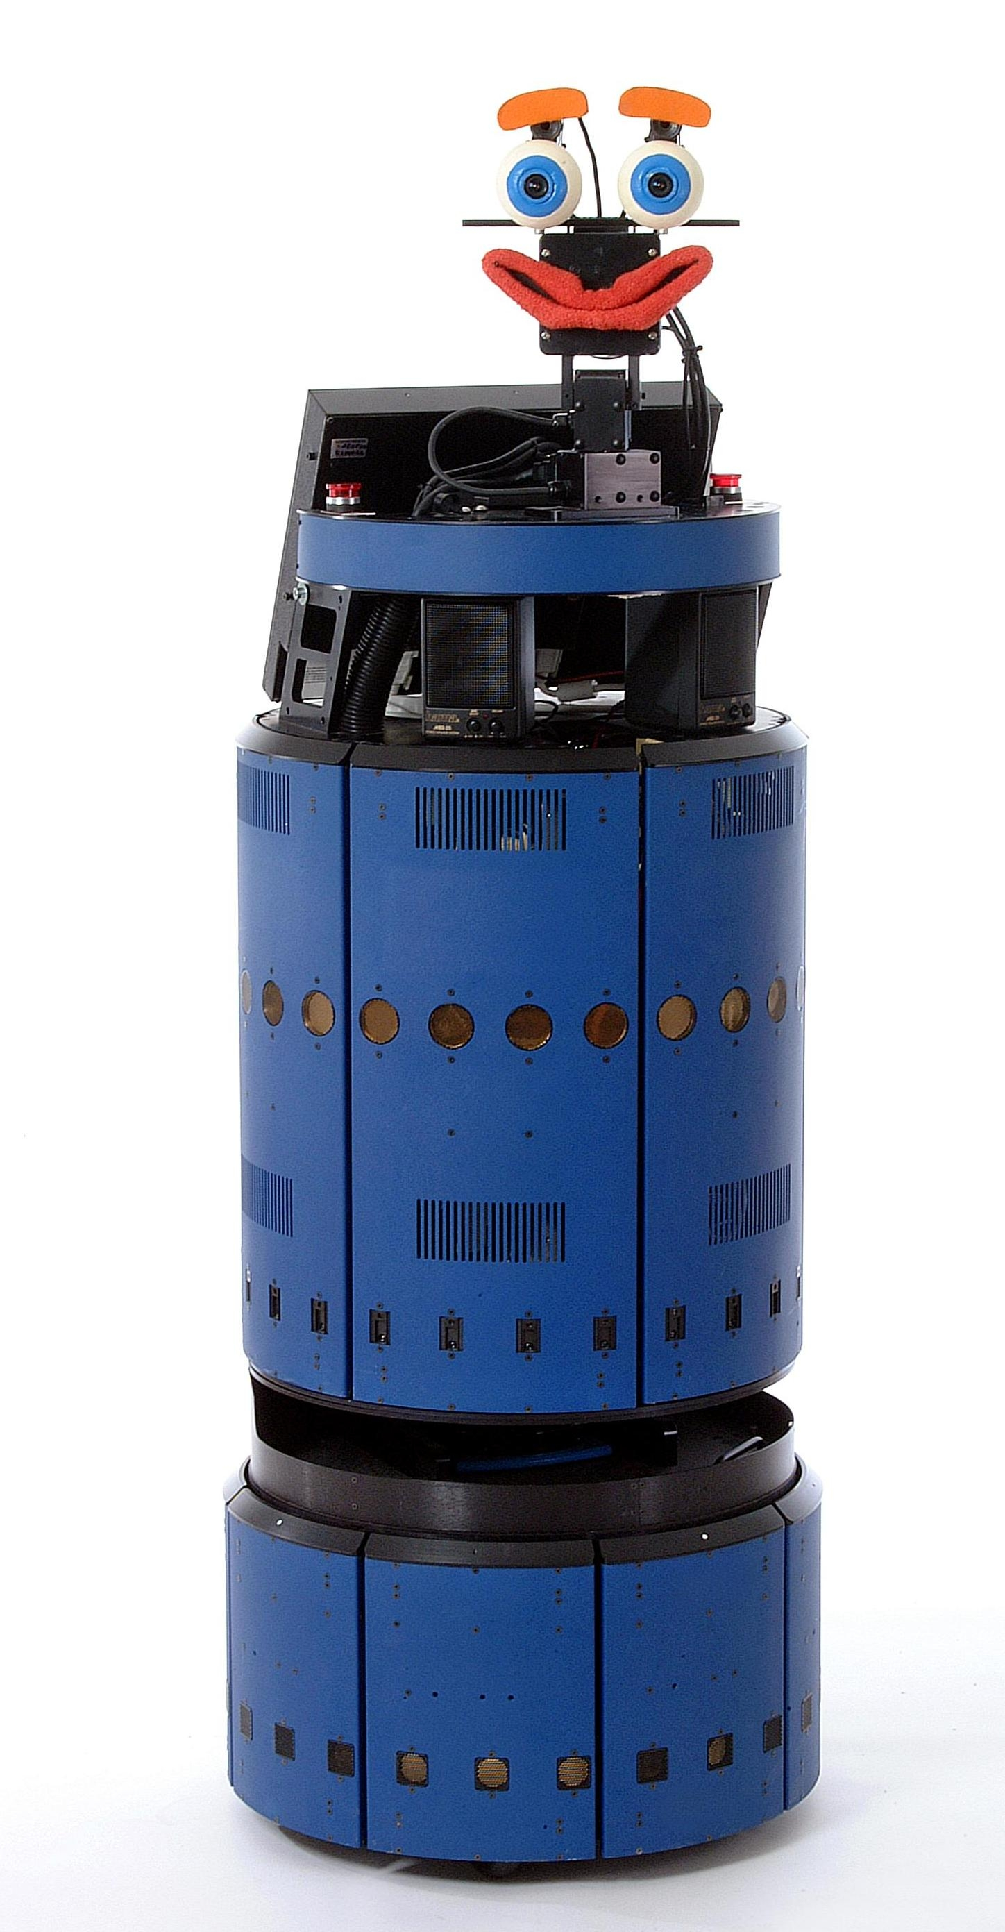

Resulting Map Obtained with Ultrasound Sensors

Slide 18

Resulting Occupancy and Maximum Likelihood Map
The maximum likelihood map is obtained by clipping the occupancy grid map at a threshold of 0.5

Slide 19
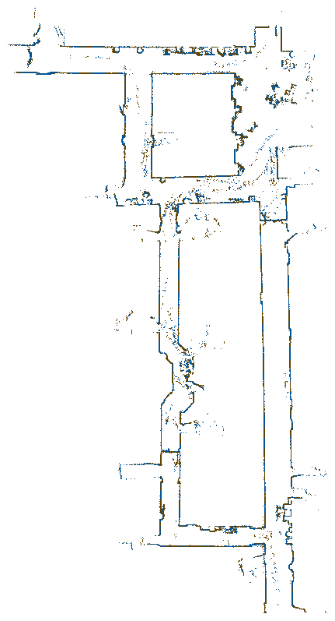
Occupancy Grids: From scans to maps

Slide 20
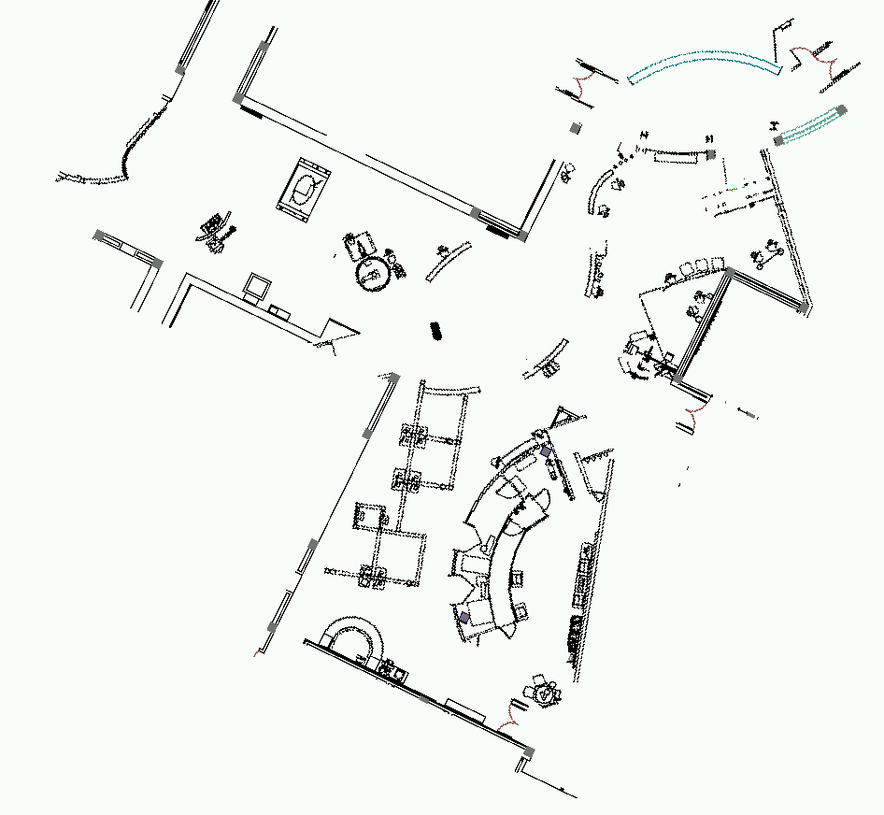
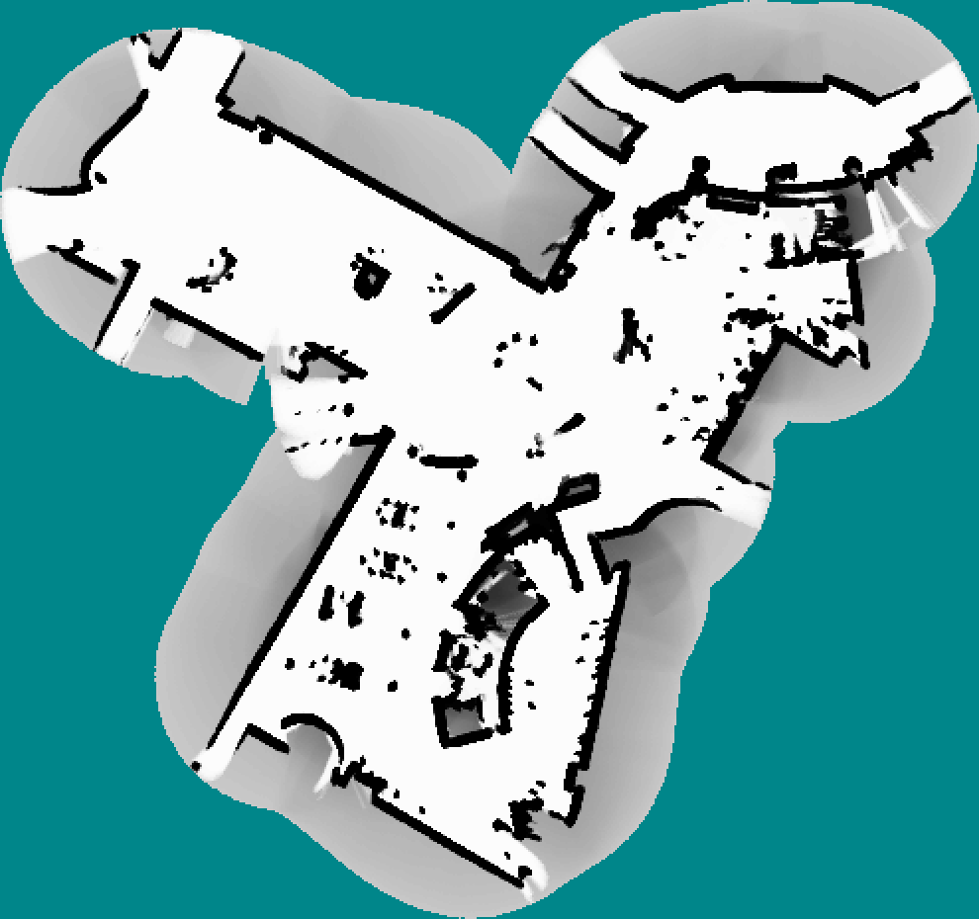
Tech Museum, San Jose
CAD map
occupancy grid map

Slide 21
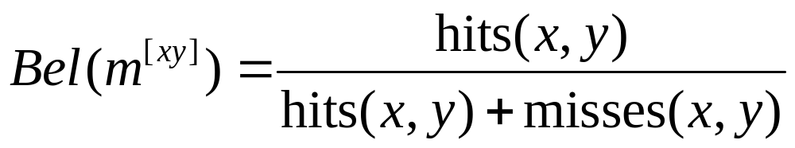
Alternative: Simple Counting
For every cell count
  hits(x,y): number of cases where a beam ended at <x,y>
  misses(x,y): number of cases where a beam passed through <x,y>
Value of interest: P(reflects(x,y))

Slide 22


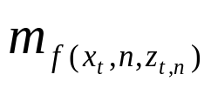


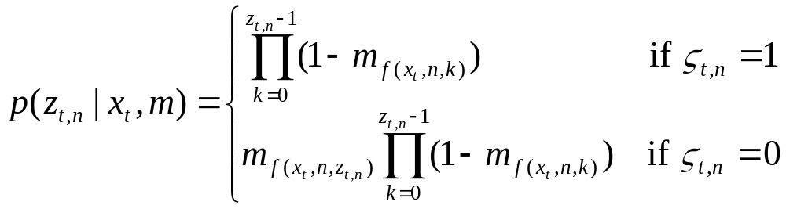
The Measurement Model
pose at time t:
beam n of scan t:
maximum range reading:
beam reflected by an object:
0
1
n

Slide 23
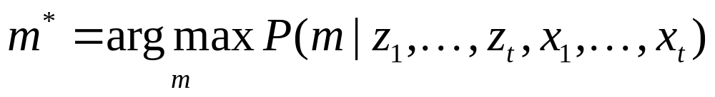
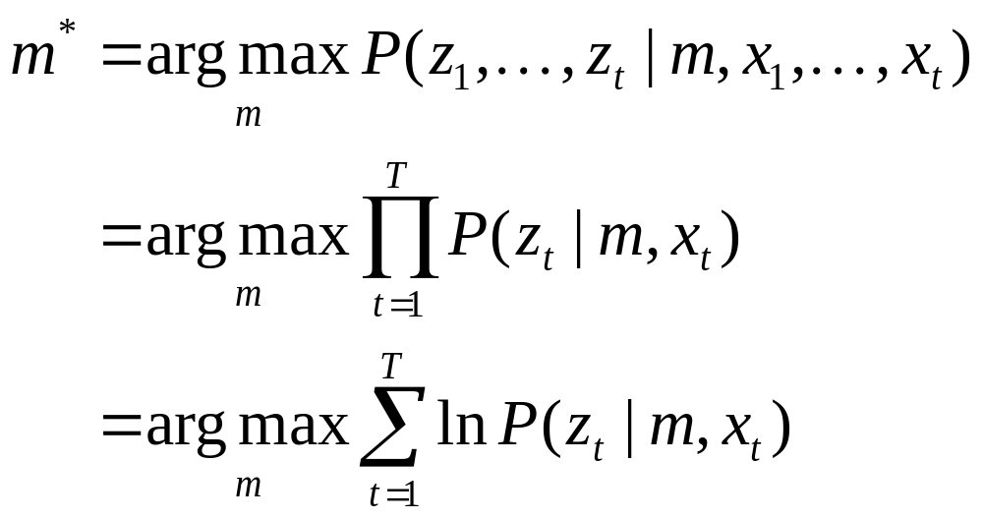
Computing the Most Likely Map
Compute values for m that maximize
Assuming a uniform prior probability for p(m), this is equivalent to maximizing (applic. of Bayes rule)

Slide 24
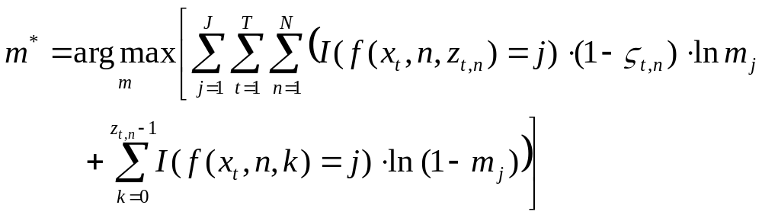
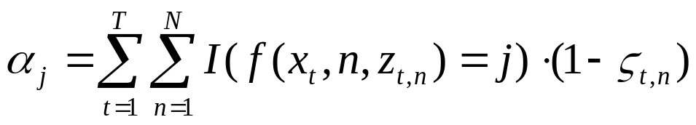
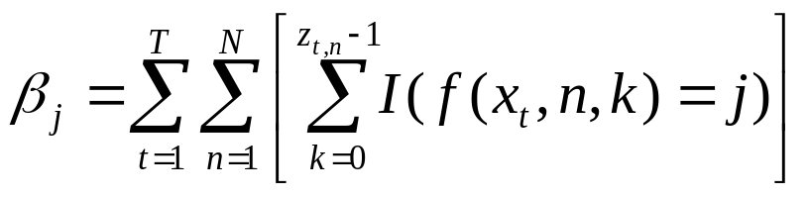
Computing the Most Likely Map
Suppose

Slide 25
Meaning of α_{j} and β_{j}
corresponds to the number of times a beam that is not a maximum range beam ended in cell j (hits(j))
corresponds to the umber of times a beam intercepted cell j without ending in it (misses(j)).

Slide 26
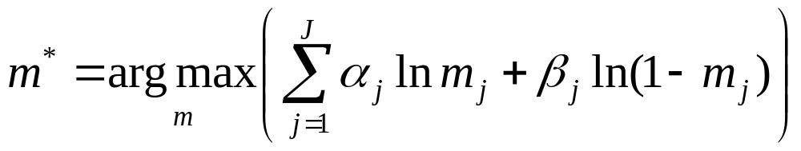
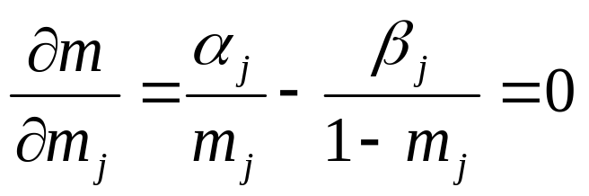
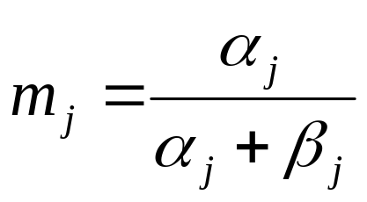
Computing the Most Likely Map
We assume that all cells m_{j} are independent:
If we set
we obtain
Computing the most likely map amounts to counting how often a cell has reflected a measurement and how often it was intercepted.

Slide 27
Difference between Occupancy Grid Maps and Counting
The counting model determines how often a cell reflects a beam.
The occupancy model represents whether or not a cell is occupied by an object.
Although a cell might be occupied by an object, the reflection probability of this object might be very small.

Slide 28
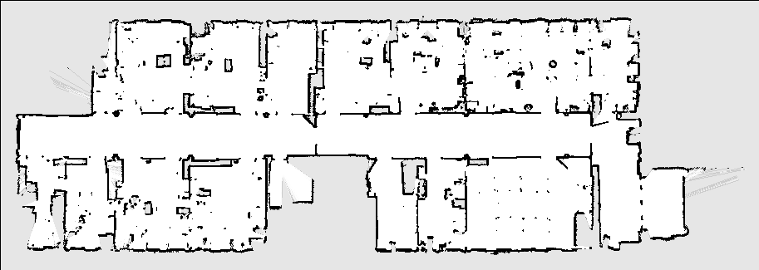
Example Occupancy Map

Slide 29
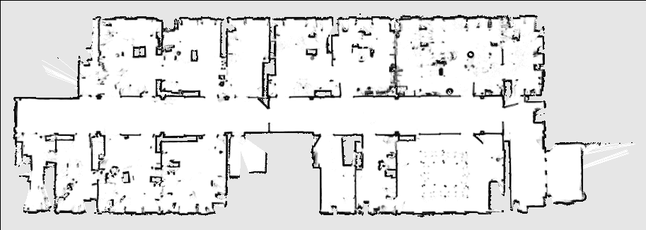
Example Reflection Map
glass panes

Slide 30
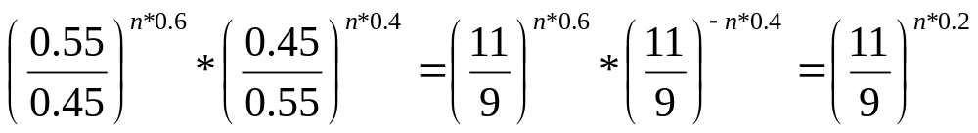
Example
Out of 1000 beams only 60% are reflected from a cell and 40% intercept it without ending in it.
Accordingly, the reflection probability will be 0.6.
Suppose p(occ | z) = 0.55 when a beam ends in a cell and p(occ | z) = 0.45 when a cell is intercepted by a beam that does not end in it.
Accordingly, after n measurements we will have
Whereas the reflection map yields a value of 0.6, the occupancy grid value converges to 1.

Slide 31
Summary
Occupancy grid maps are a popular approach to represent the environment of a mobile robot given known poses.
In this approach each cell is considered independently from all others.
It stores the posterior probability that the corresponding area in the environment is occupied.
Occupancy grid maps can be learned efficiently using a probabilistic approach.
Reflection maps are an alternative representation.
They store in each cell the probability that a beam is reflected by this cell.
We provided a sensor model for computing the likelihood of measurements and showed that the counting procedure underlying reflection maps yield the optimal map.

