Slide 1
Probabilistic Robotics
Planning and Control:
Markov Decision Processes

Slide 2
Problem Classes
Deterministic vs. stochastic actions
Full vs. partial observability

Slide 3
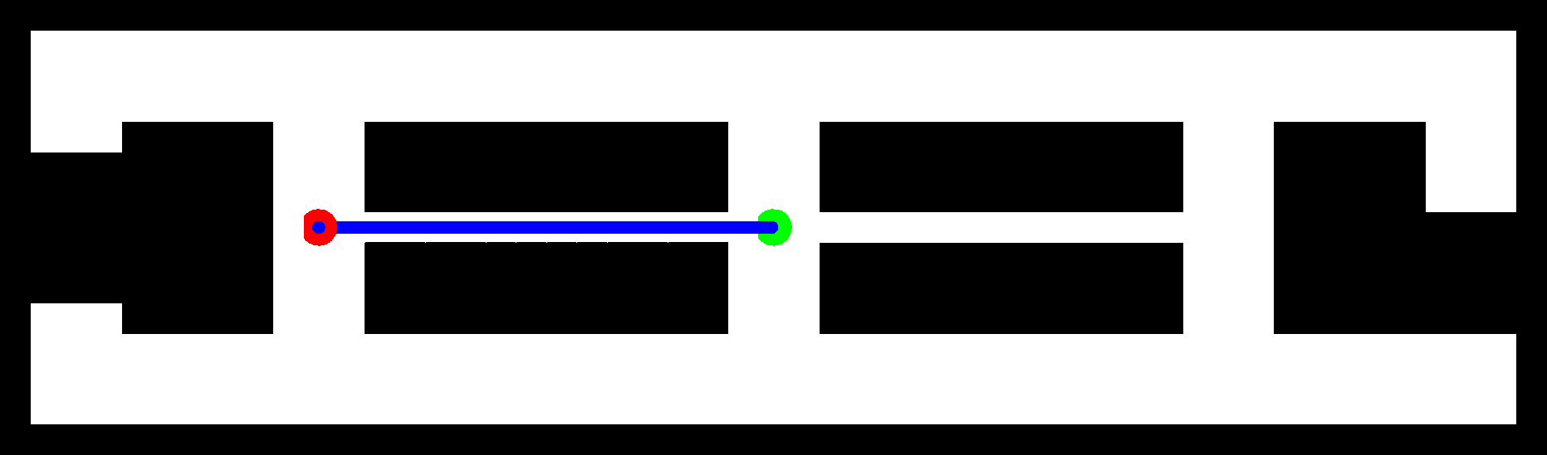
Deterministic, fully observable

Slide 4
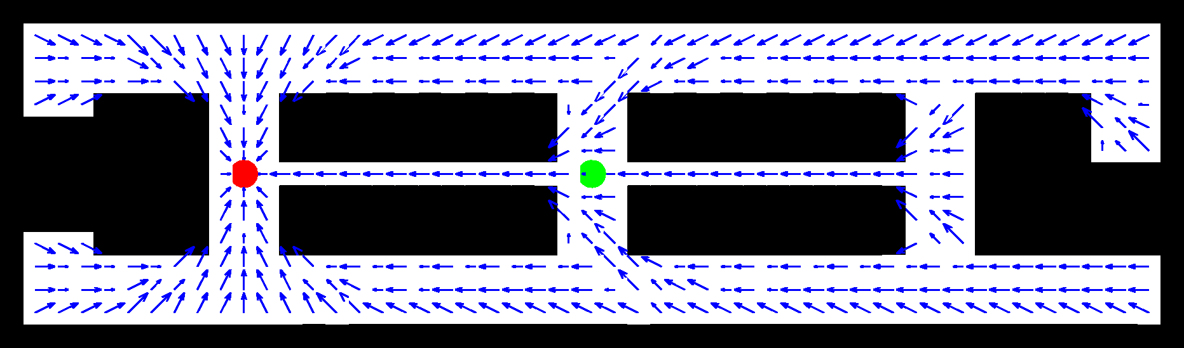
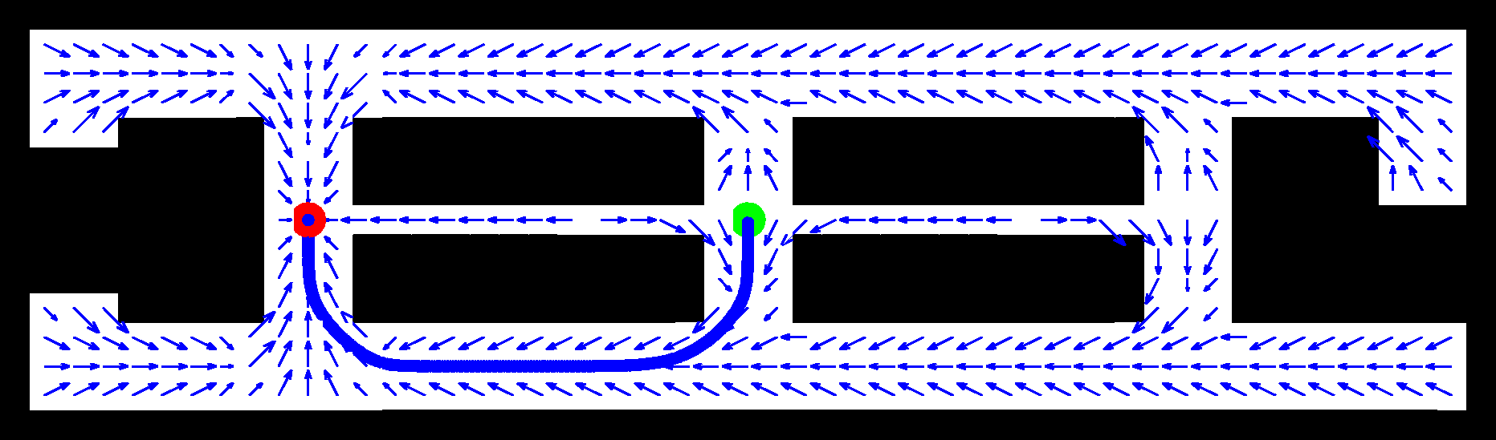
Stochastic, Fully Observable

Slide 5
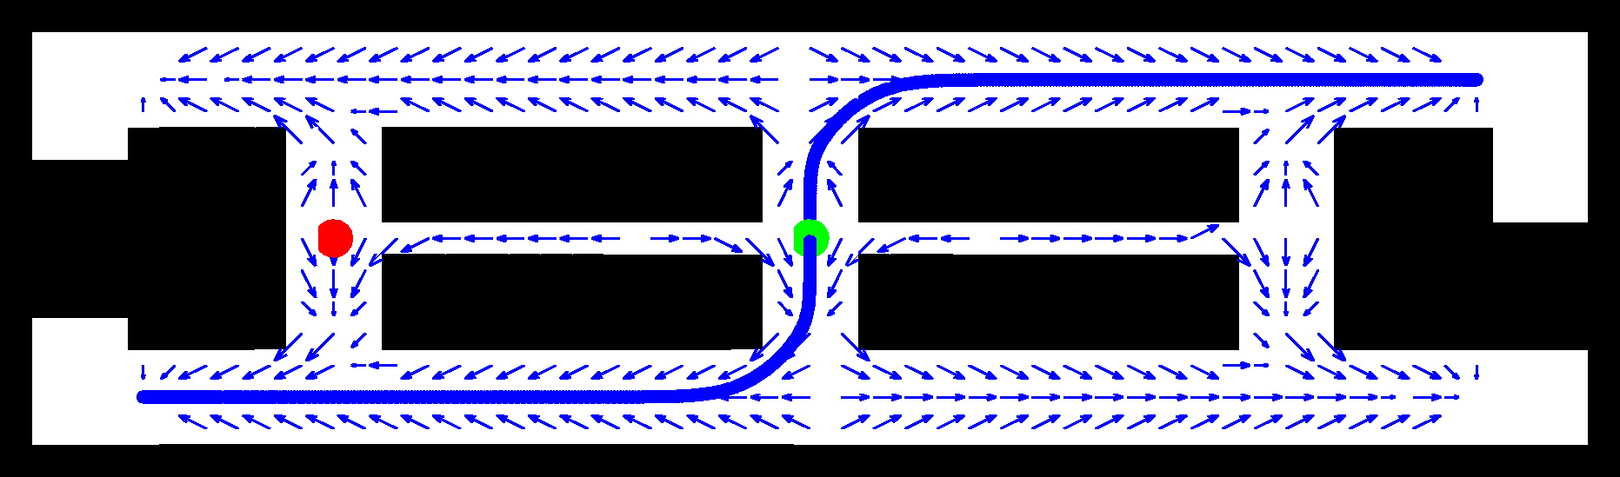
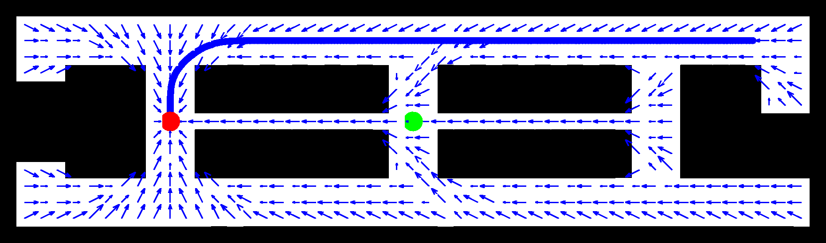
Stochastic, Partially Observable

Slide 6
Markov Decision Process (MDP)
r=1
s₂
0.01
0.9
0.7
0.1
r=0
0.3
0.99
s₃
s₁
0.3
r=20
0.3
0.4
0.2
s₅
s₄
r=0
r=-10
0.8

Slide 7
Markov Decision Process (MDP)
Given:
States x
Actions u
Transition probabilities p(x‘|u,x)
Reward / payoff function r(x,u)
Wanted:
Policy π(x) that maximizes the future expected reward

Slide 8
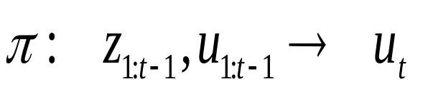
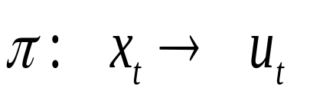
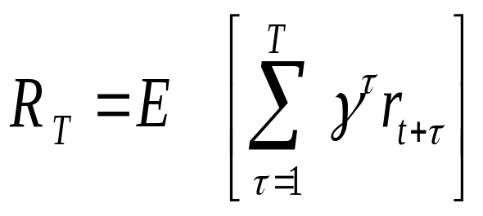
Rewards and Policies
Policy (general case):
Policy (fully observable case):
Expected cumulative payoff:
  T=1: greedy policy
  T>1: finite horizon case, typically no discount
  T=infty: infinite-horizon case, finite reward if discount < 1

Slide 9
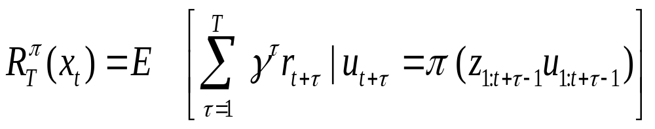
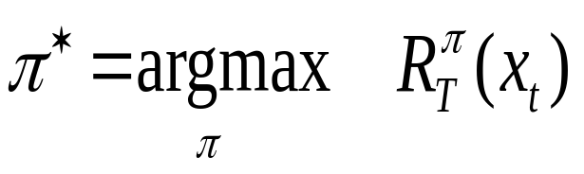
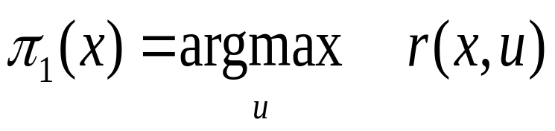
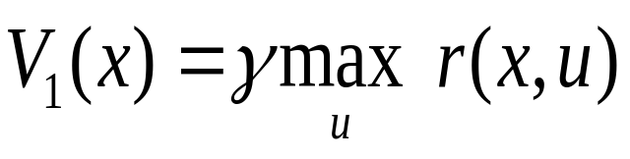
Policies contd.
Expected cumulative payoff of policy:
Optimal policy:
1-step optimal policy:
Value function of 1-step optimal policy:

Slide 10
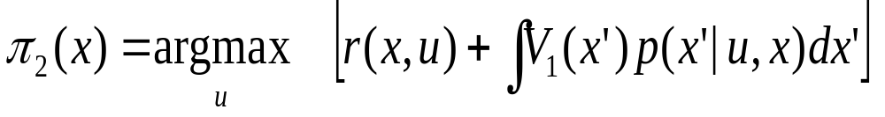
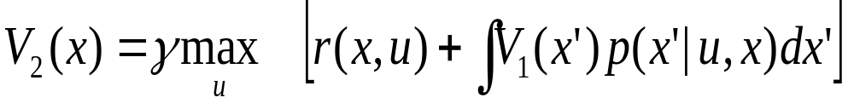
2-step Policies
Optimal policy:
Value function:

Slide 11
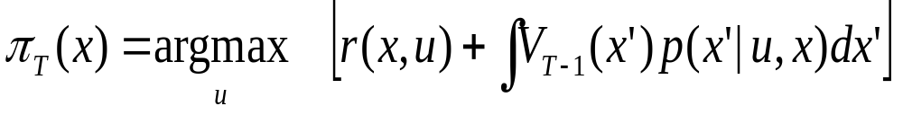
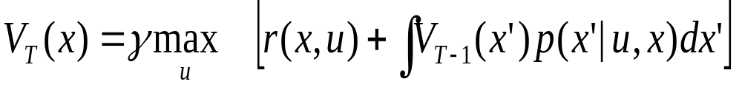
T-step Policies
Optimal policy:
Value function:

Slide 12
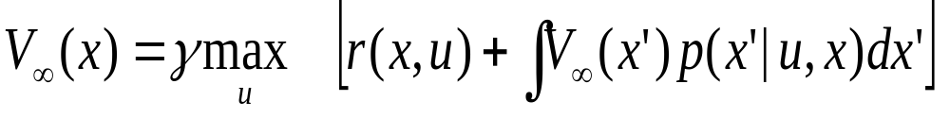
Infinite Horizon
Optimal policy:
Bellman equation
Fix point is optimal policy
Necessary and sufficient condition

Slide 13
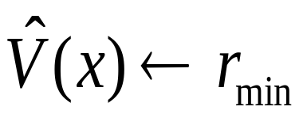
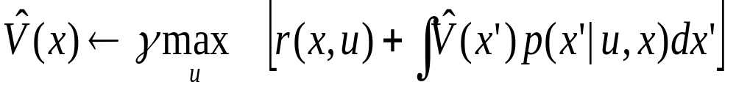
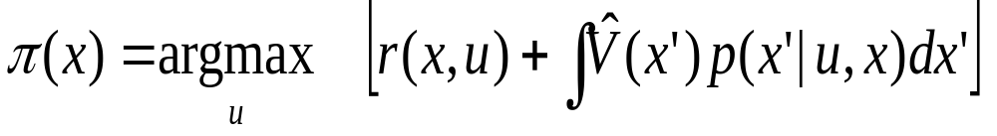
Value Iteration
for all x do
endfor
repeat until convergence
  for all x do
  endfor
endrepeat

Slide 14
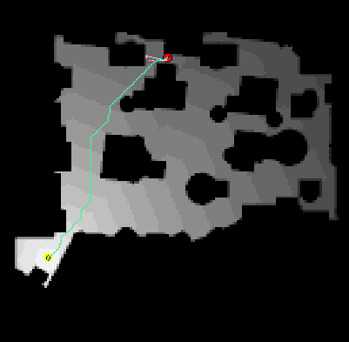
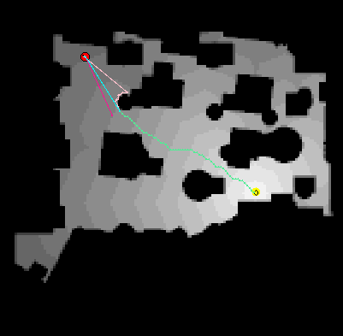
Value Iteration for Motion Planning

Slide 15
Value Function and Policy Iteration
Often the optimal policy has been reached long before the value function has converged.
Policy iteration calculates a new policy based on the current value function and then calculates a new value function based on this policy.
This process often converges faster to the optimal policy.

