Slide 1
Probabilistic Robotics
Bayes Filter Implementations
Particle filters

Slide 2
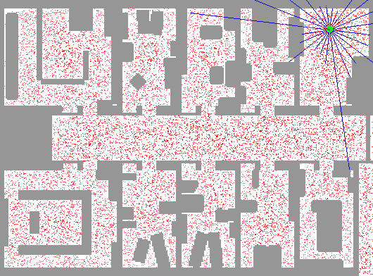
Sample-based Localization (sonar)

Slide 3
Particle Filters
Represent belief by random samples
Estimation of non-Gaussian, nonlinear processes
Monte Carlo filter, Survival of the fittest, Condensation, Bootstrap filter, Particle filter
Filtering: [Rubin, 88], [Gordon et al., 93], [Kitagawa 96]
Computer vision: [Isard and Blake 96, 98]
Dynamic Bayesian Networks: [Kanazawa et al., 95]d

Slide 4
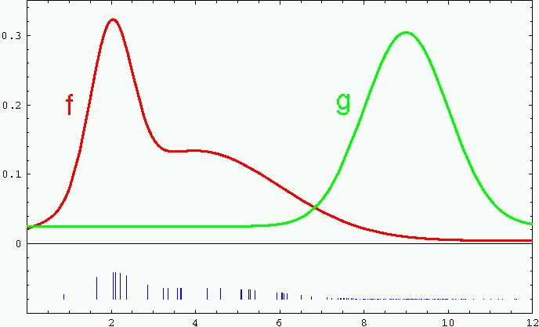
Importance Sampling
Weight samples: w = f / g

Slide 5
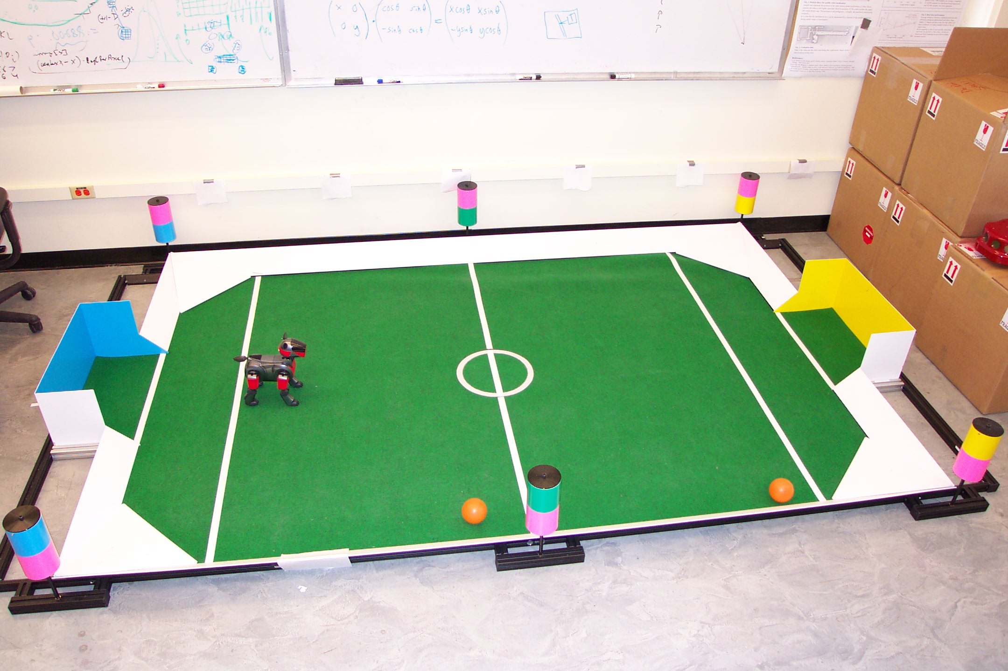
Importance Sampling with Resampling:
Landmark Detection Example

Slide 6
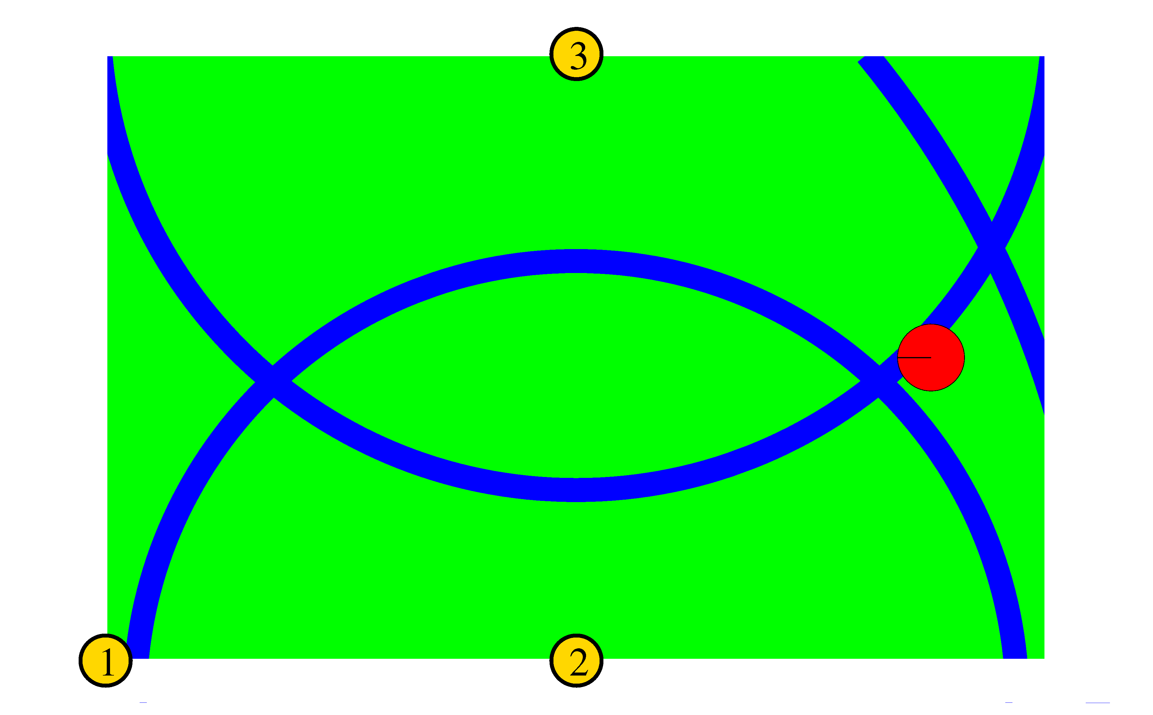
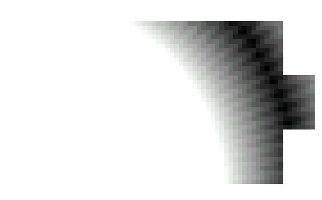
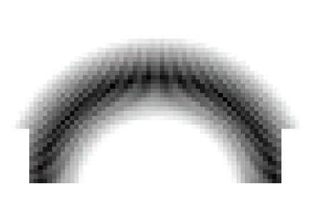
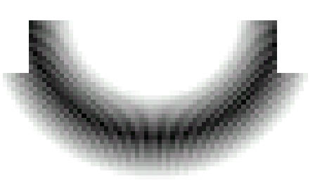
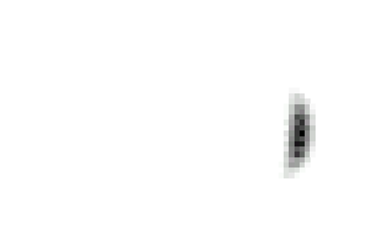
Distributions

Slide 7
Distributions
Wanted: samples distributed according to p(x| z₁, z₂, z₃)

Slide 8
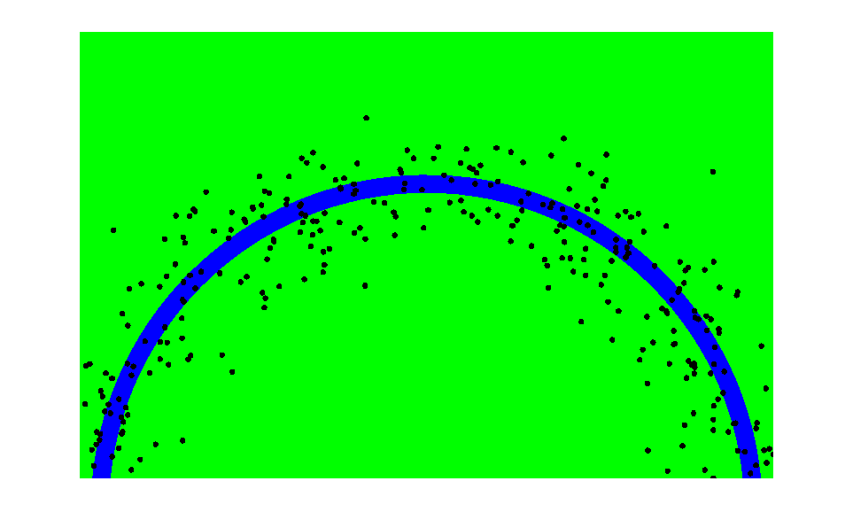
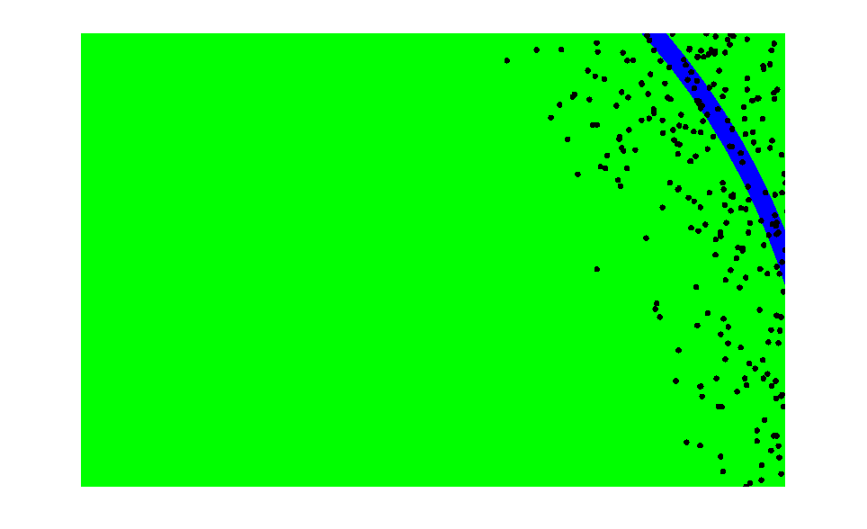
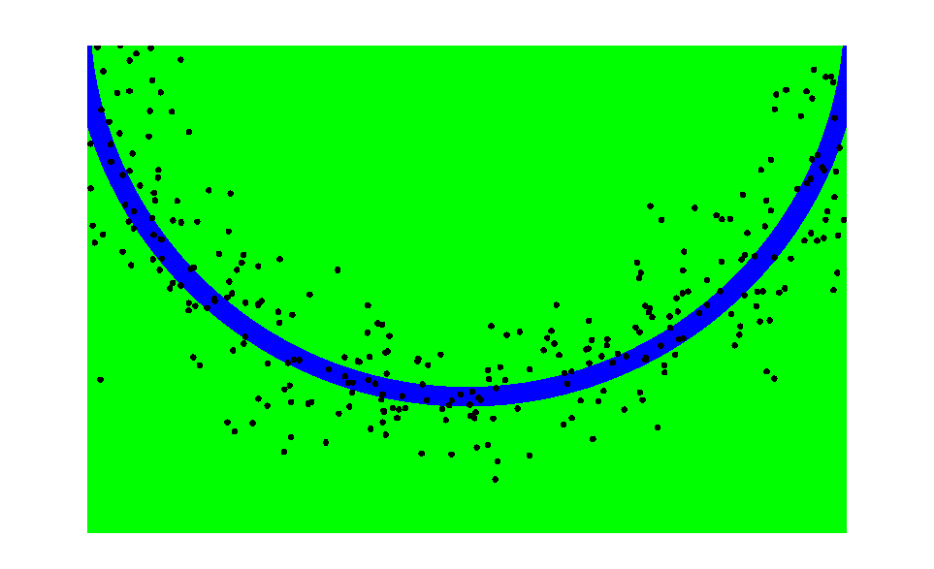
This is Easy!
We can draw samples from p(x|z_{l}) by adding noise to the detection parameters.

Slide 9
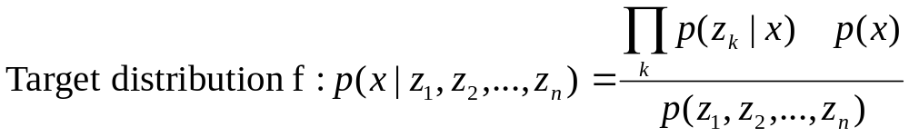
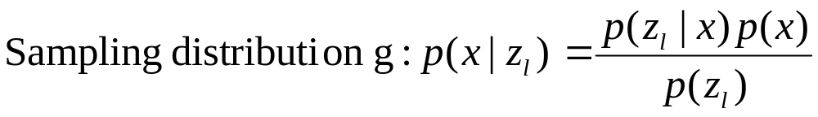
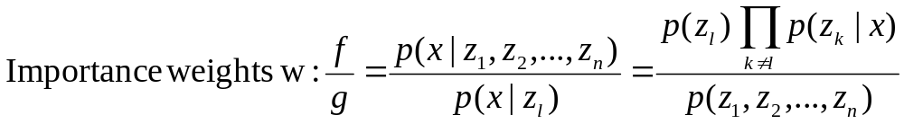
Importance Sampling with Resampling

Slide 10
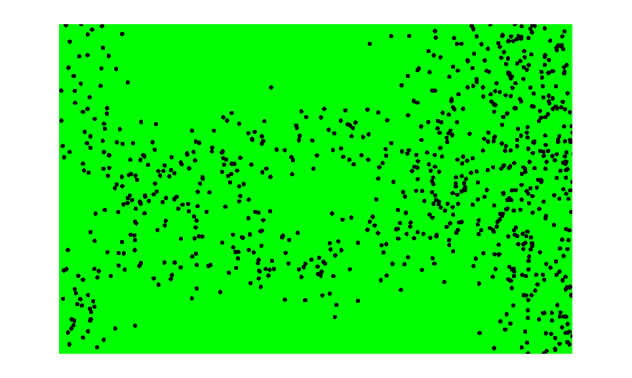
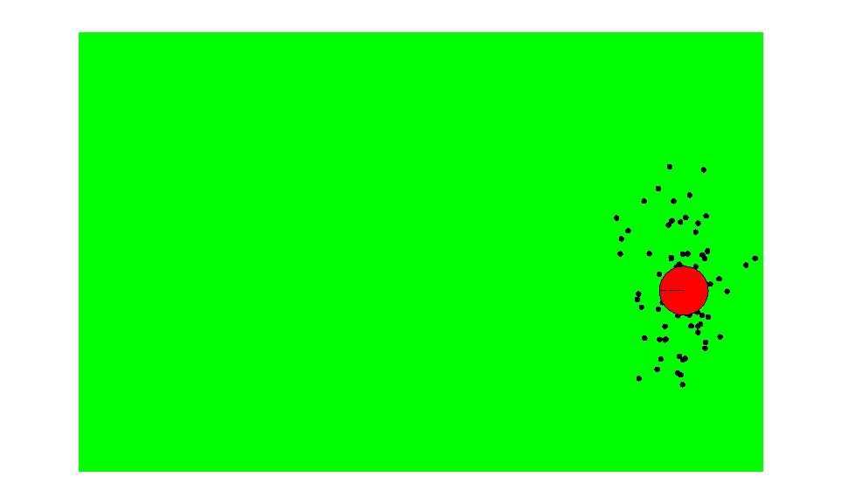
Importance Sampling with Resampling
Weighted samples
After resampling

Slide 11
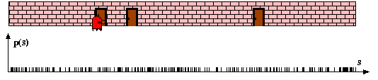
Particle Filters

Slide 12
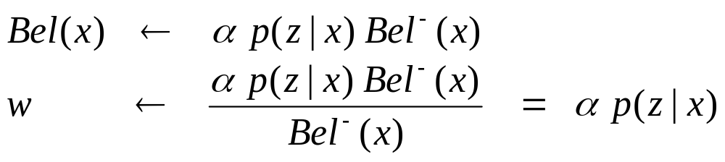
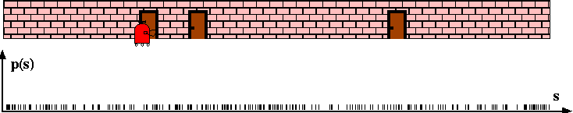
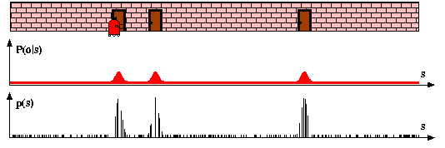
Sensor Information: Importance Sampling

Slide 13
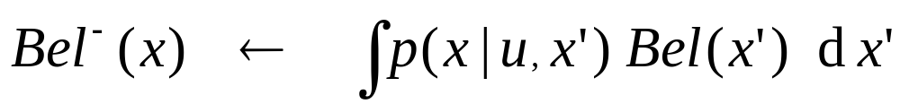
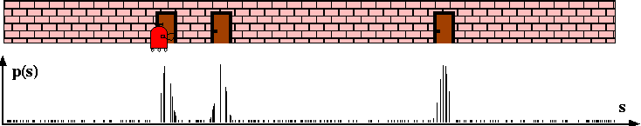
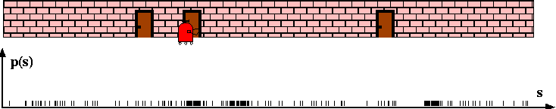
Robot Motion

Slide 14
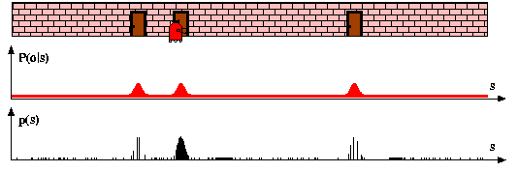
Sensor Information: Importance Sampling

Slide 15
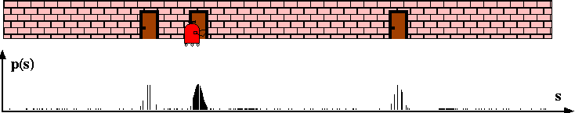
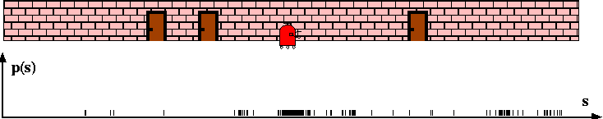
Robot Motion

Slide 16










Particle Filter Algorithm
Algorithm particle_filter( S_{t-1}, u_{t-1} z_{t}):
For Generate new samples
Sample index j(i) from the discrete distribution given by w_{t-1}
Sample from using and
Compute importance weight
Update normalization factor
Insert
For
Normalize weights

Slide 17
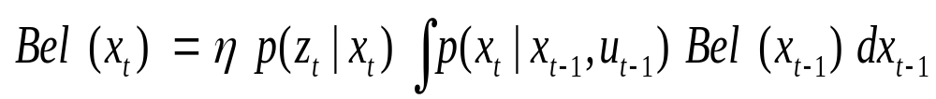
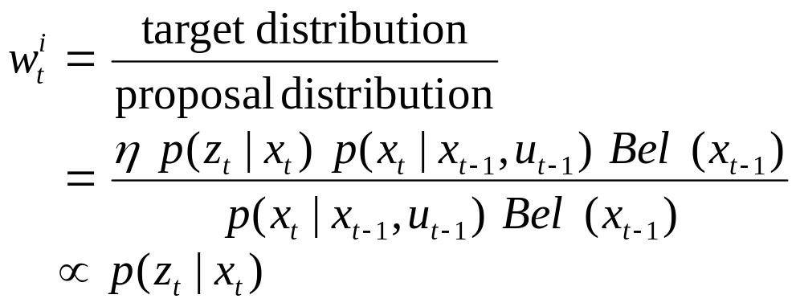
Particle Filter Algorithm
draw x^{i}_{t−1} from Bel(x_{t−1})
draw x^{i}_{t} from p(x_{t} | x^{i}_{t−1},u_{t−1})
Importance factor for x^{i}_{t}:

Slide 18
Resampling
Given: Set S of weighted samples.
Wanted : Random sample, where the probability of drawing x_{i} is given by w_{i}.
Typically done n times with replacement to generate new sample set S’.

Slide 19
Resampling
w_{n}
w₁
w_{n}
w₁
w₂
w₂
W_{n-1}
W_{n-1}
w₃
w₃
Stochastic universal sampling
Systematic resampling
Linear time complexity
Easy to implement, low variance
Roulette wheel
Binary search, n log n

Slide 20








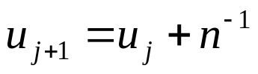
Resampling Algorithm
Algorithm systematic_resampling(S,n):
For Generate cdf
Initialize threshold
For Draw samples …
While ( ) Skip until next threshold reached
Insert
Increment threshold
Return S’
Also called stochastic universal sampling

Slide 21
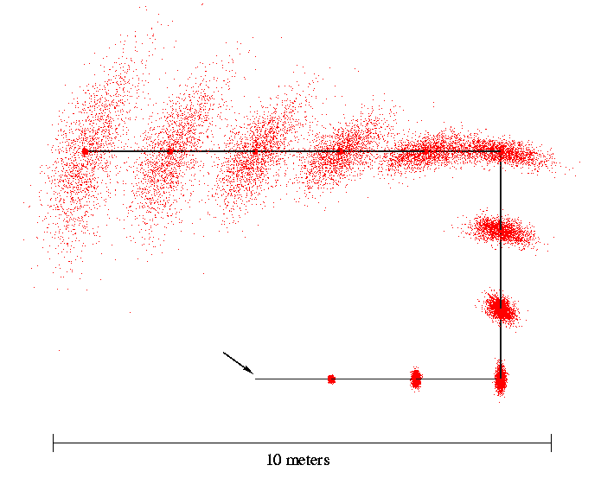
Motion Model Reminder
Start

Slide 22
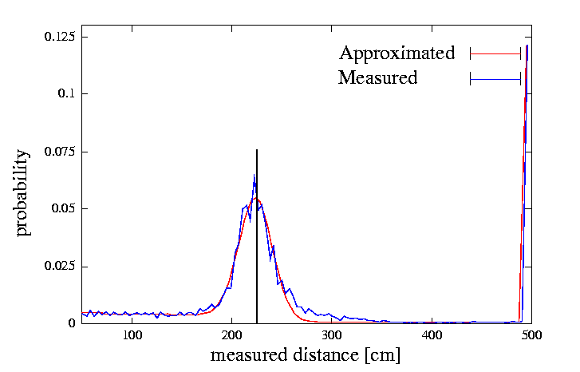
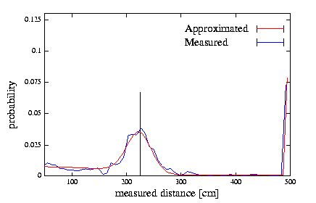
Proximity Sensor Model Reminder
Laser sensor
Sonar sensor

Slide 23
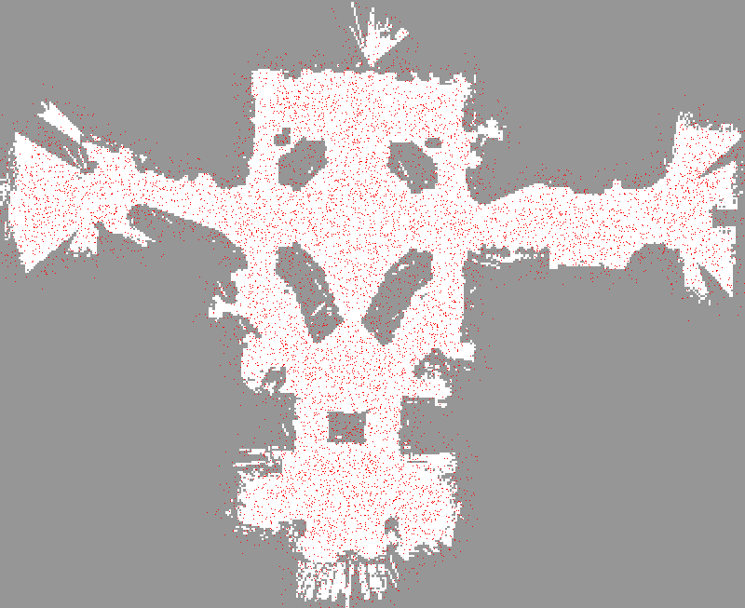

Slide 24
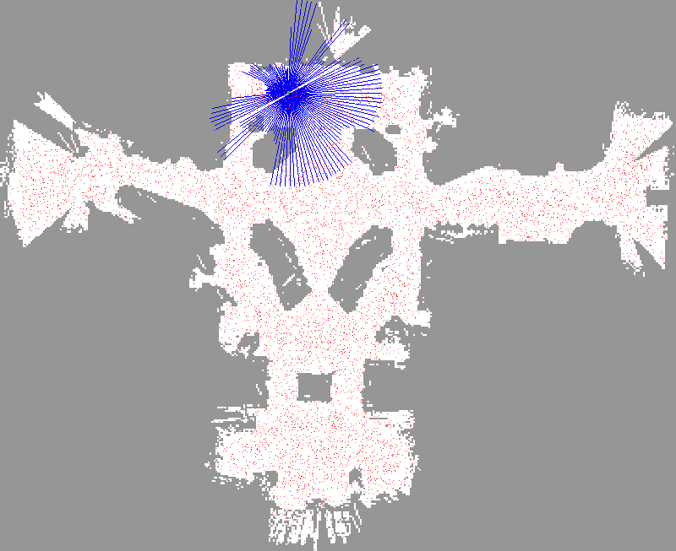

Slide 25
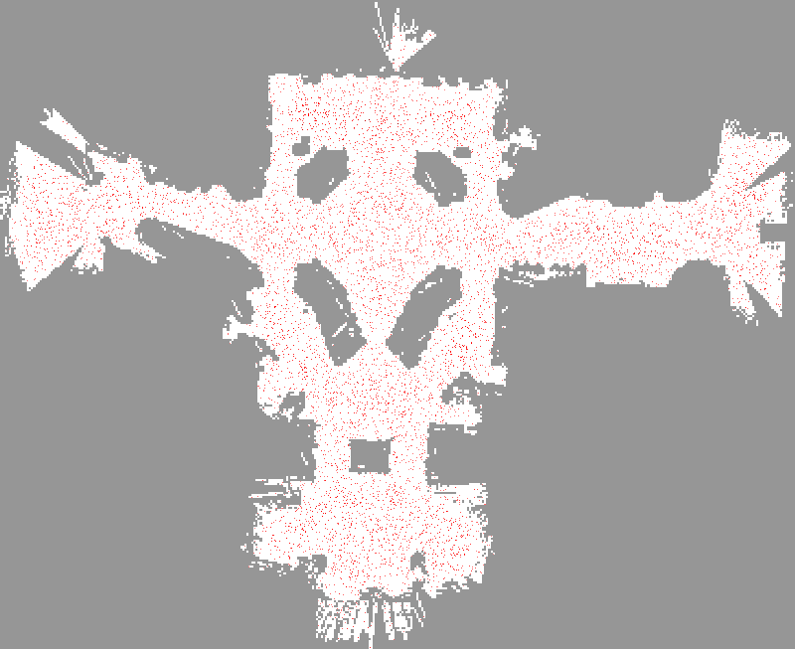

Slide 27
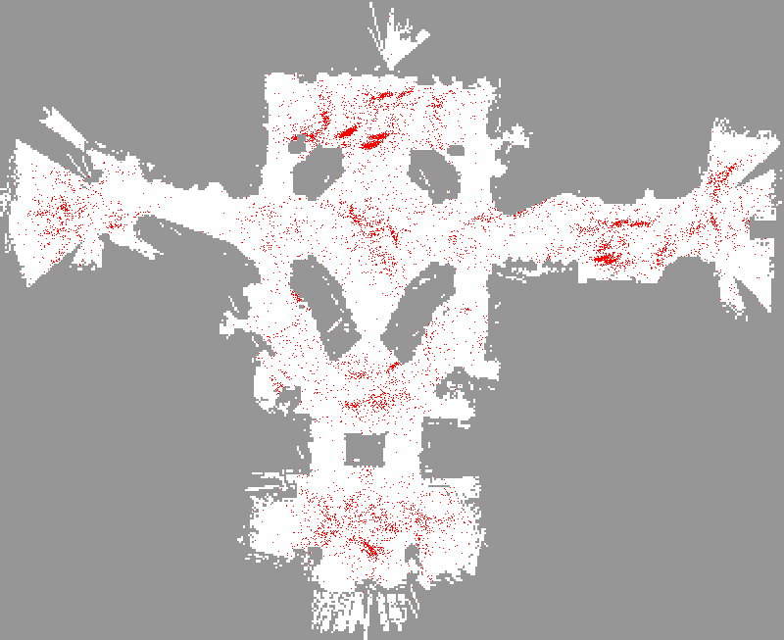

Slide 28
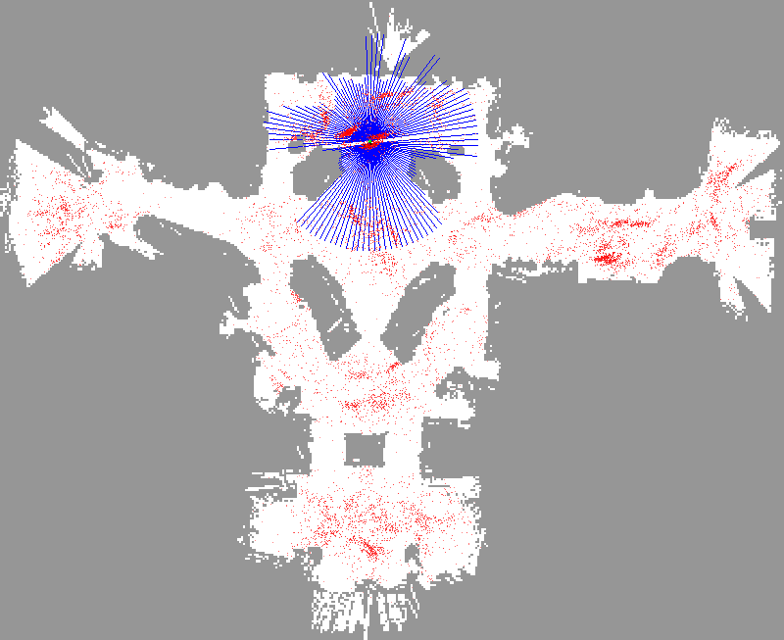

Slide 29
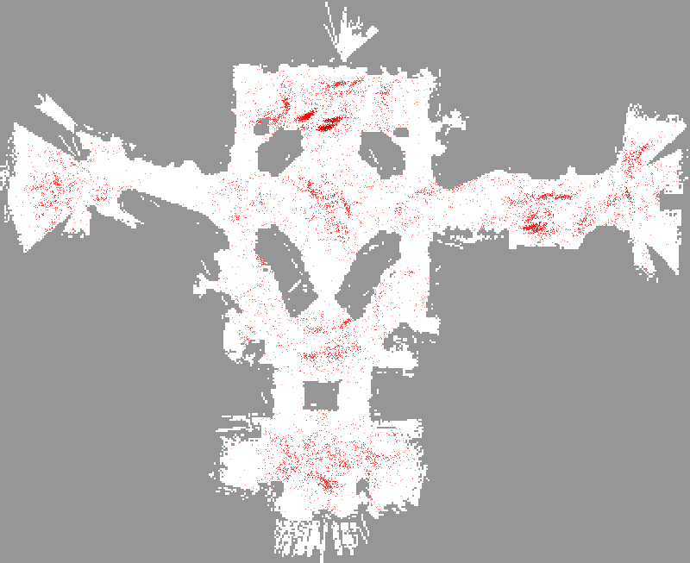

Slide 30
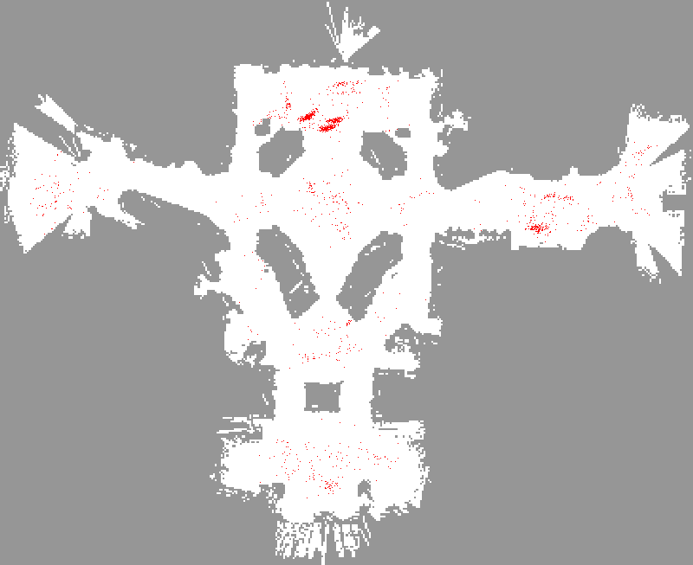

Slide 31
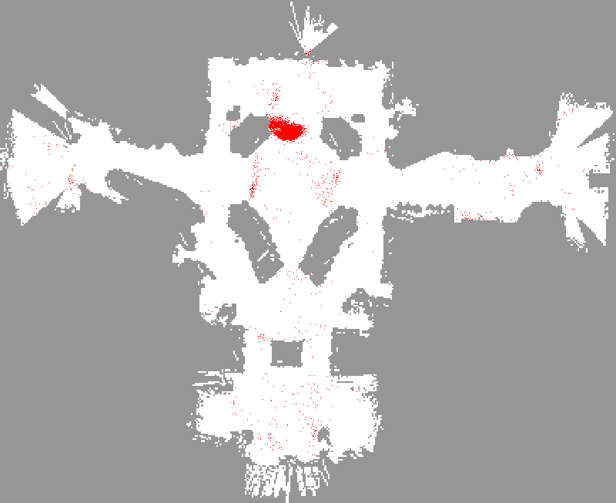

Slide 32
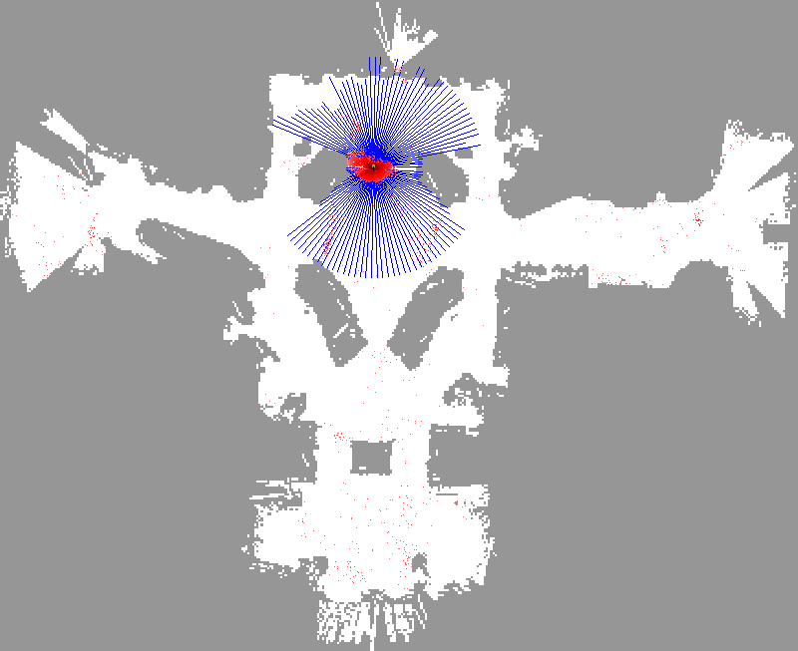

Slide 33


Slide 34
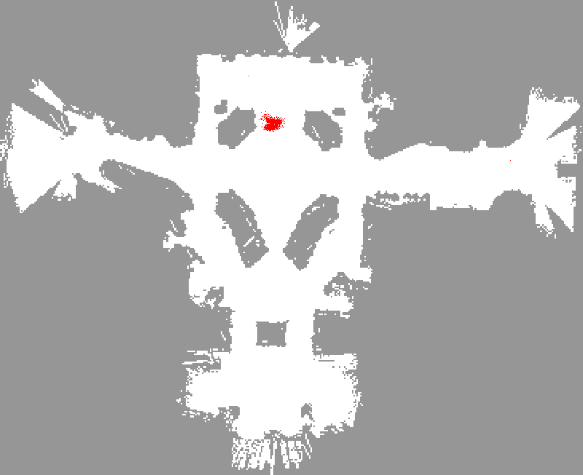

Slide 35
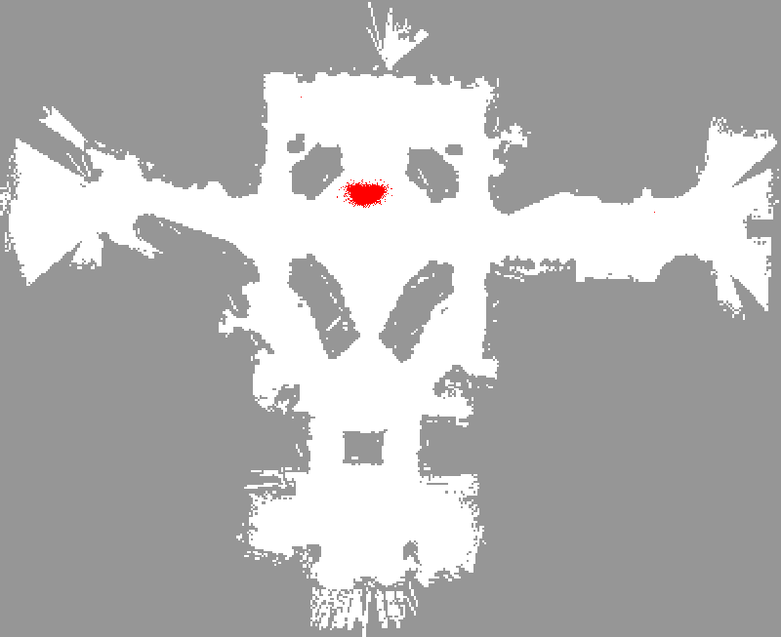

Slide 36
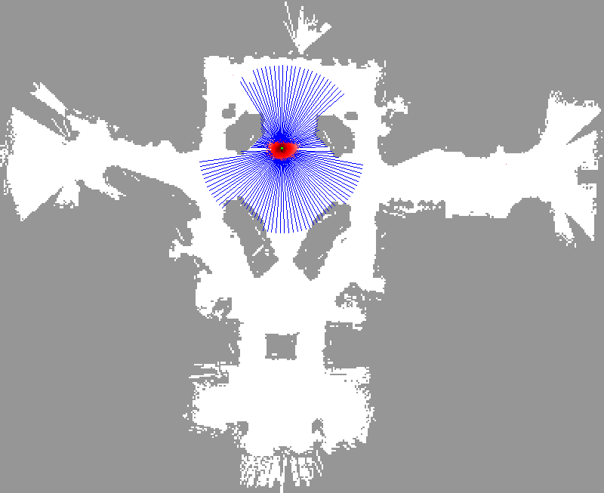

Slide 37
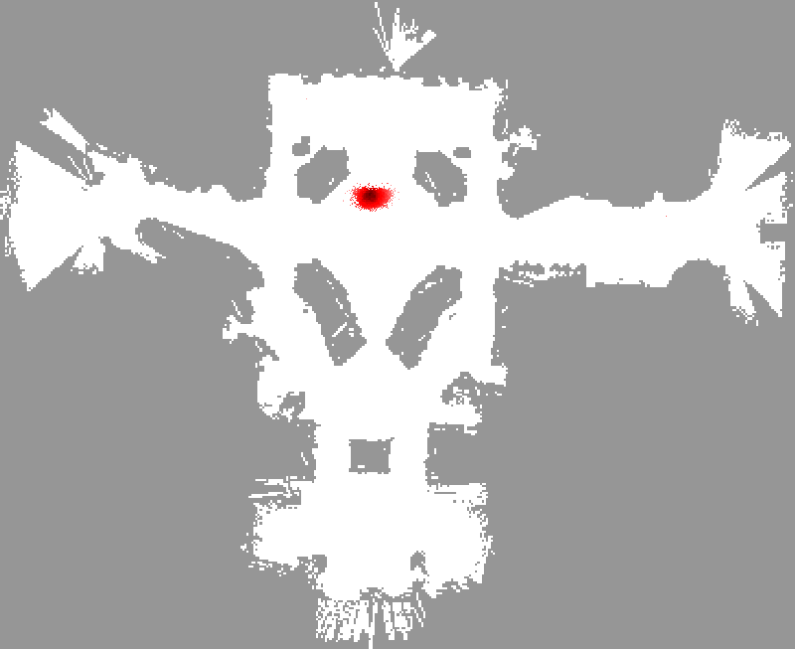

Slide 38
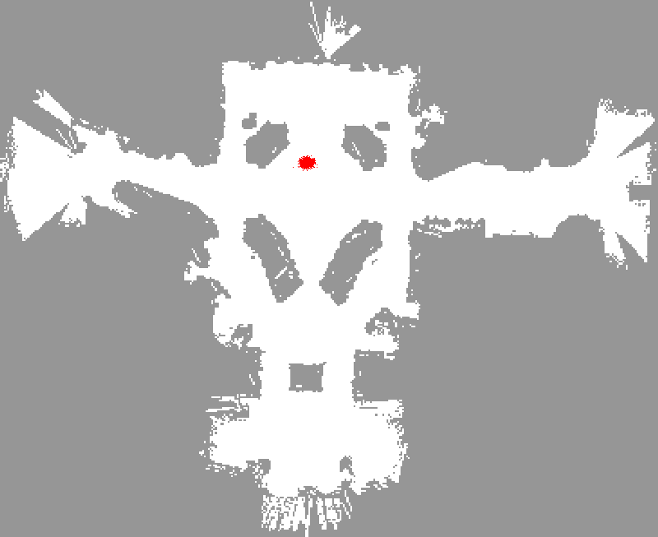

Slide 39
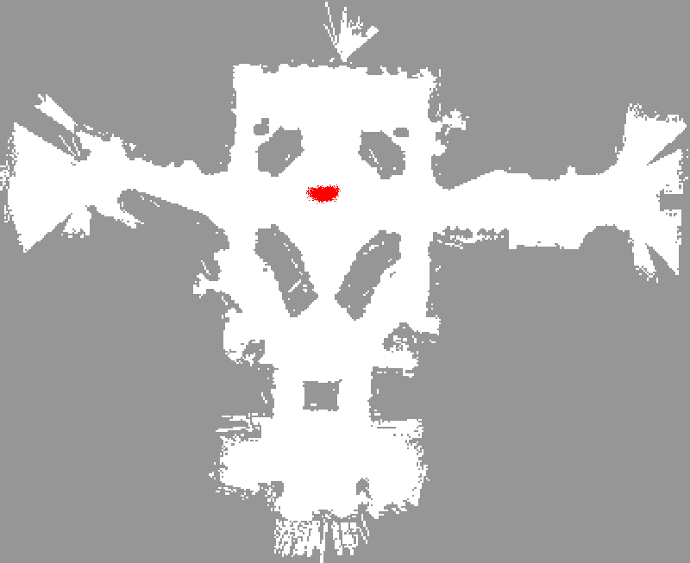

Slide 40
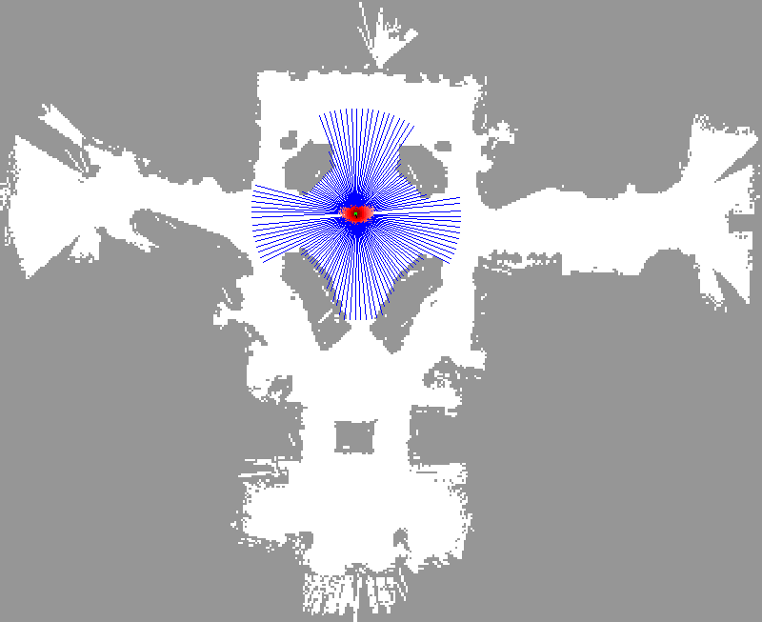

Slide 42
Sample-based Localization (sonar)

Slide 43
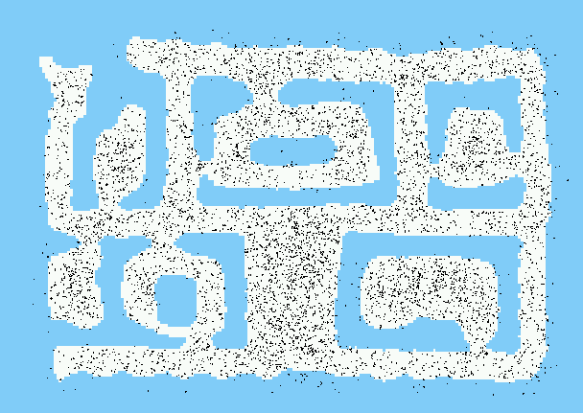
Initial Distribution

Slide 44

After Incorporating Ten Ultrasound Scans

Slide 45

After Incorporating 65 Ultrasound Scans

Slide 46
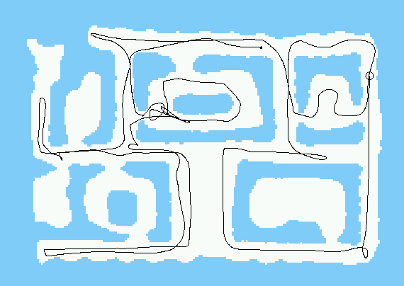
Estimated Path

Slide 47


Using Ceiling Maps for Localization

Slide 48

Vision-based Localization
P(z|x)
z
h(x)

Slide 49


Under a Light
Measurement z:
P(z|x):

Slide 50


Next to a Light
Measurement z:
P(z|x):

Slide 51


Elsewhere
Measurement z:
P(z|x):

Slide 52

Global Localization Using Vision

Slide 53

Robots in Action: Albert

Slide 54


Application: Rhino and Albert Synchronized in Munich and Bonn
[Robotics And Automation Magazine, to appear]

Slide 55

Localization for AIBO robots

Slide 56
Limitations
The approach described so far is able to
  track the pose of a mobile robot and to
  globally localize the robot.
How can we deal with localization errors (i.e., the kidnapped robot problem)?

Slide 57
Approaches
Randomly insert samples (the robot can be teleported at any point in time).
Insert random samples proportional to the average likelihood of the particles (the robot has been teleported with higher probability when the likelihood of its observations drops).

Slide 58


Random Samples
Vision-Based Localization
936 Images, 4MB, .6secs/image
Trajectory of the robot:

Slide 59

Odometry Information

Slide 60

Image Sequence

Slide 61

Resulting Trajectories
Position tracking:

Slide 62

Resulting Trajectories
Global localization:

Slide 63

Global Localization

Slide 64

Kidnapping the Robot

Slide 65

Recovery from Failure

Slide 66
Summary
Particle filters are an implementation of recursive Bayesian filtering
They represent the posterior by a set of weighted samples.
In the context of localization, the particles are propagated according to the motion model.
They are then weighted according to the likelihood of the observations.
In a re-sampling step, new particles are drawn with a probability proportional to the likelihood of the observation.

