Slide 1
Probabilistic Robotics
Wheeled Locomotion

Slide 2
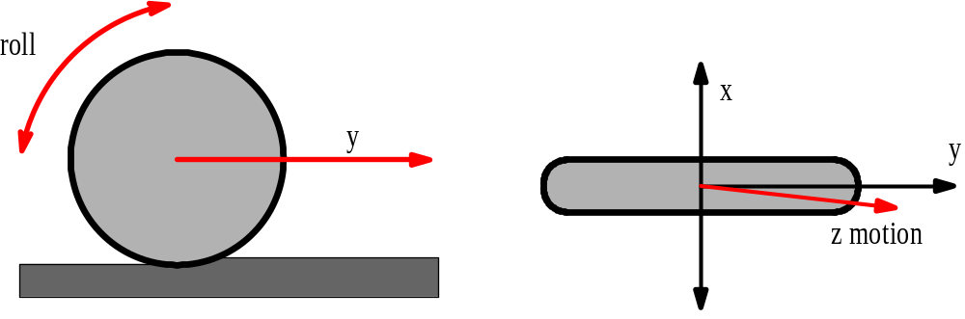
Locomotion of Wheeled Robots
Locomotion (Oxford Dict.):
Power of motion from place to place
Differential drive (AmigoBot, Pioneer 2-DX)
Car drive (Ackerman steering)
Synchronous drive (B21)
Mecanum wheels, XR4000

Slide 3
Instantaneous Center of Curvature
ICC
For rolling motion to occur, each wheel has to move along its y-axis

Slide 4
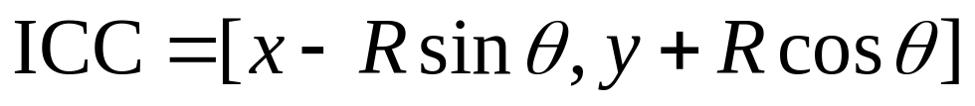
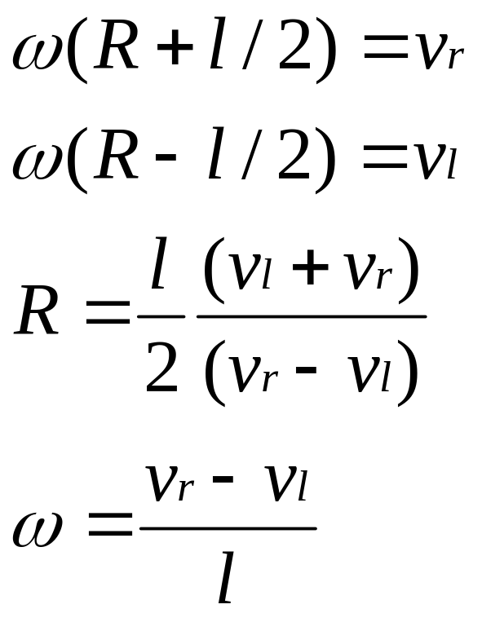
Differential Drive
y
ω
ICC
v
l
R
θ
(x,y)
x
v
r
l/2

Slide 5
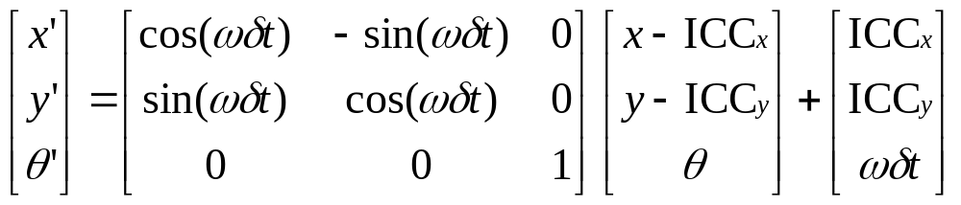
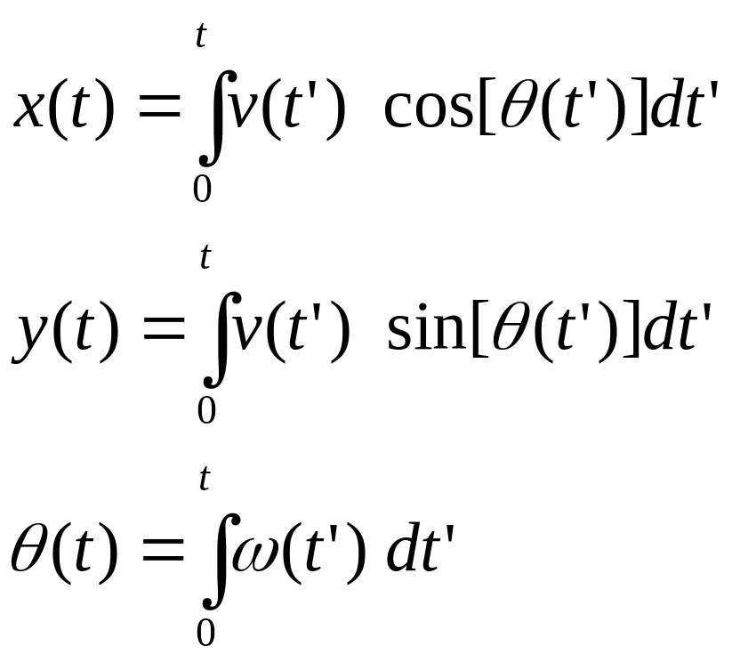
Differential Drive: Forward Kinematics
ICC
R
P(t+δt)
P(t)

Slide 6
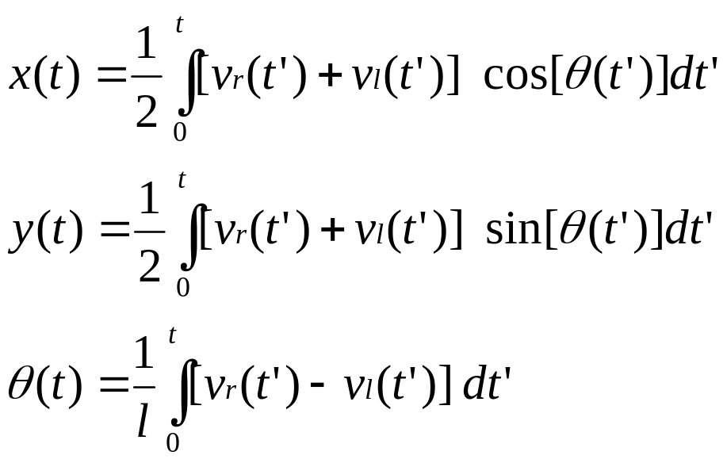
Differential Drive: Forward Kinematics
ICC
R
P(t+δt)
P(t)

Slide 7
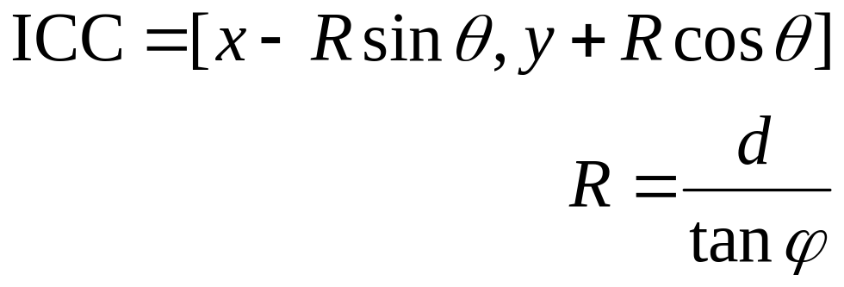
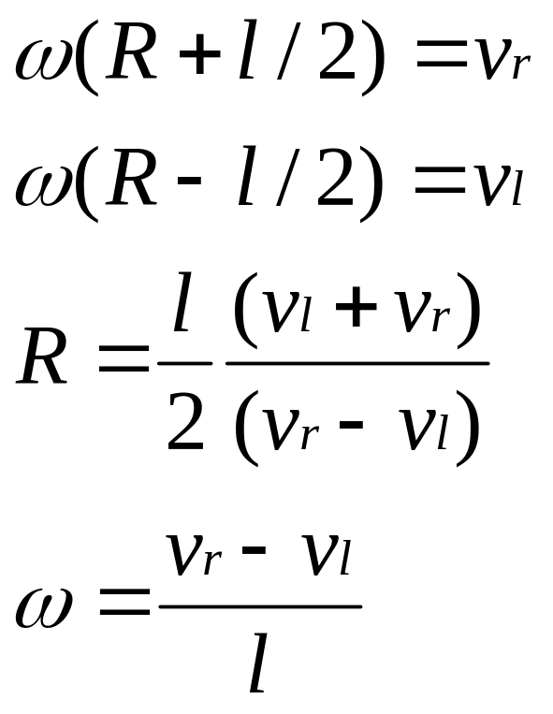
Ackermann Drive
y
ω
ICC
ϕ
ϕ
v
l
d
R
θ
(x,y)
x
v
r
l/2

Slide 8
Synchonous Drive
y
v(t)
  θ
x
ω( )
t

Slide 9
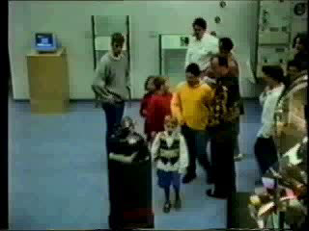
Synchro-Drive Robot

Slide 10
XR4000 Drive
y
v_{i}(t)
  θ
ω_{i}(t)
x
ICC

Slide 11
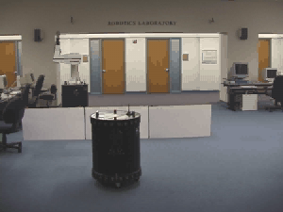
XR4000
[courtesy by Oliver Brock & Oussama Khatib]

Slide 12
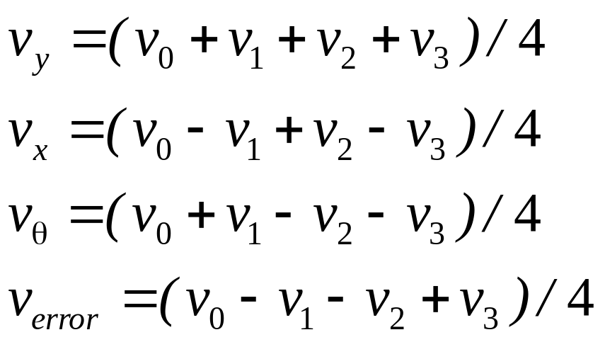
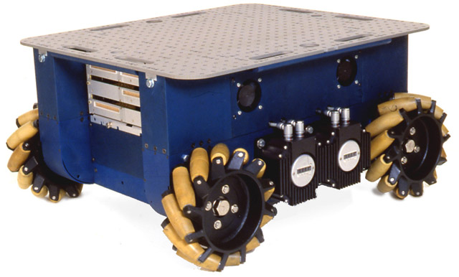
Mecanum Wheels

Slide 13
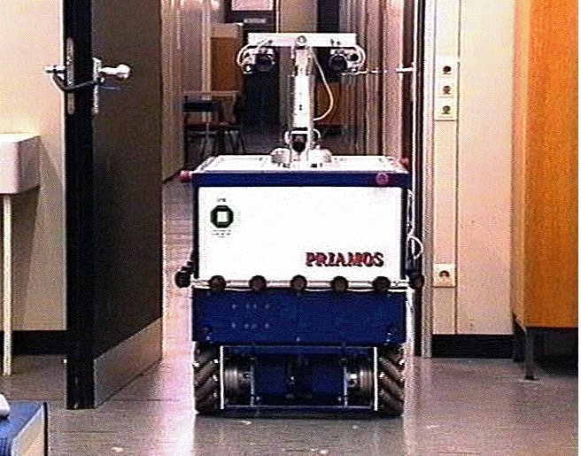
Example: Priamos (Karlsruhe)

Slide 14
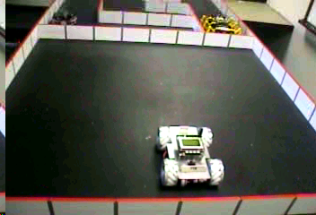
Example

Slide 15
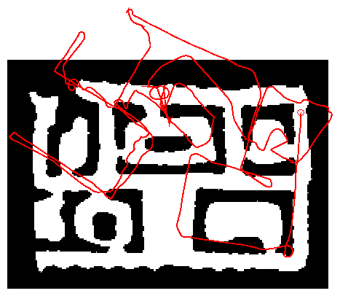
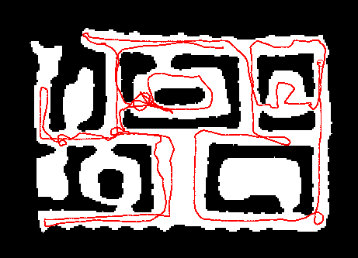
Odometry

Slide 16
Non-Holonomic Constraints
Non-holonomic constraints limit the possible incremental movements within the configuration space of the robot.
Robots with differential drive or synchro-drive move on a circular trajectory and cannot move sideways.
XR-4000 or Mecanum-wheeled robots can move sideways.

Slide 17
Holonomic vs. Non-Holonomic
Non-holonomic constraints reduce the control space with respect to the current configuration (e.g., moving sideways is impossible).
Holonomic constraints reduce the configuration space.

