Slide 1

Research Progress Record
Enmao Diao
Oct 31, 2018

Slide 2
Computation
4 NVIDIA TITAN XP roughly better than two P10 at Microsoft Azure
12GB memory each, smaller than one P10 but two larger than one P10
For Joint model, one epoch takes 600s
✓ Set up GPU computation environment at Duke Cluster Computing

Slide 3
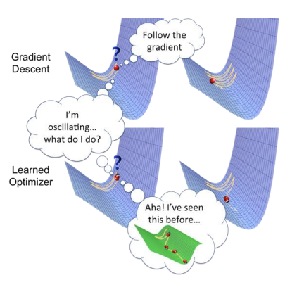
Last Milestones
General
Better tuning parameter strategy for optimization
Setting a milestone for each objective and adjust tuning parameter based on the distance between the milestone and the current performance
https://arxiv.org/pdf/1810.04650v1.pdf
Meta Learning
Use models to learn the learning rate and other hyper parameters (learn to learn)
Transfer Learning
Add hidden and memory state for the whole model
Growing Memory cell
Memory Issue
Test Truncated BPTT and models that consume less memory

Slide 4
Last Milestones
Compression and Classification
Experiment better classification performance
Test on ImageNet and Coco Dataset after memory issue fixed
Try to add support for varying image size
Test with large image shape with deeper models with ImageNet
Test with Kodak and RAID (raw images) dataset
Test with other metrics and PSNR-HVS and MS-SSIM
Add entropy codec and Compare with other classical codecs like JPG2000, BPG
Test dynamic functionality and performance
Test more multi-scale model
Test distributed codecs with smaller encoders
Test decoders for different number of nodes
Experiment smaller gap among the number of nodes
Experiment images from different angle for distributed systems
Start Video Compression

Slide 5
Last Milestones
Generative Codec and unsupervised learning
Experiment K-means and GMM for MNIST data with Gaussian VAE
Experiment Dirichlet Process GMM for gradually growing number of clusters (dictionary building)
Experiment Concrete VAE (Bernoulli distribution reparametrized by Gumbel Trick)
Combine Clustering, Concrete VAE and our codecs

Slide 6
Last Milestones
Compression and Detection
Combine Faster-RCNN with our codecs

Slide 7
Last Milestones
Other Tracks
Audio Compression, Music Information Retrieval and Speech Recognition
Web Crawler for crawling images from URL (data mining)

Slide 8
Data
MNIST dataset
60000 handwritten 0-9 digits images for training, 10000 for test
Original shape 28x28, resized to 32x32
CIFAR10 dataset (cannot exceed 30 PSNR and 74% accuracy)
50000 natural images of 10 classes like airplane, automobile, cat, dog, etc for training, 10000 for test
Original shape 32x32
SVHN dataset
Street View House Numbers data containing 0-9 digits RGB cropped images. 73257 digits for training, 26032 digits for testing, and 531131 additional (not used this time), somewhat less difficult samples, to use as extra training data.
http://ufldl.stanford.edu/housenumbers/

Slide 9
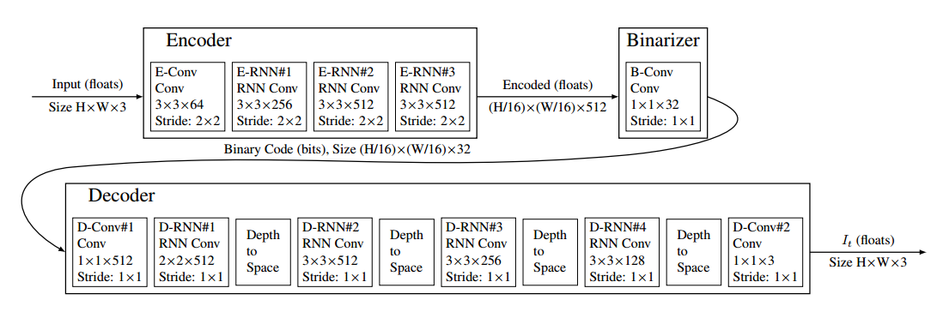
Model
Google Model

Slide 10
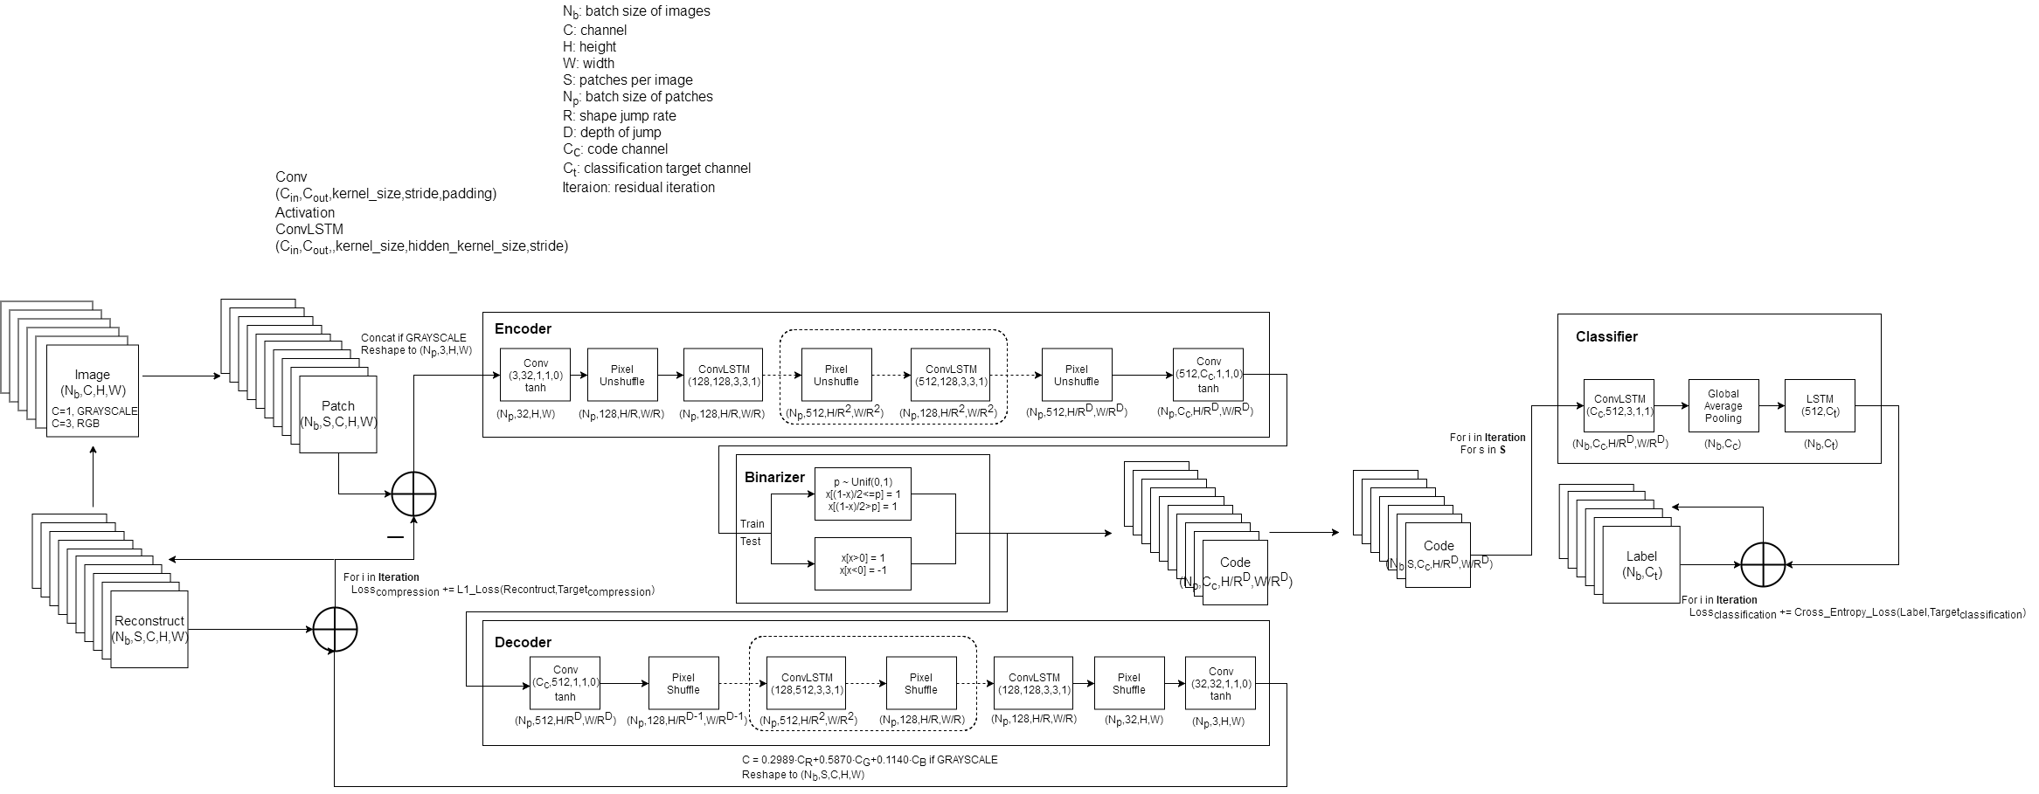
Model

