Slide 1

Research Progress Record
Enmao Diao
Aug 28, 2018

Slide 2
Abstract
Computation
Data
Compression and Classification
Rate Variable Classification
Two stage (isolated) optimization
CIFAR10
Distributed Compression
Codec Conversion

Slide 3
Computation
My own desktop GPU: GTX 1080 TI (cutting edge single-precision)
Azure(or AWS) cluster GPU available: V100, P100, K80 (double-precision, more memory)
GTX 1080 TI(~$750) is the same generation as P100 (~ $ 8000)

Slide 4
Computation
Test
One epoch of running MNIST(60000 samples) on our residual network takes 1000 s on my machine and takes more than 3000s on one K80, takes 2000s with two K80s, and takes 1000s with four K80s
Takes 900s on one P100, and takes 430s on two P100s, and takes 270s on 4 P100s
https://azure.microsoft.com/en-us/pricing/details/virtual-machines/linux/

Slide 5
Data
MNIST dataset
60000 handwritten 0-9 digits images for training, 10000 for test
Original shape 28x28, resized to 32x32
CIFAR10 dataset
50000 natural images of 10 classes like airplane, automobile, cat, dog, etc for training, 10000 for test
Original shape 32x32
Head Pose Image dataset
http://www-prima.inrialpes.fr/perso/Gourier/Faces/HPDatabase.html

Slide 6
Compression and Classification
Milestones
Classification part is not rate variable
Tuning parameter for multi-objective optimization or two stage (isolated) optimization
More complex iid image data, like CIFAR10, ImageNet
Add LSTM for patch data? for frame data?
Web crawler for retrieving large volume of data to search for architecture and compressing images

Slide 7
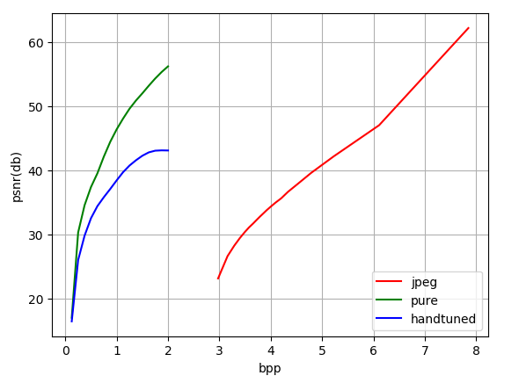
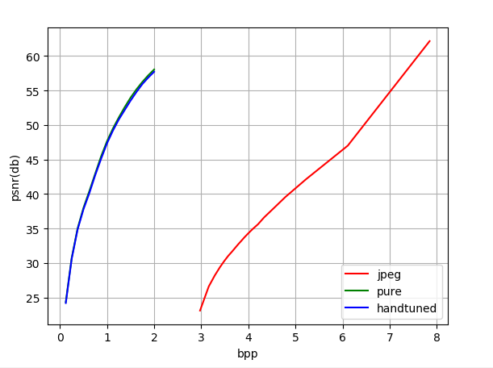
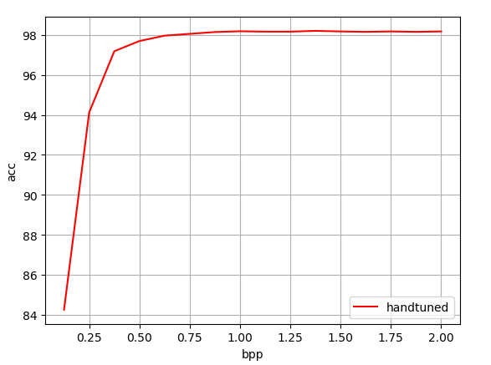
Compression and Classification
Classification part is not rate variable (MNIST)
With pure LSTM based network, we can achieve rate variable classification
Last time results
Current results

Slide 8
Compression and Classification
Classification part is not rate variable (CIFAR10)
With pure LSTM based network, we can achieve rate variable classification
Current results

Slide 9
Compression and Classification
Two stage (isolated) optimization

Slide 10
Compression and Classification
Patched LSTM
Pad and unpad different size of images (sequence), otherwise we can only use batch_size = 1
(Variable rate) classification for non-uniform sizes of images

Slide 11
Distributed Compression
Milestones
Split image dataset into several subset of data
Each slave node has a sperate encoder
The main host receive the codes from slave nodes and concatenate them together to decode them from a single decoder
The system should yield better rate-distortion curve compared to decode each slave node separately
Possible to add classification and other objectives

Slide 12
Codec Conversion
Milestones
Convert between classical codecs like jpeg, png and neural network based codecs
Convert between neural network based codecs
Convert between classical codecs
Can we convert between lossy compressed codes and lossless compressed codes with neural network

