Slide 1
(a)
(b)
(c)

Slide 2
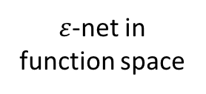
Expert learning
Base expert
(level 1)
Compound expert
(level 2)
Compound expert
Prediction of functions
Function base
Function flow
Change of flow
$ε$-net in function space
Patterns of local transition
Variations of patterns
Interpretation

Slide 3




(a) All-way switch
(b) Directional switch
Time $t−1$
Time $t$
Time $t−1$
Time $t$

Slide 4
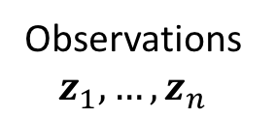
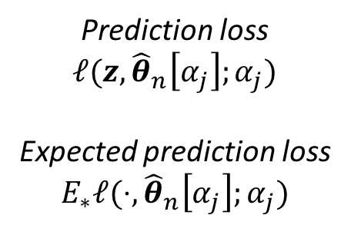

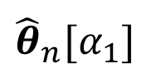
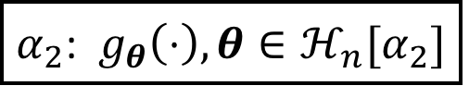
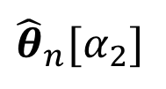

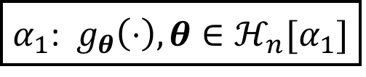
Models
$α_{1}$: $g_{θ}\left(⋅\right), θ∈ℋ_{n}[α_{1}]$
$${\hat{θ}}_{n}[α_{1}]$$
Observations $z_{1},…,z_{n}$
$α_{2}$: $g_{θ}\left(⋅\right), θ∈ℋ_{n}[α_{2}]$
$${\hat{θ}}_{n}[α_{2}]$$
$${\hat{θ}}_{n}[α_{j}]$$
Prediction loss
$$ℓ(z,{\hat{θ}}_{n}\left[α_{j}\right];α_{j})$$
Expected prediction loss
$$E_{∗}ℓ(⋅,{\hat{θ}}_{n}\left[α_{j}\right];α_{j})$$
Future $z$
True data generating process

Slide 5
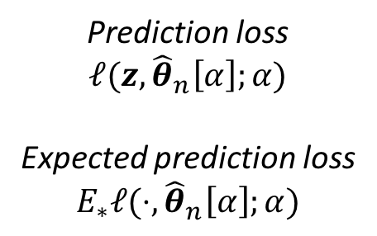
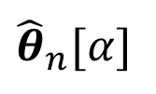
Models
$α_{1}$: $g_{θ}\left(⋅\right), θ∈ℋ_{n}[α_{1}]$
$${\hat{θ}}_{n}[α_{1}]$$
Observations $z_{1},…,z_{n}$
$α_{2}$: $g_{θ}\left(⋅\right), θ∈ℋ_{n}[α_{2}]$
$${\hat{θ}}_{n}[α_{2}]$$
$${\hat{θ}}_{n}[α]$$
Prediction loss
$$ℓ(z,{\hat{θ}}_{n}\left[α\right];α)$$
Expected prediction loss
$$E_{∗}ℓ(⋅,{\hat{θ}}_{n}\left[α\right];α)$$
Future $z$
True data generating process

Slide 6
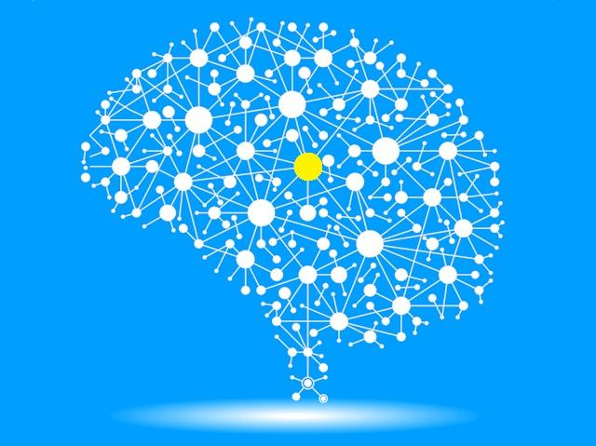
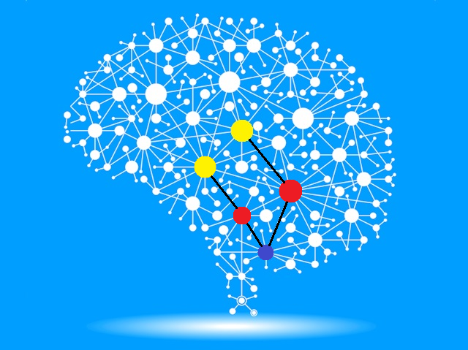
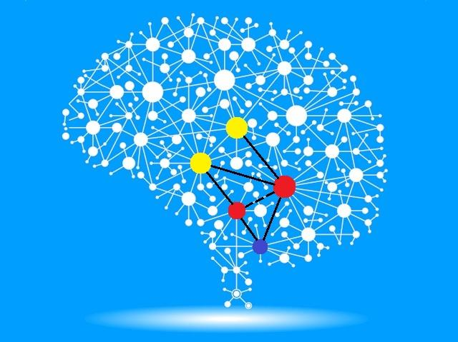
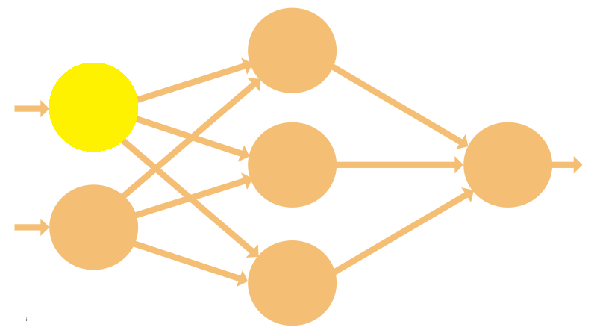
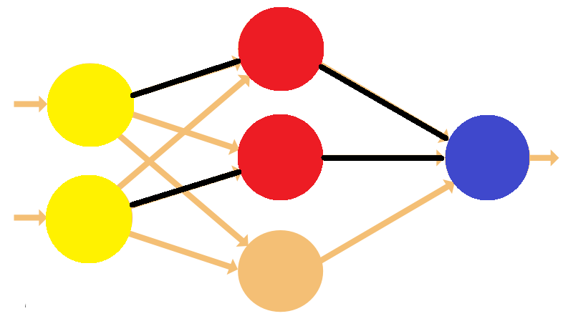
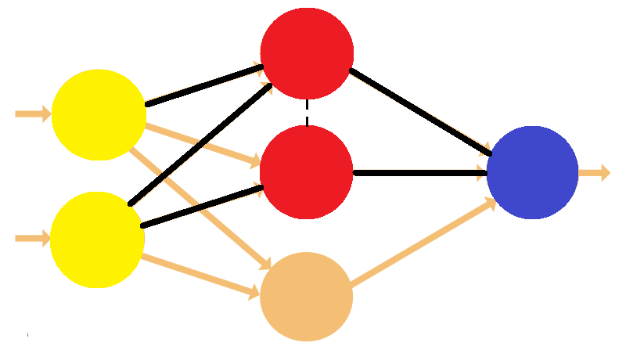
Neural Networks
see something
see more things
data
more data
Similar to a human brain, neurons are activated to adapt to the currently observed data in an online fashion.

