Slide 1

Research Progress Record
Enmao Diao
Sep 26, 2018

Slide 2
Abstract
Computation
Data
Compression and Classification
Codec Conversion
Milestones

Slide 3
Computation
My own desktop GPU: GTX 1080 TI (cutting edge single-precision)
Azure(or AWS) cluster GPU available: V100, P100, K80 (double-precision, more memory)
One epoch of running MNIST(60000 samples) on our batch based residual network takes 700 s on my machine and takes 500s on one P100

Slide 4
Data
MNIST dataset
60000 handwritten 0-9 digits images for training, 10000 for test
Original shape 28x28, resized to 32x32
CIFAR10 dataset (cannot exceed 30 PSNR and 74% accuracy)
50000 natural images of 10 classes like airplane, automobile, cat, dog, etc for training, 10000 for test
Original shape 32x32
SVHN dataset
Street View House Numbers data containing 0-9 digits RGB cropped images. 73257 digits for training, 26032 digits for testing, and 531131 additional (not used this time), somewhat less difficult samples, to use as extra training data.
http://ufldl.stanford.edu/housenumbers/

Slide 5
Compression and Classification
Last time milestones
Classification part is not rate variable
Tuning parameter for multi-objective optimization or two stage (isolated) optimization
More complex iid image data, like CIFAR10, ImageNet
Add LSTM for patch data? for frame data?
Web crawler for retrieving large volume of data to search for architecture and compressing images

Slide 6
Compression and Classification
Last time milestones
Split image dataset into several subset of data
Each slave node has a sperate encoder
The main host receive the codes from slave nodes and concatenate them together to decode them from a single decoder
The system should yield better rate-distortion curve compared to decode each slave node separately
Possible to add classification and other objectives

Slide 7
Codec Conversion
Last time milestones
Convert between classical codecs like jpeg, png and neural network based codecs
Convert between neural network based codecs
Convert between classical codecs
Can we convert between lossy compressed codes and lossless compressed codes with neural network

Slide 8
Compression and Classification
Batch-based Network
Images are cut into small patches (32x32) and the patches are treated batch-wise independently
Suitable for small size images where memory is not an issue
Each time we feed in residual as input and compute the loss with respect to the residual. Tested loss between sum of residuals and input images and gain better preliminary results (not shown this time)
Tuning parameter is sensitive and affect dataset differently, fixed to 1e-3 for now
CIFAR10 unable exceed 30 PSNR and 74% accuracy, possibly because CIFAR10 is already highly compressed. Try to add forward and backward connection to set up multi-scale compression but no improvement on CIFAR 10
My implementation now is suitable for any batch of images of the same size and shapes are divisible by 2

Slide 9
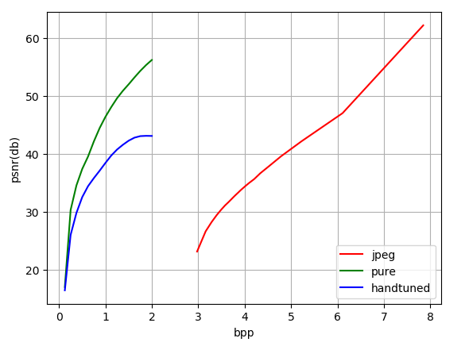
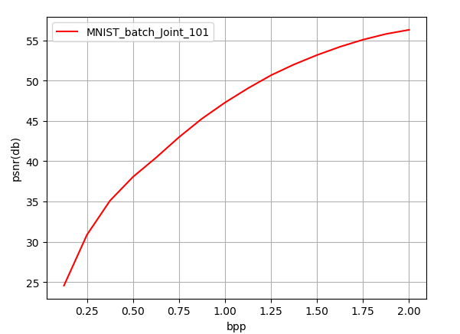
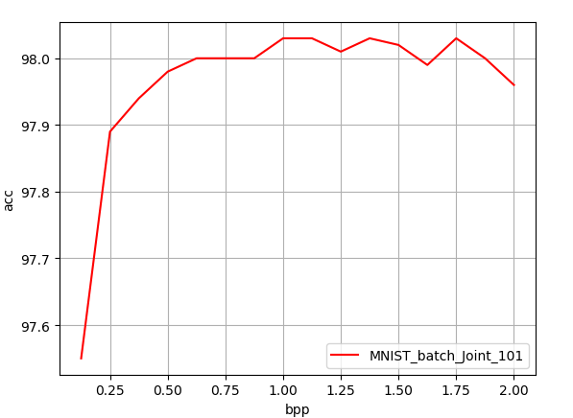
Compression and Classification
Batch-based Network
MNIST
Last time results
Current results

Slide 10
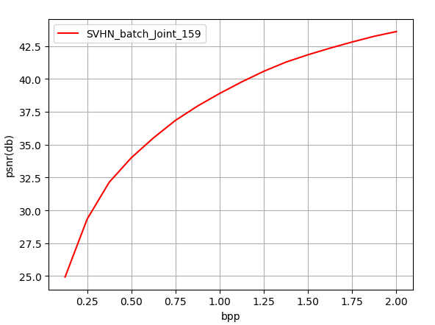
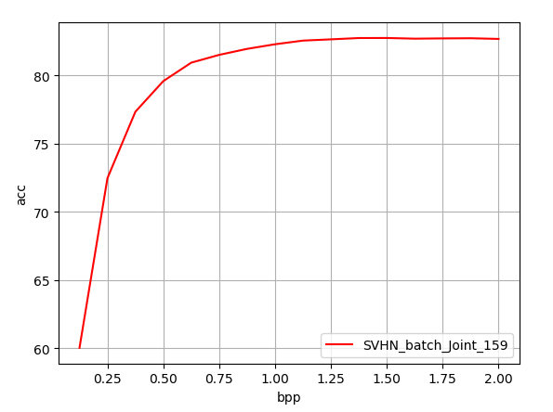
Compression and Classification
Batch-based Network
SVHN
Current results

Slide 11
Compression and Classification
Patch-based Network
Images are cut into small patches (32x32) and the patches are treated as a dependent sequence following a zigzag fashion
Suitable for large size images where memory is a threshold for computation
Have tried different ways of feeding sequence with residuals. The only one that works is first to feed the residuals for one patch first and then another patch.
Sum of residual loss also has a gain (not shown this time)
Have tried to feed difference of patches as sequence, works only preliminary result
Tuning parameter is sensitive and affect dataset differently, fixed to 1e-3 for now
My implementation is suitable for any batch of images of the same size and shapes are divisible by 2.

Slide 12
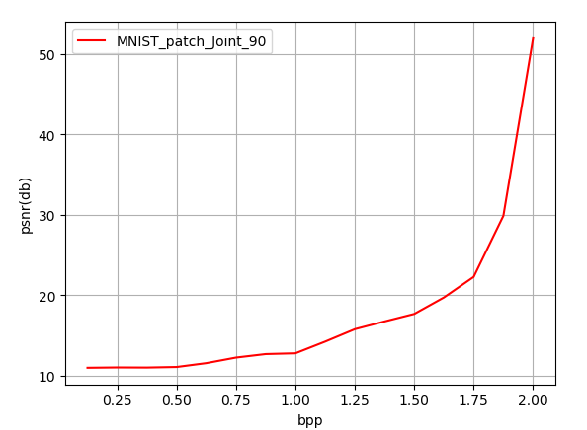
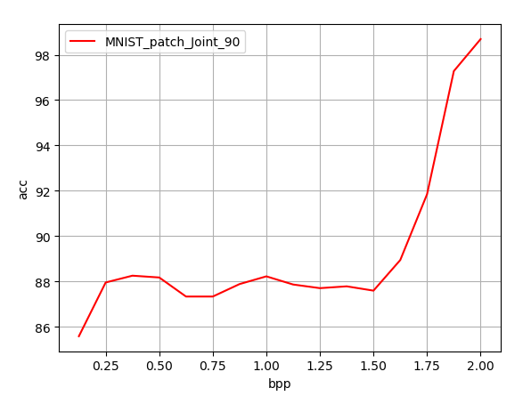
Compression and Classification
Patch-based Network
MNIST
Current results

Slide 13
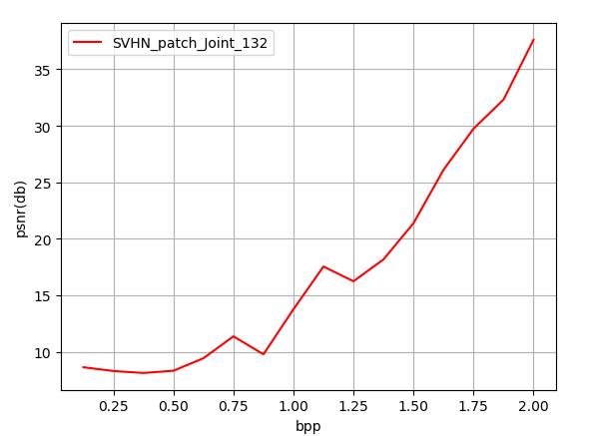
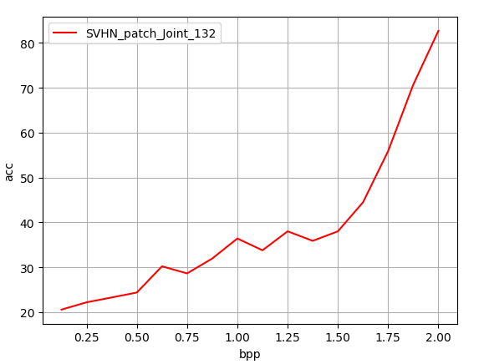
Compression and Classification
Patch-based Network
SVHN
Current results

Slide 14
Compression and Classification
Distributed Network
Images are cut into small patches (32x32) and the patches are fed into different encoders as slave nodes
Suitable for large number of images where parallel computation is possible but network connection is a threshold
Concat batches at decoder as main node. The performance is almost identical as using one encoder.
Tuning parameter is sensitive and affect dataset differently, fixed to 1e-3 for now
My implementation is suitable for any batch of images of the same size and shapes are divisible by 2.

Slide 15
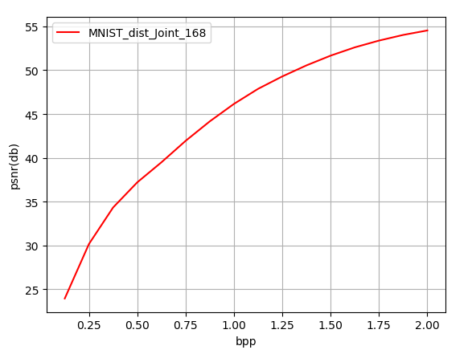
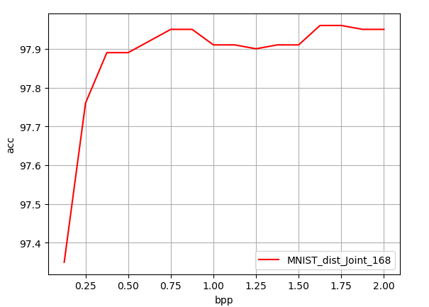
Compression and Classification
Distributed Network (4 slave node)
MNIST
Current results

Slide 16
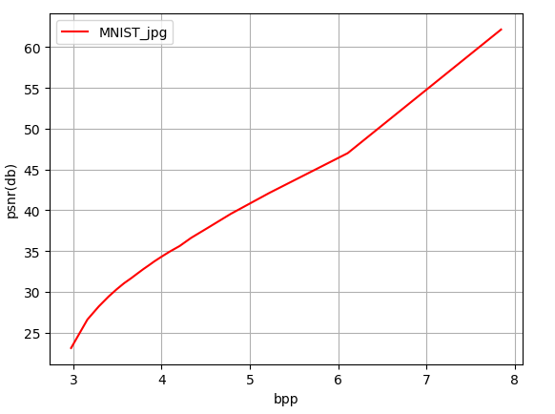
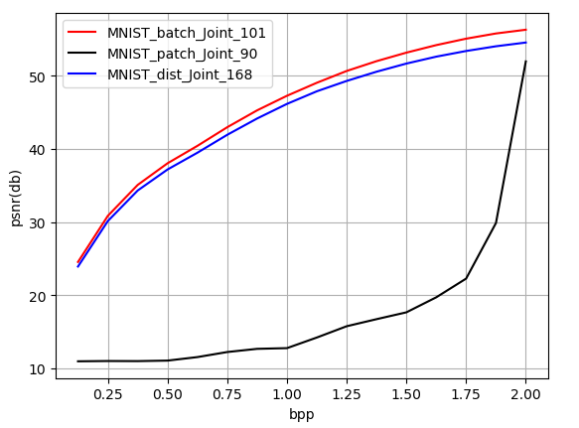
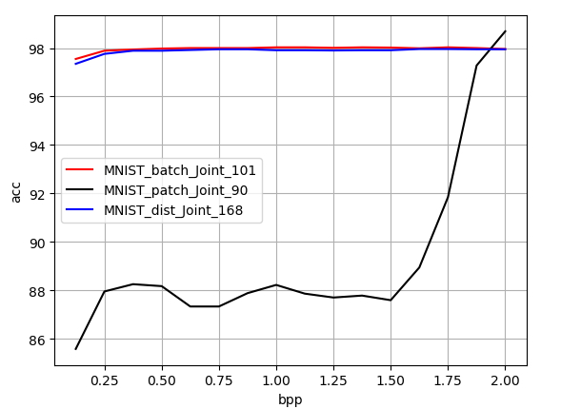
Compression and Classification
Across Comparison
MNIST
Current results

Slide 17
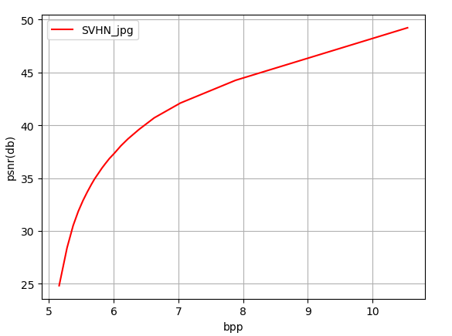
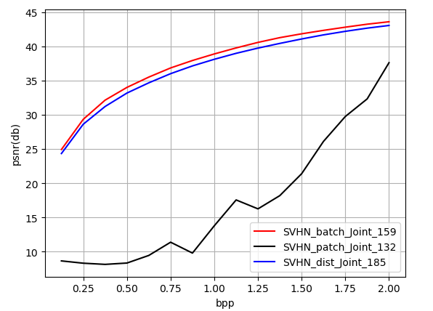
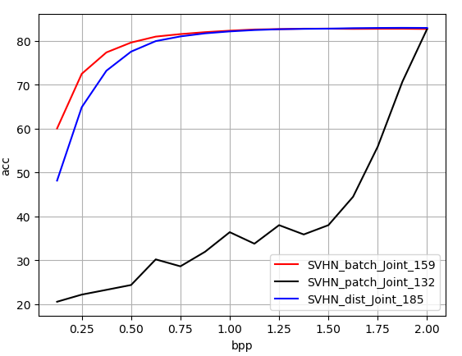
Compression and Classification
Across Comparison
SVHN
Current results

Slide 18
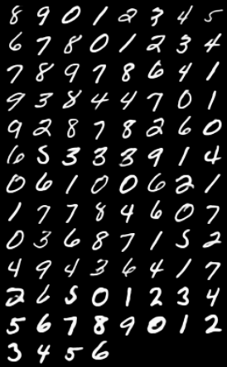
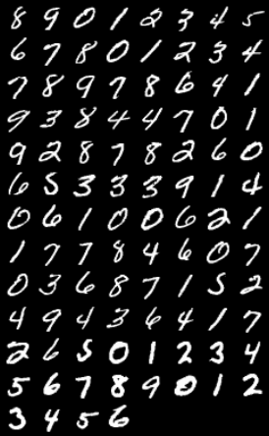
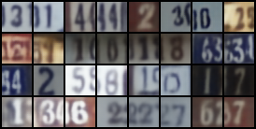
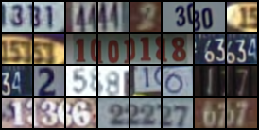
Compression and Classification
Example output
MNIST
SVHN

Slide 19
Codec Conversion
The main problem I encounter is that each image is coded to different size of code. Not sure it is owing to the entropy codec or the DCT codec itself.
The source code for JPG and other classical codecs is not widely available in python.

Slide 20
Milestones
General
Set up GPU computation environment at Duke Cluster Computing
Better tuning parameter strategy for optimization
Setting a milestone for each objective and adjust tuning parameter based on the distance between the milestone and the current performance
Test on multi-stage optimization
✓ First train on compression and then classification
First train on one dataset and then test and train on another

Slide 21
Milestones
Compression and Classification
Further Test forward and backward (less important)
✓ Further test sum of residual loss
✓ Further test difference of patches patch-based network
Explore on overlapping patches and patch sequence formation
✓ Test on ImageNet and COCO dataset
✓ Test on larger patch size i.e. 128x128
✓ Experiment variable depth model. So far we have 4 compression module at encoder and 4 at decoder. Compression rate is 1/16 for each residual iteration
Test on multi-scale codec
✓ Test on pixel unshuffled model
Experiment variable code size for different images? May depend on entropy codec?
✓ Experiment with more slave nodes
Experiment asynchronous distributed system

Slide 22
Milestones
Codec Conversion
✓ Searching for source code for JPG and its entropy codec
Experiment conversion between classical codecs like JPG JPG2000 BPG (lossy) and PNG BMP (lossless)
Explore different size of codes for different images
Experiment conversion between codecs trained on different dataset
Experiment conversion between trained codecs and classical codecs

Slide 23
Milestones
Other tracks
Explore generative model and experiment a variational model for binary autoencoder. Generative model is suitable for change detection and other inference tasks. Gumbel Softmax trick can be a good start
✓ Set up MS COCO dataset for Detection task and explore detection and caption in addition to compression and classification

