Slide 1
Customer Interviews
Tips & Techniques

Slide 2
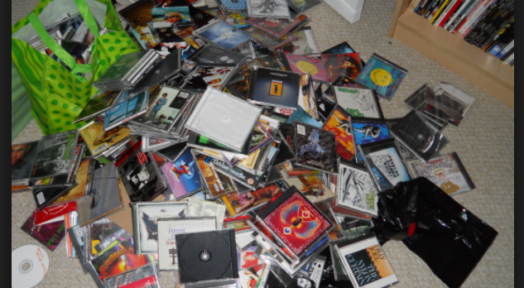
Innovation begins with observation

Slide 3
Got an Idea?
Ask Someone!!
Many solutions fail because they solve no meaningful problem, and we tend to fall in love with our ideas and let our biases get the better of us
Notes:
that’s the best part about interviews! Not only will they help you validate whether the customer has the problem you think they do, if they don’t, interviews will point you to one they do have. You win either way.

Slide 4
Why
Customer Experience is the source of your credibility
Without it, how can you make product or prioritization decisions?

Slide 5
“What if we found ourselves building something that nobody wanted? In that case, what did it matter if we did it on time and on budget?”
Eric Ries, author, Lean Startup

Slide 6
Customer Research
Customer Research is the answer - What is the question?

Slide 7

Customer Interviews – A Special Kind of Pain
Notes:
Talk to a stranger. Fun!!
That stranger is busy…and hates being sold things. Getting better.
That stranger will most likely kill your dreams and destroy your vision. Let me at it?!

Slide 8
How do you ask questions?
It’s easy to focus on what you want to know rather than on how you ask, but the way you ask questions matters a lot in terms of what and how much you can discover
You can learn unexpected and important things by changing how you frame your questions
Notes:
Typically only have limited time with our interview subjects. It is important not to waste the time that we have with our interviewees

Slide 9
Closed Ended vs Open Ended Questions
Do you know the difference between closed and open ended questions?

Slide 10
What is an open ended question?
Open-ended questions are questions that allow someone to give a free-form answer.
By asking an open ended question you are providing the recipient with the ability to engage and give you information you didn’t know you needed
Notes:
You don’t know what you don’t know

Slide 11
Phrasing questions is key
What did you use to create your Kindle book
What would you recommend I use to create my Kindle book?

Slide 12

Boundaries are important too
Do give people freedom to talk
Don’t be too vague so that the interviewee does not go into detail about the specifics of the topic

Slide 13

Interviews in Practice

Slide 14
Setting Up an Interview
Send subject relevant information prior to the meeting
We want to improve our products and process…
Ask for 20 minutes (telephone interview) or 60 minutes (onsite interview)
Offer choices of “yes” “Would Monday or Tuesday be best?” “Which is better for you? 10am or 2pm?”
Assure them sales people won’t be participating

Slide 15
Schedule
15mins Prep time
Set up equipment – ensure you have everything you need
30mins + for interview itself
15mins Review notes and next steps
Don’t do anything else during this time!!!

Slide 16
5 introductory questions
What should I know about your role?
Tell me about the problems were you trying to solve?
How did you solve them?
What did you learn?

Slide 17
Some more questions
What’s the hardest part about…[INSERT PROBLEM CONTEXT]
Can you tell me about the last time that happened?
Why was that hard?
What, if anything, have you done to solve that problem?
What don’t you love about the solutions you’ve tried?

Slide 18
Listen
Ask questions and then listen listen listen
“And then what happened?”
“Go on...”
“Tell me more...”
DO NOT USE THE INTERVIEW TO DEMONSTRATE TO THE CUSTOMER THAT YOU UNDERSTAND THEIR PROBLEM – YOU DON’T!

Slide 19
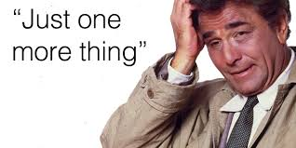

Slide 20
Closing Question
If you had the ear of our CEO, what would you say?
Is there anything you feel that I have not asked that is relevant to the conversation?
If you could choose to solve one problem, what would it be?

Slide 21
Next Steps
Be sure to log contact information
Transcribe the call
Lots of inexpensive resources are available
Send a thank-you

Slide 22
Others stop talking when you start talking

Slide 23
Analyze
What techniques do you use to analyze customer interview data?

Slide 24
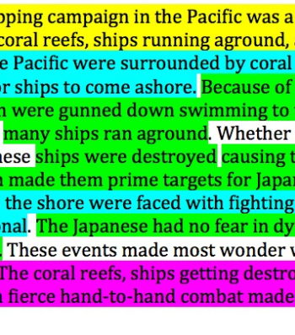
Data mining
Yellow: general insight
Green: positives
Red: negatives
Blue: competitors

Slide 25

Using Word Clouds

Slide 26
Other Tools
MS Excel
Trello
Post Its

Slide 27
Dynamics of customer interviews
You can’t plan a conversation
Unexpected Behaviours
Environment distractions

Slide 28
Consequences of the Interviewer's Actions and Bias
How do your own actions - your instructions - or lack there of, create problems in the interview
Leading questions - how does your own bias impact the subject of your interview?
Missed opportunities to probe your subject based on your own preconceptions - how you WANT your subject to answer you

Slide 29
The art of conversation
Skill in interview
Listening is key - are you a good listener?
80:20 ratio (80% subject - 20% interviewer)
Interrupting your subject vs probing vs going off track

Slide 30
The Skill of Asking Questions
How interview questions are articulated produces certain types of response
If it is not clear to the interviewee what you are asking, then it is not going to be easy for them to answer the question
Preparation – prepare questions then follow up questions
Be prepared for the subject to not understand what you are asking - probes are your friend

Slide 31
Common Interviewer Failures
"Noise" in your head - distractions of self talk
How the questions were asked – leading/unclear?
Failure to get insights
Letting the interview go off course
Lack of focus
Uncertainty about the topic leads to wasted questions

Slide 32
Takeaways
Interview is a skill that we have to develop

