Slide 1
Test Driven Development – Live!

Slide 2

Diarmaid McGowan
@diarmaidmcgowan
Full Stack Software Engineer
@CompozedLabs @AllstateNI

Slide 3
TDD

Slide 4
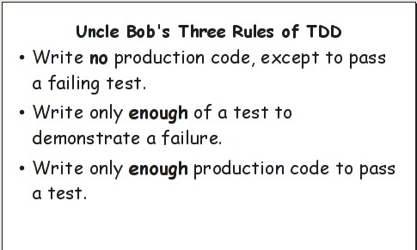
Notes:
You are not allowed to write any production code unless it is to make a failing unit test pass.
You are not allowed to write any more of a unit test than is sufficient to fail; and compilation failures are failures.
You are not allowed to write any more production code than is sufficient to pass the one failing unit test.

Slide 5
Red
Green
Refactor

Slide 6
Why use TDD?

Slide 7
Live TDD Prime factors kata...

Slide 8
Code gets more general
Tests get more specific

Slide 9
Why use TDD?

Slide 10
Confidence

Slide 11
Code
http://bit.ly/tdd-talk-code
Robert C. Martin - Advanced TDD: The Transformation Priority Premise
http://bit.ly/unclebob2014
Test Driven Development: By Example by Kent Beck
https://www.amazon.co.uk/gp/product/0321146530
Extreme Programming Explained: Embrace Change by Kent Beck https://www.amazon.co.uk/gp/product/0321278658/
Uncle Bobs https://cleancoders.com/ videos
http://agilemanifesto.org/

Slide 12
Thank you.

