Slide 1
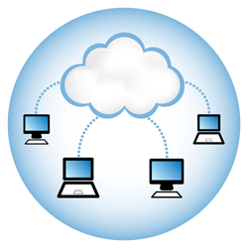
MongoDB, Mongoose and Cloud Storage
Frank Walsh, Diarmuid O’Connor

Slide 2

Agenda
Cloud Databases
MongoDB
Mongoose
Mongo in the cloud

Slide 3
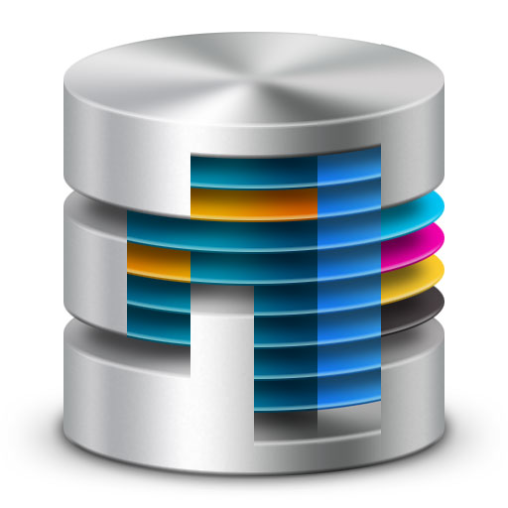
Databases in Enterprise Apps
Most data driven enterprise applications need a database
Persistence: storage of data
Concurrency: many applications sharing the data at once.
Integration: multiple systems using the same DB
Enterprise Application DBs require backups, fail over, maintenance, capacity provisioning.
Traditionally handled by a Database Administrator (the DBA).
This Photo by Unknown Author is licensed under CC BY
Notes:
- As of last year, still most common means fo system integration.

Slide 4
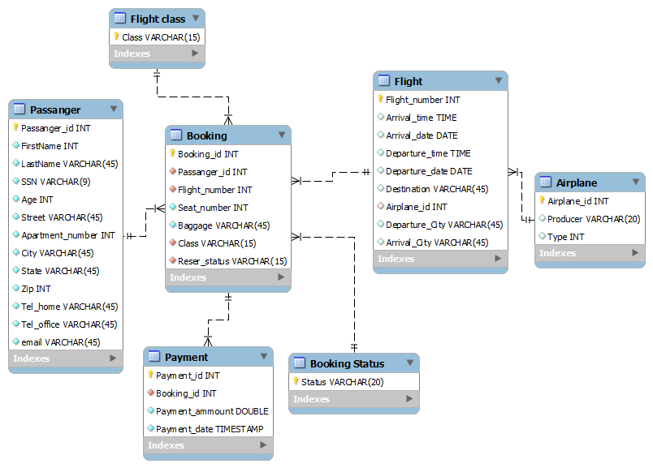
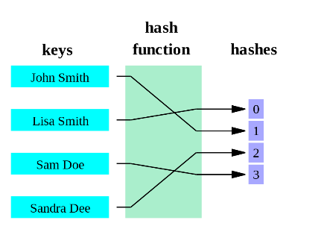
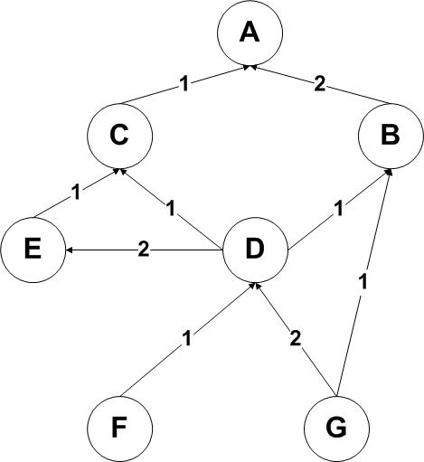
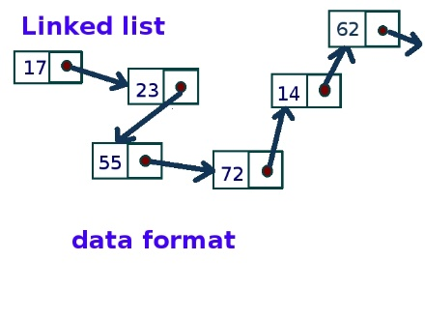
Structured & Unstructured Data
Relational Database
Relational Databases:
Organise data into structured tables and rows
Relations have to be simple, they cannot contain any structure such as a nested record or a list
In memory data structures
Much more varied structure
Lists, Queues, Stacks, Graphs, Hashing
In Memory Data Structures
This Photo by Unknown Author is licensed under CC BY-SA
This Photo by Unknown Author is licensed under CC BY-SA
This Photo by Unknown Author is licensed under CC BY-SA
This Photo by Unknown Author is licensed under CC BY-SA
Notes:
There is a divide between the relational model and the in-memory data structures.
Use relational algebra to conduct operations using SQL on those relations.
In memory data structures Are a better match for certain types of problems

Slide 5
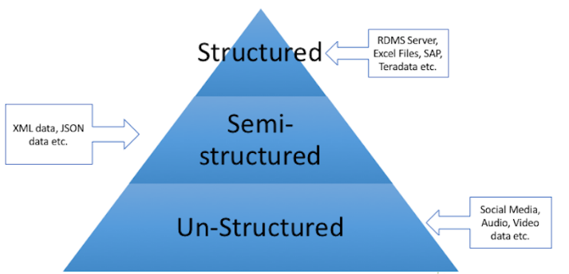
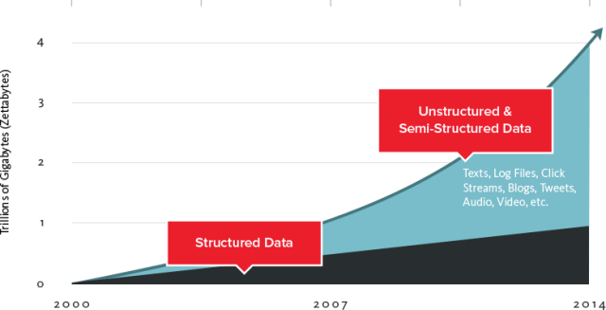
Time

Slide 6

Databases in the Cloud
For some apps, a traditional relational database may not be the best fit
Organisations are capturing more data and processing it quicker – can be expensive/difficult on traditional DB
Traditionally, relational database is designed to run on a single machine in predicable environment
May be economic to run large data and computing loads on clusters.
Hard to estimate scaling requirements, particularly if it’s a web app?
Are you going to do Data mining?
One approach is to use the Cloud for you DB
Designed for scale
Can be outsourced so you don’t have to deal with infrastructure requirements.
This Photo by Unknown Author is licensed under CC BY-SA
Notes:
Do you need db schema definition?
Many NoSQL databases are designed explicitly to run on clusters, so they make a better ﬁt for big data scenarios.

Slide 7
Cloud DB Advantages
Removes Management costs
Inherently scalable
No need to define schemas(if NoSQL) etc.
Lots of Cloud DB offerings out there
SQL based
NoSQL based
If organisation policy/standards do not allow outsourcing:
- Can host yourself, most NoSQL DBs are free.

Slide 8
Cloud Database Practices
Drop Consistency
this makes distributed systems much easier to build
Drop SQL and the relational model
simpler structures are easier to distribute:
key/value pairs
structured documents
pseudo-tables
tend to be schema-free, accepting data as-is
Offer HTTP interfaces using XML or JSON
Web APIs!!!

Slide 9
Designing Distributed Data
App data is not homogeneous
some kinds of data will be much larger
consider using different databases for different requirements.
user details,billing - needs consistency
require traditional database
user data,content - needs partition tolerance
replicate to keep safe
analytics,sessions - needs availability
"eventually consistent" is good enough

