Slide 1

Mongoose
Mongo with Node.js
This Photo by Unknown Author is licensed under CC BY-SA

Slide 2

Mongoose Overview
Mongoose is a object-document model module in Node.js for MongoDB
Wraps the functionality of the native MongoDB driver
Exposes models to control the records in a doc
Supports validation on save
Extends the native queries

Slide 3

Mongoose first?
????
Shortcut to understanding the basics
Similar to Object Relational Mapping libraries like JPA/Hibernate
Easier concept if coming from relational DB background.
This Photo by Unknown Author is licensed under CC BY-NC

Slide 4
Installing & Using Mongoose
Run the following from the CMD/Terminal
Import the module
Connect to the database

Slide 5
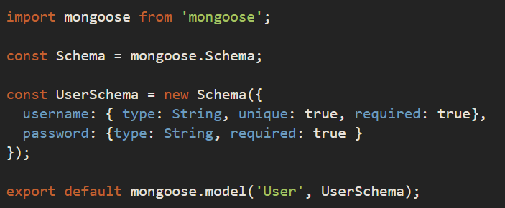
Mongoose Schemas and Models
Mongoose supports models
i.e. fixed types of documents
Needs a mongoose.Schema
Each of the properties must have a type
Number, String, Boolean, array, object

Slide 6
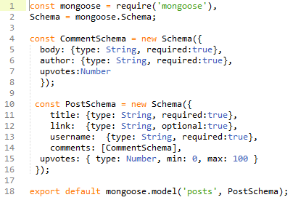
Mongoose Schemas – Arrays & sub-documents
Comments property is an Array of CommentSchemas

Slide 7
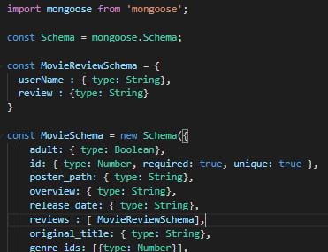
Mongoose Schemas - Arrays
Review property is an Array of MovieReviewSchema

Slide 8
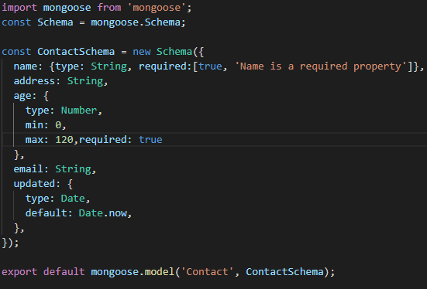
Mongoose Schema – Built-in Validation
constraints on properties :

Slide 9

Mongoose Custom Validation
Developers can define custom validation on their properties (e.g. validate email field is correct format)
Using Regular Expression (regex) to test for a valid email. If you’ve not come across them before check out https://www.w3schools.com/jsref/jsref_obj_regexp.asp

Slide 10
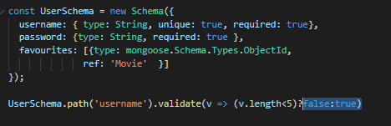
Mongoose Custom Validation
Developers can define custom validation on their properties (e.g. validate length of username when trying to save)

Slide 11
Data Manipulation Mongoose
Mongoose supports all the CRUD operations:
Create –> Model.create()
Read –> Model.find()
Update –> Model.update(condition, props, cb)
Remove –> Model.remove()
Can operate with "error first" callbacks or promises.

Slide 12


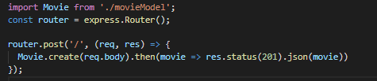


Create with Mongoose

Slide 13
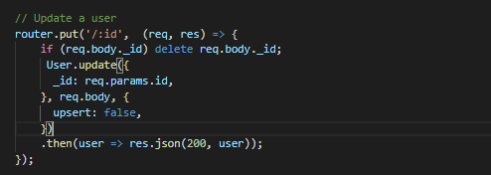
Update with Mongoose

Slide 14
Mongoose Queries
Mongoose provides a more expressive version of the native MongoDB
Instead of: {$or: [{conditionOne: true}, {conditionTwo: true}]
Do: .where({conditionOne:true}).or({conditionTwo: true})

Slide 15
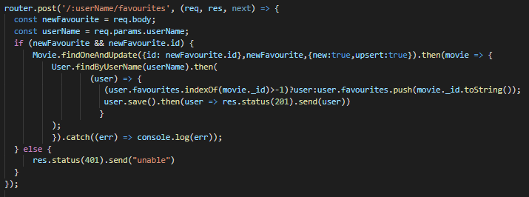
Mongoose Queries
Mongoose supports many queries:
For equality/non-equality
Selection of some properties
Sorting
Limit & skip
All queries are executed over the object returned by Model.find*()
Model.findOne() returns a single document, the first match
Model.find() returns all
Model.findById() queries on the _id field.

Slide 16

Mongoose Queries
Can build complex queries and execute them later
The above finds all contacts where age >17 and <66 and living in either Waterford, Kilkenny or Wexford

Slide 17
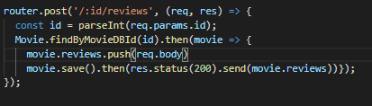
Mongoose Sub-Docs
Ex: Movies – Adding a review to a favourite movie.

