Slide 1

Mongodb
This Photo by Unknown Author is licensed under CC BY-NC-ND

Slide 2
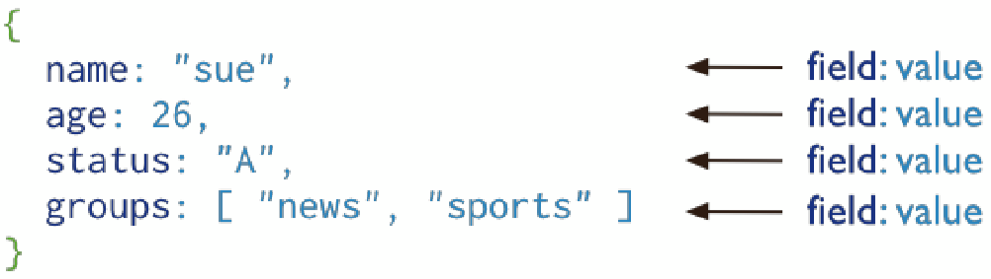
Introduction
Document-oriented database
A record in MongoDB is a document, which is a data structure composed of ﬁeld and value pairs.
MongoDB documents are similar to JSON objects
Field Values can be other documents, arrays, arrays of other documents.
Reduces need for “Joins”
Community support - popular choice
Notes:
Uses JSON natively – nice fit for Node.js

Slide 3
Mongo Terminology
Each database contains a set of "Collections"
Collections contain a set of JSON documents
there is no schema (in the DB…)
The documents can all be different
means you have rapid development
adding a property is easy - just starting using in your code
Makes deployment easier and faster
roll-back and roll-forward are safe - unused properties are just ignored
Collections can be indexed and queries
Operations on individual documents are atomic
MongoDB Server
Database
Collection
Document
{“_id”:” 5c92448b…”,
“name”:”Frank”,
“gender”:”male”}
Document
{“_id”:” 3a92c48b…”,
“name”:”Frank”,
“gender”:”male”,
“status”:”active”}
Document
{“_id”:” 7292b48b…”,
“name”:”Frank”,
“status”:”active”,
“upvotes”:0}

Slide 4
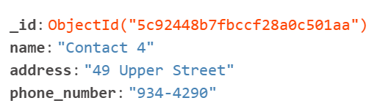
Mongo Documents
MongoDB stores data records as BSON documents.
BSON is a binary representation of JSON documents.
Each document stored in a collection requires a unique _id field and is reserved for use as a primary key.
If an inserted document omits the _id field, the MongoDB driver automatically generates an ObjectId for the _id field.
ObjectId values consist of 12 bytes.

Slide 5
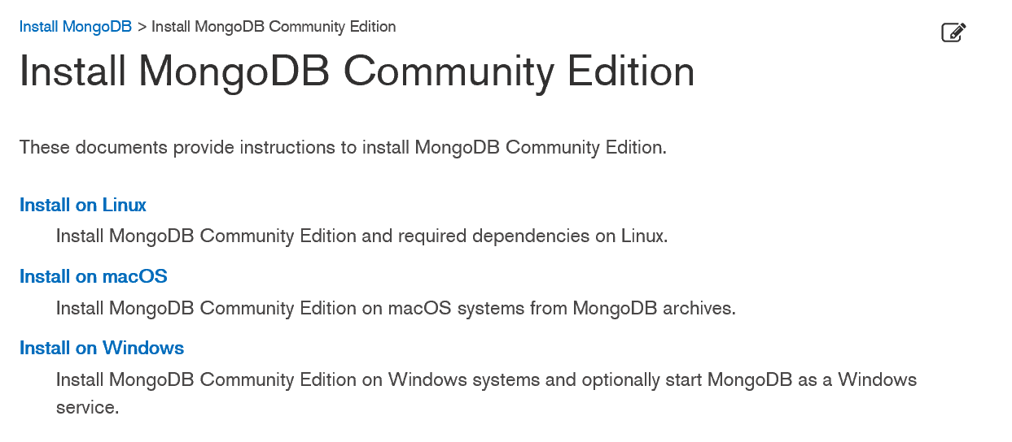


Getting Started (locally)
Install Mongo community edition for your OS:
Specify a directory for your db files and start Mongodb server.

Slide 6
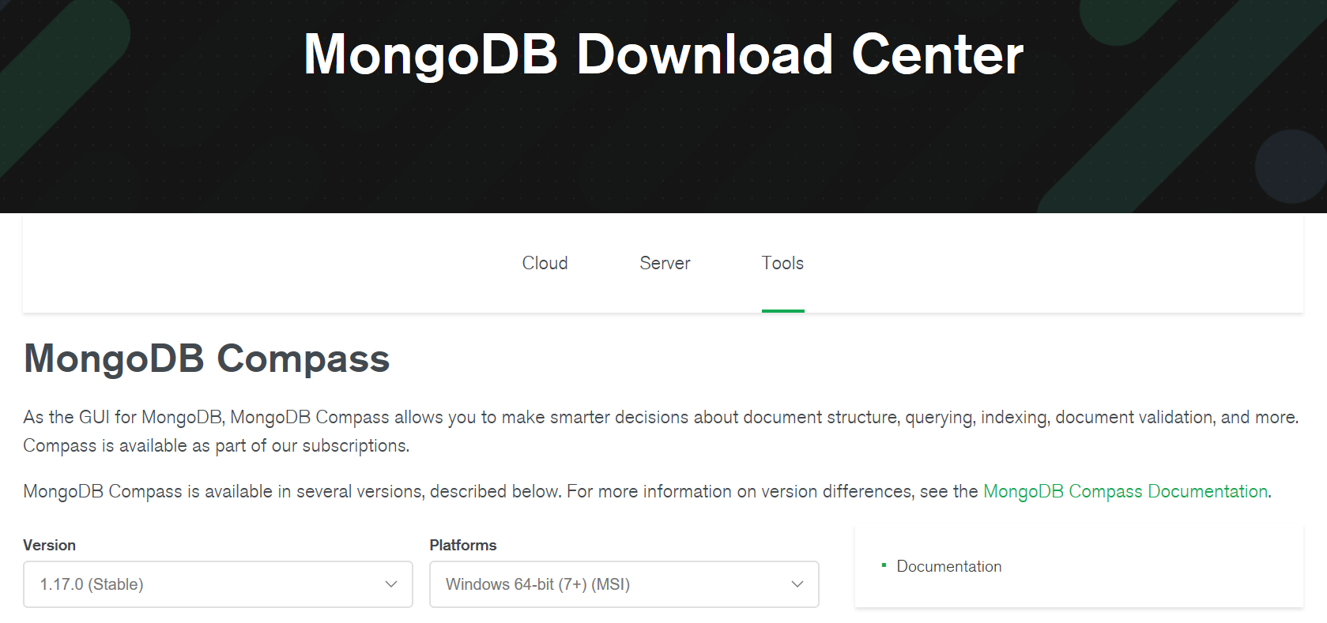
Getting Started (locally)
Install Mongo Compass, Graphical User Interface for managing MongoDB.
For windows, comes as part of mongodb install
Other platforms can get it here:

