Slide 1
Sessions & Schema Methods

Slide 2
Example: Using Schema Methods for Simple Authentication
Restrict access to Posts API (require authentication):
Create users schema with methods for
Finding users
Checking password
Use express-session middleware to create and manage user session (using cookies)
Create an authentication route to set up “session”
Create your own authentication middleware and place it on /api/movies route

Slide 3
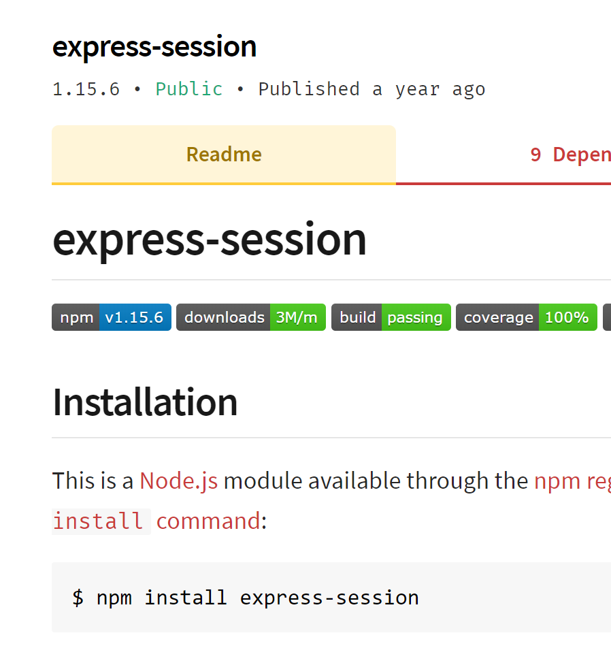
Aside: Sessions
Requests to Express apps are stand-alone by default
no request can be linked to another.
By default, no way to know if this request comes from a client that already performed a request previously.
Sessions are a mechanism that makes it possible to “know” who sent the request and to associate requests.
Using Sessions, every user of you API is assigned a unique session:
Allows you to store state.
The express-session module is middleware that provides sessions for Express apps.

Slide 4
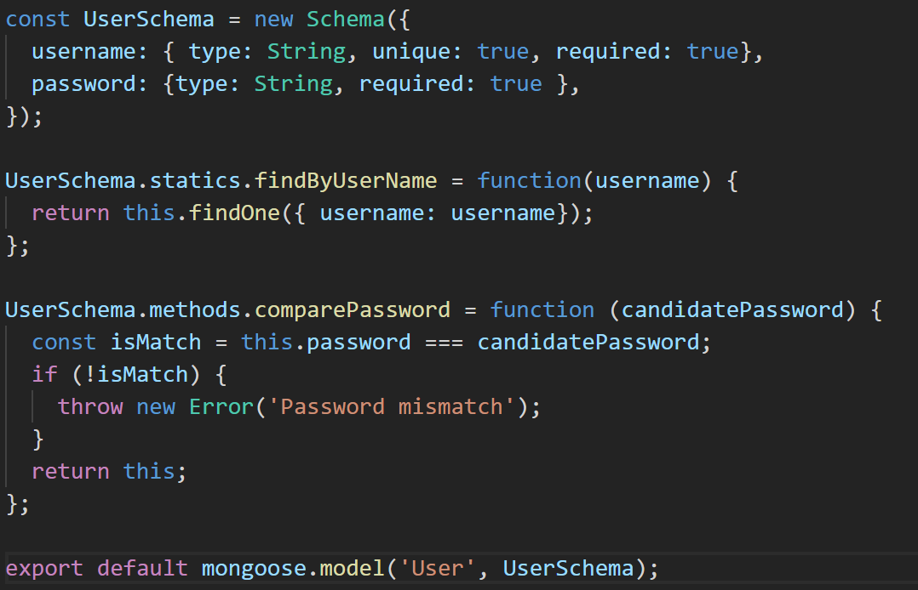
User Schema with Static & Instance Methods
Static Method: belongs to schema. Independent of any document instance
Instance Method: belongs to a specific document instance.

Slide 5
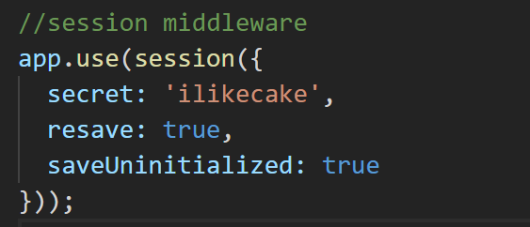
express-session middleware
Session middleware that stores session data on server-side
Puts a unique ID on client
Add to Express App middleware stack:

Slide 6
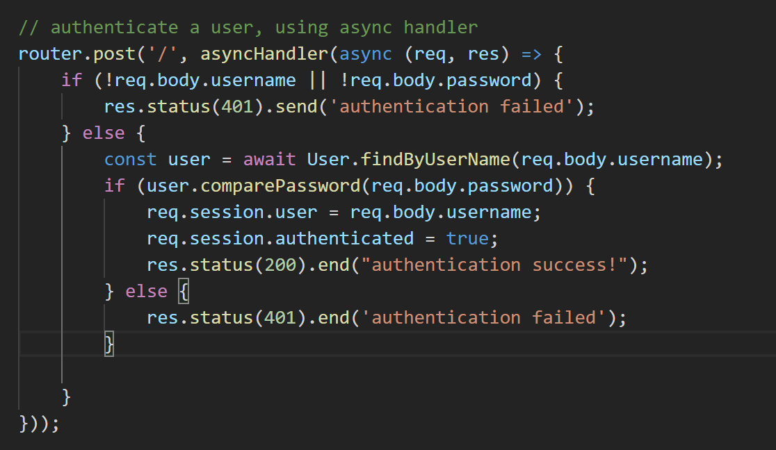
Create User Route to authenticate
Use /api/user to authenticate, passing username and password in HTTP body
/api/users/index.js
Using static method to find User document
Using instance method to check password
/index.js

Slide 7
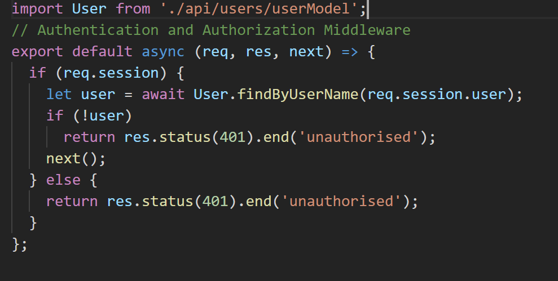
Authentication Middleware
authenticate.js
Checks for user ID in session object. If exists, called next middleware function, otherwise end req/res cycle with 401
index.js
Authentication middleware applied on /api/posts route.

Slide 8
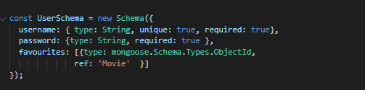
Object Referencing
Using Object ID to reference Movie document

Slide 9
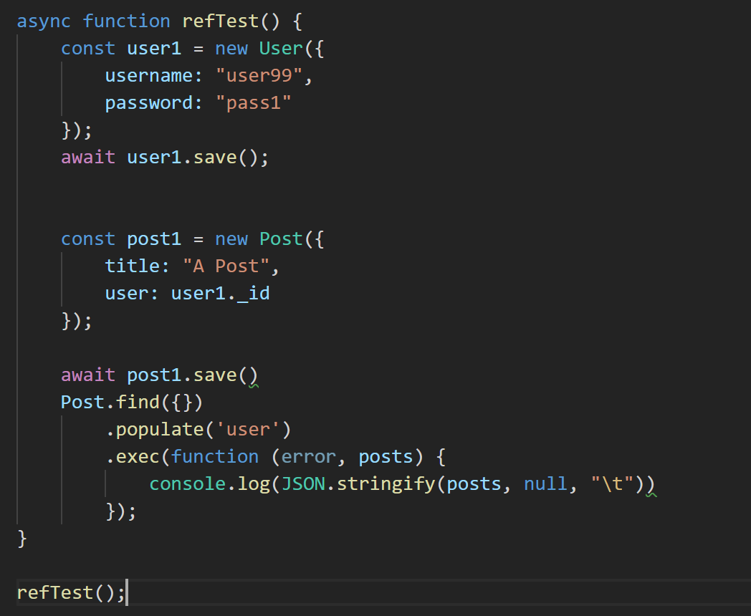
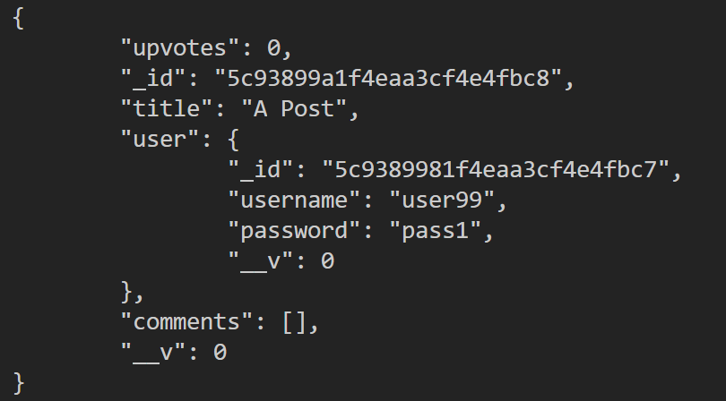
Query Population using Refs
https://github.com/fxwalsh/ewd-examples-2020.git
Allows you to automatically replace the speciﬁed paths in the document with document(s) from other collection(s).
output

