Slide 1

Introduction to Node.js
Frank Walsh
Diarmuid O'Connor

Slide 2

Agenda
What is node.js
Non Blocking and Blocking
Event-based processes
Callbacks in node
Node Package Manager(NPM)
Creating a node app
Introduction to Express

Slide 3
What's Node: Basics
A Javascript runtime. “Server side JS”
The “.js” doesn’t mean that it’s written completely in JavaScript.
approx. 40% JS and 60% C++
Ecosystem of packages (NPM)
Official site: “Node's goal is to provide an easy way to build scalable network programs”.
Single Threaded, Event based
Supports concurrency using events and callbacks…

Slide 4
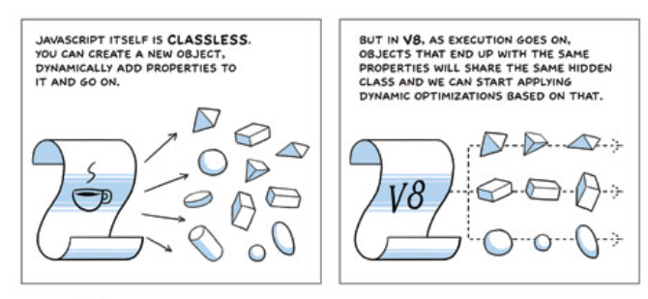
What’s Node: V8.
Embedded C++ component
Javascript virtual machine.
Very fast and platform independent
Find out a bit about it's history here:
http://www.google.com/googlebooks/chrome/big_12.html
Notes:
Same javascript engine used in chrome
Just in time compiler – compile a little, run a little
Speculative optimisations

Slide 5

What is Node.js: Event-based
Input/Output (io) is slow.
Reading/writing to data store, network access.
Read 4K randomly from SSD* 150,000 ns ~1GB/sec SSD
Round trip over network within same datacenter 500,000 ns
Send packet US->Netherlands->US 150,000,000 ns
This Photo by Unknown Author is licensed under CC BY-NC
I/O operations detrimental to highly concurrent apps (e.g. web applications)
Solutions to deal with this are:
Blocking code combined with multiple threads of execution (e.g. Apache, IIS)
Non-blocking, event-based code in single thread (e.g. NGINX, Node.js)
CPU operations are fast.
L1 cache reference 0.5 ns
L2 cache reference 7 ns
Source: https://gist.github.com/jboner/2841832
1ns = 10⁻⁹ s (0.000000001s)
Notes:
So input output is relatively slow. What I’m talking about here is reading/writing to a data store, any kind of access to resources over a network, even within your organisation. And I mean relative in relation to CPU operations. For example, referencing L1 and L2 cache takes a couple of nano seconds (extremely fast). Accessing 4K from an SSD takes about 150,000 ns. However, sending a packet from the US to the Netherlands and back could take 150 million ns (.15 of a second).
So IO operations can be detrimental to highly concurrent apps yet we do need them (for example, I’ll probably need to access a DB.

Slide 6
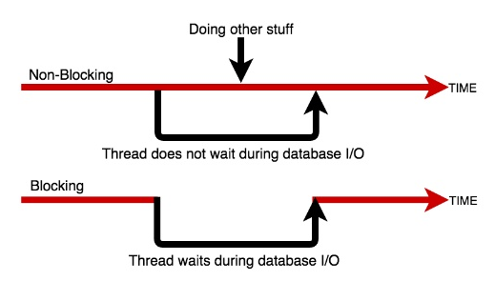
Blocking/Non-blocking Example
Blocking
Read from file and set equal to contents
Print Contents
Do other stuff...
Non-blocking
Read from File
Whenever read is complete, print contents
Do other stuff...

Slide 7
Blocking/Non-blocking: JS
Blocking
import fs from 'fs';
const contents = fs.readFileSync('./readme.md’, ‘utf8’);
console.log(contents);
console.log('Doing something else');
Console output
Hello World……
Doing something else
Non-blocking
import fs from 'fs’;
fs.readFile('./text.txt’,’uft8’, (err, contents) => {
console.log(contents);
});
console.log('Doing something else');
Console output
Doing something else
Hello World ……

Slide 8
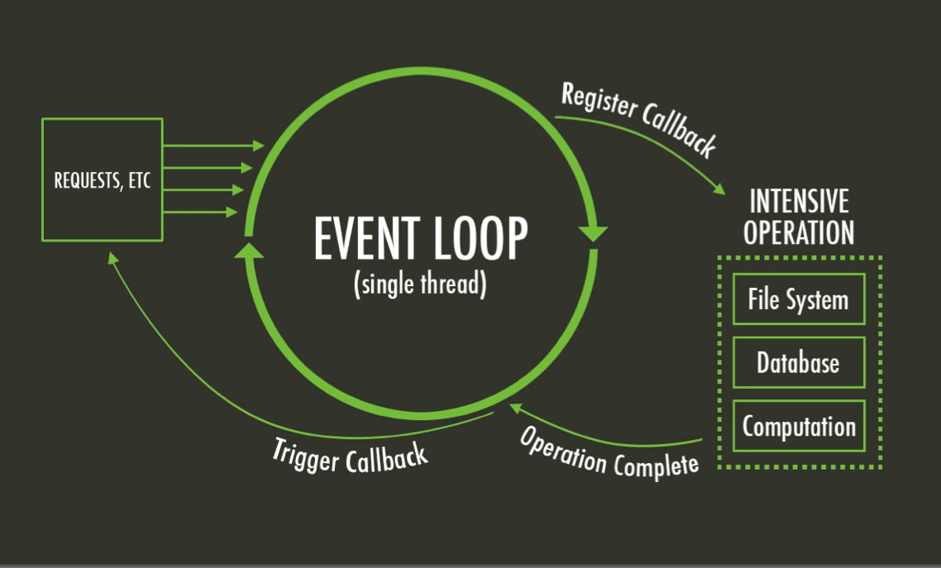
The Node Event Loop and Callbacks
A Callback is a function called at the completion of a given task. This prevents any blocking, and allows other code to be run in the meantime
The Event Loop checks for known events, registers Callbacks and, triggers callback on completion of operation
This Photo by Unknown Author is licensed under CC BY-SA

Slide 9
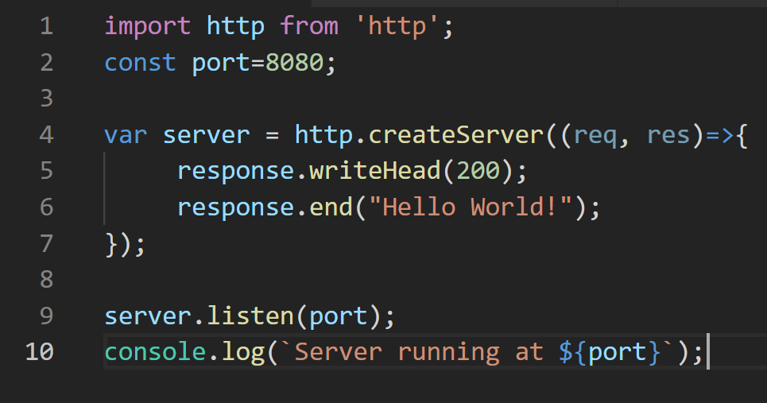
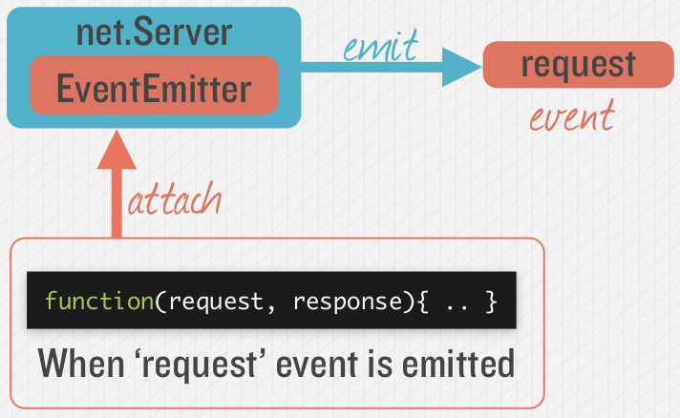

Node.js - Simple HTTP Server
Event Queue
Known Events
request
request
Event Loop
Notes:
Most node applications are waiting for “events” to occur. The event loop waits for events to occur, and then triggers the associated callback function when that event is detected. Node has many built-in events, such as the

Slide 10
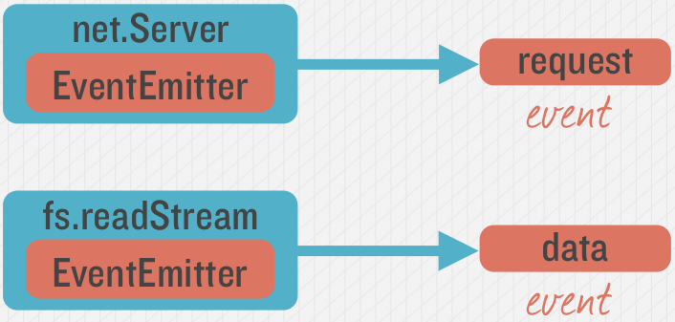
Emitting Event in Node
Many objects can emit events in node.

Slide 11
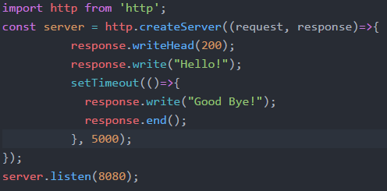
Example – Hello/Goodbye Callback
“Request” Callback
“Timeout” Callback

Slide 12
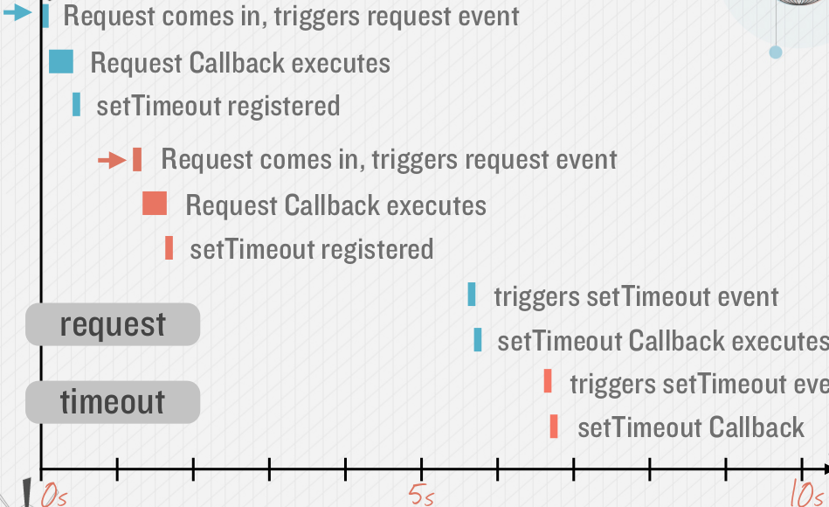
Callback Timeline, Non Blocking
Timing example: 2 requests to web application (indicated by red and blue in diagram)

Slide 13
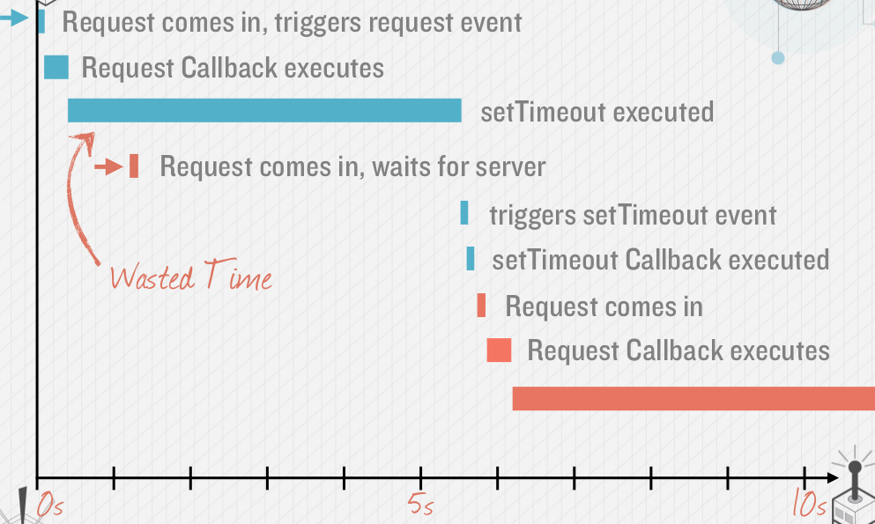
Avoid Blocking Calls in Node.js apps
What if setTimeout() blocked…
setTimeout in previous slide is an example of an asynchronous, non-blocking call.
Avoid potential blocking/ synchronous calls
Activity likely to be blocking should be called asynchronously.
Examples:
Calls to 3rd party Web Services
Database queries
Computationally expensive operations (image file processing)

Slide 14
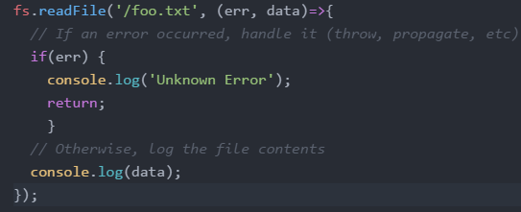
Node “Error First” Callbacks
Error object
The “error-first” callback (or “node-style callback”) is a standard convention for many Node.js callbacks.
Successful response data
If no error, err will be set to null

