Slide 1
Node Modules

Slide 2
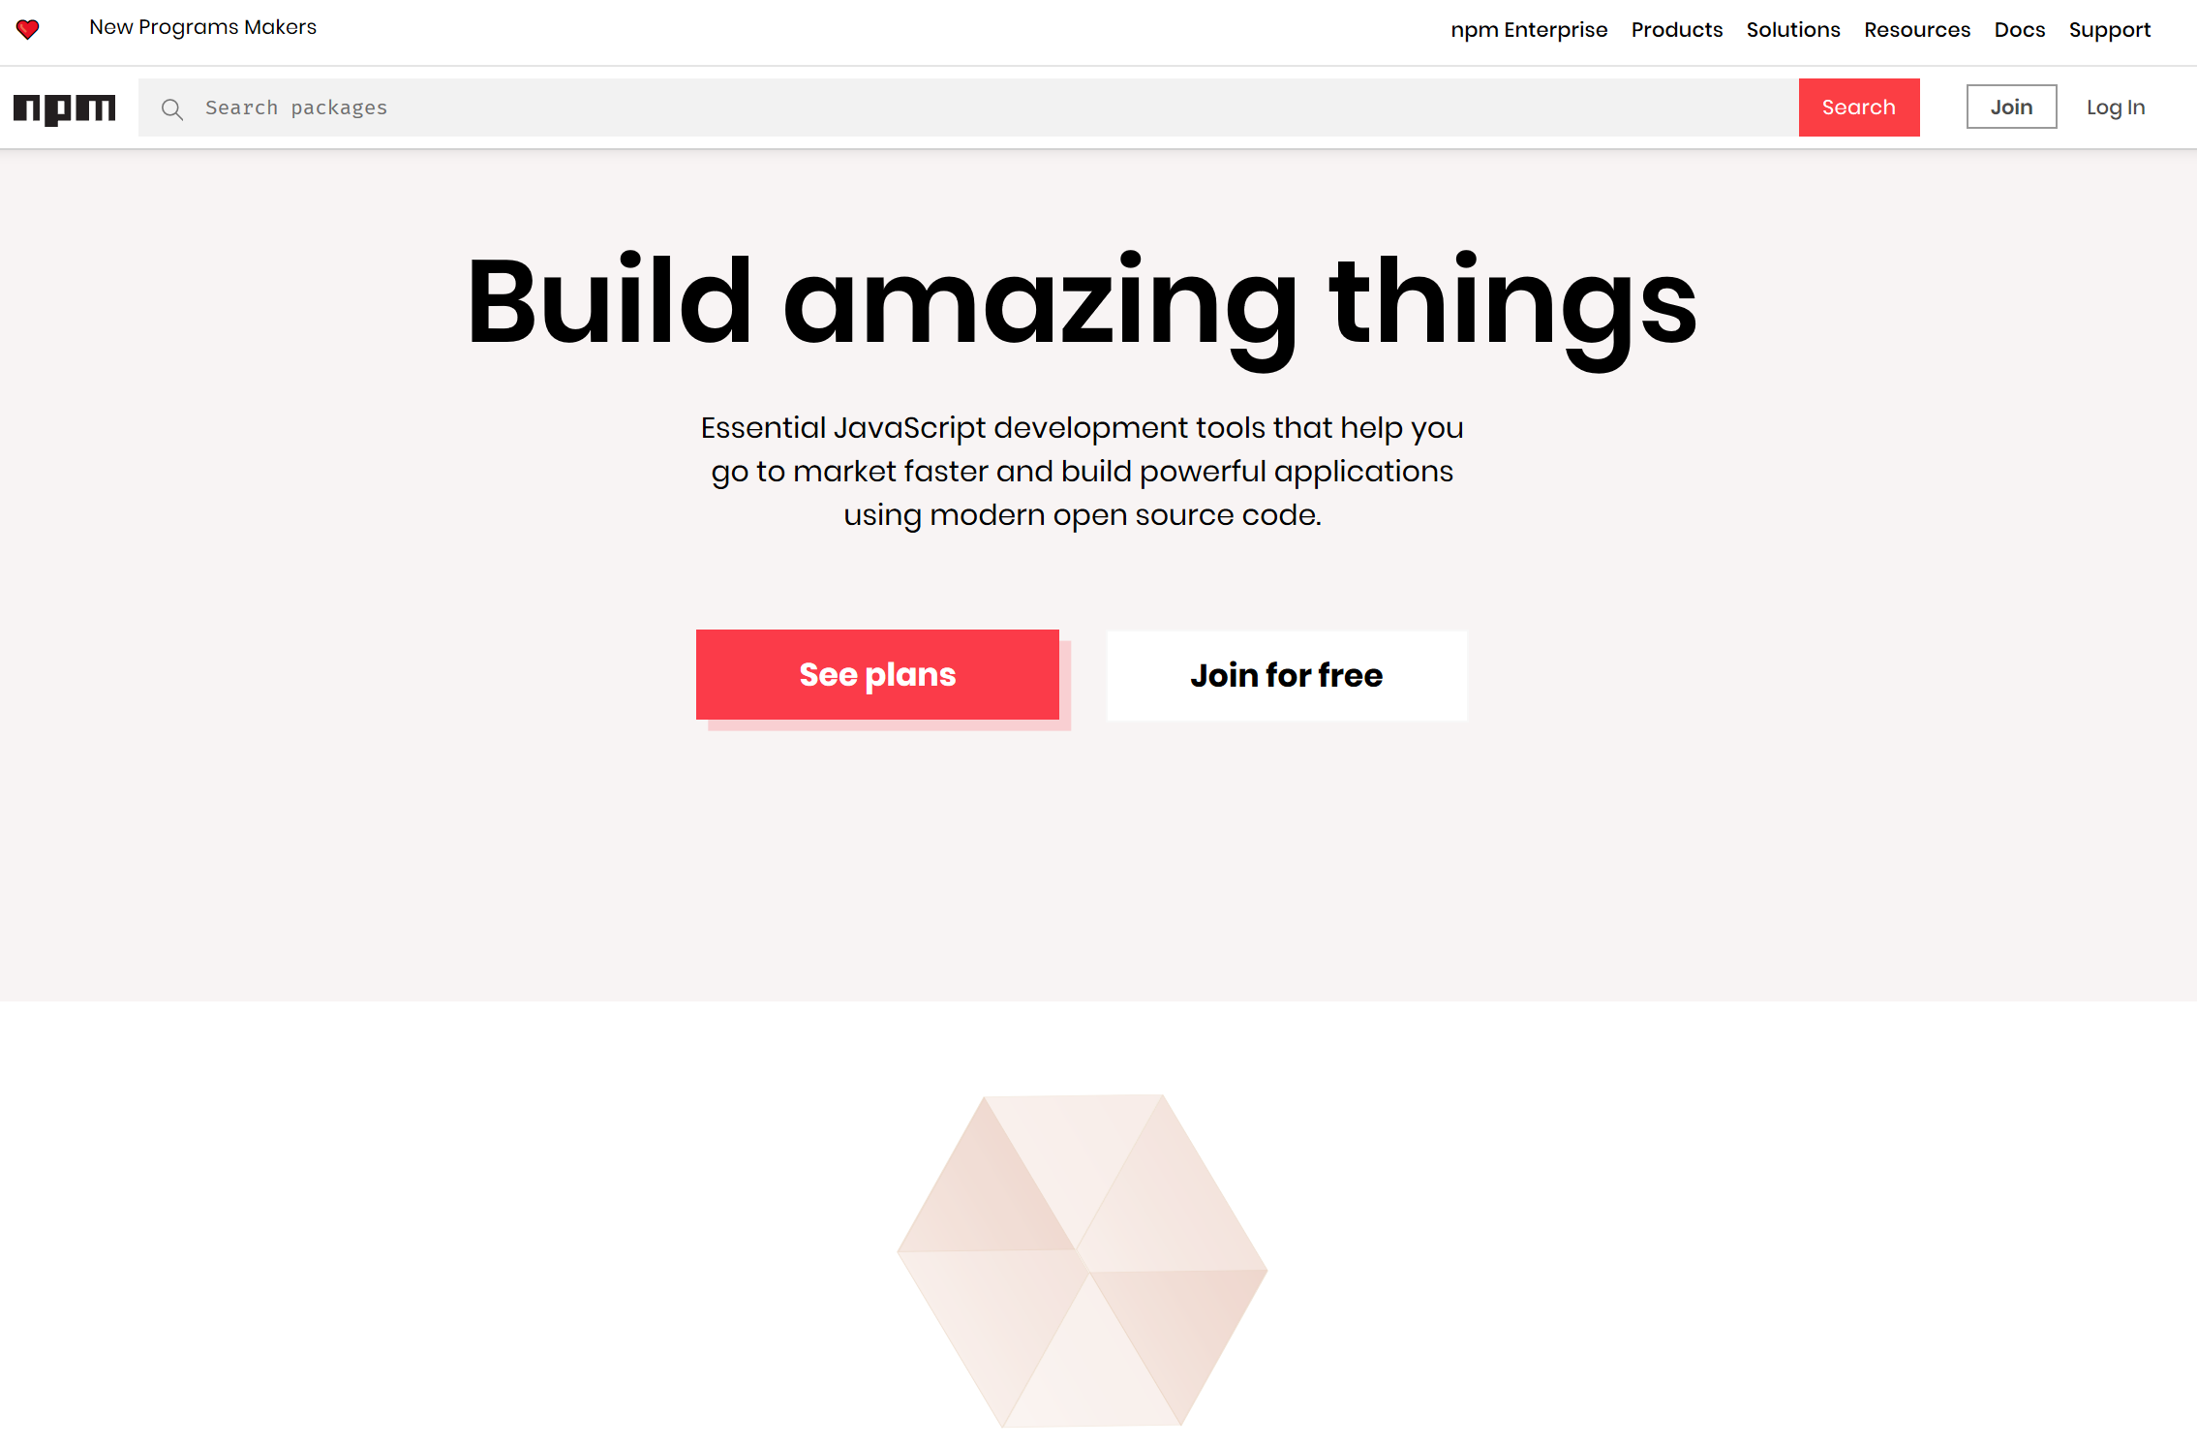

Slide 3

Node Modules
Node has a small core API
Most applications depend on third party modules
Curated in online registry called the Node Package Manager system (NPM)
NPM downloads and installs modules, placing them into a node_modules folder in your current folder.

Slide 4
NPM init
You can use NPM to manage your node projects
Run the following in the root folder of your app/project:
npm init
This will ask you a bunch of questions, and then create a package.json for you.
It attempts to make reasonable guesses about what you want things to be set to, and then writes a package.json file with the options you've selected.

Slide 5
Node Modules
To install NPM modules, navigate to the application folder and run “npm install”. For example :
npm install express --save
This installs into a “node_module” folder in the current folder.
The --save bit updates your package.json with the dependency
To use the module in your code, use:
import express from 'express';
This loads express from local node_modules folder.

Slide 6
Global Node Modules
Sometimes you may want to access modules from the shell/command line.
You can install modules that will execute globally by including the '-g'.
Example, Grunt is a Node-based software management/build tool for Javascript.
npm install -g grunt-cli
This puts the “grunt” command in the system path, allowing it to be run from any directory.

Slide 7
NPM Common Commands
Common npm commands:
– npm init initialize a package.json file
– npm install <package name> -g install a package, if –
g option is given package will be installed globally, --save
and --save-dev will add package to your dependencies
– npm install install packages listed in package.json
– npm ls –g listed local packages (without –g) or global
packages (with –g)
– npm update <package name> update a package

Slide 8
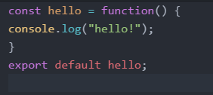
Creating your own Node Modules
We want to create the following module called custom_hello.js:
To access in our application, index.js:
import hello from './custom_hello'; hello();
Export defines what
import returns

Slide 9
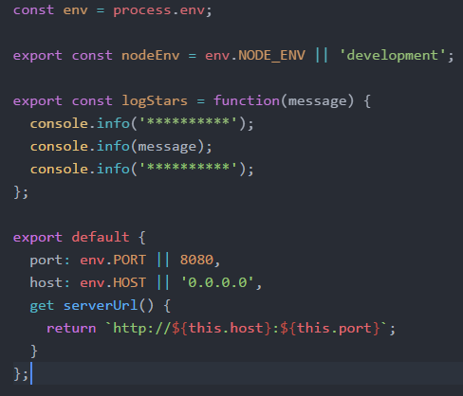
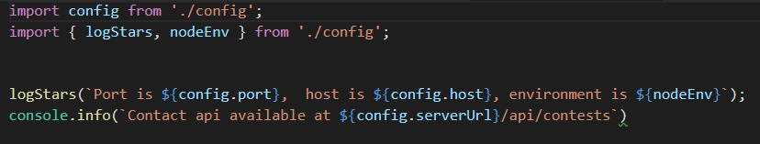
Creating your own Node Modules
Config.js
Exporting Multiple Properties
Accessing in other scripts

Slide 10


The import search
Import searches for modules based on path specified:
Just providing the module name will search in node_modules folder

Slide 11
The Express Package

Slide 12
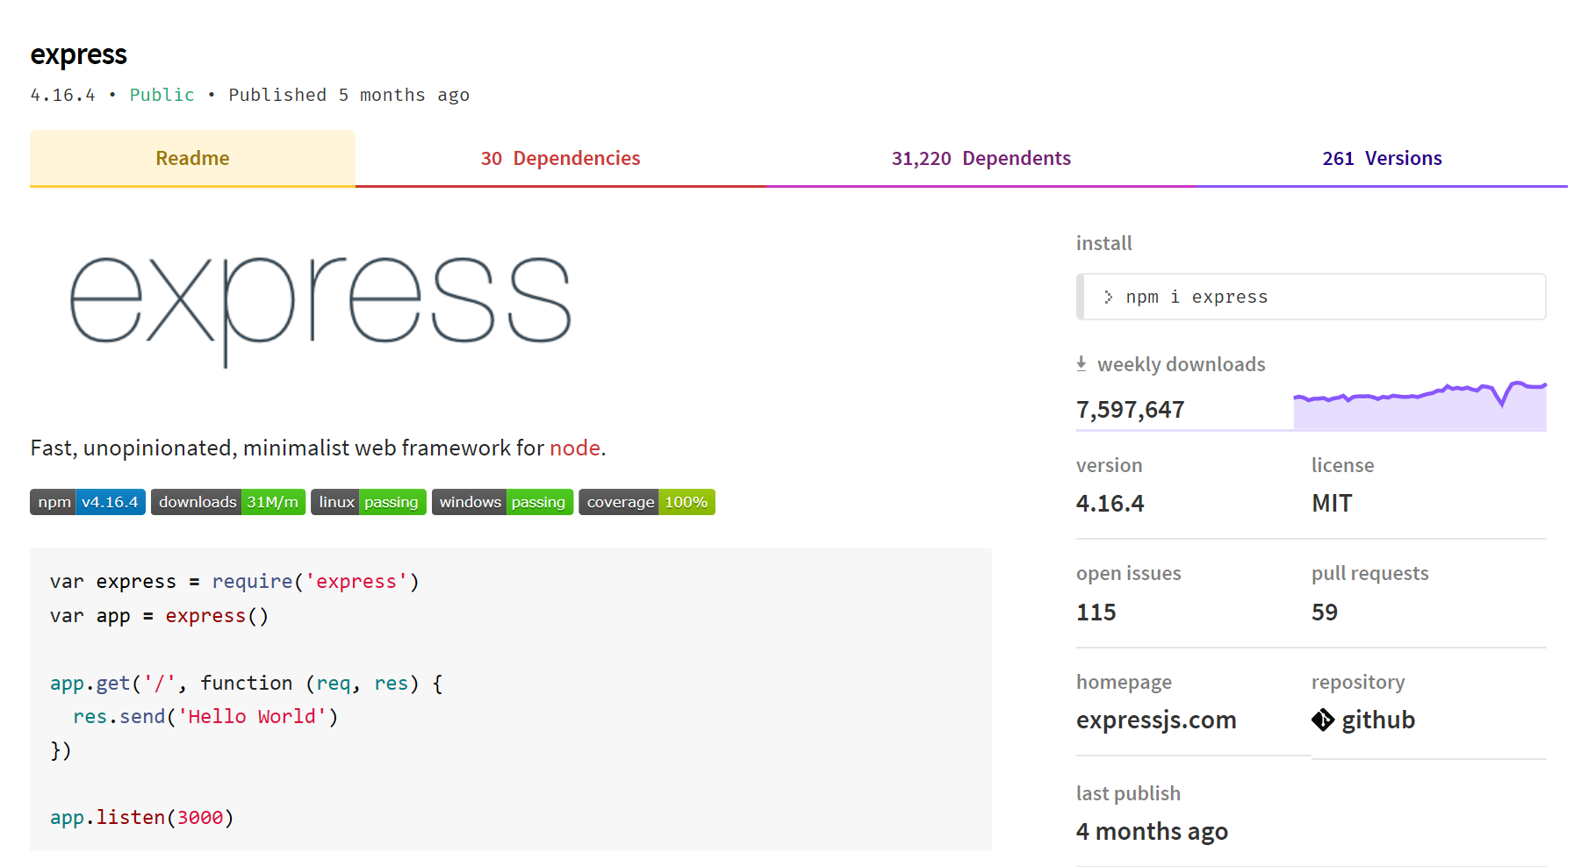
What is Express?
Notes:
Web application framework for Node
Built on the Connect middleware package
It's popular because it‘s
Minimalist,
Fast
Simple

Slide 13
What Express Gives Us...
Parses arguments and headers
Easy Routing
Route a URL to a callback function
Sessions
File Uploads
Middleware…

Slide 14
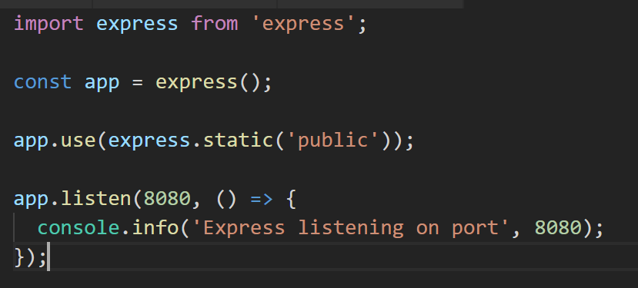
Simple Express App (index.js)
Loads Express module
Instantiates Express server
Define static content for HTTP GET

Slide 15
Getting Started with Express
Installing Express
[local install] C:\> npm install express --save
[global install] C:\> npm install express -g

Slide 16
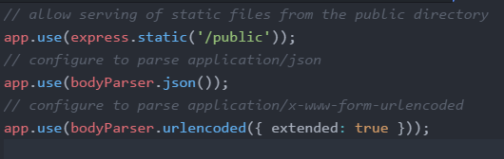
Express Configuration
Express allows you to easily configure your web app behaviour...

Slide 17
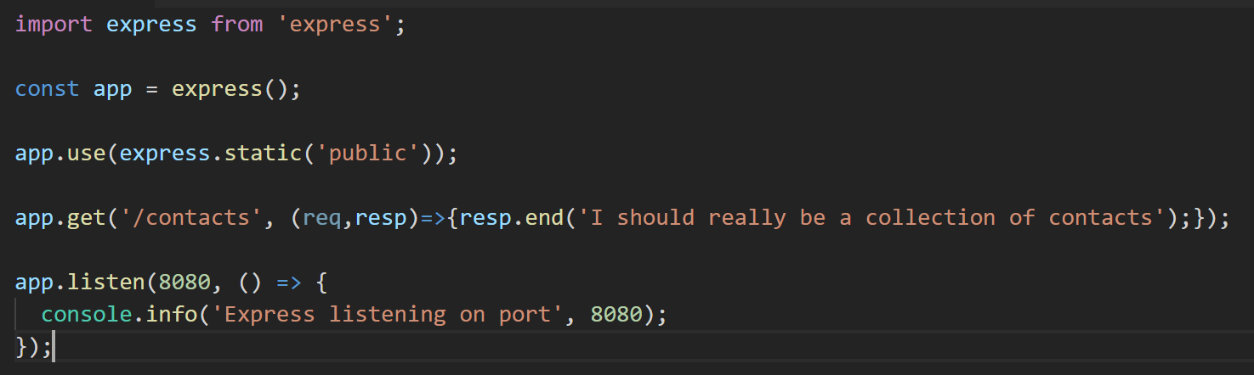
(/*)?
Routing Examples
Syntax follows the pattern:
App.[verb](path, (req,res)=>{});
HTTP POST request
// Other Route examples
app.post(‘/contacts’, createContact);
app.get('/app/:app', routes.getapp);
//Catch-all
app.all(‘/private(/*)?', requiresLogin);
Parametised URL. Accepts :app route argument
Catch-all – works for all HTTP verbs

Slide 18
Node Applications Structure

Slide 19
Structuring Node Apps
Node Server Code needs to be structured
Manage code base
Keeps code maintainable
Nodes packaging system supports this approach
Typical Node.js application code:
main app code
api implementation code
helper code

Slide 20
Example Approach:
Use a “project root” folder is the top level and contains the “entry point” or main server code
Always run npm in this folder to ensure just one node_modules folder
Use a public folder within the node folder for any static content

Slide 21
Basic Node App Structure
Root of your actual application
/projectroot/
package.json
readme.md
index.js
public/
/images
/stylesheets
/scripts
index.html
node_modules/
api/
Tells Node and NPM what packages are required
The main entry point for the Express application
Static content (if you need it)
Output directory for all NPM installations

