Slide 1

JavaScript Asynchronous Patterns
Async Await

Slide 2

Agenda
Async Await
Further/advanced async behaviour

Slide 3

Recap -Javascript Characteristics
JavaScript is single threaded
JavaScript is event driven
Events happen – we write code to deal with them
Can use callbacks to do this
JavaScript can be Asynchronous
Order of operation results may differ from order they were called…

Slide 4
Callbacks (again)

Slide 5

What have Callbacks ever done for us...
Great for things that can happen multiple times
Great if you don't really care about what happened before you attached the listener
Great if it's a straight-forward, stand-alone event with a quick resolution time
Great if callback is not part of sequential process.
E.g. key press event on control.
document.getElementById("demo").addEventListener("keypress", myFunction);
But...

Slide 6
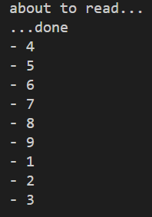
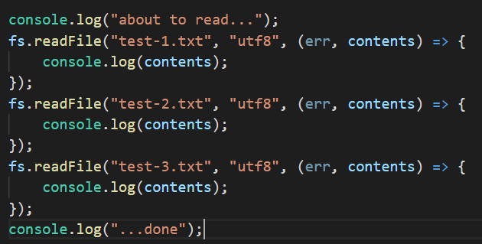
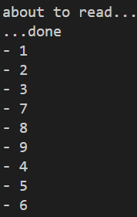
Multiple Callbacks
I want this to happen sequentially… but order of callback events is indeterminate.
Possible Result
Possible Result
Notes:
You have no idea what order the callbacks will execute. Once the callback is registered/scheduled, you’ve no idea when the underlying process (n this case the file read) will report back.

Slide 7
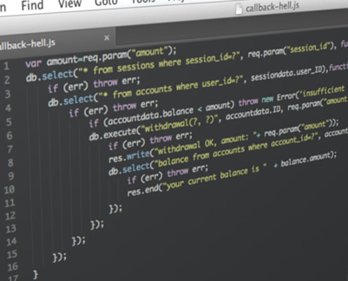
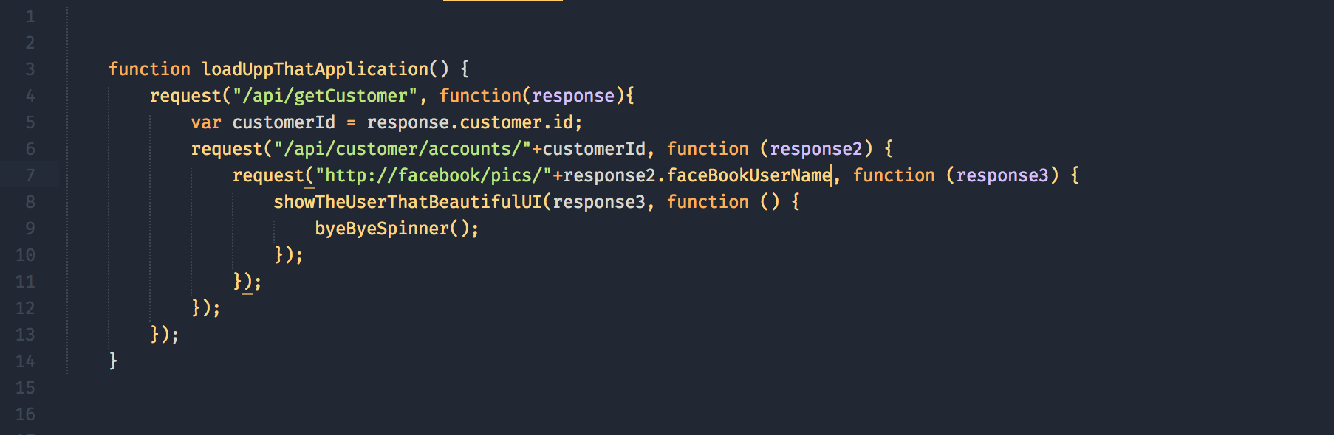
Callback Hell – Multiple sequential requests

Slide 8
Async Functions
using async/await

Slide 9
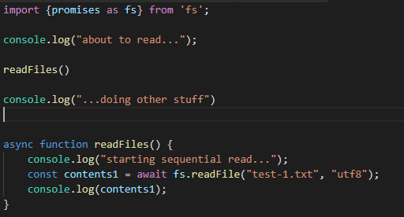
Async/Await !
async/await and promises are essentially the same under the hood
async is a keyword
Used in function declaration
await is used during the promise handling
must be used within an async function
async functions return a promise, regardless of what the return value is within the function.
Available now! in most good browsers as well as Node.js

Slide 10
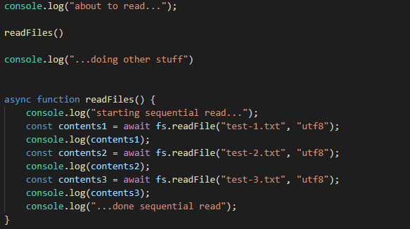
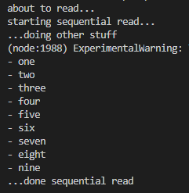
Async/Await Sequential read
output

Slide 11
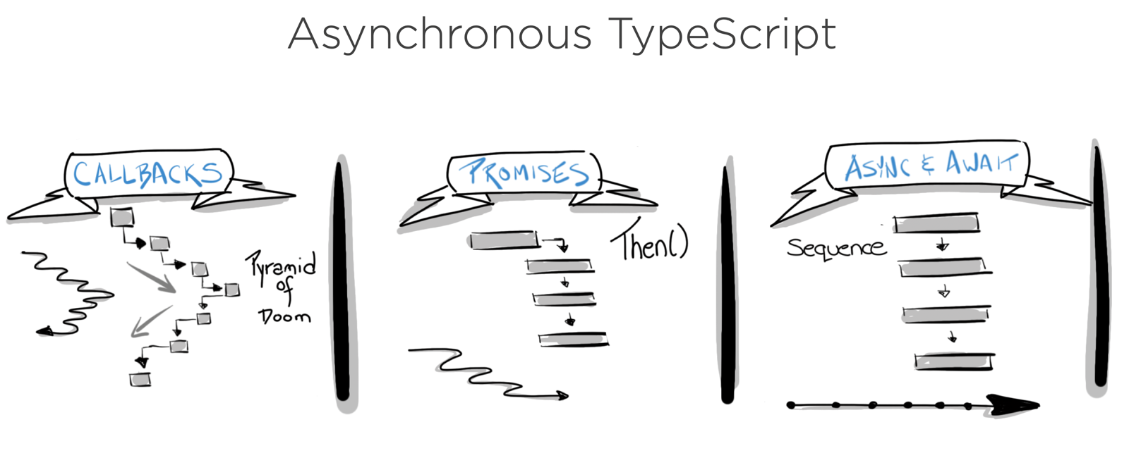
Callbacks vs Promises vs Async-Await
Asynchronous Javascript
This Photo by Unknown Author is licensed under CC BY

Slide 12
Error Handling

Slide 13
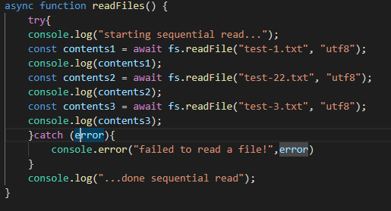
Error Handling – async await
Use try -catch

Slide 14
Further Asynchronous features…

Slide 15
Wrapper Function for Error handling
Express can’t handle promise errors/rejections
An Async function always returns a Promise.
can wrap the async function to catch errors in Express Apps
Can drop try/catch in every async function
Makes code more readable?
import asyncHandler from 'express-async-handler';
const router = express.Router();
// Get all users
router.get('/', asyncHandler(async (req, res) => {
const users = await User.find();
res.status(200).json(users);
}));

Slide 16

Parallelism
Takes 1000ms
async function series() { await wait(500); // Wait 500ms… await wait(500); // …then wait another 500ms. return "done!"; }
Some processes need to be sequential
Eg. Had to get data back from API BEFORE getting link URL
REMEMBER: Should only be sequential if you need to be...
Takes ~500ms
async function parallel() { const wait1 = wait(500); // Start a 500ms timer asynchronously… const wait2 = wait(500); // this timer happens in parallel. await wait1; // Wait 500ms for the first timer… await wait2; // …by which time this timer has already finished. return "done!"; }

Slide 17
Sources
https://developers.google.com/web/fundamentals/primers/promises
https://stackoverflow.com/questions/2069763/difference-between-event-handlers-and-callbacks
https://medium.com/@Abazhenov/using-async-await-in-express-with-node-8-b8af872c0016

