Slide 1
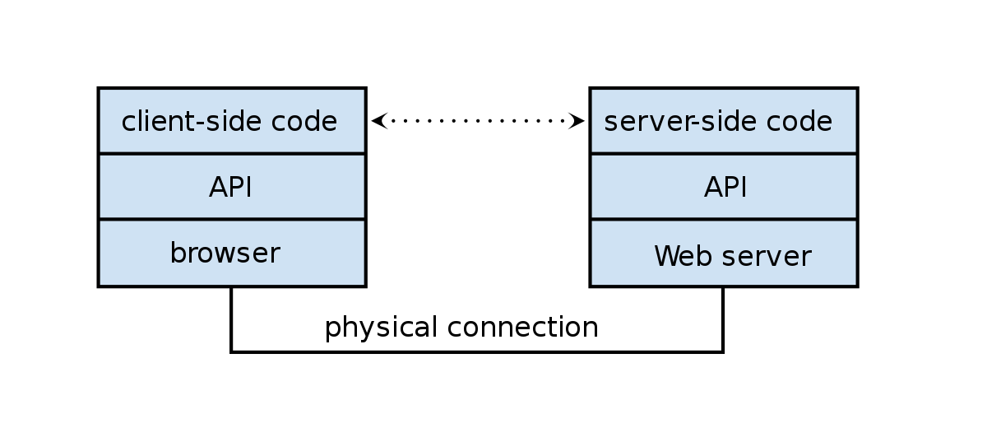
Web API Design
Frank Walsh

Slide 2
Agenda
Web API
REST
API Value
API Design

Slide 3
Web APIs

Slide 4
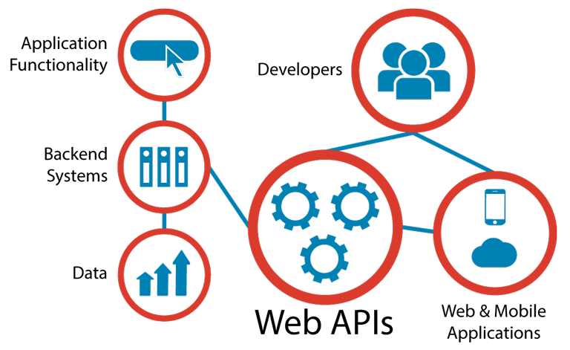
Web APIs
Programmatic interface exposed via the web
Uses open standards typically with request-response messaging.
E.g messages in JSON or XML
HTTP as transport
URIs
Example would be Restful web service described in previous lectures.
Typical use:
Expose application functionality via the web
Machine to machine communication
Distributed systems

Slide 5
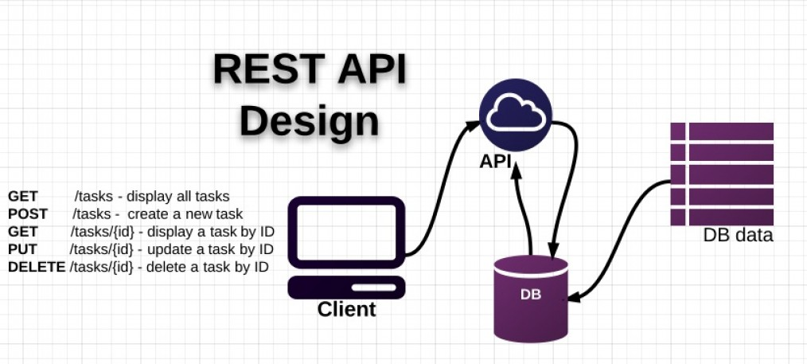
Traditional API Design
API design happens after the release of some a data-rich application
Existing application “wrapped” in API
Created as an afterthought.
Tightly bound application needs data/function exposed as API.
Shoe-horned in as a separate entity.

Slide 6

“API First” approach
Collaboratively design, mockup, implement and document an API before the application or other channels that will use it even exist.
Uses “clean-room” approach.
the API is designed with little consideration for the existing IT landscape.
the API is designed as though there are no constraints.

Slide 7
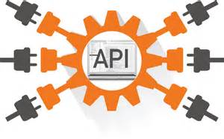
Advantages of API First
Suits multi-device environment of today.
An API layer can serve multiple channels/devices.
Mobile/tablet/IoT device
Scalable, modular, cohesive and composeable
If designed properly(e.g. microservice architecture)
See later slides
Concentrate on function first rather than data

Slide 8

APIs in the Internet of Things
Many new IoT devices being released.
Devices are limited on their own
It's the innovative use of those devices with accompanying APIs that generate value
"Build a better mousetrap, and the world will beat a path to your door" - Ralph Waldo Emerson
Rentokil believe they have using APIs( https://www.computerworlduk.com/it-business/rentokil-on-iot-rat-traps-cash-for-apps-incentives-apis-3612866/)
Rentokil increased operational efficiency through the automatic notifications of a caught animal and its size

Slide 9
API Design
Use principle of developer-first
put target developers’ interests ahead of other considerations
Strive for a better developer experience
Commit to RESTful APIs
Use a Interface Description Language like:
RESTful API Markup Language (RAML)
Swagger (YAML/JSON)
Take a grammatical approach to the functionality
Keep interface simple and intuitive

Slide 10

REST
Short for Representational State Transfer
Set of Principles for how web should be used
Coined by Roy Fielding
One of the HTTP creator
A set of principles that define how Web standards(HTTP and URIs) can be used.

Slide 11
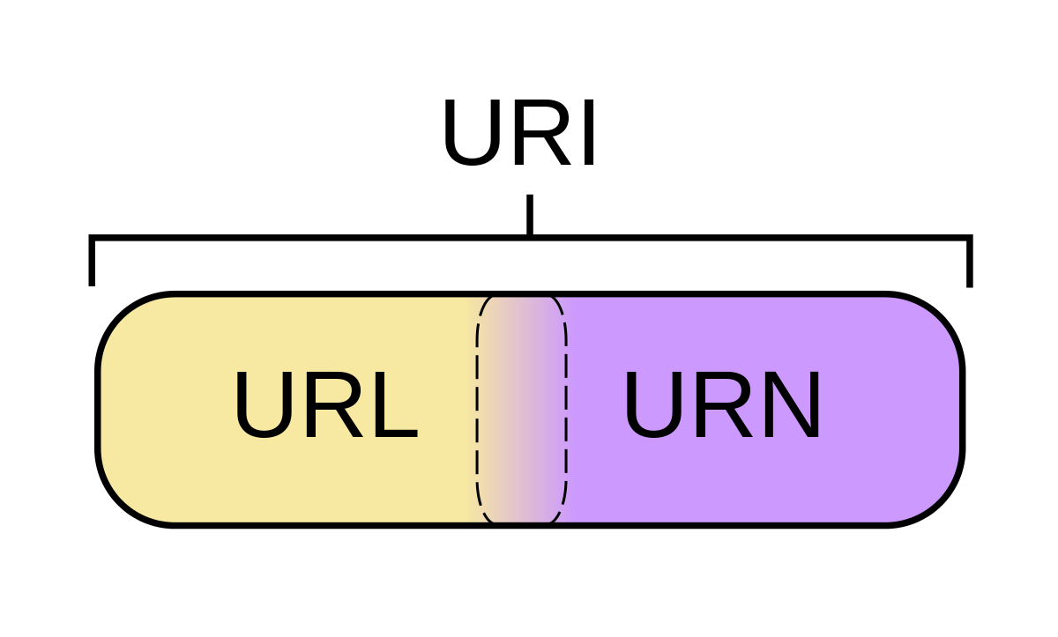
Key REST Principles
Every “thing” has an identity
URL
Link things together
Hypermedia/Hyperlinks
Use standard set of methods
HTTP GET/POST/PUT/DELETE
Manipulate resources through their representations
Resources can have multiple representations
JSON/XML/PNG/...
Communicate stateless
Should not depend on server state.

Slide 12
API Design
In Rest, everything is based around resources
the “things” you’re working with are modelled as resources described by URI paths--like /users, /groups, /dogs
Notice they are nouns .
Verbs in URLs are BAD
The things that you do on these things (or nouns) are characterised by the fixed set of HTTP methods
What GET,POST,PUT does is something that the designer/developer gets to put into the model.
The metadata (the adjectives) is usually encoded in HTTP headers, although sometimes in the payload.
The responses are the pre-established HTTP status codes and body. (200, 404, 500 etc.)
The representations of the resource are found inside the body of the request and response
Resource/Path | GET | POST | PUT | DELETE
/dogs | List dogs | Create New Dog | Bulk Update dogs | Not Applicable
/dogs/{id} | Details of Dog {id} | Not Applicable | Update details of dog {id} | Delete dog {id}

Slide 13
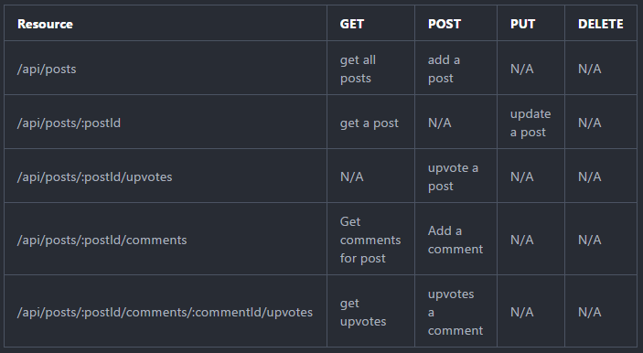
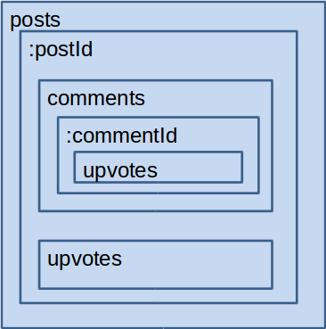
API Design - Containment
URIs embed ids of “child” resources
Post creates child resources
Put/Delete for updating /removing resources

Slide 14
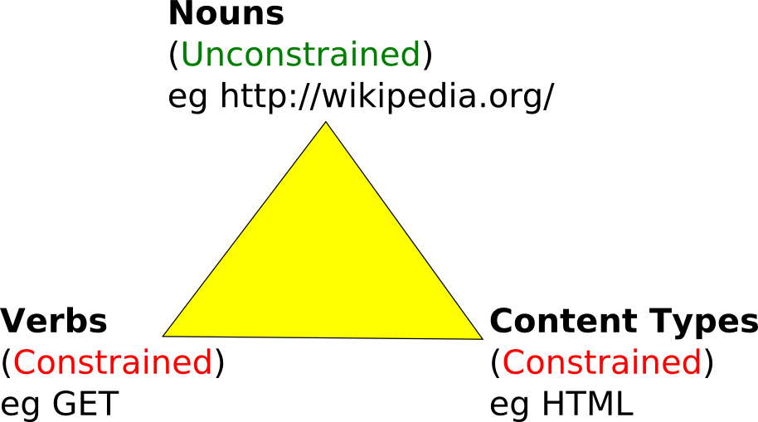
API Design
This Photo by Unknown Author is licensed under CC BY

Slide 15
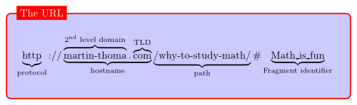
URLs
Uniquely identifies a resource over the web. protocol://hostname:port/path
Query string used to include data in a URL. For example
https://www.myhome.com/heating?status=on
This Photo by Unknown Author is licensed under CC BY-SA

Slide 16
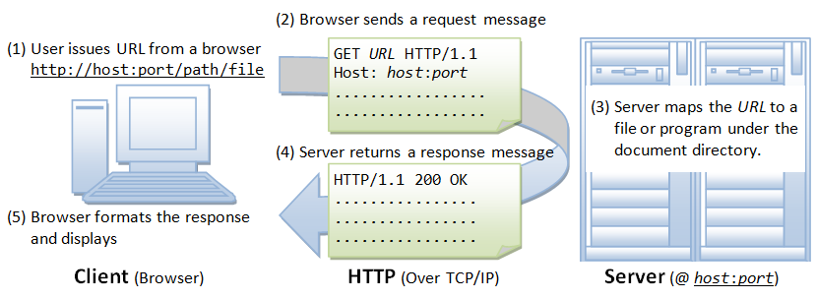
HTTP request from App.
Browser:

Slide 17
HTTP Protocol (Request)
HTTP clients (e.g. a browser) translates a URL into a request message according to the specified protocol; and sends the request message to the server.
For example, the browser translated the URL http://www.nowhere123.com/doc/index.html into the following request message:
GET /docs/index.html HTTP/1.1 Host: www.nowhere123.com Accept: image/gif, image/jpeg, */* Accept-Language: en-us Accept-Encoding: gzip, deflate User-Agent: Mozilla/4.0 (compatible; MSIE 6.0; Windows NT 5.1) (blank line)

Slide 18
HTTP Protocol (Response)
When this request message reaches the server, the server can take either one of these actions:
The server interprets the request received, maps the request into a file under the server's document directory, and returns the file requested to the client.
The server interprets the request received, maps the request into a program kept in the server, executes the program, and returns the output of the program to the client.
The request cannot be satisfied, the server returns an error message.
An example of the HTTP response message is below:
HTTP/1.1 200 OK
Date: Sun, 18 Oct 2009 08:56:53 GMT
Server: Apache/2.2.14 (Win32)
Last-Modified: Sat, 20 Nov 2004 07:16:26 GMT
Content-Length: 44
Connection: close
Content-Type: text/html
<html><body><h1>It works!</h1></body></html>

Slide 19
HTTP Methods
Safe Method (no action on server/resource, “idempotent”)
GET
Request resources without sending data
POST
Can be used to create new resources with data that you are sending
PUT/Patch
Modify/ Partially Modify objects with data that you are sending
DELETE
Delete objects without sending data
Usually contains body
(the data sent to server)
Changes stuff!

Slide 20

OpenAPI
Specification for machine-readable interface files for describing, producing, consuming, and visualising Restful Web Services
The OpenAPI Initiative is an open-source collaboration project of the Linux Foundation
Origins in Swagger… (https://swagger.io/specification/)
The OpenAPI Specification (OAS) defines a standard, language-agnostic interface to RESTful APIs
YAML can be used to describe an OpanAPI.
This Photo by Unknown Author is licensed under CC BY

Slide 21
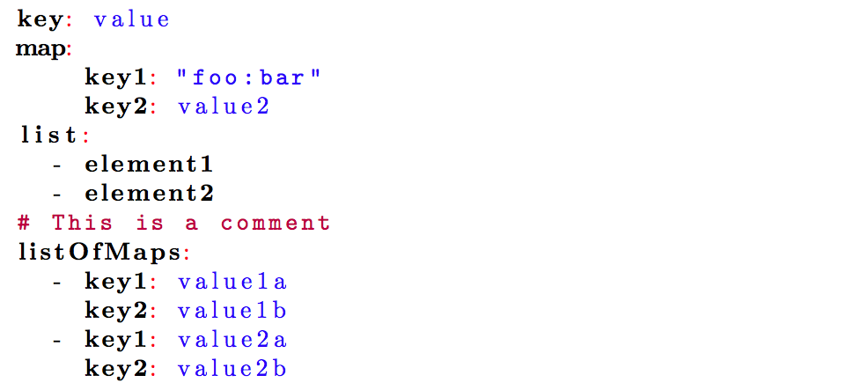
YAML
Human friendly, cross language, data serialization language.
YAML Ain’t Markup Language
Documents begin with --- and end with …
Indentation of lines denotes the structure within the document.
Comments begin with #
Members of lists begin with –
Key value pairs use the following syntax
<key>: <value>
Quick tutorial here
https://keleshev.com/yaml-quick-introduction
This Photo by Unknown Author is licensed under CC BY-SA

Slide 22
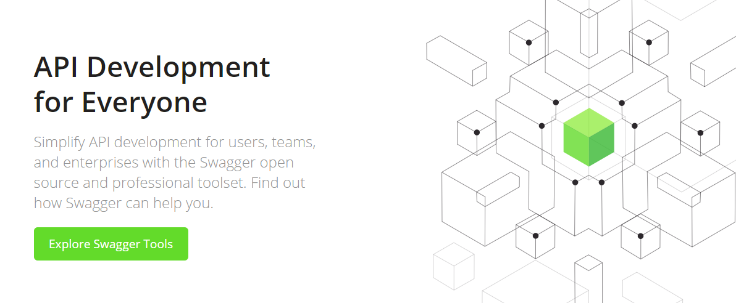
Swagger

