Slide 1

Clean Architecture
Using Javascript
Frank Walsh

Slide 2
What’s Clean Architecture
Lots of different architectures/project Structures
Clean, Model/View/Controller, Domain Driven Dev.
Clean Architecture is a software design pattern for building scalable and maintainable systems
Key concepts for Clean Architecture
Separation of Concerns(SoC): dividing the application into four concentric layers, with each layer having a specific role
The Dependency Rule: code dependencies must always point inwards
See the next slide….

Slide 3
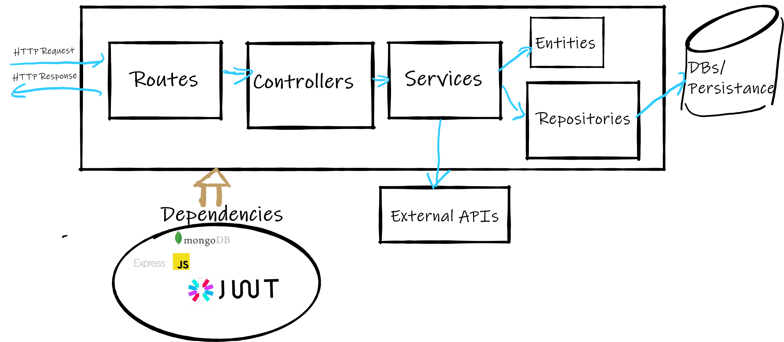

A clean Architecture inspired approach
HTTP/API/Express context ends here
Notes:
Layered Architecture: a HTTP layer --> which is "outside" the service layer --> which is "outside" the database access layer --> which is... you get the picture

Slide 4

Dependency Inversion/Dependency Injection
Dependency Injection (DI) can be used to manage dependencies between components, ensuring that the core business logic remains decoupled from external dependencies.
Define abstractions (interfaces) for dependencies
E.G. define interface that represent the abstract operations required for data persistence
In the outer layers, create concrete implementations of the interfaces defined in the inner layers
Inject dependencies: When instantiating components, inject the concrete implementations of the required interfaces as constructor or function parameters

Slide 5
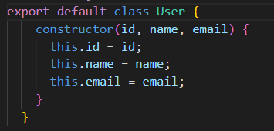

Entities
Represent the core business objects of the application
E.g. “Movie”,”User”,”Account”
Code Taken From Example: https://github.com/fxwalsh/ewd-week9-example.git

Slide 6
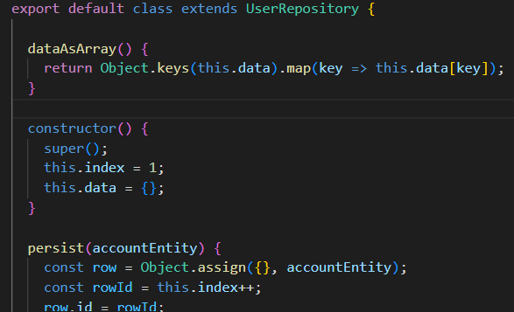
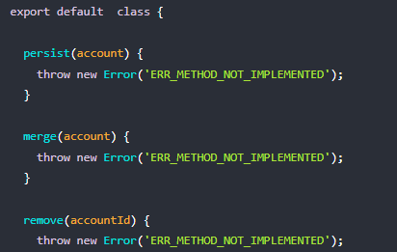


Repositories
Defines the Database/Data Store Interactions
Define “Interface Description” for Repository
Provide implementation
InMemoryRepository.js
UserRepository.js
Implementation extends
“Interface Description”
In future, will implement for
MongoDB

Slide 7
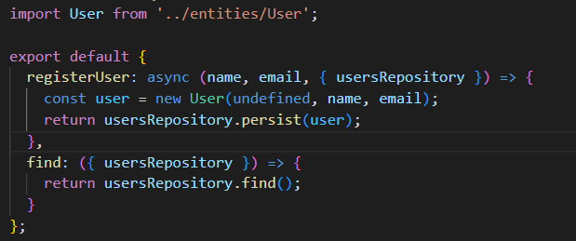


Services
Contains the applications business logic that our API supports(e.g. register new user, get movie details ).
UserService.js
UsersRepository supplied via
Dependency Injection
Notes:
Services should contain the majority of your business logic: - logic that encapsulates your business requirements, calls your data access layer or models, calls API's external to the Node application. And in general, contains most of your algorithmic code.

Slide 8
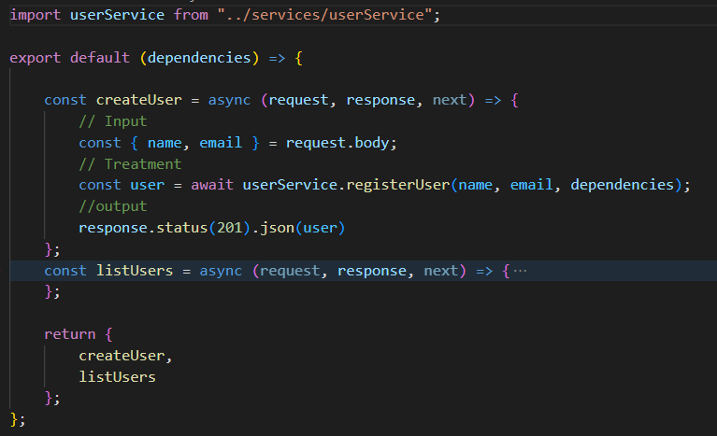


Controllers
For API, the Controllers extract the parameters (query and/or body) from the HTTP request, call the relevant service, and return the HTTP response.
Object containing External Dependencies supplied as argument to the function that returns the controller
Notes:
I think of controllers as "orchestrators". They call the services, which contain more "pure" business logic. But by themselves,controllers don't really contain any logic other than handling the request and calling services. The services do most of the work, while the controllers orchestrate the service calls and decide what to do with the data returned.
Services should contain the majority of your business logic: - logic that encapsulates your business requirements, calls your data access layer or models, calls API's external to the Node application. And in general, contains most of your algorithmic code.

Slide 9
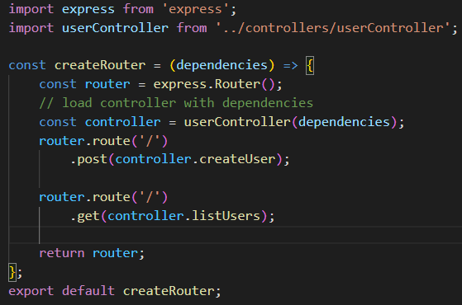

Routes
Roouters handle the HTTP requests that hits the API and route them to appropriate controller
They can also be used to chain together several controllers.
Connects the Express.js Framework to the architecture

Slide 10
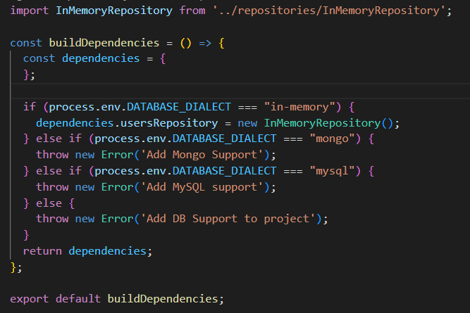
External Dependencies - Database
A component that exists outside of the core business logic of an application. :
E.g. databases, user interfaces, third-party libraries/frameworks
In this example, the dependencies.js module exports a function that builds a dependency object.
Use it to "inject" infrastructure dependencies(such as Repositories) into the routes/services.
For now, we just have DB details

Slide 11
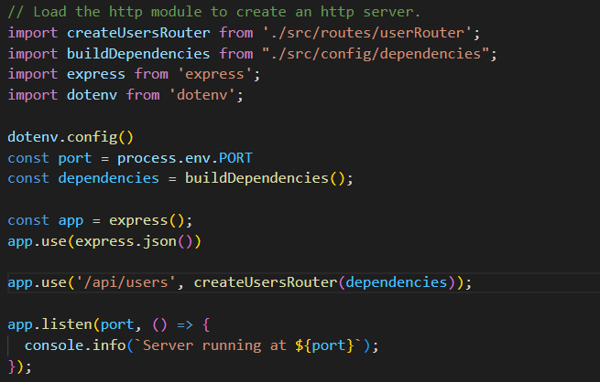


Bringing it together! - The Api “entry point” Index.js
Import functions that will build router and dependencies for API
Build dependencies object for API
Create Router and “inject” dependencies
See Example Here: https://github.com/fxwalsh/ewd-week9-example.git

