Slide 1

Navigation
The React Router library

Slide 2
Routing - Introduction
Allows multiple views in an app.
But there’s only one page (.html) → Single Page App (SPA)
Keeps the browser’s URL in sync with the UI.
Adheres to traditional web principles:
Addressability.
Information sharing.
Deep linking.
Not supported by the React framework.
A separate library is required: React Router.

Slide 3
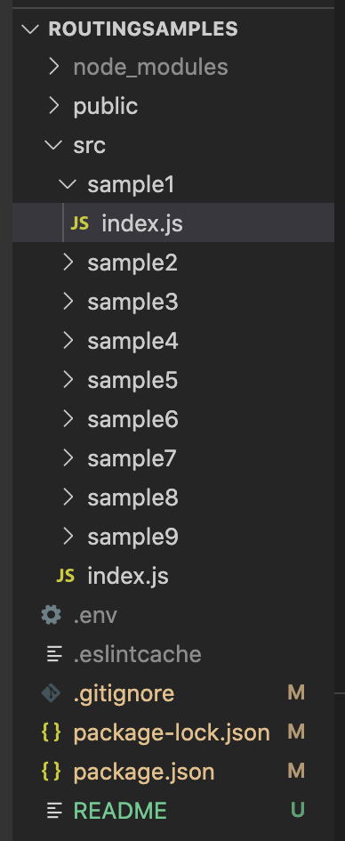

Demos
See lecture archive.
Each sample demos a routing feature.
<Link>

Slide 4
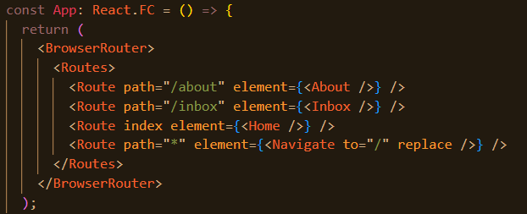
Basic routing configuration
 | URL | Components
1 | / | Home
2 | /about | About
3 | /inbox | Inbox
Declarative style.
<BrowserRouter> - matches browser’s URL to a <Route> path.
Matching Route’s> element is mounted on the DOM.
element can take any arbitrary TSX.
Use index for root path case (/).
Use * path for 404 case.
<Navigate> changes browser’s URL address.
App component termed the Router component.
Ref. src/sample1
Notes:
The replace prop, when set to true, means that navigating to this new route will replace the current entry in the history stack instead of adding a new one. This means that if the user clicks the browser's back button, they won't go back to the previous route before the redirection.

Slide 5
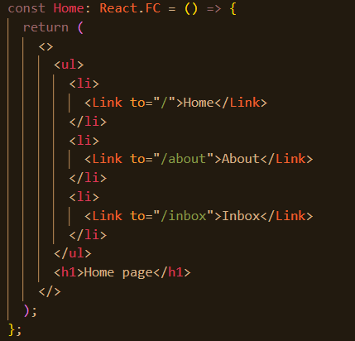
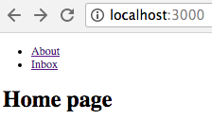
Hyperlinks
Use the <Link> component for internal links.
Use anchor tag for external links - <a href . . . . . >
Ref. src/sample2/
<Link> changes browser’s URL address (event)
→ React Router handles event by consulting its routing configuration
→ Selected Route’s elements mounted on DOM → Browser repaints the screen.

Slide 6
Dynamic segments.
Parameterised URLs, e.g. /users/22, /users/12/purchases
How to declare a parameterised path in the routing configuration?
How does a component access the parameter value?
Ex: Suppose the Inbox component shows messages for a specific user, where the user’s id is part of the browser URL
e.g /inbox/123, where 123 is the user’s id.
Solution: <Route path='/inbox/:userId’ element={ <Inbox/> } />
The colon (:) prefixes a parameter in the path.
Parameter name is arbitrary.
Ref src/sample3

Slide 7
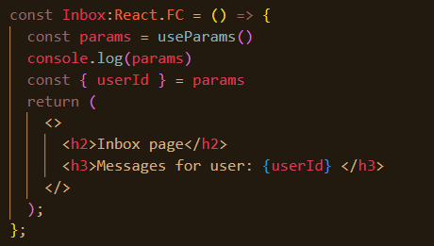
Dynamic segments.
useParams hook (React Router library).
Returns an object containing the parameter value.
Other useful hooks also provided (see later)
More than one parameter allowed.
e.g. /users/:userId/categories/:categoryName

Slide 8
Nested Routes
Objective: A component’s child is dynamically determined from the browser’s URL (Addressability).
EX.: (See src/sample4) Given the route:
<Route path='/inbox/:userId’ element={ <Inbox /> } />,
use the following rules to determine a nested component hierarchy:
/inbox/XYZ/statistics /inbox/XYZ/draft
<Inbox> <Inbox>
<Stats/> <Drafts/>
</Inbox> </Inbox>

Slide 9
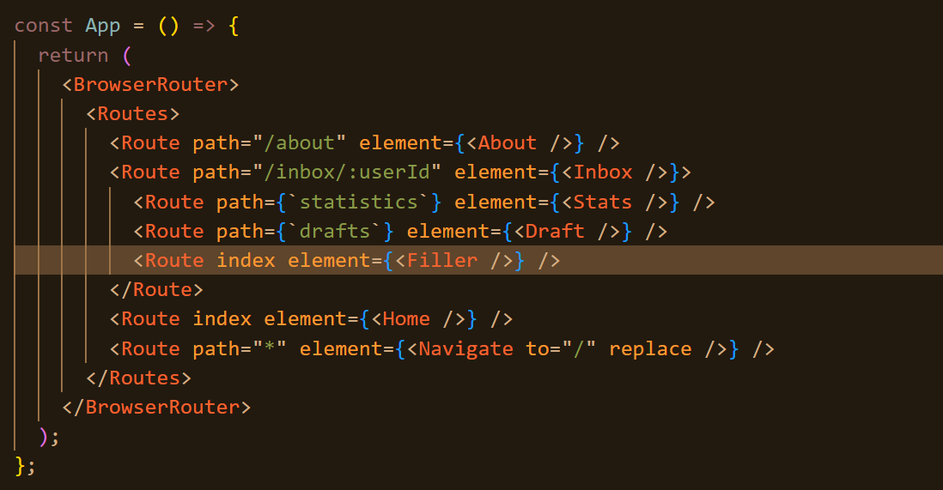
Nested Routes
Use RELATIVE path strings in the nested <Route> entries.
The index <Route> is optional.
For the default case.
Avoids a ‘blank’ section on screen.
Use <Outlet/> as a placeholder in the container component

Slide 10
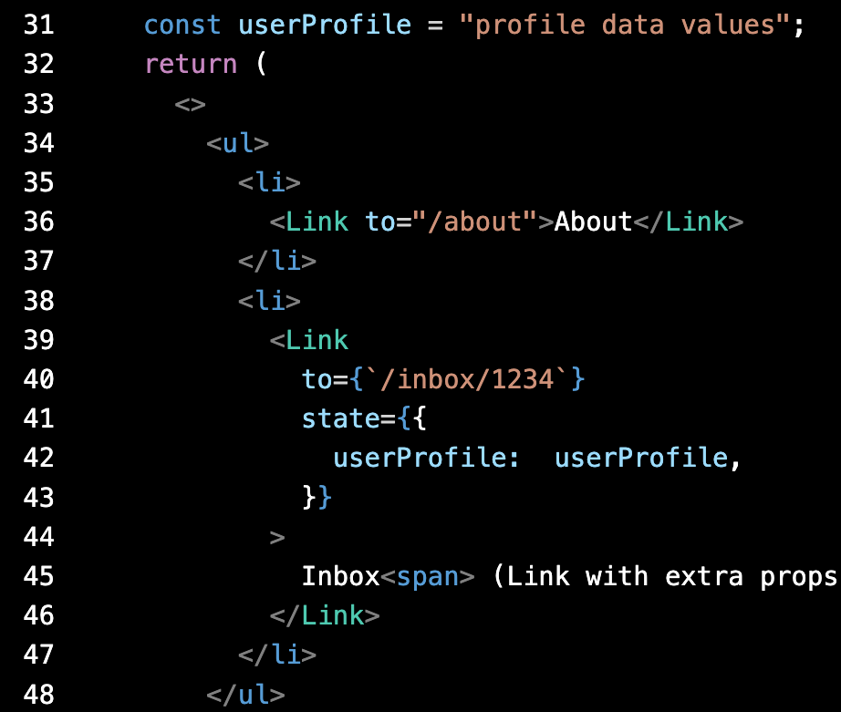
Extended <Link>
Objective: Supply data to the component mounted by a <Link>.
EX.: See /src/sample5/.
How does Inbox access the userProfile data included in the hyperlink?
A.: The useLocation hook

Slide 11
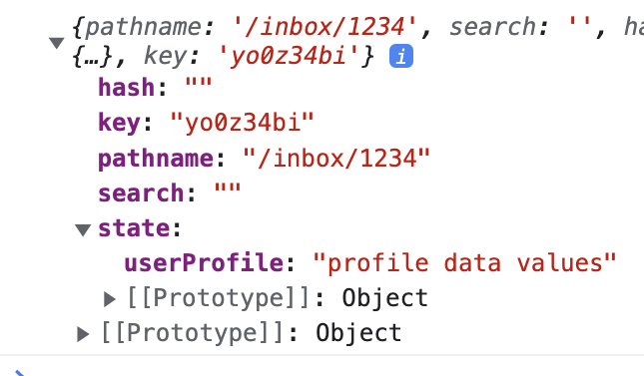
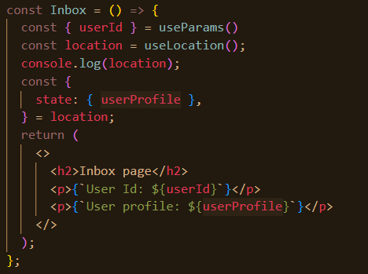
Extended <Link>
React Router creates a location object each time the URL changes.

Slide 12
Routing
More later

