Slide 1

JavaScript Asynchronous Patterns
Async Await

Slide 2

Recap -Javascript Characteristics
JavaScript is single threaded
JavaScript is event driven
Events happen – we write code to deal with them
Can use callbacks to do this
JavaScript can be Asynchronous
Order of operation results may differ from order they were called…

Slide 3
Callbacks (again!)

Slide 4

What have Callbacks ever done for us...
Great for things that can happen multiple times
Great if you don't really care about what happened before you attached the listener
Great if it's a straight-forward, stand-alone event with a quick resolution time
Great if callback is not part of sequential process.
E.g. key press event on control.
document.getElementById("demo").addEventListener("keypress", myFunction);
But...

Slide 5
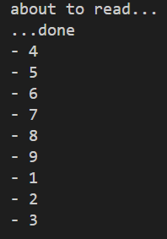
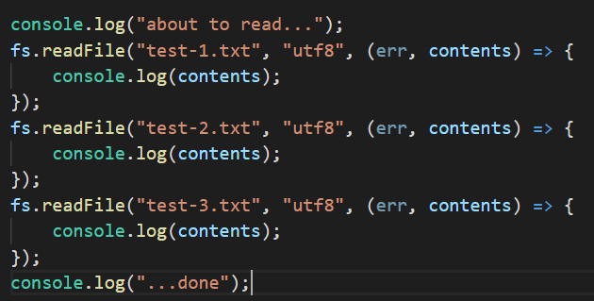
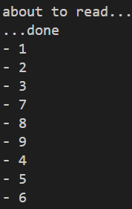
Multiple Callbacks
I want this to happen sequentially… but order of callback events is indeterminate.
Possible Result
Possible Result
Notes:
You have no idea what order the callbacks will execute. Once the callback is registered/scheduled, you’ve no idea when the underlying process (n this case the file read) will report back.

Slide 6
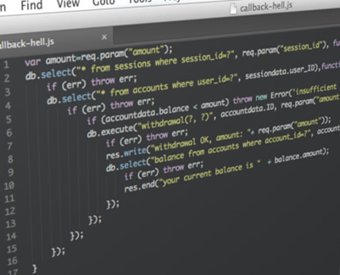
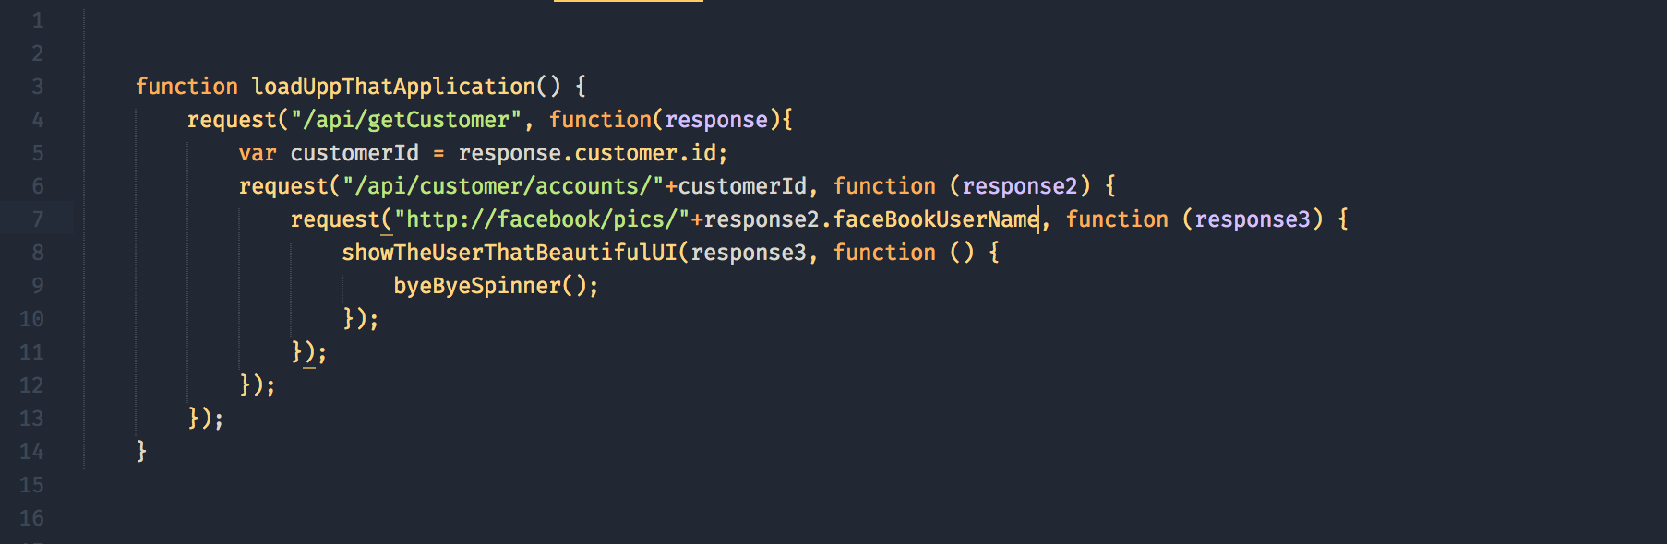
Callback Hell – Multiple sequential requests

Slide 7
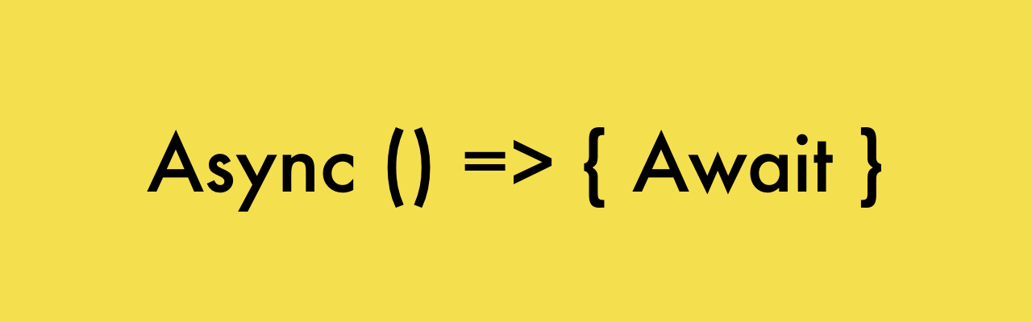
Async Functions
using async/await

Slide 8
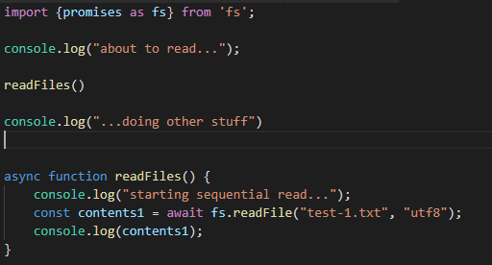
Async/Await !
async/await and promises are essentially the same under the hood
async is a keyword
Used in function declaration
await is used during the promise handling
must be used within an async function
async functions return a promise, regardless of what the return value is within the function.
Available now! in most good browsers as well as Node.js

Slide 9
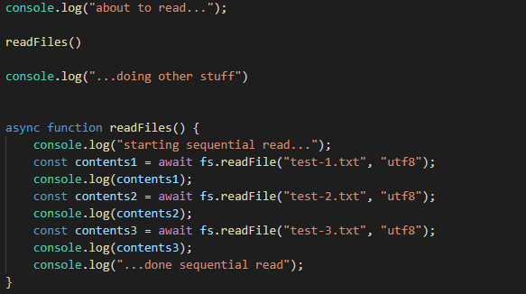
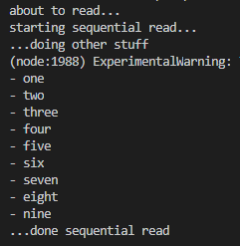
Async/Await Sequential read
output

Slide 10
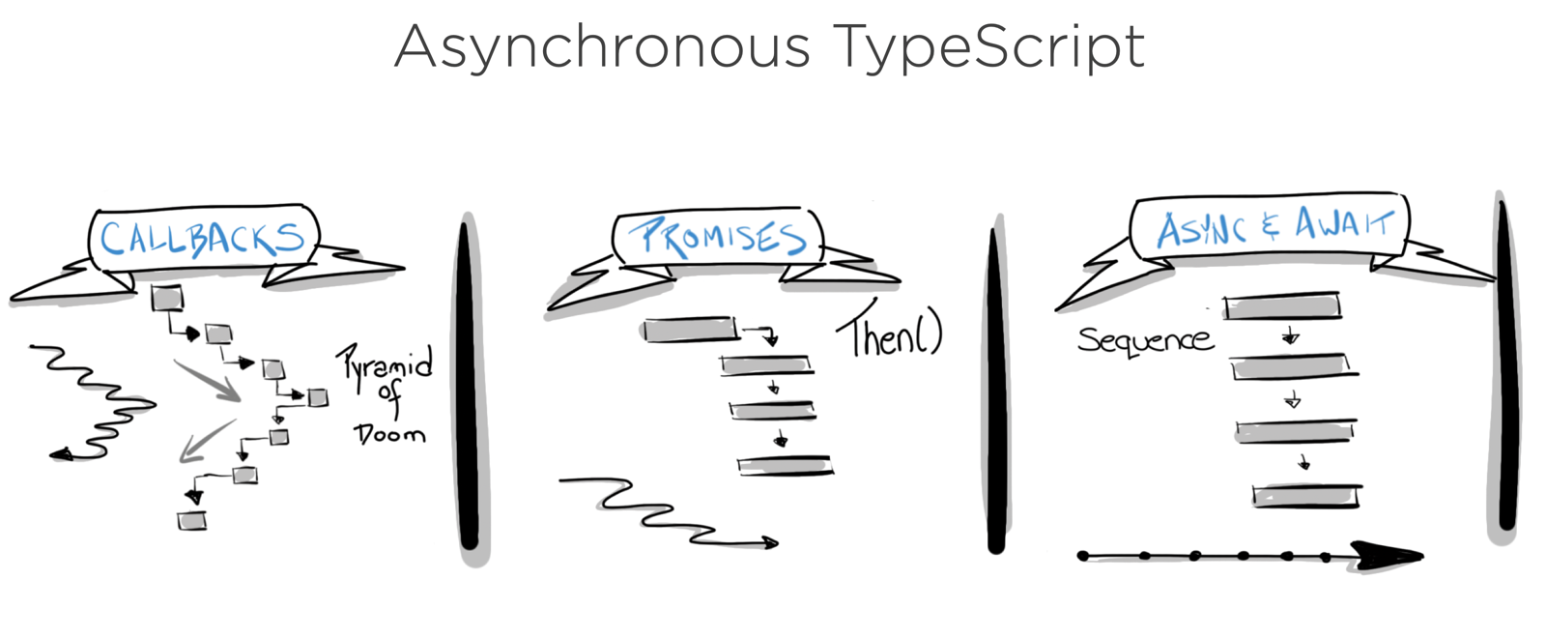
Callbacks vs Promises vs Async-Await
Asynchronous Javascript
This Photo by Unknown Author is licensed under CC BY

Slide 11
Error Handling

Slide 12
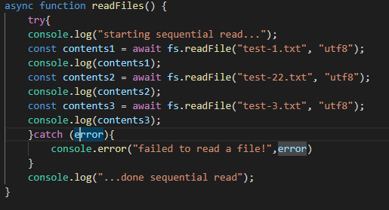
Error Handling – async await
Use try -catch

Slide 13
Further Asynchronous features…

Slide 14
Wrapper Function for Error handling
Express can’t handle promise errors/rejections
An Async function always returns a Promise.
can wrap the async function to catch errors in Express Apps
Can drop try/catch in every async function
Makes code more readable?
import asyncHandler from 'express-async-handler';
const router = express.Router();
// Get all users
router.get('/', asyncHandler(async (req, res) => {
const users = await User.find();
res.status(200).json(users);
}));

Slide 15

Parallelism
Takes 1000ms
async function series() { await wait(500); // Wait 500ms… await wait(500); // …then wait another 500ms. return "done!"; }
Some processes need to be sequential
Eg. Had to get data back from API BEFORE getting link URL
REMEMBER: Should only be sequential if you need to be...
Takes ~500ms
async function parallel() { const wait1 = wait(500); // Start a 500ms timer asynchronously… const wait2 = wait(500); // this timer happens in parallel. await wait1; // Wait 500ms for the first timer… await wait2; // …by which time this timer has already finished. return "done!"; }

Slide 16
ES6 Classes

Slide 17
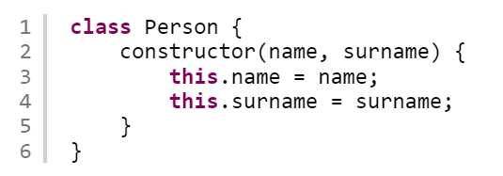
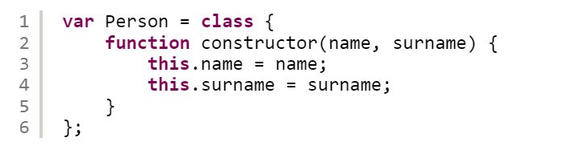
JavaScript Classes
ECMAScript 2015, also known as ES6, introduced JavaScript Classes.
Classes are special functions that facilitate the creation of constructors and prototype-based inheritance. Just like in functions, you can declare a class or express it:

Slide 18
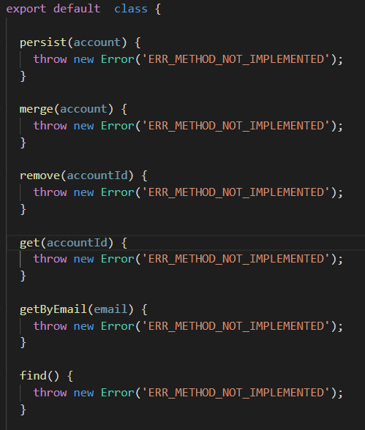
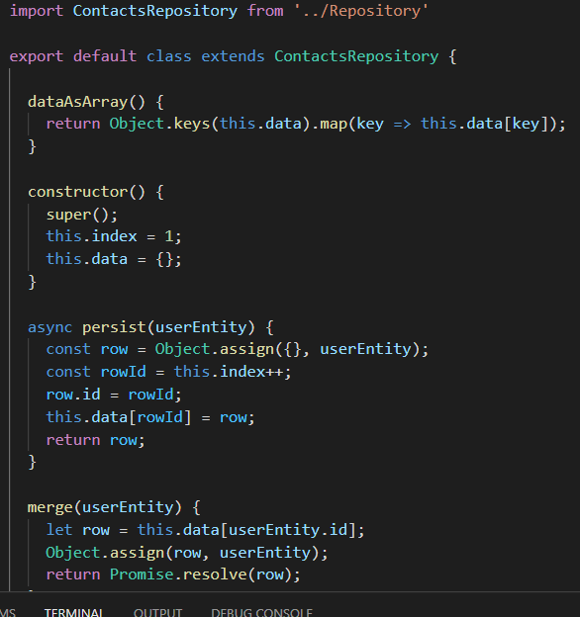


Javascript Classes - inheritance
To create a class inheritance, use the extends keyword.
A class created with a class inheritance inherits all the methods from another class:
Repository.js

Slide 19
Express Project Strucure/Architecture

Slide 20
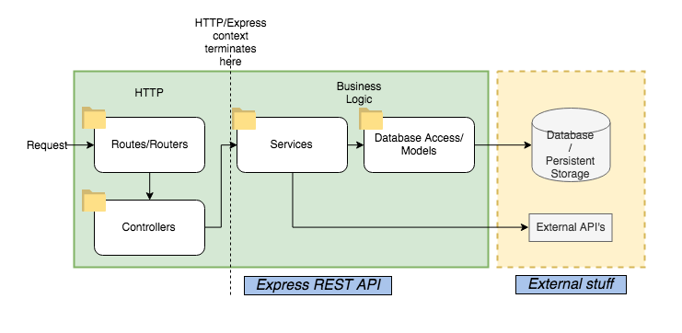
Express Project Structure
Lots of different architectures/project Structures
Clean, Model/View/Controller, Domain Driven Dev.
Our Rest API will follow this Layered Arcgitecure
Notes:
Layered Architecture: a HTTP layer --> which is "outside" the service layer --> which is "outside" the database access layer --> which is... you get the picture

Slide 21
Simple Layered Approach
HTTP logic layer
Routers:
handle the HTTP requests that hits the API and route them to appropriate controller
Controllers:
Processes request object, pull out data from request, validate, then send to service(s)
Business logic Layer
Services: derived from use cases/business requirements
Data Access: Repository/data store access
Notes:
I think of controllers as "orchestrators". They call the services, which contain more "pure" business logic. But by themselves,controllers don't really contain any logic other than handling the request and calling services. The services do most of the work, while the controllers orchestrate the service calls and decide what to do with the data returned.
Services should contain the majority of your business logic: - logic that encapsulates your business requirements, calls your data access layer or models, calls API's external to the Node application. And in general, contains most of your algorithmic code.

Slide 22
Sources
https://developers.google.com/web/fundamentals/primers/promises
https://stackoverflow.com/questions/2069763/difference-between-event-handlers-and-callbacks
https://medium.com/@Abazhenov/using-async-await-in-express-with-node-8-b8af872c0016

