Slide 1
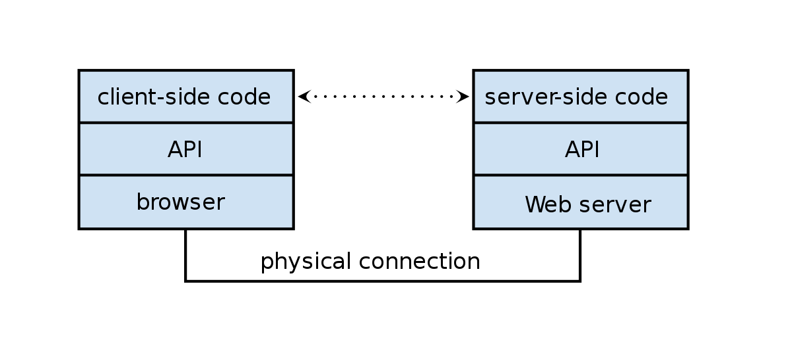
Web API Design
Frank Walsh

Slide 2
Agenda
Web API
REST
API Value
API Design

Slide 3
Web APIs

Slide 4
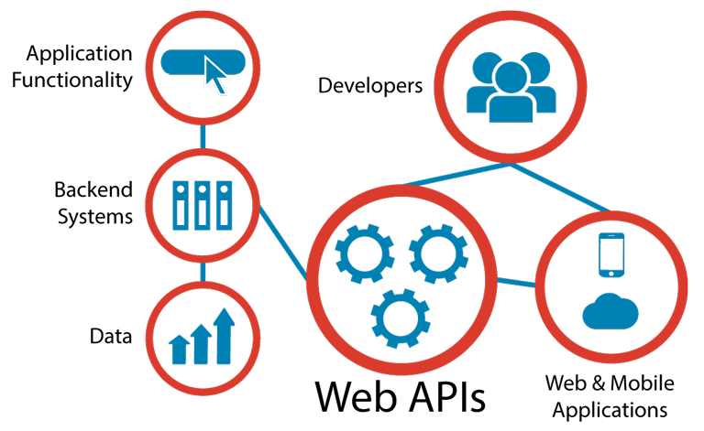
Web APIs
Programmatic interface exposed via the web
Uses open standards typically with request-response messaging.
E.g messages in JSON or XML
HTTP as transport
URIs
Example would be web APIs described in previous lectures.
Typical use:
Expose application functionality via the web
Machine to machine communication
Distributed systems

Slide 5
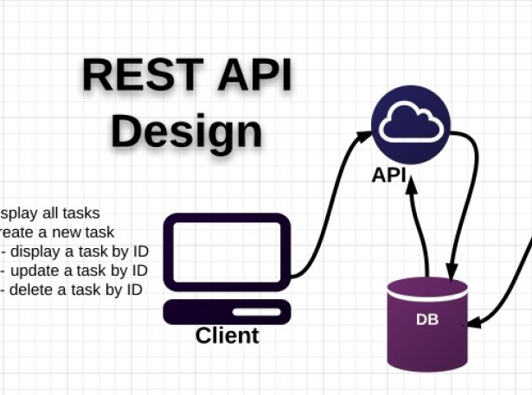
Traditional API Design
API design happens after the release of some a data-rich application
Existing application “wrapped” in API
Created as an afterthought.
Tightly bound application needs data/function exposed as API.
Shoe-horned in as a separate entity.

Slide 6

“API First” approach
Collaboratively design, mockup, implement and document an API before the application or other channels that will use it even exist.
Uses “clean-room” approach.
the API is designed with little consideration for the existing IT landscape.
the API is designed as though there are no constraints.

Slide 7
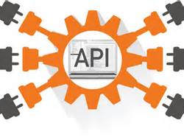
Advantages of API First
Suits multi-device environment of today.
An API layer can serve multiple channels/devices.
Mobile/tablet/IoT device
Scalable, modular, cohesive and composable
If designed properly(e.g. microservice architecture)
See later slides
Concentrate on function first rather than data

Slide 8
API Design Approach
Use principle of developer-first
put target developers’ interests ahead of other considerations
Strive for a better developer experience
Commit to RESTful APIs
Take a grammatical approach to the functionality
Keep interface simple and intuitive

Slide 9

REST

Slide 10
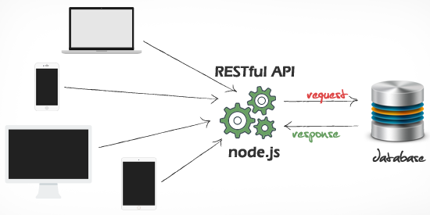
What’s REST?
Short for Representational State Transfer
Set of Principles for how web should be used
Coined by Roy Fielding
One of the HTTP creators
A set of principles that define how Web standards(HTTP and URIs) can be used.
This Photo by Unknown Author is licensed under CC BY
Notes:
principal authors of the HTTP specification and the originator of the Representational State Transfer architectural style. He is an authority on computer network architecture and co-founded the Apache HTTP Server project.
'Architectural Styles and the Design of Network-based Software Architectures' (2000)

Slide 11
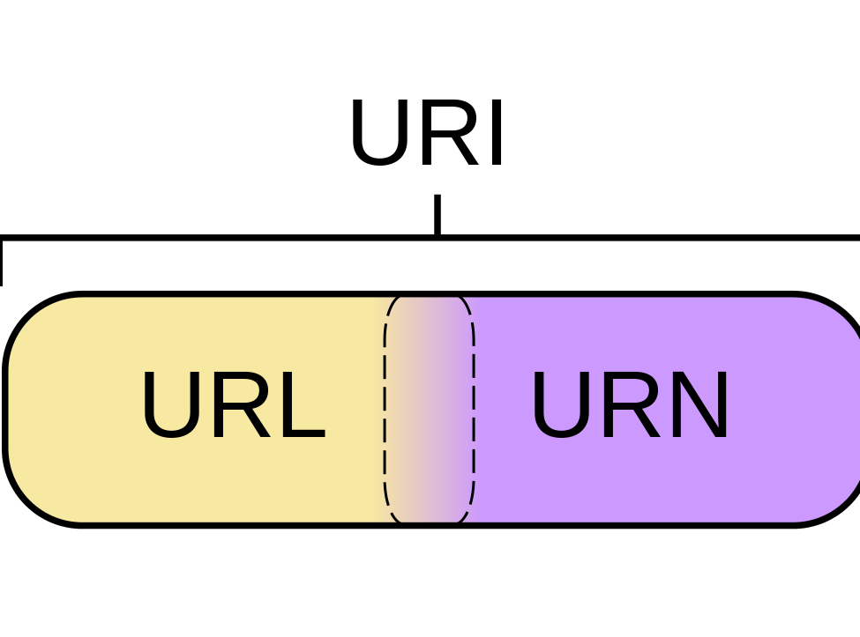
Key REST Principles
Every “thing” has an identity
Uniform Resource Identifier
Use standard set of methods
HTTP GET/POST/PUT/DELETE/PATCH
Manipulate resources through their representations
Resources can have multiple representations
JSON/XML/PNG/...
Communicate stateless
Should not depend on server state.
Notes:
Some URIs provide a means of locating and retrieving information resources on a network (either on the Internet or on another private network, such as a computer filesystem or an Intranet), these are Uniform Resource Locators (URLs). Other URIs provide only a unique name, without a means of locating or retrieving the resource or information about it, these are Uniform Resource Names (URNs). the server does not store any state about the client session on the server-side. Each request from the client to server must contain all of the information necessary to understand the request, and cannot take advantage of any stored context on the server.

Slide 12

HTTP

Slide 13
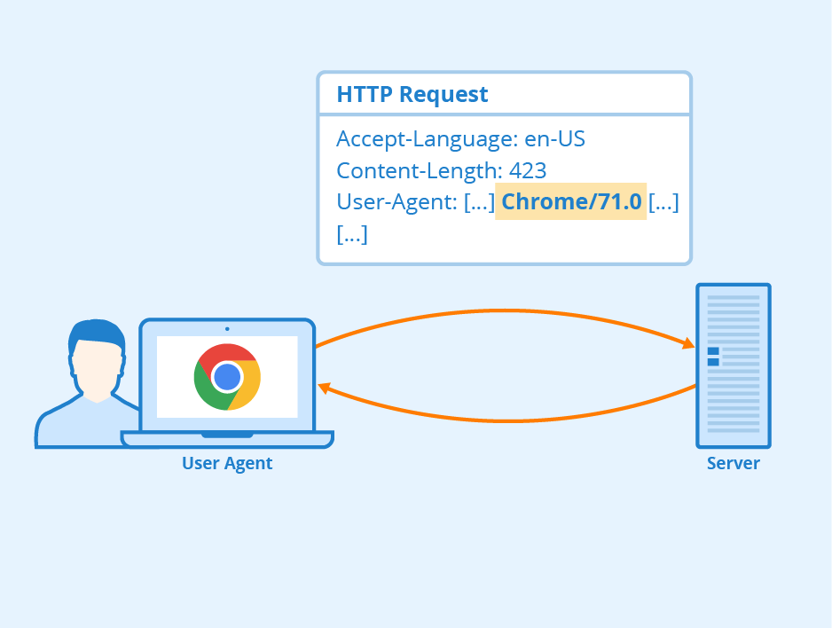
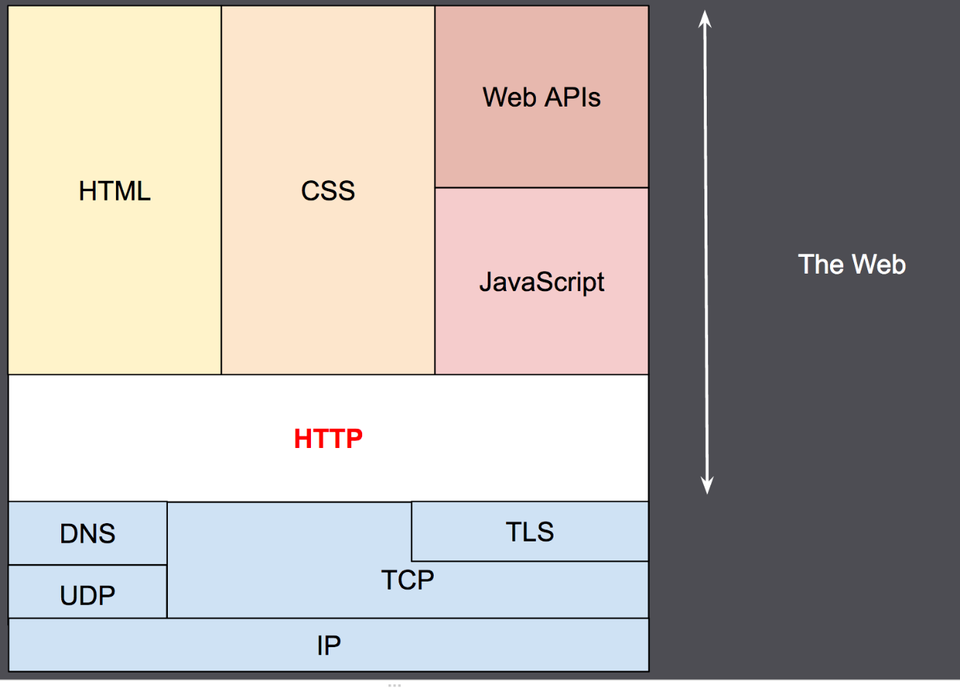
Hypertext Transfer Protocol
To design a REST API, you need to know the HTTP protocol
This Photo by Unknown Author is licensed under CC BY-SA
Notes:
Application Layer Protocol. Tends to use TCP/TLS for HTTPs.
Tend to be more familiar with it from client side.

Slide 14
HTTP Overview: Components
Client: the user-agent, any program that acts for the user – e.g. a browser
Server: provides the resource as requested by the client. A
Appears as a single machine virtually, however may actually be a collection of servers, sharing the load (load balancing)
Can contain complex software interrogating other computers to generate response
Proxies: Computers that relay HTTP messages and perform tasks such as caching, filtering, load balancing, authentication, logging, forwarding

Slide 15
HTTP Protocol (Request)
HTTP clients (e.g. a browser) translates a URL into a request message according to the specified protocol; and sends the request message to the server.
For example, a client could translated the URL http://www.nowhere123.com/api/movies into the following request message:
GET /api/movies HTTP/1.1 Host: www.nowhere123.com Accept: application/json, */* Accept-Language: en-us Accept-Encoding: gzip, deflate User-Agent: Mozilla/4.0 (compatible; MSIE 6.0; Windows NT 5.1) (blank line)

Slide 16
HTTP Protocol (Response)
When this request message reaches the server, the server can take either one of these actions:
The server interprets the request received, maps the request into a file under the server's document directory, and returns the file requested to the client.
The server interprets the request received, maps the request into a program kept in the server, executes the program, and returns the output of the program to the client.
The request cannot be satisfied, the server returns an error message.
An example of the HTTP response message is below:
HTTP/1.1 200 OK
Date: Sun, 18 Oct 2009 08:56:53 GMT
Server: Apache/2.2.14 (Win32)
Last-Modified: Sat, 20 Nov 2004 07:16:26 GMT
Content-Length: 44
Connection: close
Content-Type: application/json
{page:1, total_pages:100, total_results: 1000
“results”: […

Slide 17

HTTP Protocol: Content-Type Header
The Content-Type tells the client what the content type of the returned content.
Also known as “MIME” ,”media type”, "content type")
a video file might be audio/mpeg, or an image file image/png).
The Internet Assigned Numbers Authority (IANA) is the official authority for the standardization and publication of these classifications.

Slide 18
HTTP Protocol: Methods (or Verbs)
Safe Method (no action on server/resource, “idempotent”)
GET
Request resources without sending data
POST
Can be used to create new resources with data that you are sending
PUT/PATCH
Modify/ Partially Modify objects with data that you are sending
DELETE
Delete objects without sending data
Usually contains body
(the data sent to server)
Changes stuff!

Slide 19

Uniform Resource Indicators
URI

Slide 20
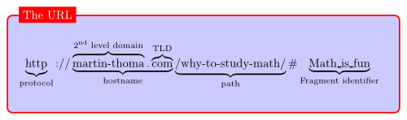
Uniform Resource Locator
Uniquely identifies a resource over the web. protocol://hostname:port/path
Query string used to include data in a URI. For example
https://www.myhome.com/heating?status=on
This Photo by Unknown utho is licensed under CC BY-SA

Slide 21
Uniform Resource Locator: Query String
A query string is a part of a URL that assigns values to specified parameters.
Often used to filter results returned by API
https://randomuser.me/api?results=10&gender=female

Slide 22

API Design

Slide 23
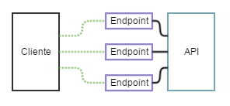
API Design: Endpoints
An endpoint is the combination of a HTTP method and an URI
GET: /api/friends
An endpoint can be interpreted as an action on a resource.
POST: /api/friends means “create a new Friend”
This Photo by Unknown Author is licensed under CC BY-SA

Slide 24
API: Design
Everything is based around resources
the “things” you’re working with are modelled as resources described by URI paths--like /users, /groups, /dogs
Notice they are nouns .
Verbs in URLs are BAD
The things that you do on these things (or nouns) are characterised by the fixed set of HTTP methods
What GET,POST,PUT does is something that the designer/developer gets to put into the model.
The metadata (the adjectives) is usually encoded in HTTP headers, although sometimes in the payload.
The responses are the pre-established HTTP status codes and body. (200, 404, 500 etc.)
The representations of the resource are found inside the body of the request and response
Resource/Path | GET | POST | PUT | DELETE
/friends | List friends | Create New Friend | Bulk Update Friends | Not Applicable
/friends/{id} | Details of Friend {id} | Not Applicable | Update details of Friend {id} | Delete friend {id}
Notes:
Plural nouns
When designing a RESTful API avoid using singular nouns to describe a resource. Always think of a resource in a URI as a repository which contains one or many resources of the same type. So make sure you use plural nouns (e.g: /articles/{id} instead of /article/{id}).

Slide 25
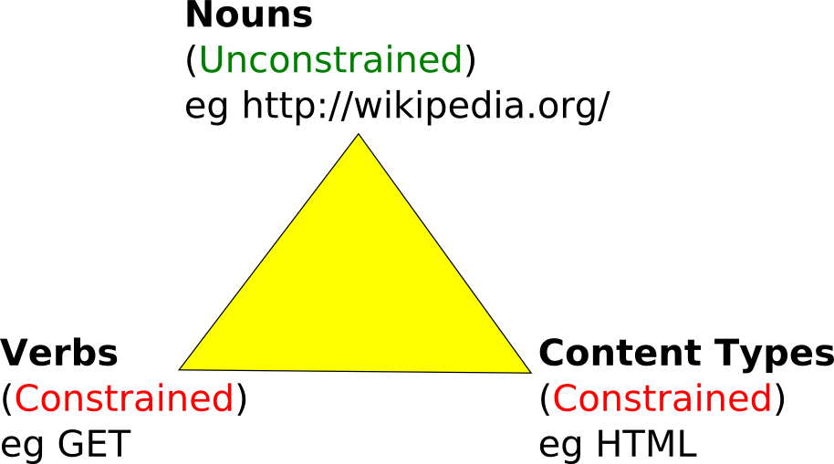
API: Design
This Photo by Unknown Author is licensed under CC BY

Slide 26
API: Good Practice1
Always specify content-type
Wrap your responses:
Use a standard model for responses to enable easier processing by clients
Example: TMDB Movie API for GET: /movies?page=1&api_key=c183b23922…
Uses a model that defines the page, total pages, total results and results.
{
"page": 1,
"total_pages": 500,
"total_results": 10000,
"results": [
{
"adult": false,
"backdrop_path": "/hJuDvwzS0SPlsE6MNFOpznQltDZ.jpg",
"genre_ids

Slide 27
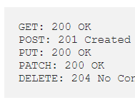
API: Good Practice2
HTTP Status Codes are important
HTTP client rely on correct use the standard HTTP status codes ranges correctly.

Slide 28
EXRTA BIT: OpenAPI & Swagger

Slide 29

OpenAPI
Specification for machine-readable interface files for describing, producing, consuming, and visualising Restful Web Services
The OpenAPI Initiative is an open-source collaboration project of the Linux Foundation
Origins in Swagger… (https://swagger.io/specification/)
The OpenAPI Specification (OAS) defines a standard, language-agnostic interface to RESTful APIs
YAML can be used to describe an OpanAPI.
This Photo by Unknown Author is licensed under CC BY

Slide 30
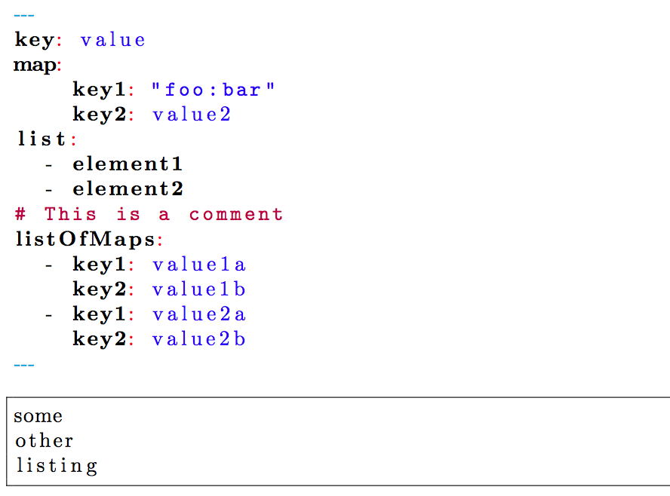
Open API: YAML
Human friendly, cross language, data serialization language.
YAML Ain’t Markup Language
Documents begin with --- and end with …
Indentation of lines denotes the structure within the document.
Comments begin with #
Members of lists begin with –
Key value pairs use the following syntax
<key>: <value>
Quick tutorial here
https://keleshev.com/yaml-quick-introduction
This Photo by Unknown Author is licensed under CC BY-SA

Slide 31
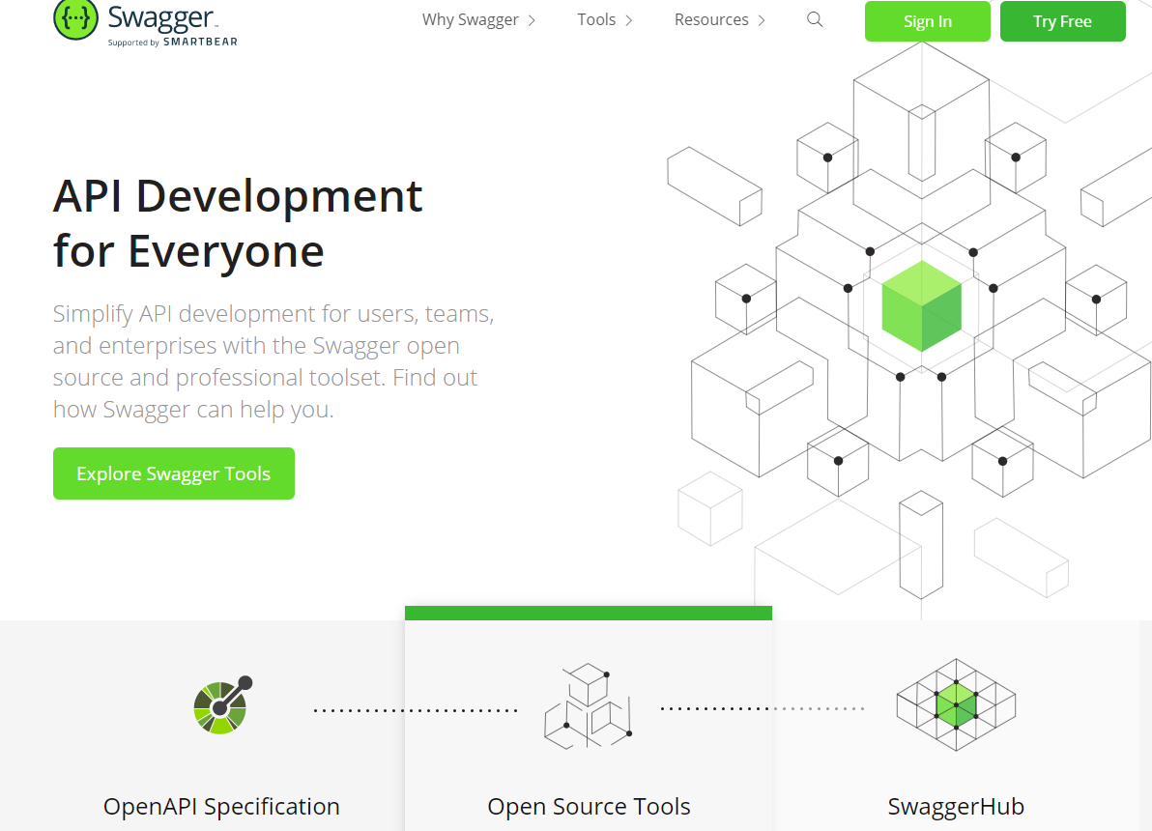
Swagger

Slide 32
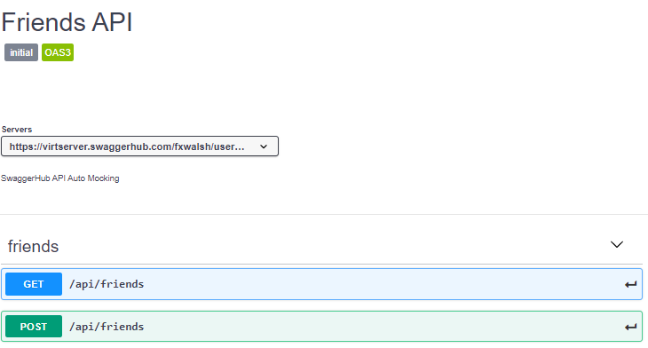
Demo

